Slide 1
Committee on Earth Observation Satellites
CEOS/CGMS preparation
for SBSTA-43
John Bates
Plenary Agenda Item 9
29th CEOS Plenary
Kyoto International Conference Center
Kyoto, Japan
5 – 6 November 2015

Slide 2
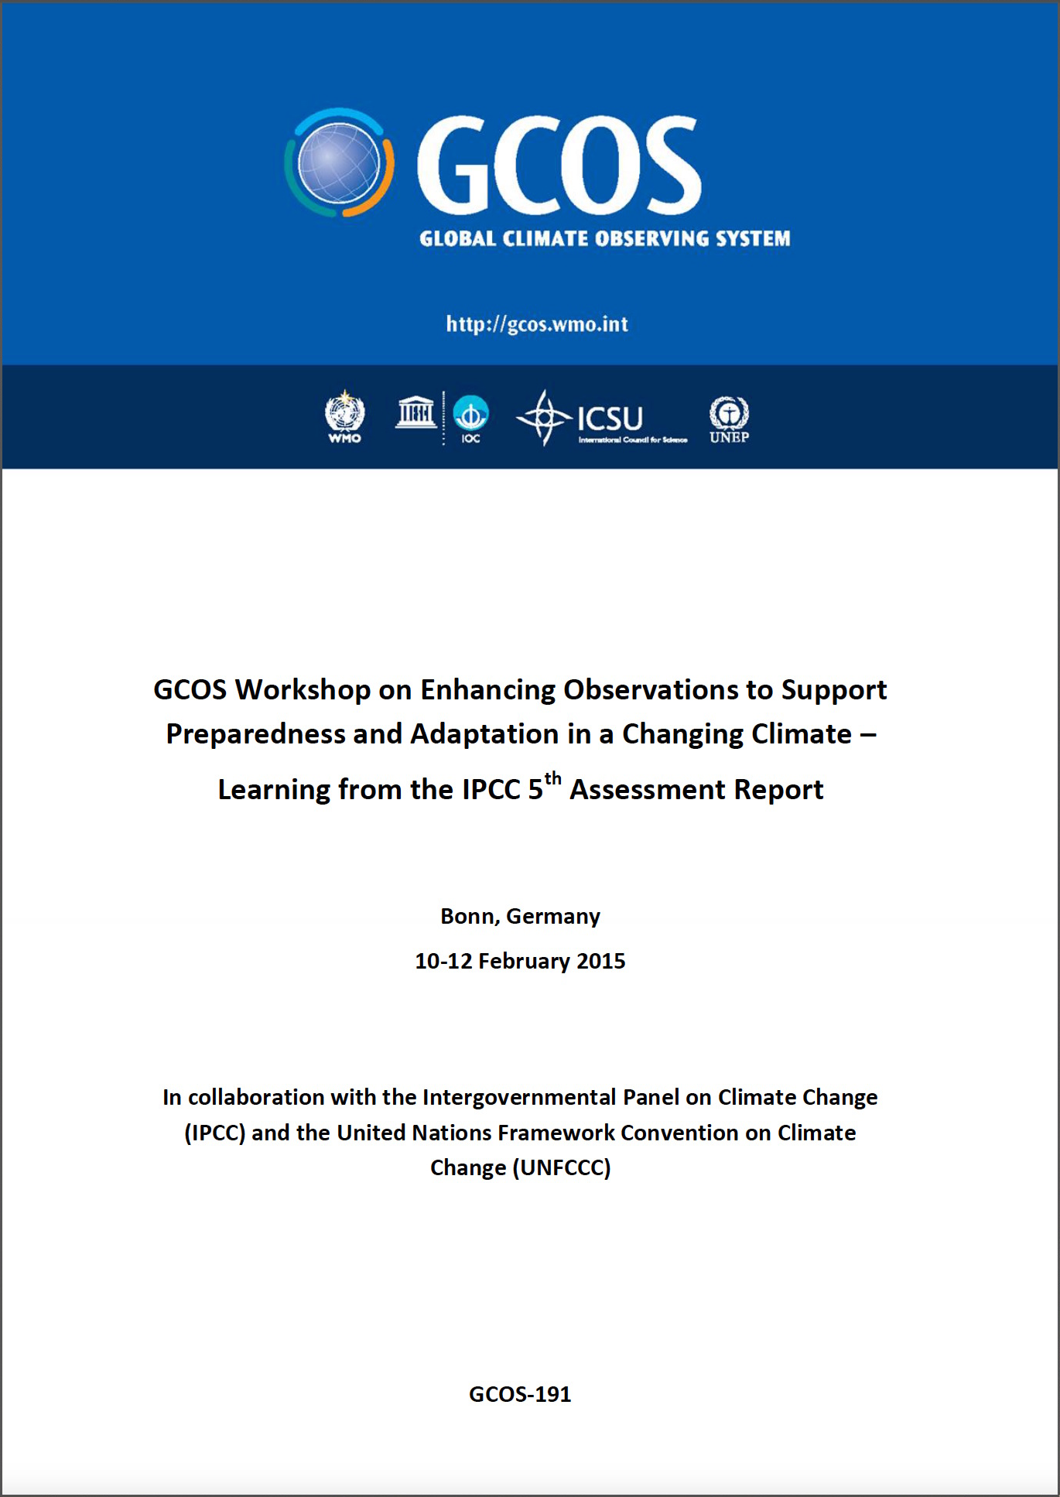
CEOS/CGMS preparation for SBSTA-43
Background
CEOS, now CEOS/CGMS, has been invited to report to the Subsidiary Body on Scientific and Technological Advice – Research and Systematic Observations since 2002
SBSTA-41 ‘noted the importance of continuing and sustaining satellite observations on a long-term basis and welcomed the efforts to develop an architecture for climate monitoring from space’
SBSTA-41 also called for ‘Enhancing Observations’ Workshop.

Slide 3
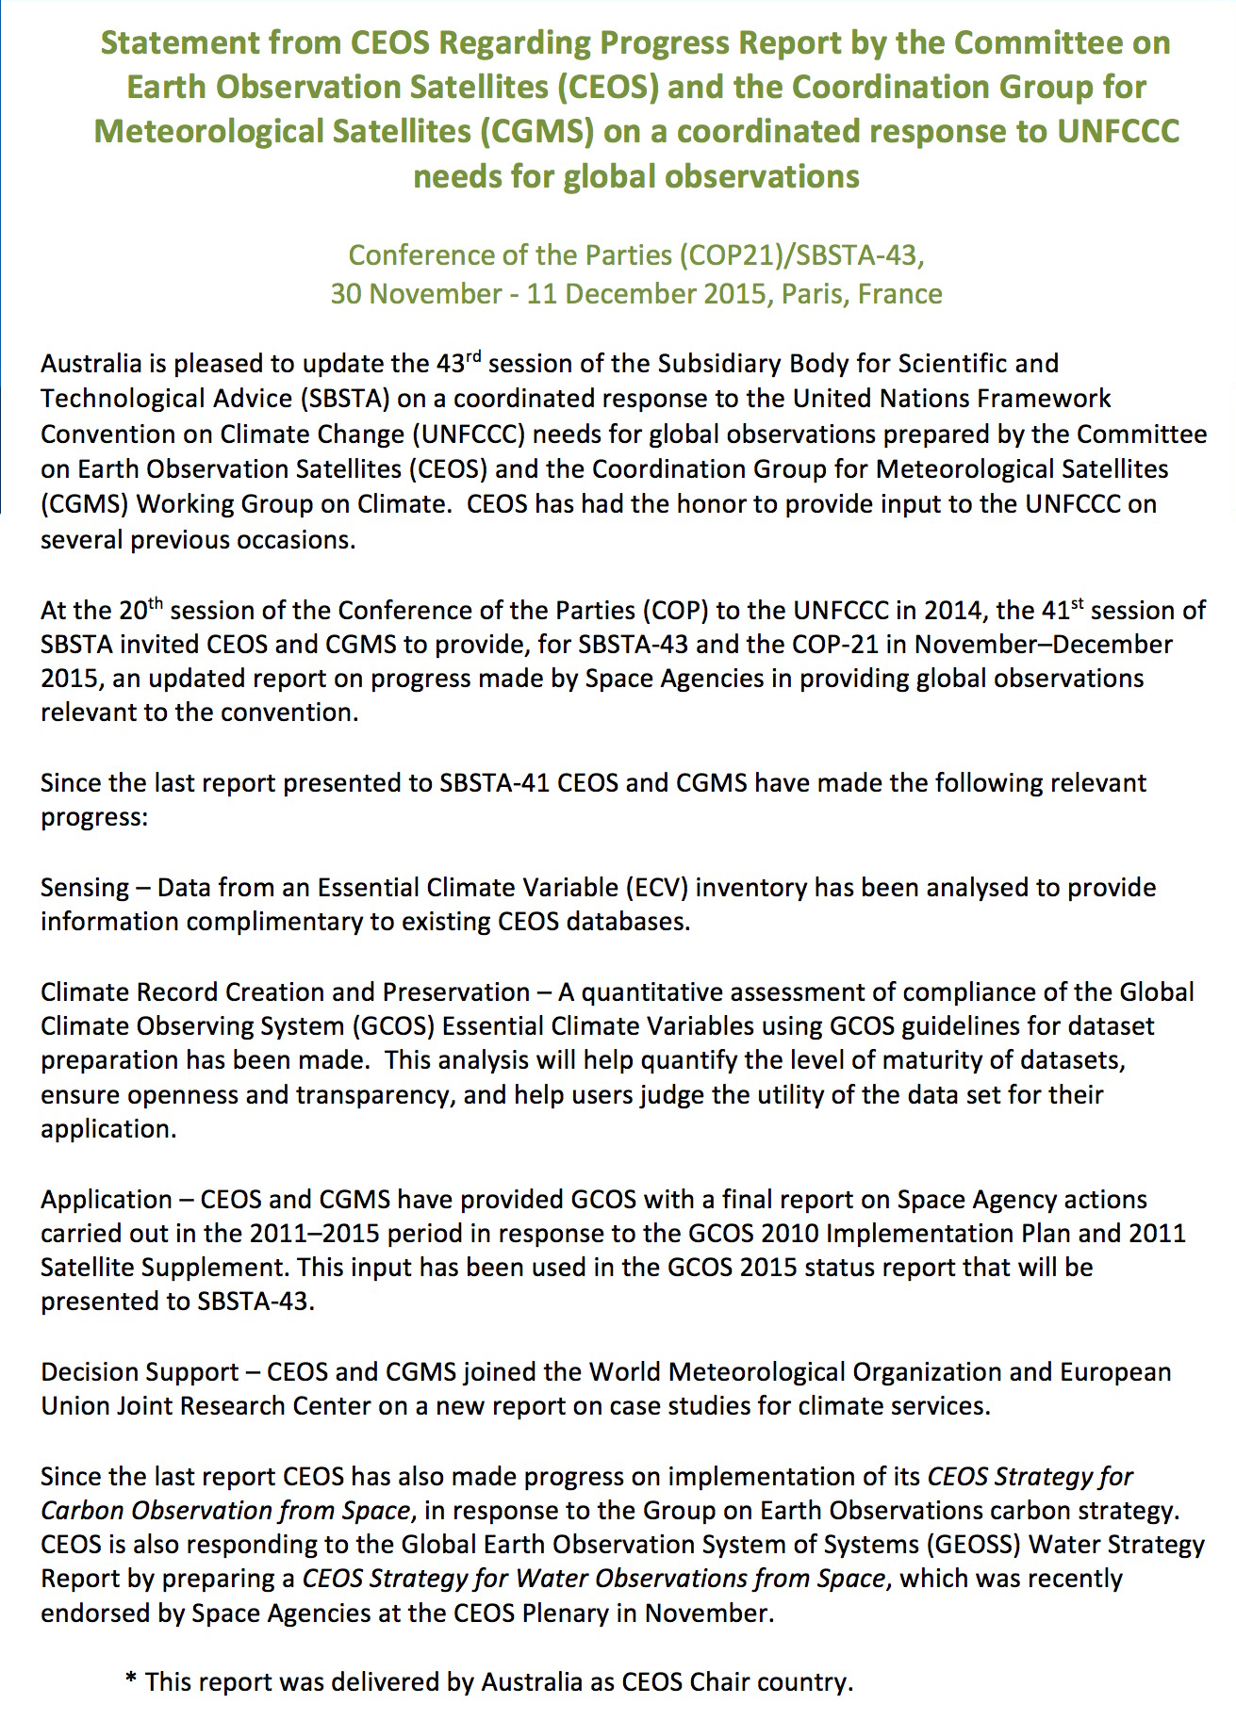
CEOS/CGMS preparation for SBSTA-43
SBSTA-43 Process
WGClimate worked with Florin Vladu SBSTA Secretariat to coordinate and submit input
CEOS Chair delegate is invited to read statement at opening of SBSTA-43 and statement is submitted to CEOS Plenary for endorsement
SBSTA Chair will share summary of key elements received for COP-21 for WGClimate review
WGClimate is working with SBSTA delegates to review and comment on CEOS/CGMS input
WGClimate will respond to final report and recommendations from SBSTA-43

