Slide 1

Committee on Earth Observation Satellites
Working Group on Climate Report
John Bates, NOAA
Plenary Agenda Item 8
29th CEOS Plenary
Kyoto International Conference Center
Kyoto, Japan
5 – 6 November 2015

Slide 2
Working Group on Climate Overview
Notable WGClimate Activities Since 28th CEOS Plenary
Report to and feedback from the UN Framework Convention on Climate Change (UNFCCC) Committee of the Parties (COP-20) Subsidiary Body on Scientific and Technological Advice (SBSTA-41)
        Significant progress on the ECV inventory including version control, reference assessment and compliance against GCOS guidelines, and reference gap analysis proposed.
Significant progress in case studies linking CDRs to societal applications and informed policy decisions and significant interactions with Climate Services, Mitigation, and Adaptation communities
Incoming Chair and Vice Chair of WGClimate – Pascal Lecomte, ESA and Jörg Schulz, EUMETSAT

Slide 3
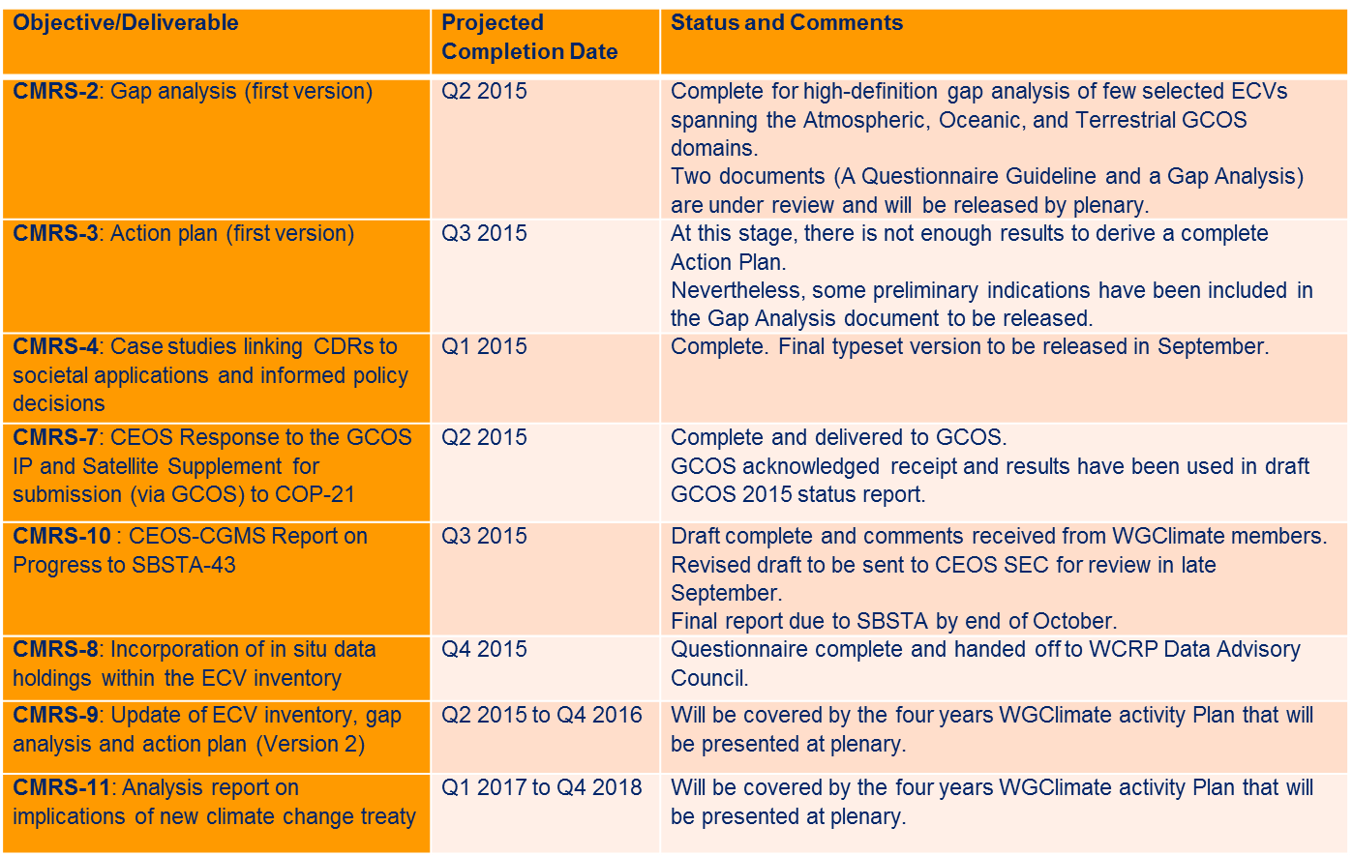
Climate Monitoring, Research, and Services
CEOS 2015-2017 Work Plan Objectives
and Deliverables Status

Slide 4
Experience with Applying
ECV Assessment and Gap Analysis
ECV Reference Assessment Results
ECV Gap Analysis Results
GCOS Guideline | Atmospheric | Oceanic | Terrestrial
1. Full description of all steps taken in the generation of FCDRs and ECV products, including algorithms used, specific FCDRs used, and characteristics and outcomes of validation activities | 71% | 75% | 75%
2. Application of appropriate calibration/validation activities | 74% | 55% | 66%
3. Statement of expected accuracy , stability and resolution (time, space) of the product, including, where possible, a comparison with the GCOS requirements | 73% | 72% | 56%
4. Assessment of long-term stability and homogeneity of the product | 50% | 44% | 48%
5. Information on the scientific review process related to FCDR/product construction (including algorithm selection), FCDR/product quality and applications | 50% | 48% | 48%
6. Global coverage of FCDRs and products where possible | 88% | 92% | 91%
7. Version management of FCDRs and products, particularly in connection with improved algorithms and reprocessing | 100% | 73% | 95%
8. Arrangements for access to the FCDRs, products and all documentation | 66% | 69% | 67%
9. Timeliness of data release to the user community to enable monitoring activities | 47% | 46% | 52%
10. Facility for user feedback | 100% | 69% | 77%
11. Application of a quantitative maturity index if possible | 4% | 0% | 0%
12. Publication of a summary (a webpage or a peer-reviewed article) documenting point-by-point the extent to which this guideline has been followed | 68% | 52% | 61%

Slide 5
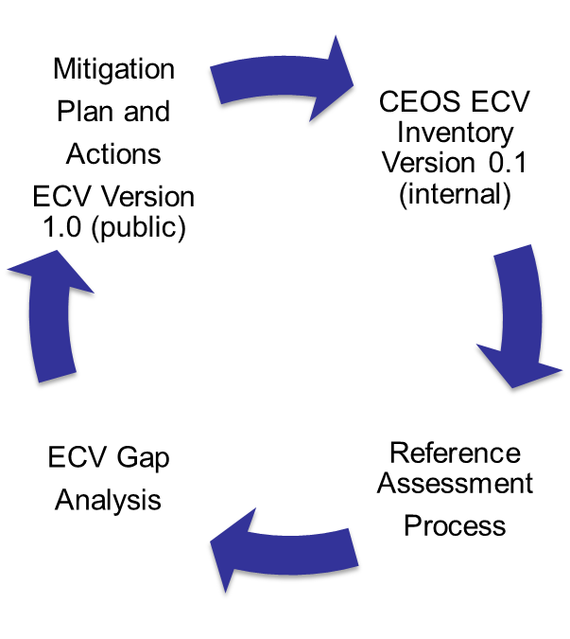
Experiences with ECV Inventory Collection, Assessment, Gap Analysis and Action Plan Cycle
ECV Inventory is the principle activity of WGClimate to capture the physical architecture of climate observing systems
Each step was an opportunity to develop further Best Practices.
ECV Inventory data call was interpreted differently by different agencies and participation varied.
Reference Assessment scored ECV inventory answers against GCOS data set guidelines.
High-Definition Gap Analysis considered gaps spanning 41 conditions.
Mitigation Plan and actions are very difficult to develop and needs harmonization with GCOS responsibilities.

Slide 6
Outgoing Chair Thoughts and Feedback Requested from CEOS on WGClimate and the ECV Inventory
International coordination is always dependent on a ‘coalition of the willing’
  WGClimate is a worthwhile effort requiring community participation.
  Moving forward, WGClimate should explore complementary ways to accomplish the next steps in the ECV inventory cycle.
For ECV Inventory - Data Calls are essential yet difficult and participation is mixed.
  Consider using a data set metadata model Obs4ECV that would include most of the parameters of the ECV inventory (proposed to WDAC)
For ECV Assessment – Systematic assessment worked well once implemented and so should continue in the future
For ECV Gap Analysis and Action Plan – Several options should be explored, for example:
  Ask Agencies to consider implementing gap analysis as part of programs.
  Host gap analysis workshop to perform analysis every few years (possibly co-hosted with GCOS).
  Formalize WGClimate support for ECV inventory (EU contribution appreciated).

Slide 7
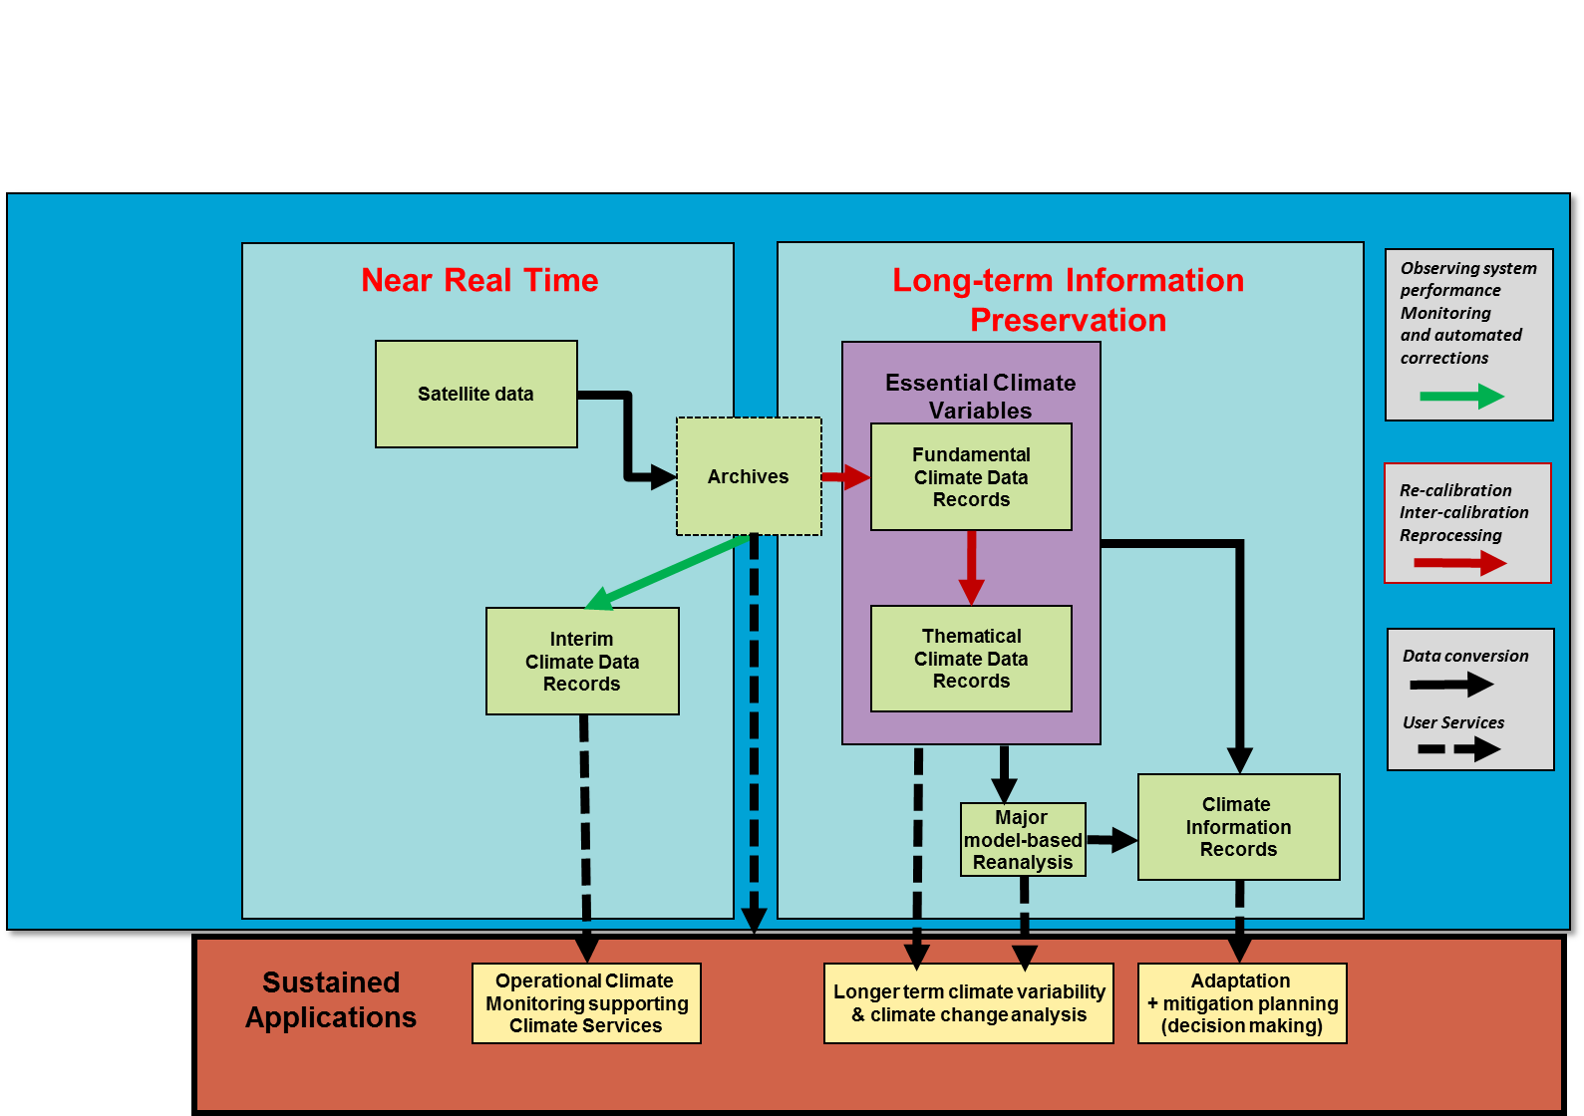
How Climate Observations Will Increasingly Support
Climate Monitoring, Adaptation, and Decision Making

Slide 8
Preparation for incoming WGClimate Chairmanships
  As from November 2015 the WGClimate Chair will be in Europe (ESA then EUMETSAT) for a period of 4 years
  It has been decided to use this opportunity to;
  Take a 4-Year view of the WG objectives and activities (which have now been consolidated within a 4-Year Implementation Plan)
  Form an integrated team for these 4 years to ensure a seamless implementation (including the EC-funded support to the inventory development)
  Each WG Chair will have the responsibility to complete one Inventory Cycle (questionnaire, gap analysis, action plan, etc)
  The ECV inventory is in the process of being transferred to Europe
  Next WGClimate meeting #6: Paris, hosted by CNES on March 7th to 9th, 2016

Slide 9
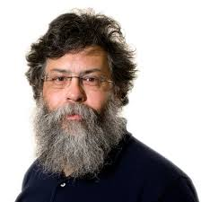
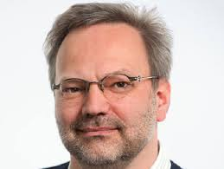
ありがとう Arigatō
Thank you to CEOS and CGMS for giving me the opportunity to serve in leadership of the Working Group on Climate for the past 5 years
Thank you for support – all who have worked on WGClimate the past 5 years
Best wishes to Pascal and Jörg on future success in leading WGClimate

