Slide 1
Committee on Earth Observation Satellites
Application for Associate Member
ANGKASA
Plenary Agenda Item 3
29th CEOS Plenary
Kyoto International Conference Center
Kyoto, Japan
5 – 6 November 2015

Slide 2
Outline
About ANGKASA
Potential Contribution to CEOS
Expectations
Summary

Slide 3
About ANGKASA
Malaysia national space agency
Established in 2002 with the vision
- Harness space as a platform for knowledge generation, wealth creation and societal well-being
3 main focus of ANGKASA:
- Education and Space Science
- Development and Operation of Space System
- Space Application and Technology Development
Currently ~ 120 stuff
- 51 research/science officers

Slide 4
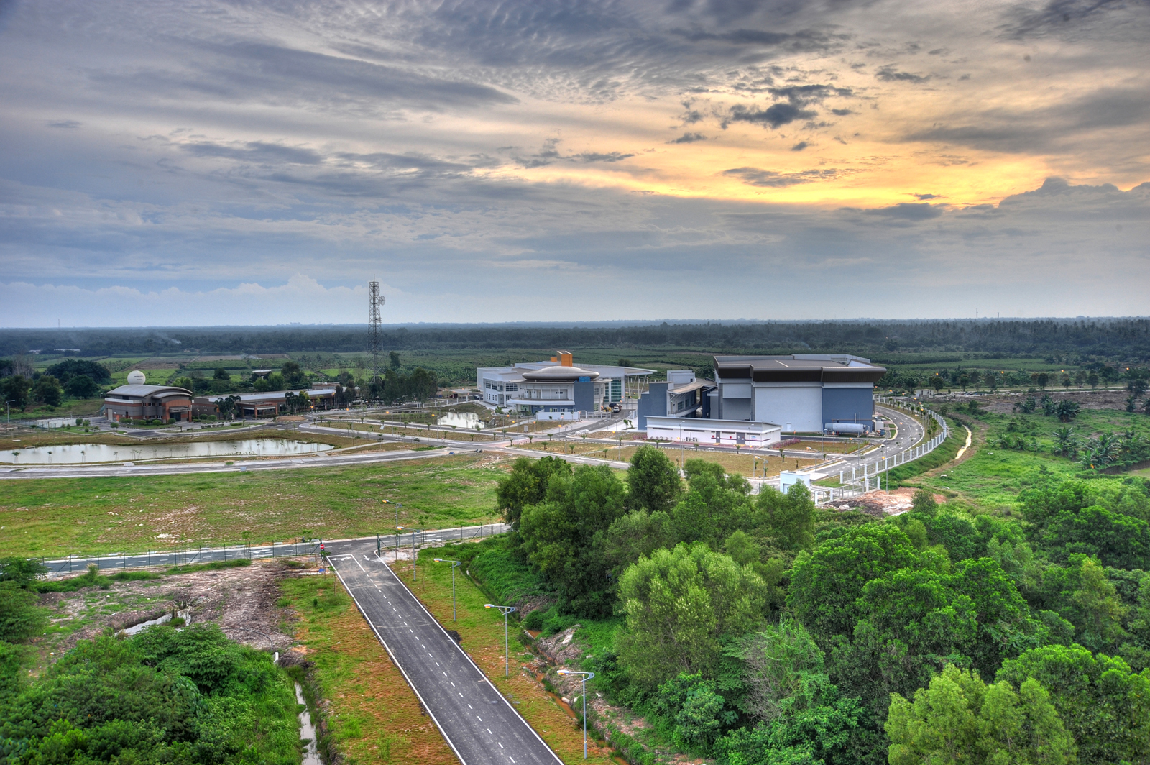
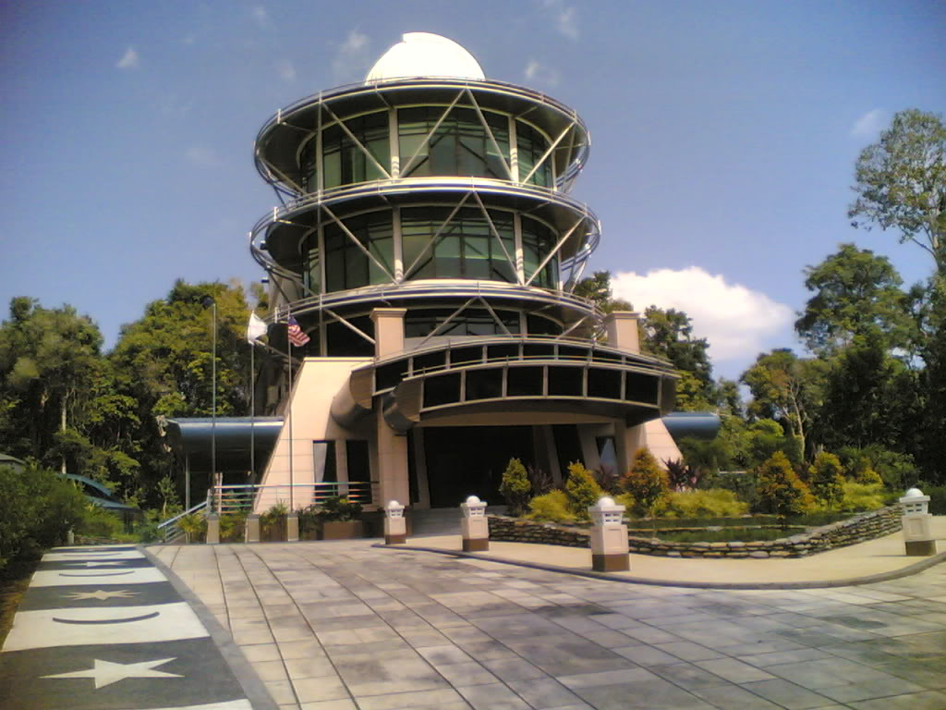
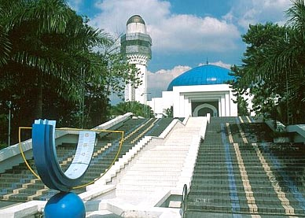
National Space Centre
National Planetarium
National Observatory

Slide 5
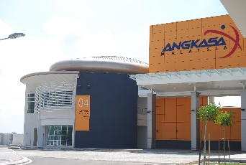
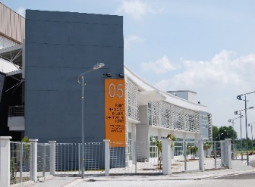
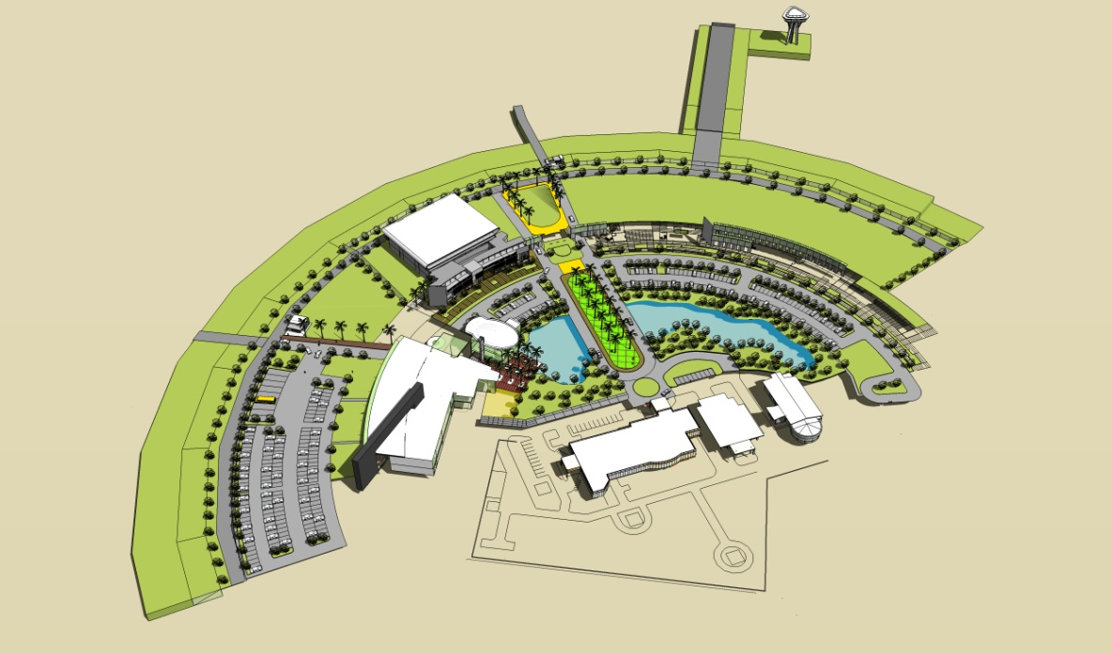
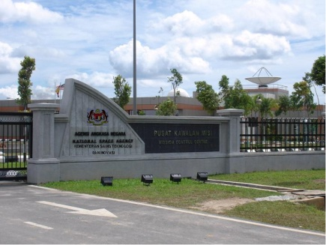
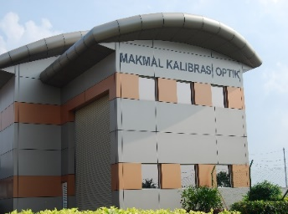
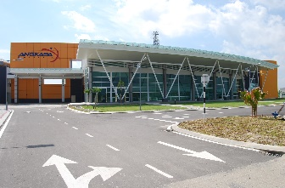
Malaysia Space Centre
Assembly, Integration
& Test Centre
Auditorium & Cafetaria
Main Entrance
Optical Calibration Lab
Data & Archiving Centre
Mission Control Facility

Slide 6
Potential Contributions
2 EO Satellites at the past, i.e. TiungSAT-1 & RazakSAT™
New EO Satellite (RazakSAT-2) expected in 2017/18
- Current status: pre-tender activities
- Access to the data in future
- Support the CEOS’s goal in closing observational gaps
EO related infrastructures, e.g. ground station, optical calibration laboratory etc
- Contribution to working group (e.g. Working Group on Calibration &
Validation, WGCV) & virtual constellations
Focal point for Malaysia
- To work with other Malaysia’s agency in supporting disaster risk
management & climate monitoring

Slide 7
Expectations
CEOS as international platform for exchange idea & information on:
- Improving EO missions
- Increasing international collaboration/cooperation
- Promoting data democracy
- Capacity building
Support from CEOS international members in addressing common issues
- e.g. in-orbit calibration & validation

Slide 8
Summary
ANGKASA is Malaysia government’s caretaker in space sector, including space-based EO
ANGKASA has EO related resources to contribute to CEOS mission & objectives
Inclusion of ANGKASA as associate member of CEOS will be win-win situation for both parties

Slide 9
Thank you for considering ANGKASA’s application for CEOS associates member
Contact
Web: www.angkasa.gov.my
Email: maszlan@angkasa.gov.my (Maszlan Ismail)
Point of contact email: wayne@angkasa.gov.my (Wayne Ng Su Wai)
Phone: +60 3 3182 4000/4074

Slide 10
Back-up Slides

Slide 11
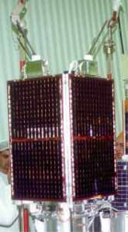
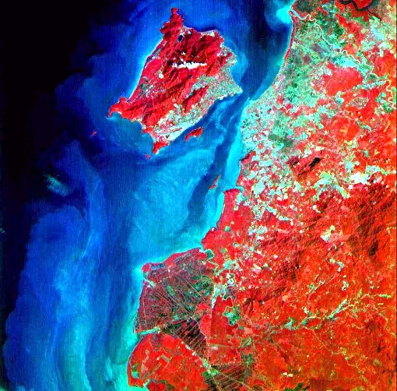
Earth Observation Program (1)
TiungSAT-1
NORAD TLE: 26548U
Launched 26 Sept 2000
Mass: ~ 50kg
Orbit
650km circular
Inclination: 64.5º
Payload
CCD Camera (72m & 1.2km resolution)
Cosmic ray Energy Deposition Experiment (CEDEX)
Digital Signal Processing Experiment

Slide 12
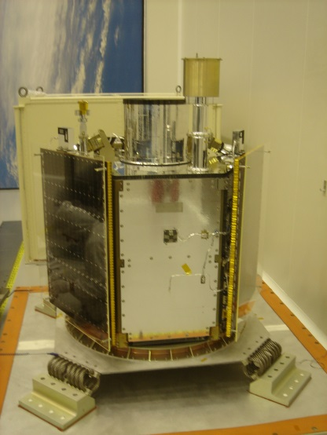
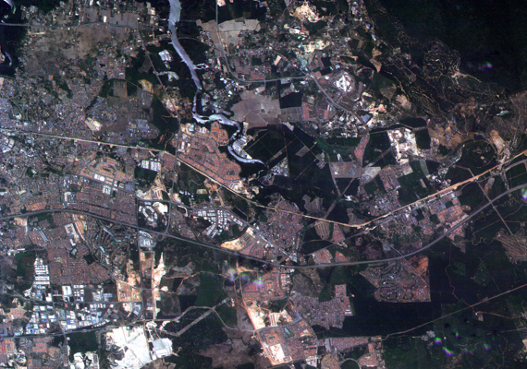
Earth Observation Program (2)
RazakSAT™
NORAD TLE: 35578U
Launched 14 July 2009
Mass: ~ 200kg
Orbit:
685km cicular
Inclination: 9º (NEqO)
Medium Aperture Camera
Multispectral (RGB & NIR) + Pan
2.5m (Pan), 5m (multispectral)
20km swath width

Slide 13
Earth Observation Program (3)
RazakSAT-2
Expected 2017
Sun-synchronous Orbit
Payload
4m (multispectral) + 1m (panchromatic)
Current status:
Pre-tender activities

Slide 14
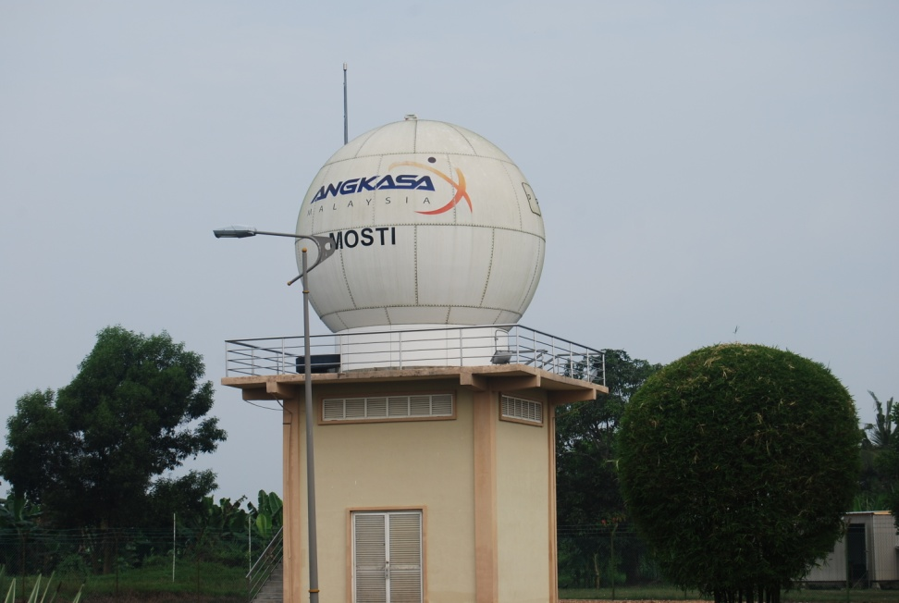
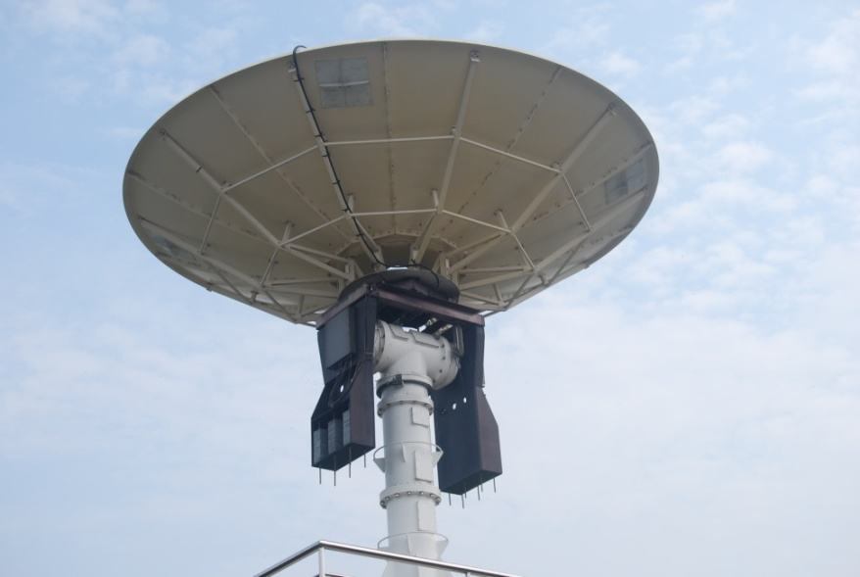
EO Related Infrastructure (1)
Ground Station
Tracking, Telemetry & Command (TT&C) of LEO & MEO satellites
2 antenna systems:
5m diameter dish antenna enclosed in radome for TT&C in S-band
7.3m diameter dish antenna for payload data reception in X-band

Slide 15
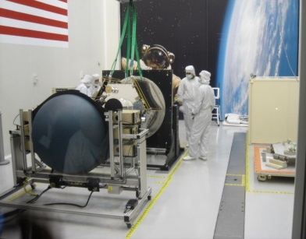
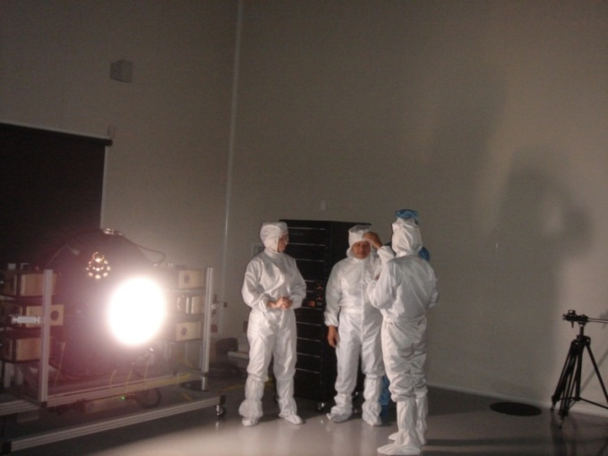
EO Related Resources (2)
Optical Calibration Lab
Cleanroom class 10,000 (fed std) with temperature 18ºC ±2ºC and humidity 50%±5%
Equipped with SI traceable
Integrating sphere
Spectroradiometer
Light source
Other support equipment
Optical bench
Turntable

Slide 16
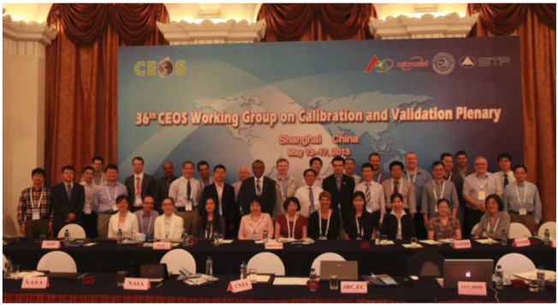
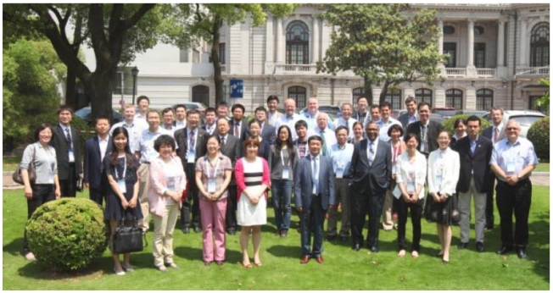
History with CEOS
First time in CEOS Plenary
Attended 36th Working Group on Calibration & Validation (WGCV) meeting in 2013
advised to become member or associate member of CEOS first before attending again

