Slide 1

Committee on Earth Observation Satellites
CEOS Chair Perspective on the 29th CEOS Plenary
JAXA (Japan aerospace Exploration Agency)
Plenary Agenda Item 2
29th CEOS Plenary
Kyoto International Conference Center
Kyoto, Japan
5 – 6 November 2015

Slide 2
Outreach to Key international frameworks
In 2015, we are in the quite important international framework updates.
UN World Conference Disaster Risk Reduction.(March 14-18@Sendai)
  - Importance of EO roll was clearly mentioned in the “Sendai Frame work for Disaster Risk Reduction 2015-2030”
      GEO Ministerial summit / GEO plenary (Nov.9-12@ Mexico)
      - GEO Strategic Plan 2016-2015, will be adopted.
COP21-UN Conference on Climate Change (Nov.30-Dec.11)
- CEOS ‘s effort of provision ECVs is key roll for the success.
UN 2030 Agenda for Sustainable Development.
- EO as indicator of Sustainable Development Goals

Slide 3
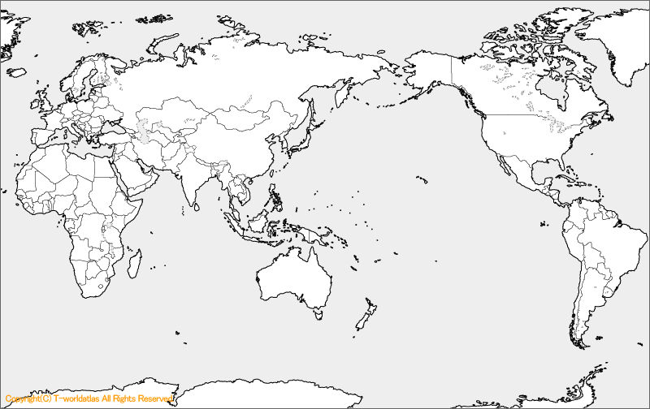
Application for Associate Membership.
- Agence Gabonaise d'Études et d'Observations Spatiales AGEOS (Gabon)
- Agensi Angkasas Negara, ANGKASA (Malaysia)
- Australian Bureau of Meteorology (Australia)
- European Union Satellite Centre (EU)
- Agencia Espacial Mexicana (Mexico)

Slide 4
Chair Priorities
Outcome of the 2015 Chair Priorities
- Data Applications Report (DAR) and its promotion at the Tokyo Symposium
- Results of the 3rd UN WCDRR in Sendai and follow up.
- Results of the GEO Blue Planet Symposium and follow up.
Identification of 2016 CEOS Chair Priorities
- Future Data Access & Analysis Architectures Study
- Non-meteorological applications for next generation geostationary satellites
Study

Slide 5
CEOS Activities
Recognize our progress and endorse future plans.
SIT ;accomplishments of 2014-2015,
Working groups
  - WGCV, WGCapD, WGClimate, WGDisasters, WGISS
Virtual consternations
AC-VC, LSI-VC, OCR-VC, OSVW-VC, OST-VC, P-VC, SST-VC
Ad Hoc Teams
- Space Data Coordination for GFOI
- GEOGLAM (GEO Global Agricultural Monitoring)
- WSIST (Water Strategy Implementation Study Team)

