Slide 1
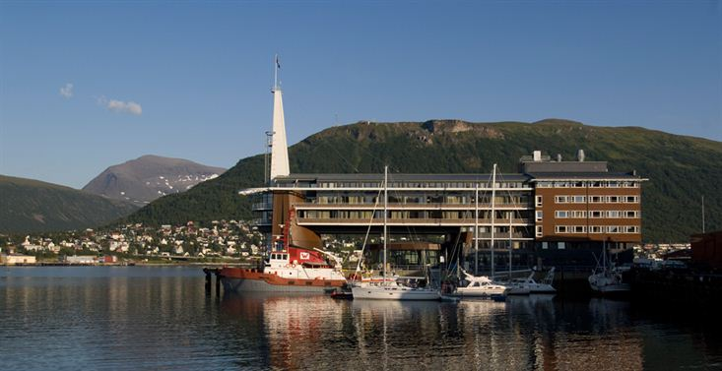

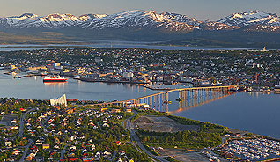
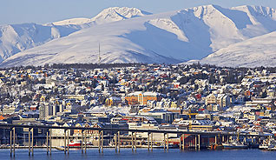
Progress on Chinese FY Meteorological Satellite Programs
WEI Caiying ZHANG Jiashen FAN Jinglong
National Satellite Meteorological Center ,CMA
CEOS Plenary, Organisational Issues Session
Tromsø, Norway
28-30 October 2014

Slide 2
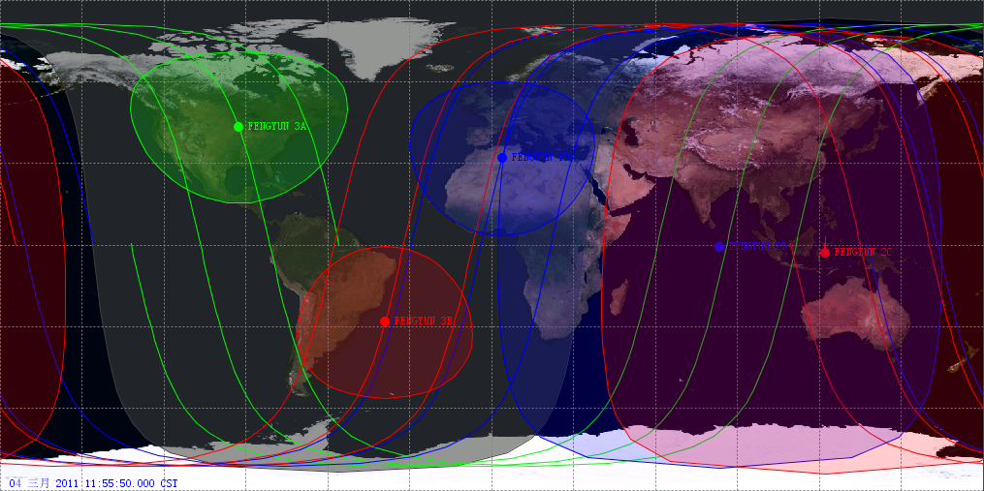
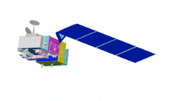
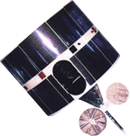

FengYun Satellite Observation Network
FY GEO: FY-2 satellites provide 30 min. interval full disc image and 6 min. interval regional rapid scan service
FY LEO: FY-3 satellites provide global observation for weather, climate and environment
DB service and near real-time data dissemination via CMACast ,internet…
/FY-3C
FY-3A
FY-2D
86.5
FY-2E
105
FY-2F
112
FY-3B
National Satellite Meteorological Center ,CMA

Slide 3
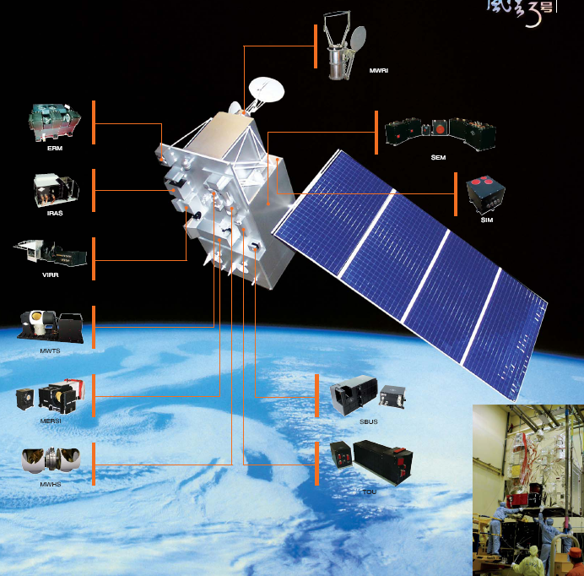
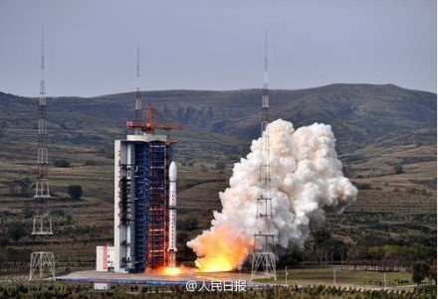
New membler: FY-3C
Launched on 23, Sept. 2013，Operation since June, 2014
ok
FY-3C, as the first operational one of new generation of CMA polar-orbiting satellite, is the successor of experimental satellites FY-3A/B working in orbit

Slide 4
FY-3C instruments(12)
Major Improvements compared with FY-3A/B
A GNSS Occultation Sounder added for GPS sounding
MWTS sounding channels increased from 4 to 13, while spatial resolution from 70Km to 20Km
MWHS sounding channels increased from 5 to 15, with 118GHz O2 absorbing band new added
Auto solar-tracking capability for SIM to improve measurement accuracy
Better performance for at least 60% of instrument specifications
Longer design life, more reliable for operational guarantee
FY-3 OPERATIONAL SATELLITE INSTRUMENTS | FY-3C
MERSI – Medium Resolution Spectral Imager (I, II) | √(I)
MWTS – Microwave Temperature Sounder (I, II) | √(II)
MWHS – Microwave Humidity Sounder (I, II) | √(II)
MWRI – Microwave Radiation Imager | √
WindRAD - Wind Radar
GAS - Greenhouse Gases Absorption Spectrometer
HIRAS – Hyperspectral Infrared Atmospheric Sounder
OMS – Ozone Mapping Spectrometer
GNOS – GNSS Occultation Sounder | √
ERM – Earth Radiation Measurement (I, II) | √(I)
SIM – Solar irradiation Monitor (I, II) | √(II)
SES – Space Environment Suite | √
IRAS – Infrared Atmospheric Sounder | √
VIRR – Visible and Infrared Radiometer | √
SBUS – Solar Backscattered Ultraviolet Sounder | √
TOU – Total Ozone Unit | √

Slide 5
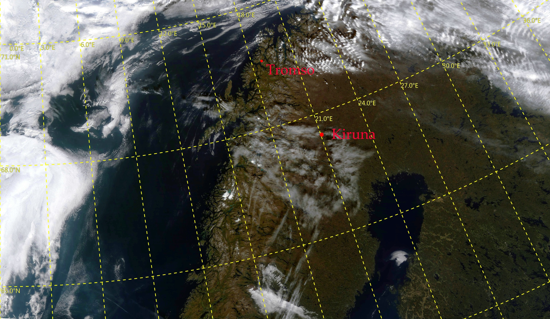
FY3C_MERSI_Scandinavian Peninsula 20140915

Slide 6
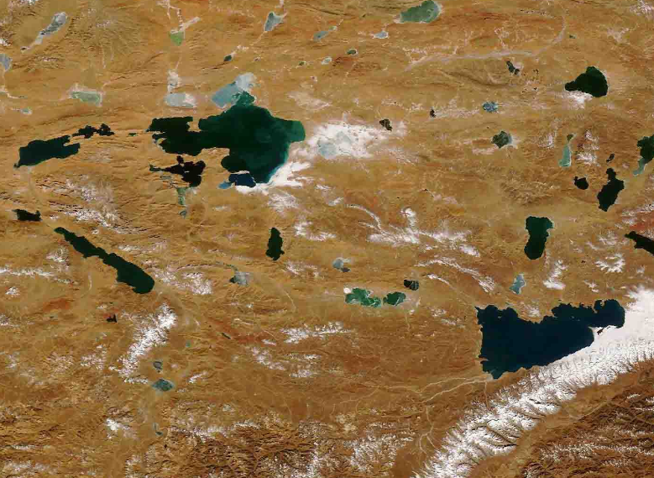
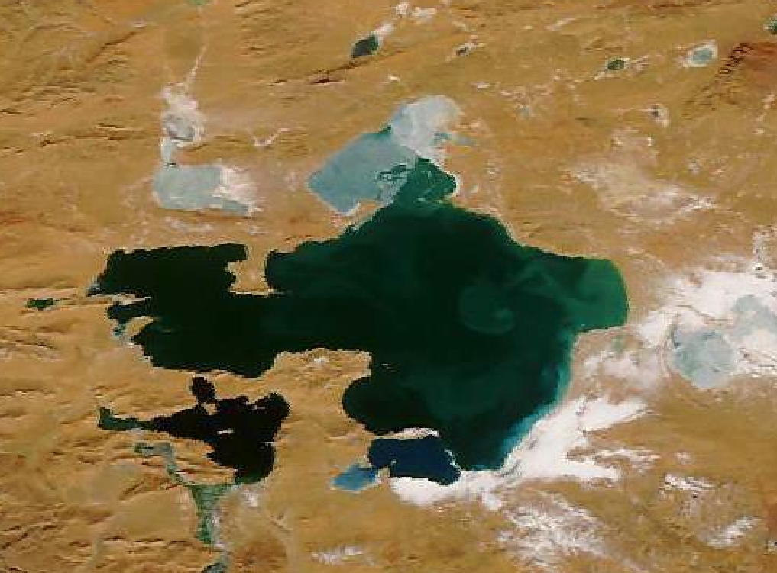
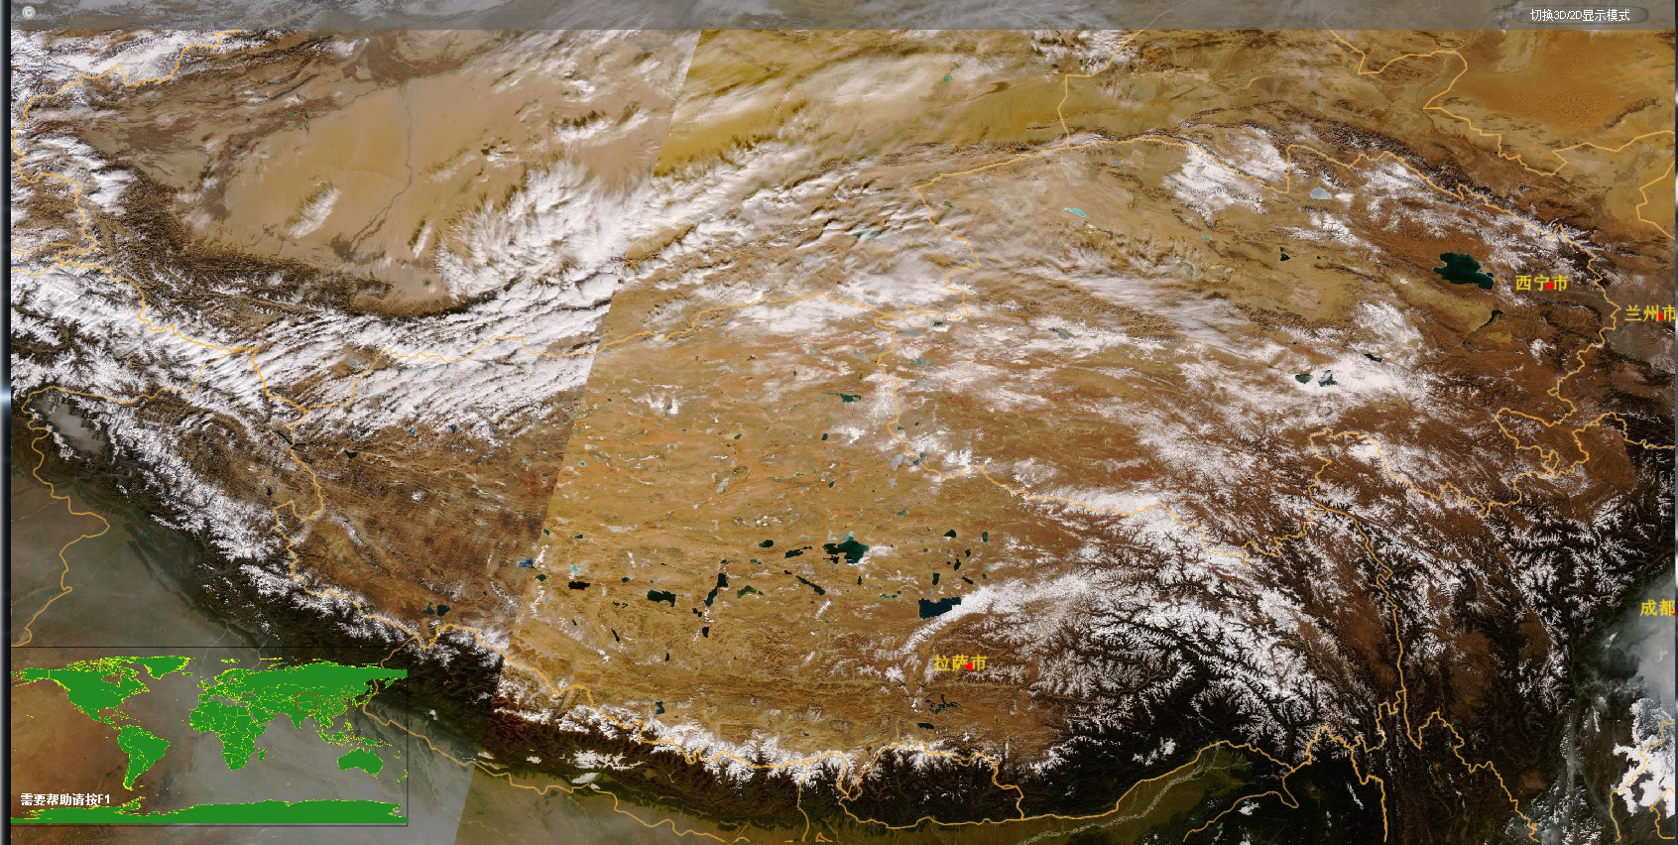
Tibet Plateau from MERSI/FY-3C (Dec. 3, 2013)
2013-12-04
6

Slide 7
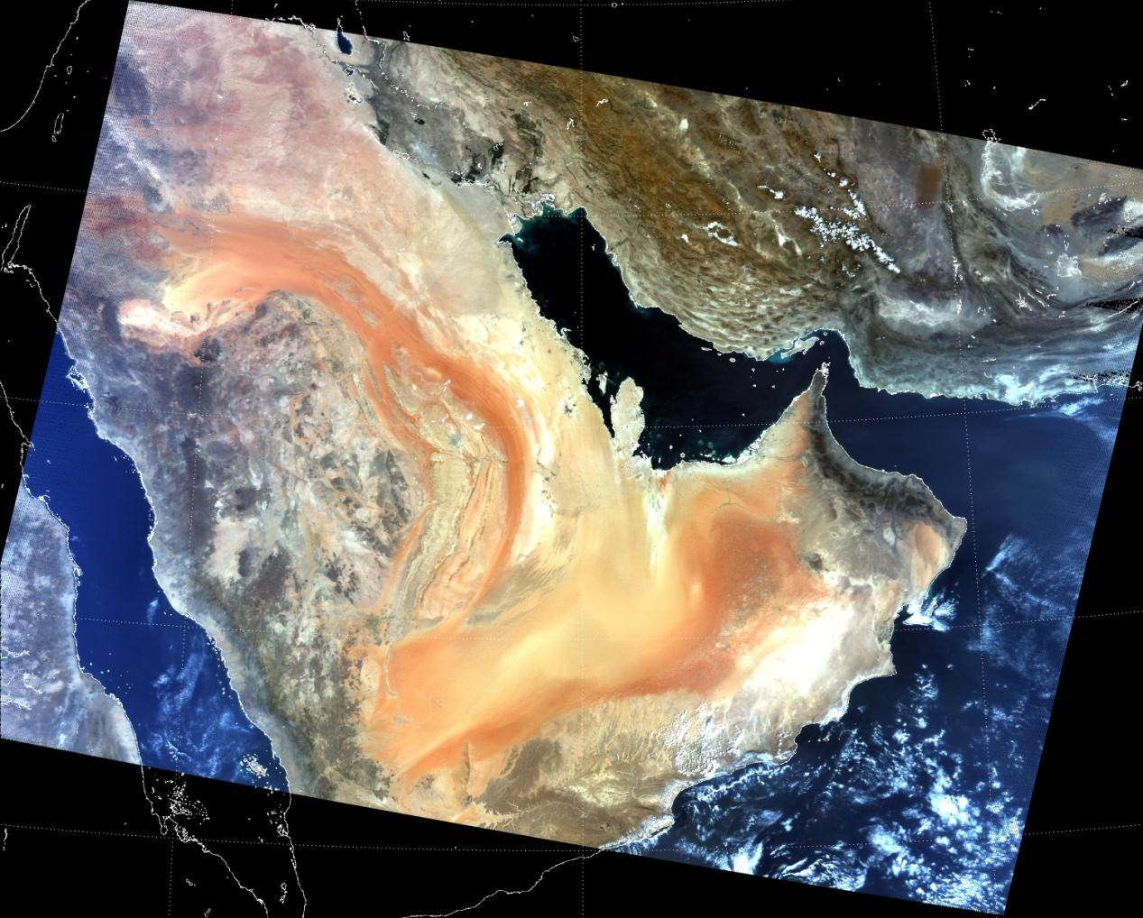
FY-3C MERSI: Arabian Peninsula

Slide 8
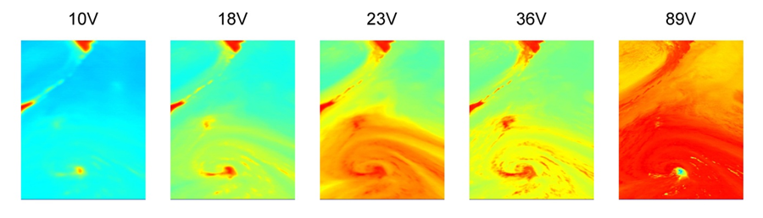
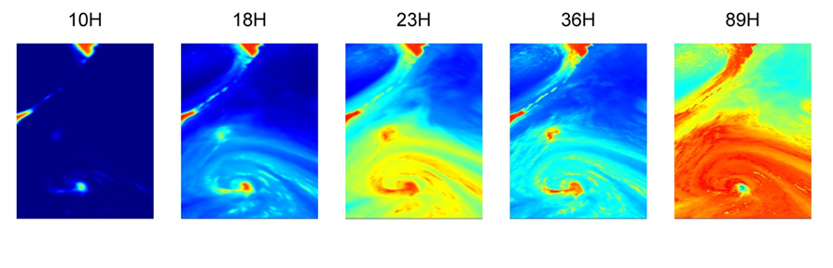
Tropical Cyclone SEPAT by FY-3C MWRI, 30 Sept. 2013
As seen from the images, only eye area of SEPAT scatters in low frequency channel(10GHz) , with the frequency increasing, the features of typhoon structure become more and more clear.

Slide 9
NEdT from FY3A/B/C MWRI (K)
Channel | 89V | 89H | 36V | 36H | 23V | 23H | 18V | 18H | 10V | 10H
FY3A | 0.67 | 0.58 | 0.31 | 0.33 | 0.38 | 0.44 | 0.43 | 0.43 | 0.43 | 0.43
FY3B | 0.55 | 0.64 | 0.26 | 0.24 | 0.36 | 0.35 | 0.35 | 0.37 | 0.30 | 0.31
FY3C | 0.41 | 0.41 | 0.27 | 0.27 | 0.33 | 0.39 | 0.40 | 0.42 | 0.31 | 0.29

Slide 10
Stability of NEdT: 2013.12.1-30d (MWTS-2)
Red line: specification; dot: on-orbit
On-orbit is better than specification
supposed to be good enough for NWP
channels

Slide 11
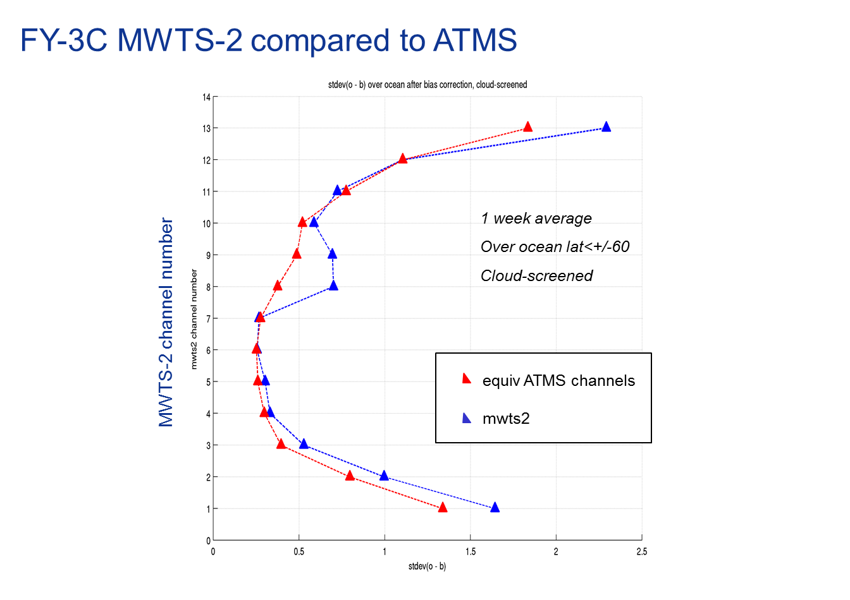
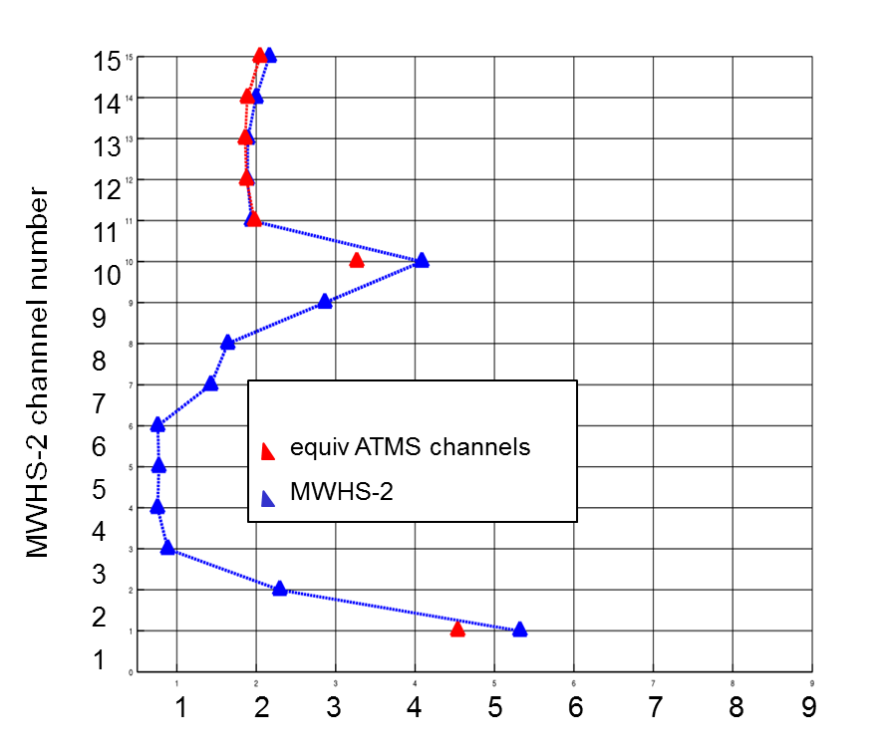
FY-3C MWTS-2/MWHS-2 compared to ATMS
FY-3C MWHS-2 compared to ATMS
Standard deviation of o-b similar to ATMS after bias correction

Slide 12

Closer collaborations among four centers
for FengYun satellite data assimilation is underway.
Share; early evaluation; preparation before launch
ECMWF(User)
Feedback
UKMO(User)
Feedback
Improved FengYun Satellite Data Assimilation
CMA/NWPC(User)
Feedback
CMA/NSMC (Agency) Basic and general support
ECMWF starts using FY-3B data in the operational forecasting system on 29 September 2014

Slide 13
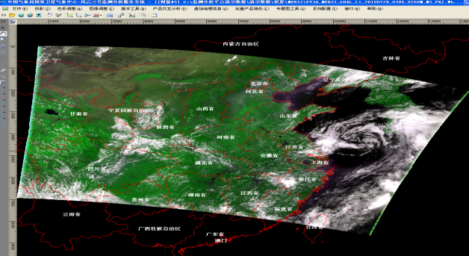
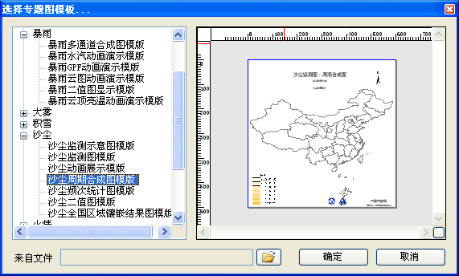
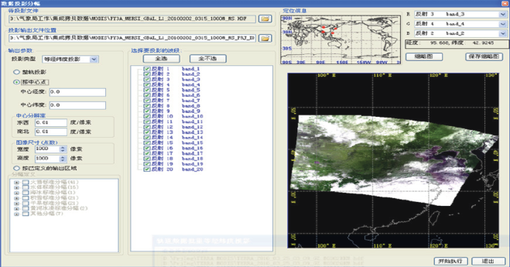
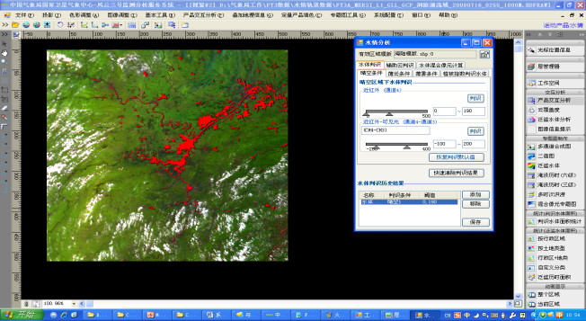
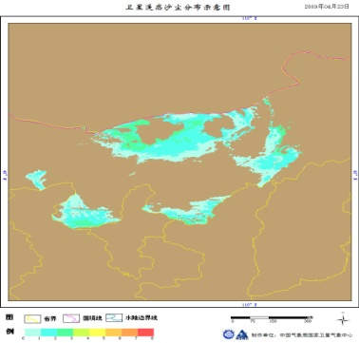
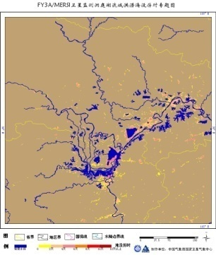
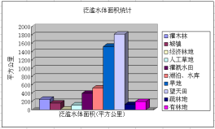
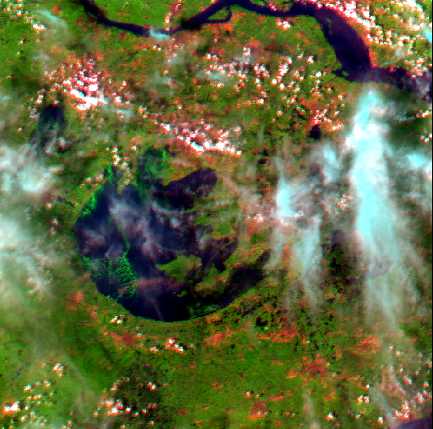
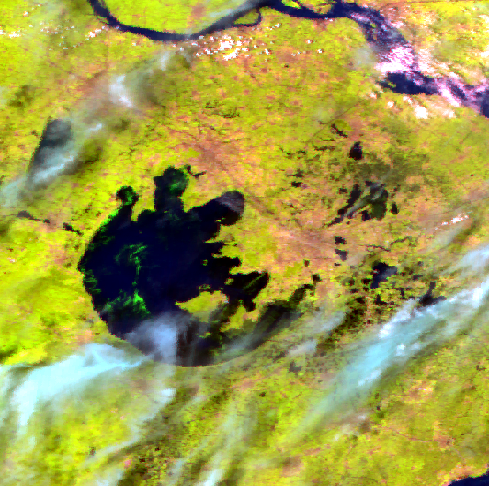
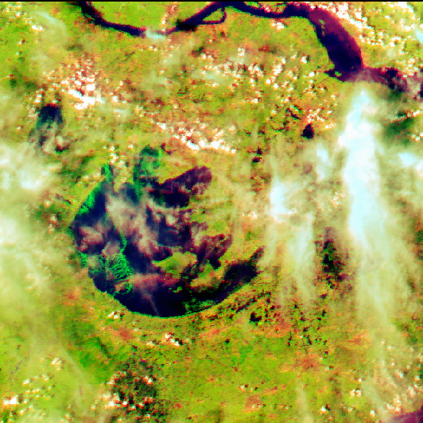
Satellite Monitoring Analysis Remote-sensing Toolkit (SMART) - for FY-3
Source
image
Objective
image
Matched
image
Reading and displaying Satellite data
Reading and displaying GIS data
Customizable color palette for data displaying
Multiple functions of color adjustment
Multiple image adjustment functions
Multiple auxiliary tools including magnetic lasso etc.
Customization of thematic map templates
Label for thematic map
Multi-source data reading and displaying
Specialized toolkit in remote sensing
Common toolkit in image processing
Thematic products analyzing
Thematic products generation
Public service
map projections in multiple windows
Image geometrical correction
Image split or and mosaic
Analyzing and processing of environmental change monitoring
Temporal analysis function of monitoring products
Thematic products
Statistic table
Operational reports, etc.
Notes:
Toolkit software package is very important to promote the product utilization. Through the product the utilization, the quality of product can be feedback.
This is the FY-3 data toolkit software package which focus on environment and disaster monitoring more.

Slide 14
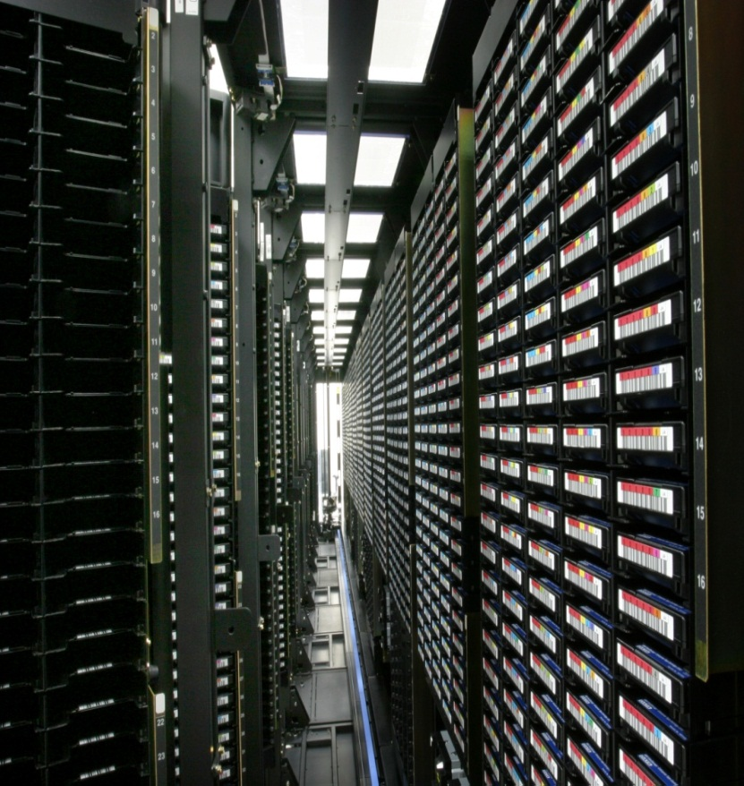
Data Delivery Services
1) Web-based Service（register user）
2) FTP Push （important user）
3) FTP Pull （register user）
4) Manual Service （emergency）
5) CMACAST （register user）
6) DB Users （register user）

Slide 15
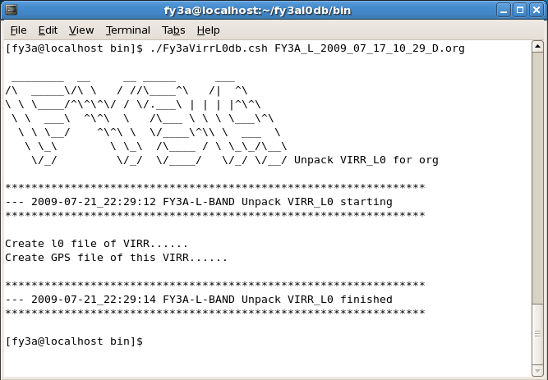
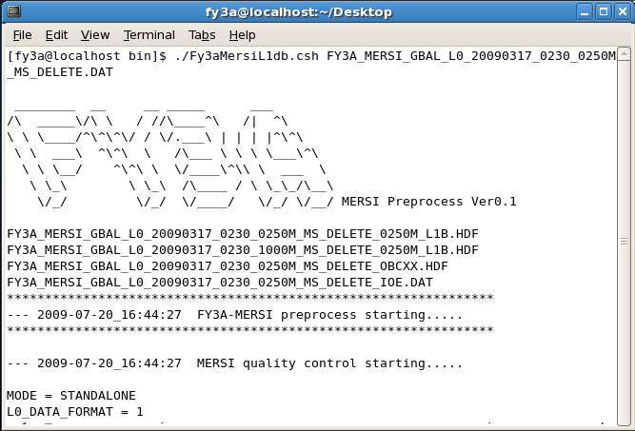
FY-3 DB Users – free access to
FY-3 International Pre-processing Packages
http://satellite.cma.gov.cn
5 Instruments available
  MERSI, VIRR, MWTS, MWHT, IRAS
Hardware recommended
  CPU: Intel Pentium Duo Core processor (>3.0Ghz)
  Hard disk: >200GB
Operating system tested
  RedHat Fedora Linux 6.0/8.0/10.0
Software packages released
  FY3L0pp: unpack raw data in both X/L bands to generate level-0 data from the 5 instruments
  FY3L1pp: processes level-0 data to generate corresponding level-1 data respectively.

Slide 16
FUTURE CMA LEO SATELLITES
07 | 08 | 09 | 10 | 11 | 12 | 13 | 14 | 15 | 16 | 17 | 18 | 19 | 20 | 21 | 22 | 23 | 24 | 25 | 26
FY-3A
FY-3B
FY-3C
FY-3D/pm
FY-3E/am
FY-3G/am
FY-3RM
Following FY-3C, FY-3D/E/F/G will be launched at the pace of one satellite every two years. The life time for each satellite is 5 years. Also, CMA is developing plan for rain observation satellite, FY-3RM. The first scheduled launch of FY-3RM is in 2019, life time 5 years.

Slide 17
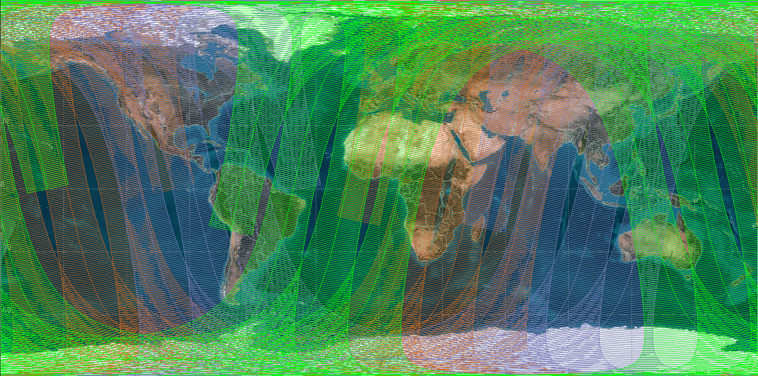
To optimize the current global polar constellation
Orbital Option: Metop+NPP+FY-3
Recognizing that global even distribution of sounding data is of great significance for the 6 hour NWP assimilation window, one approach is to constitute a three orbital fleet including Metop (Mid. Morning) + NPP (Afternoon) + FY-3 (Early Morning).
FY-3 Early Morning 6:00 AM
Metop-A 9:30 AM
NPP 13:30 PM

Slide 18

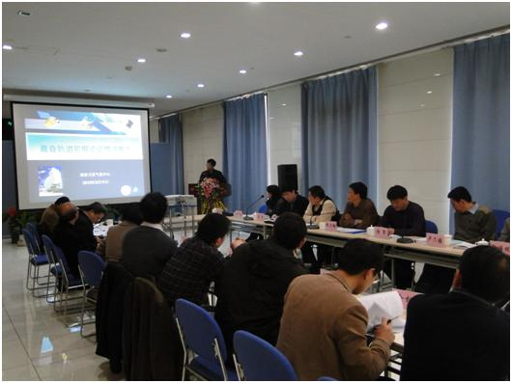
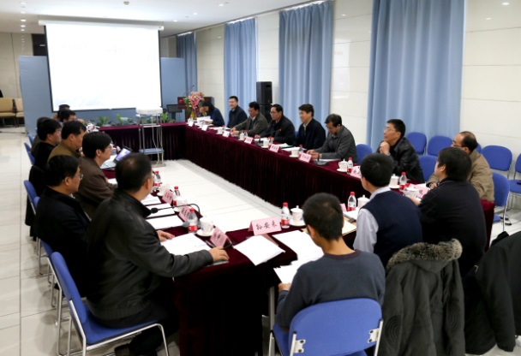
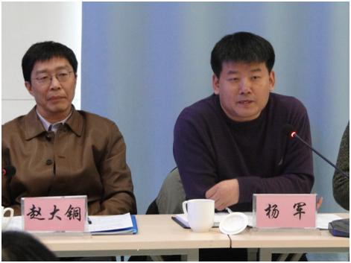
Investigating Possibility for FY-3 Early-morning Orbit
1. Potential User Workshop
  Beijing, March 11, 2013
  CMA Headquarter, NWPC, NNWPC, NCC, CAMS
2. Engineering Feasibility Seminar
  Shanghai, Nov. 8, 2012
  Shanghai, Jan. 10, 2013
  Beijing, March 12, 2013
  SAST/CAST
3. Financial Support Discussion
  Jan., 2013
  CMA, CNSA, NDRC
4. Tiger Team Meeting
  April,2013
  CMA

Slide 19
Summary
FY-3C has been improved with good performance
Closer collaborations from UKMO、ECMWF、CMA is ongoing to improve data assimilation of FY-3C in NWP
FY-2G is scheduled for launch in December this year

