Slide 1
28th CEOS Plenary – NASA Update
Michael H. Freilich
NASA
CEOS Plenary, Agenda Item 38
Tromsø, Norway 28-30 October 2014

Slide 2
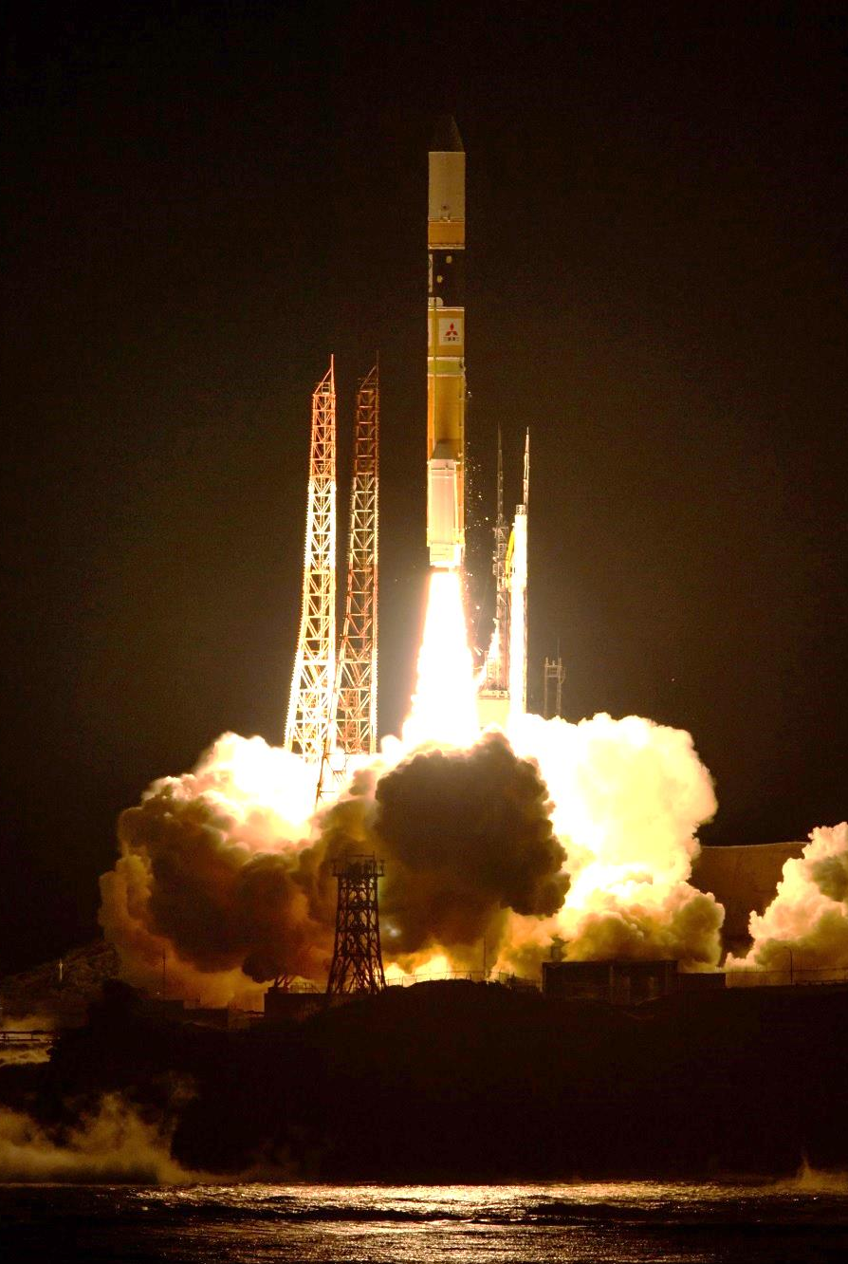
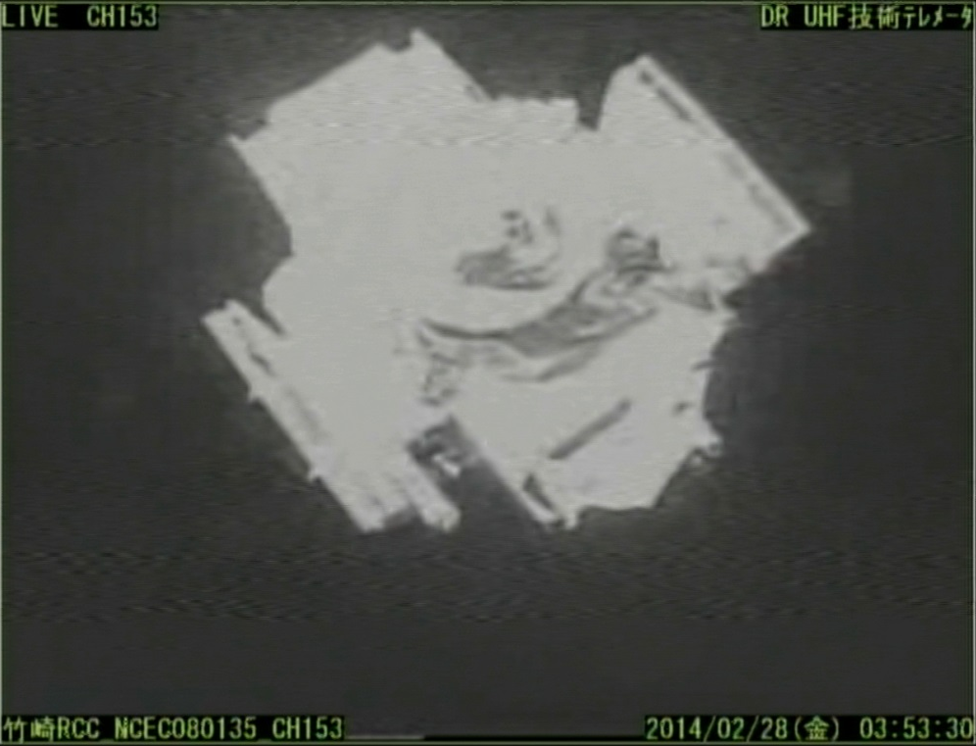
NASA-JAXA GPM Core Observatory
The GPM Core Observatory was launched on a JAXA-supplied MHI H-IIA 202 launch vehicle from JAXA’s Tanegashima Space Center, on Tanegashima Island, Japan – 28 Feb 2014.
GPM Level-2 data products available routinely: Sept 2014
The Core Observatory separation from the H-IIA second stage occurred ~16 minutes after launch.

Slide 3
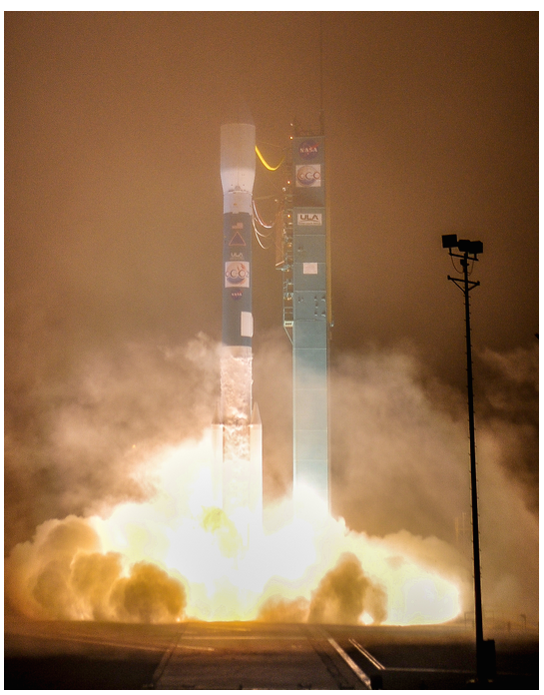
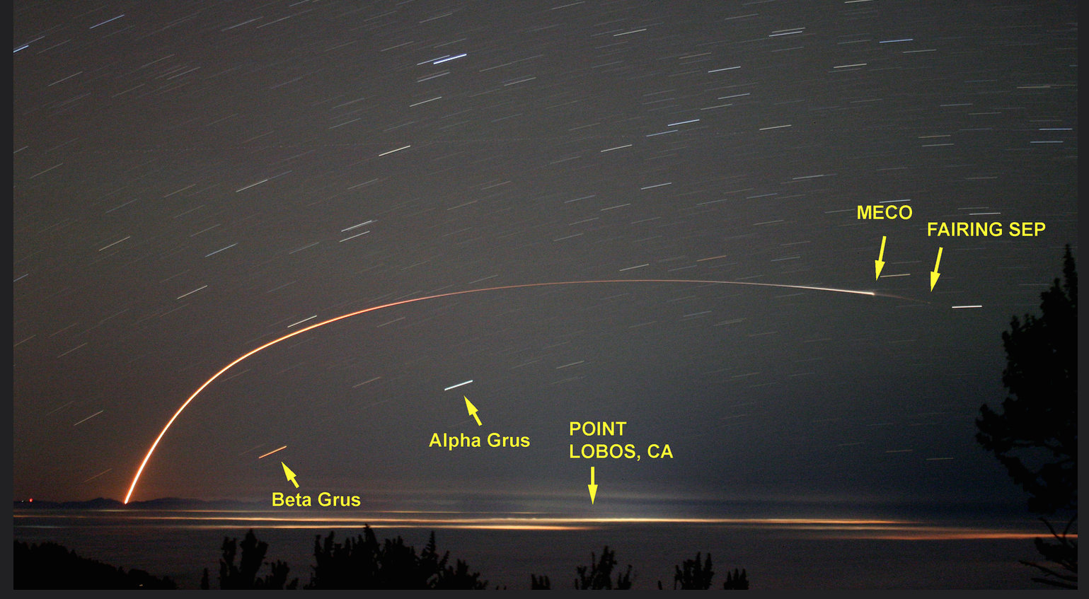
OCO-2 Launch
Five Minute-Long Exposure Image of the OCO-2 Delta II Launch from Santa Cruz, CA, Approximately 200 Miles from VAFB
OCO-2 Routine Ops began 13 Oct 2014
Lift-Off from SLC-2W (Space Launch Complex 2 West), Vandenberg Air Force Base (VAFB), CA, 2:56:23.272 am PDT,
Tuesday, 02 July 2014

Slide 4
RapidScat Installation on ISS

Slide 5
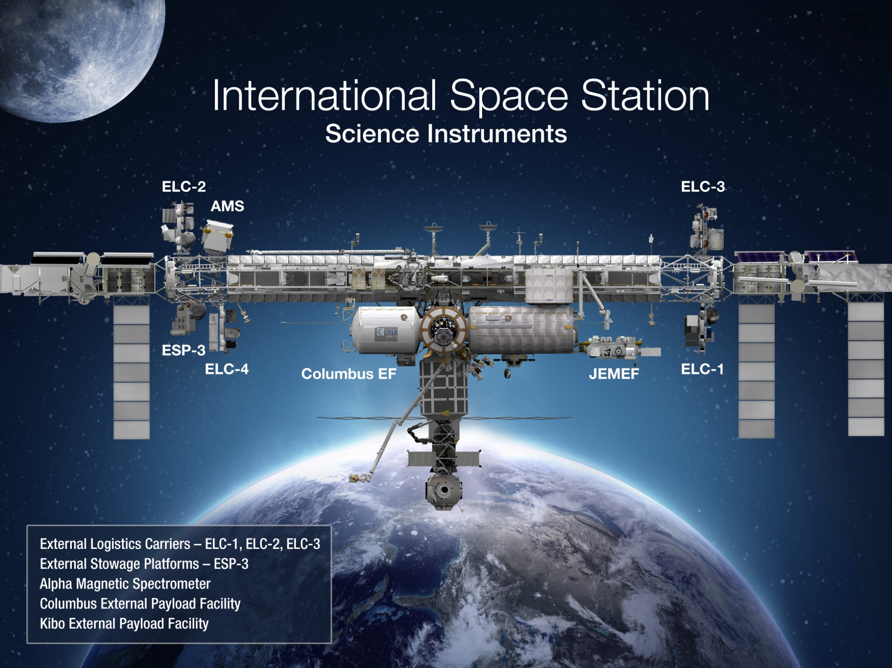
Earth
LIS (2016)
SAGE III (CY2016)
ISERV (2012)
CATS (2014)
HICO (2009)
ECOSTRESS (2018)
GEDI (2019)
RapidSCAT (2014)

Slide 6
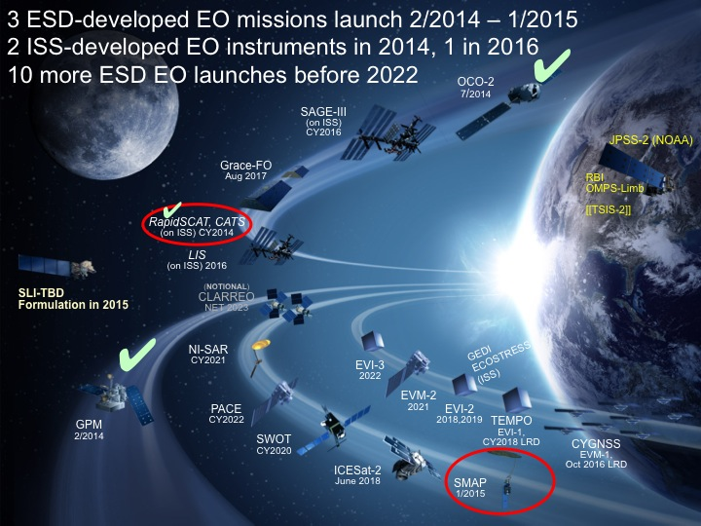
NASA Near-Term Upcoming Launches

Slide 7
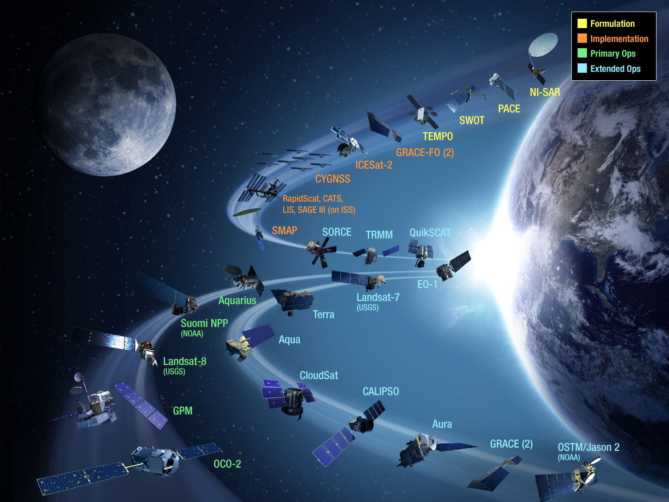
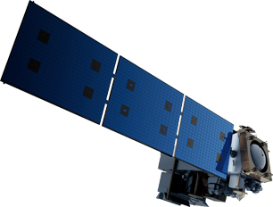
JPSS-2 (NOAA)
SLI-TBD
Formulation in 2015
RBI
OMPS-Limb
[[TSIS-2]]
[[TCTE]]

Slide 8
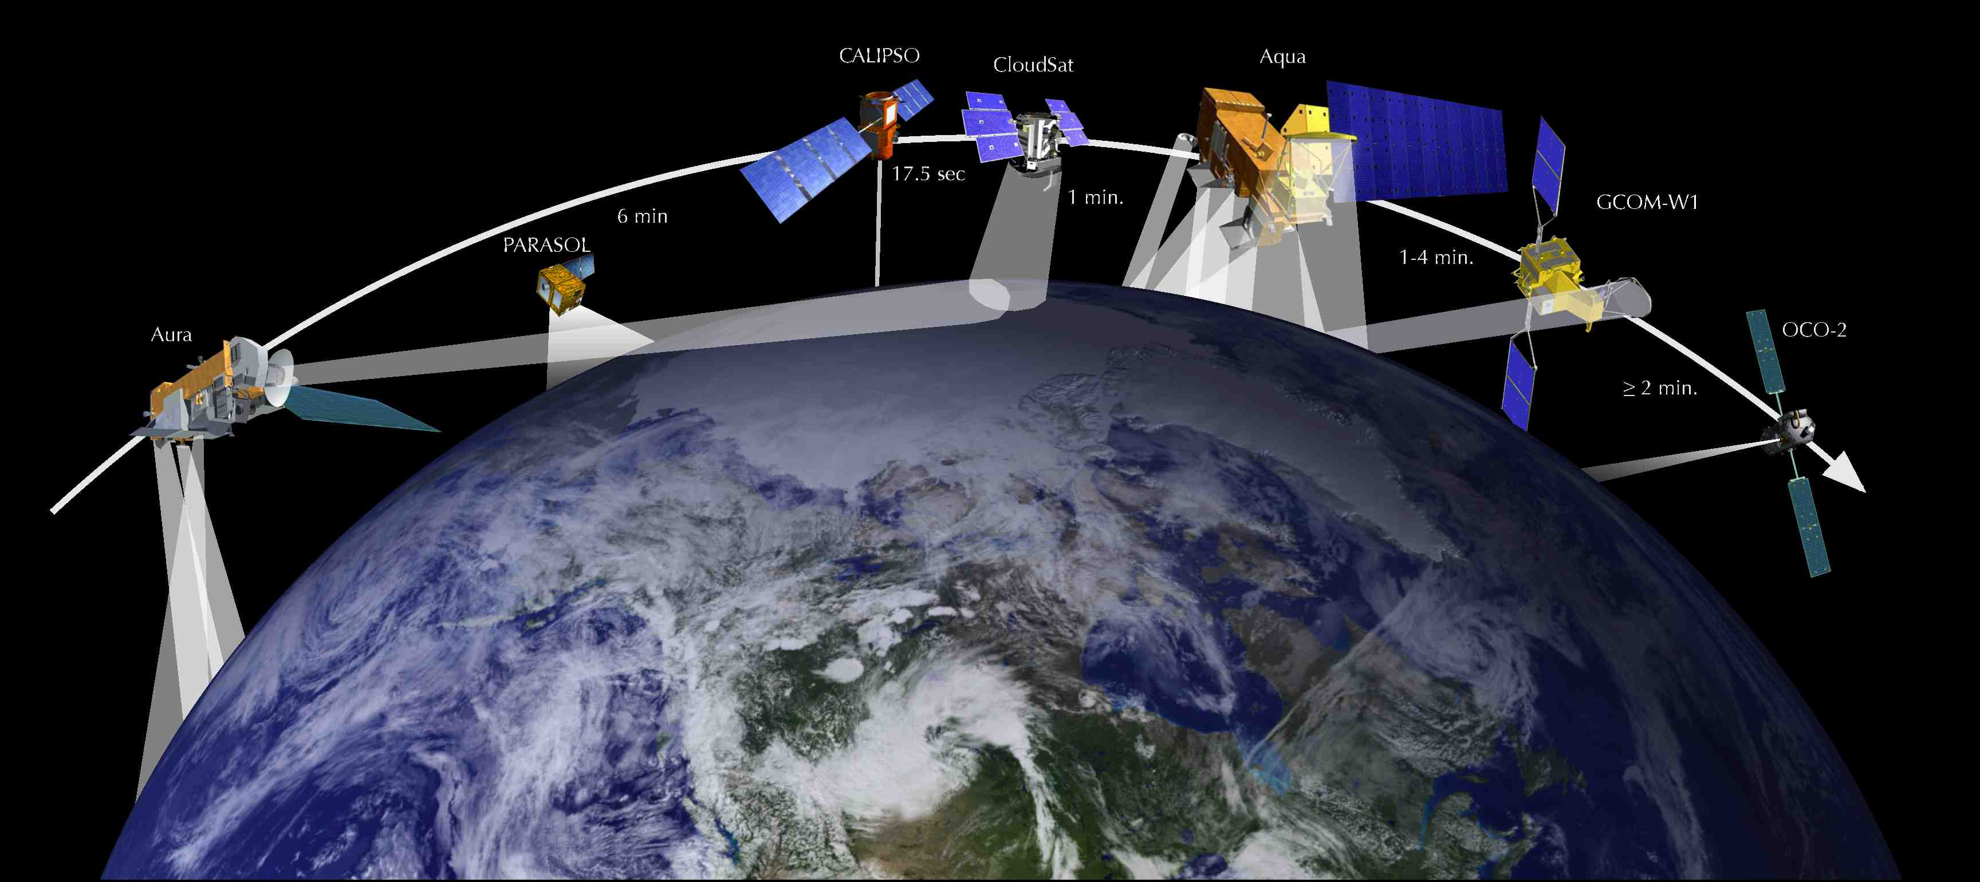
International A-Train

Slide 9
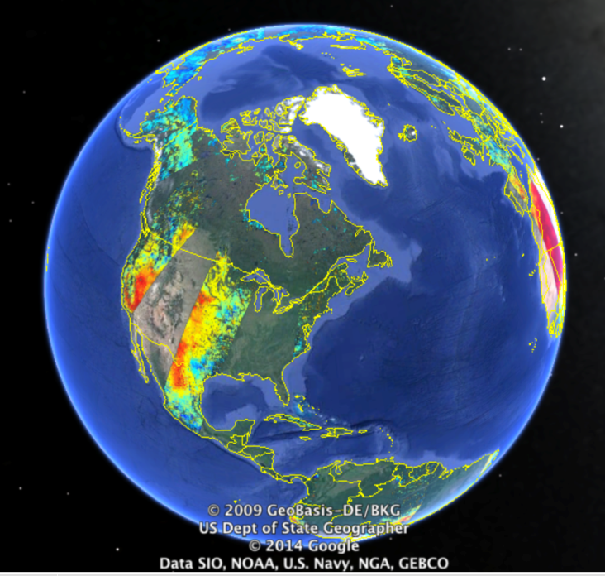
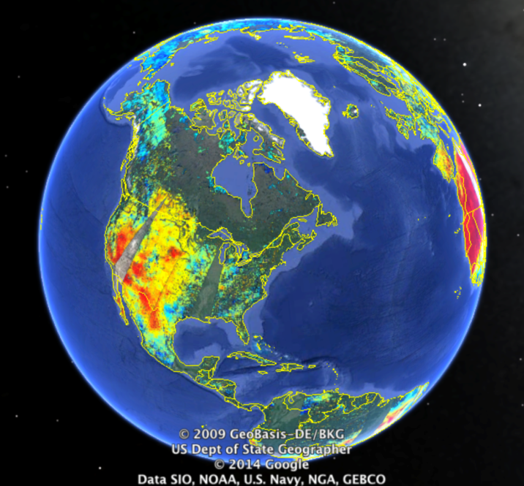
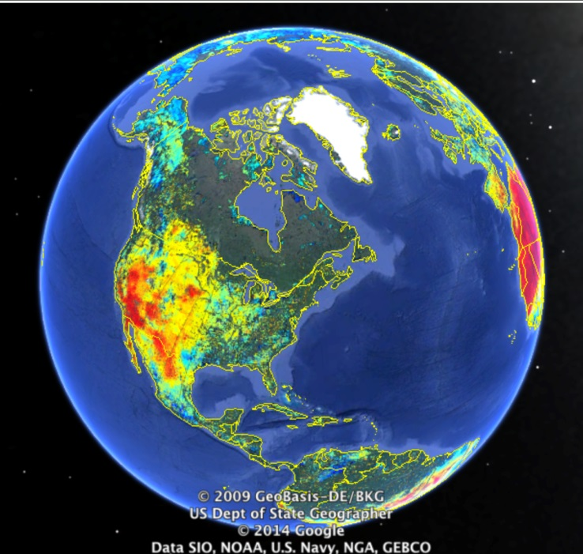
SMAP Soil Moisture : 29 January 2015 Launch
SMAP will provide moisture content measurement in the top 5 cm of soil at 10 km resolution globally every 3 days
Day 1
Days 1+2
Days 1-3
SMAP measurements of soil moisture address a wide range of water cycle research and science applications, such as weather predictions, drought/flood monitoring, and food production.
The illustrations provide the soil moisture color-coded with orange for dry conditions and blue for wet conditions.
Notes:
9

