Slide 1
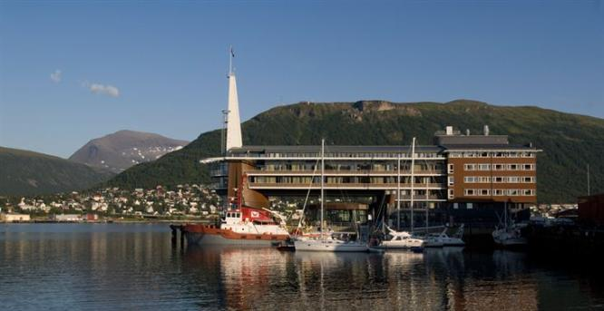
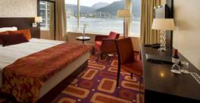
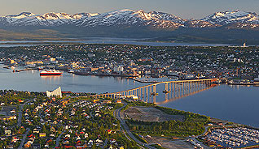
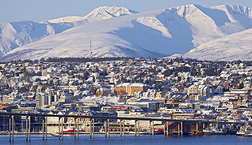
28th CEOS Plenary Session SIT Vice Chair Nomination
Pascale Ultré-Guérard
CNES, SIT chair
CEOS Plenary, Agenda Item 35
Tromsø, Norway 28-30 October 2014

Slide 2
SIT Vice Chair
A call for candidates toward CEOS members was initiated at SIT-28 (Hampton)
As no responses were received, Cnes has initiated bilateral discussions with several potential agencies.
These discussions have resulted in a letter from ESA received during the summer proposing Steven Briggs as candidate to be the SIT Vice chair during Cnes mandate and then become SIT chair
This proposal has been presented to CEOS SEC and CEOS SIT Technical Workshop
Not necessary to introduce Steven Briggs (!) but I give him the opportunity to say some words…

Slide 3
SIT Vice Chair
DECISION Plenary is invited to nominate Steven Briggs, ESA representative, as the current SIT Vice Chair becoming the next CEOS SIT Chair after the 29th Plenary in Kyoto in november 2015.

