Slide 1
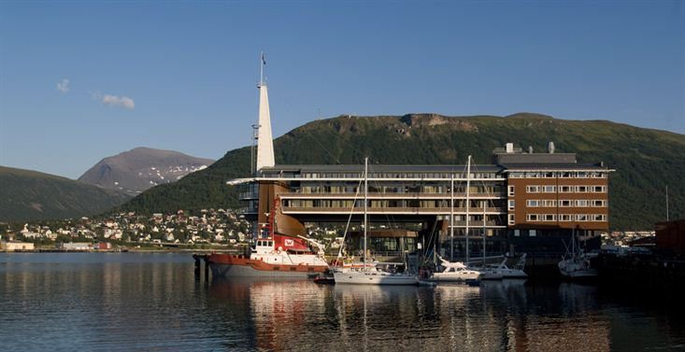
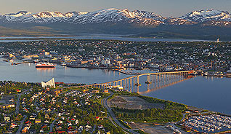
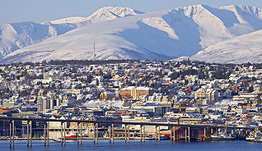
CEOS Information Management
Kim Holloway
CEOS SEO (NASA)
28th CEOS Plenary, Agenda Item 32
Tromsø, Norway 28-30 October 2014

Slide 2
Introduction
Mailing Lists
Outreach Materials
CEOS.org
Social Media

Slide 3
The CEOS Website
The Old
Last updated in 2007
35000+ visitors, 2014
Content overflow
Dated look & feel
The New
Reorganized structure
Updated look & feel
External user-friendly
Notes:
Every day, over 60 new people come to visit our website for the first time to find out who we are or what we do.

Slide 4
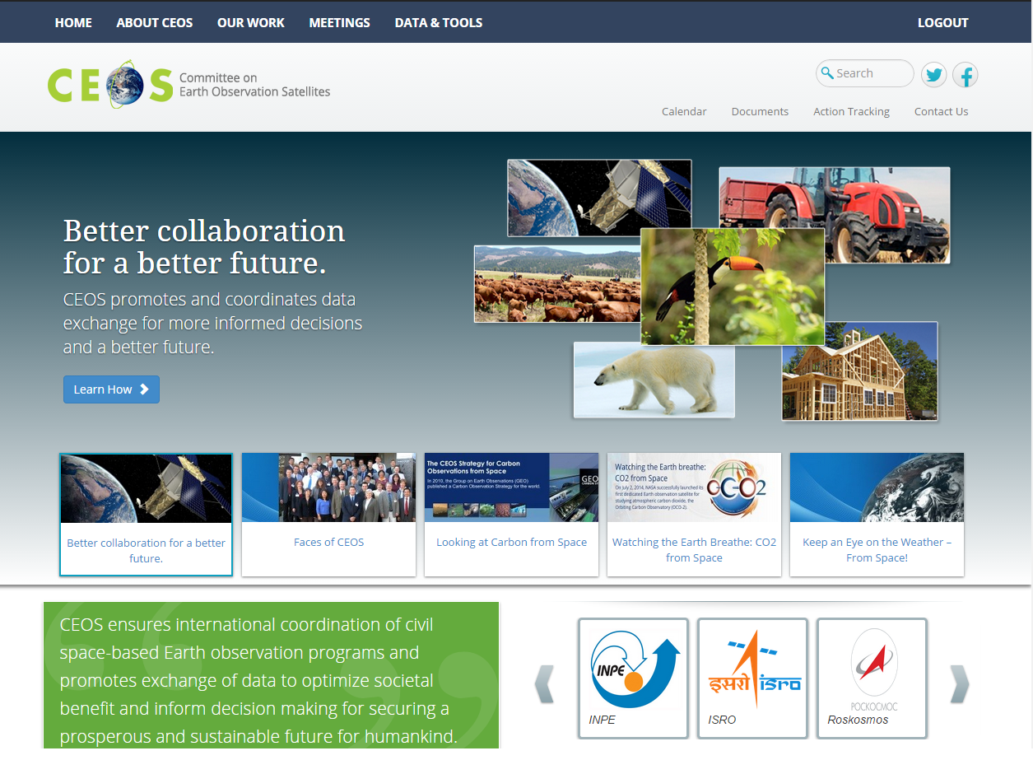
The CEOS Website
Main Menu
Social Links
Utility Menu
One-box
search
Quick Pitch: What does CEOS do?
Banner images help give a fresh look
CEOS
Mission Statement
Rotating CEOS member
agencies
Notes:
Every day, over 60 new people come to visit our website for the first time to find out who we are or what we do.

Slide 5
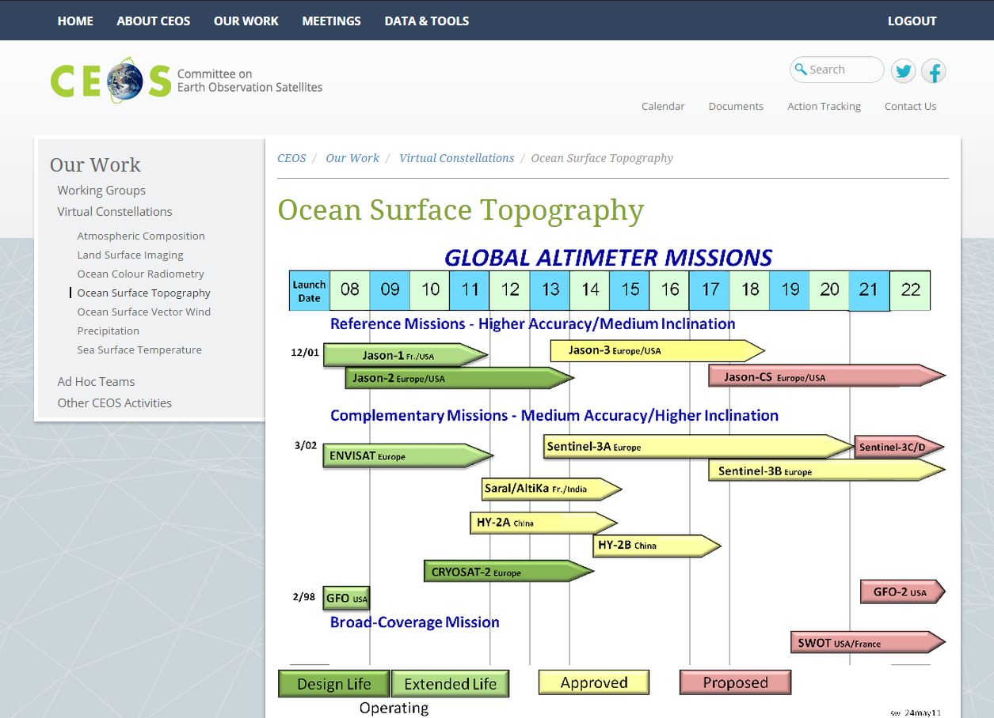
The CEOS Website
Header is consistent across the site
Hierarchical side navigation
Breadcrumb Trail
Main Content
5
Notes:
Every day, over 60 new people come to visit our website for the first time to find out who we are or what we do.

Slide 6
The CEOS Website
More New Features
Meeting registration
capabilities
Document Management
System
CEOS Work Plan Objectives/Deliverables Tracking Tool
Notes:
Every day, over 60 new people come to visit our website for the first time to find out who we are or what we do.

Slide 7
The Faces of CEOS
Link
Notes:
One of the new outreach components of the CEOS Website is a video blog we’ve created called “Faces of CEOS”. The idea is to create short interviews of the actual people of CEOS, during which we ask you what you do and why YOU think the work of CEOS is important. To test out the concept, we tried it for the first time with the SEO’s very own, Brian Killough. We’d like to interview people from all over the CEOS community to make a whole series of these videos for posting on the CEOS website. Watch the first one now.

Slide 8
The CEOS Website
Still editing/updating site content & links
Still implementing our new tools
Still want to show you what we’ve got so far…
New [beta] site, live by 2015:
Notes:
Every day, over 60 new people come to visit our website for the first time to find out who we are or what we do.

Slide 9
The CEOS Website
Still editing/updating site content & links
Still implementing our new tools
Still want to show you what we’ve got so far…
New [beta] site, live by 2015:
http://ceos.ama-hub.com/
Notes:
Every day, over 60 new people come to visit our website for the first time to find out who we are or what we do.

Slide 10
CEOS on Social Media
Follow us
on Twitter:
@CEOSdotORG
Like our page: Facebook.com/SocialCEOS
Notes:
Every day, over 60 new people come to visit our website for the first time to find out who we are or what we do.

Slide 11
CEOS on Social Media
Why?
Billions of people use social media
as their primary information resource.
We will create a global awareness of who we are, what we do, and why it’s important to the world.
Social media is where the world meets CEOS and discovers the importance of satellite Earth observations.
Notes:
Every day, over 60 new people come to visit our website for the first time to find out who we are or what we do.

Slide 12
CEOS on Social Media
Social Media Success Requires:
Strategy
Meaningful content
Interaction with our followers
CEOS-wide participation
The CEOS Social Media Strategy will define our objectives, our voice, our policies/guidelines.
Notes:
Every day, over 60 new people come to visit our website for the first time to find out who we are or what we do.

Slide 13
CEOS on Social Media
Thanks to the CEOS Website Strategy Team:
Stephane Chalifoux (CSA)
Robert Husband (EUMETSAT)
Mireille Paulin (CNES)
Jonathan Ross (GA)
Kerry Sawyer (NOAA/CEO)
Brian Williams (NASA/AMA)
Send fun ideas & feedback to: kim.e.holloway@gmail.com
Notes:
Every day, over 60 new people come to visit our website for the first time to find out who we are or what we do.

