Slide 1
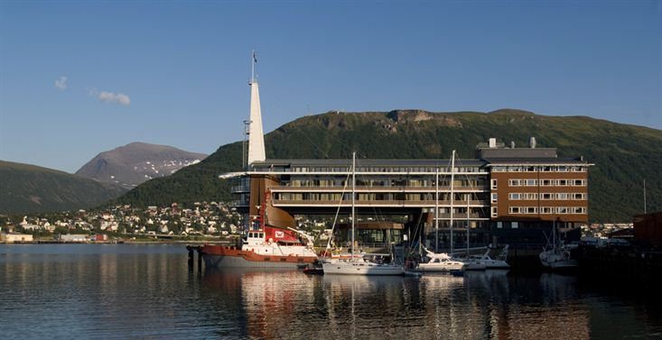
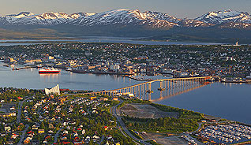
CEOS Database and EO Handbook
Ivan Petiteville
ESA
CEOS Plenary, Agenda Item #25
Tromsø, Norway 28-30 October 2014

Slide 2
Overview
2014 database update cycle
Site traffic summary
OSCAR/Space coordination
2014 Enhancements
2015 Planned Activities

Slide 3
CEOS Database 2014 Update
Annual update cycle completed and available online
database.eohandbook.com
Responses received from 27 CEOS agencies out of 31.
23 new mission records added, 117 existing records updated
44 new instrument records added, 156 existing records updated
Currently features operating or planned for launch in the next 15 years:
267 Earth observing satellite missions
784 instruments

Slide 4
Instrument Types

Slide 5
Measurement Domains

Slide 6
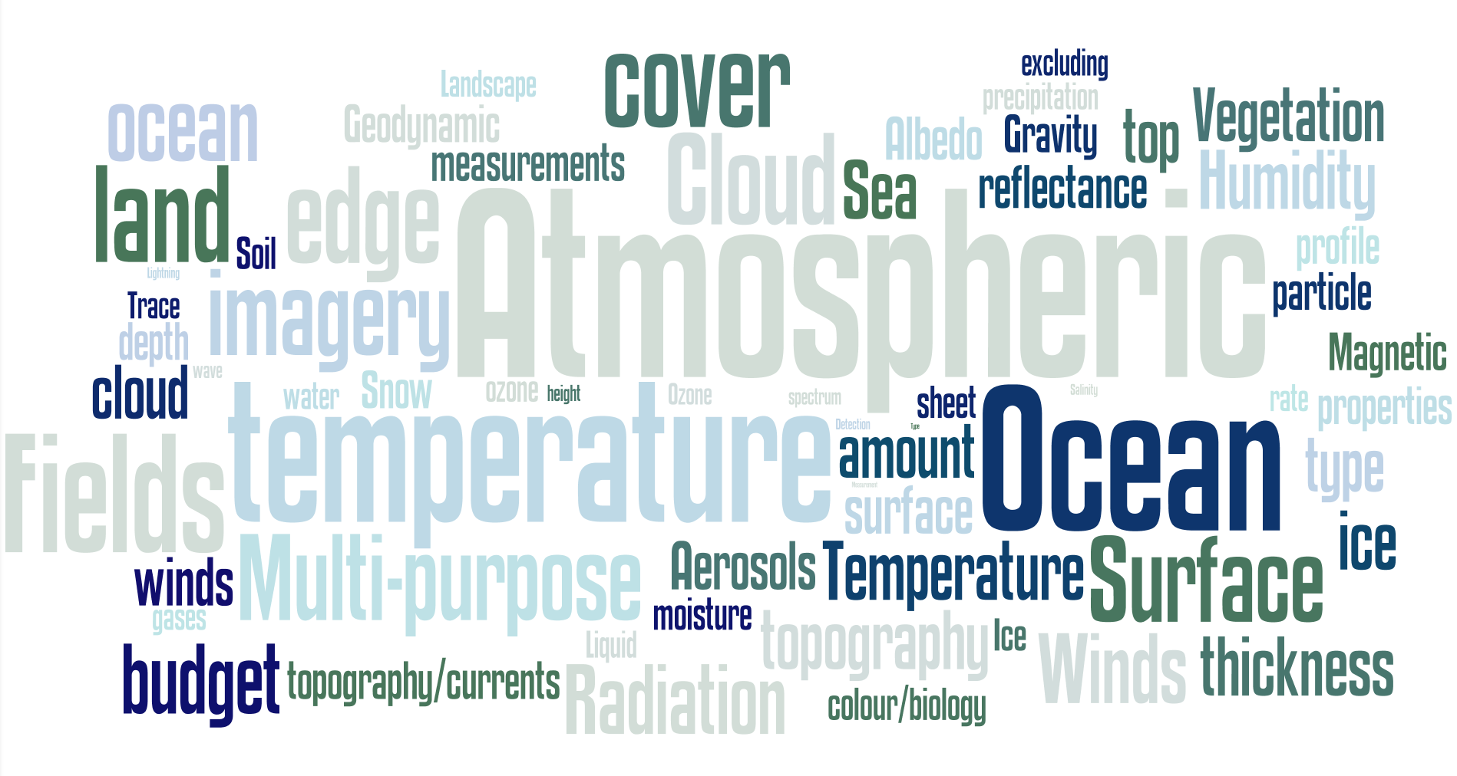
Measurements
More than 3000
Instrument-measurement mappings !!!

Slide 7
Website Usage
Since 1 January 2014
Most popular content: mission and instrument search tables
94% of users from desktop (remainder mobile)
 | CEOS DB | EO HB | Total
Visitors | 8,100 | 5,850 | 13,950
New users | 58% | 69%
Source: Search Engine | 47% | 32%
Page Views | 76,000 | 18,750 | 94,750
Pages/Session | 5.6 | 2.3

Slide 8
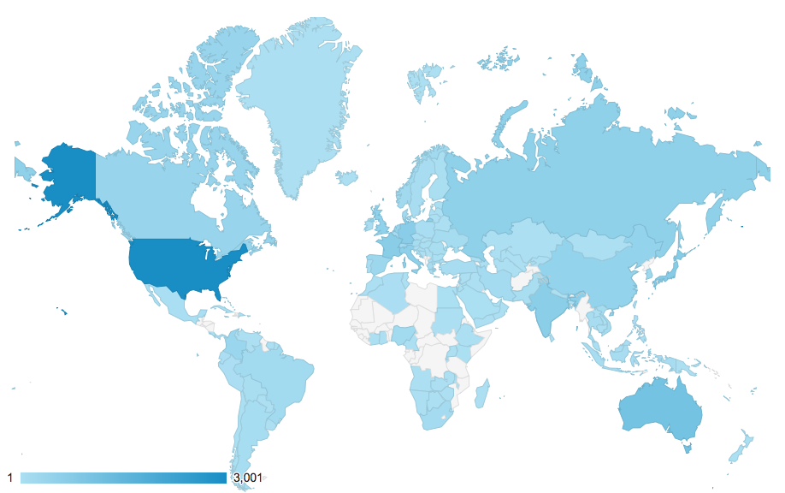
Website Usage
CEOS DB Session Locations Since 1 January 2014

Slide 9
OSCAR/Space coordination
Objective is to improve the quality of information by cross-checking part of the CEOS DB to external satellite EO databases such as OSCAR DB at WMO.
Coordination with Jerome Lafeuille of OSCAR/Space
Cooperation between OSCAR and the CEOS DB is beneficial as it can help to minimize unnecessary duplication of effort
Produced a cross-mapping between missions in the CEOS DB and OSCAR
Enables semi-automation of detection of differences between (eg) mission dates
Mapping shared with the OSCAR/Space team
Can be shared with others (e.g. Global Change Information System (GCIS) at U.S. Global Change Research Program)

Slide 10
2014 Development Activities
Support to SEO on ECV Inventory development
Pilot import and exploration of the ECV Inventory
In support of, and in (good) cooperation with, the CEOS SEO
Extends the instrument and measurement linkages to include individual ECVs
Addition of parameters to the mission and instrument search tables
e.g. instrument type
Various bug fixes and performance improvements
Challenge: Ensure Quality of Information provided outside the Annual Survey Process

Slide 11
2015 Activities
Support to the publication of a Special Edition of the EO Handbook for the 3rd UN World Conference on Disaster Reduction (WCDRR – Sendai , Japan, 14-15 March 2015)
Annual CEOS DB mission, instrument and measurement update cycle
Starting ~April, initiated by the Director of the Earth Observation Programmes at ESA
Usual cycle of improvements and updates to the CEOS DB

Slide 12
2015 Activities (cont’)
Continue ongoing import of the ECV Inventory per CEOS Work Plan
CEOS database as a user of the ECV Inventory
In coordination with WGClimate and SEO
Climate-themed EO Handbook (to be confirmed)
To be coordinated with WGClimate
Publication timed with COP-21/Paris (end 2015)
Update 2012 Climate-themed EO Handbook

