Slide 1




28th CEOS Plenary Session
Brian Killough
CEOS SEO, NASA
CEOS Plenary, Agenda Item 24
CEOS Systems Engineering Office (SEO) Report
Tromsø, Norway
28-30 October 2014

Slide 2

SEO Accomplishments in 2014
  Kim Holloway (formerly Kim Keith ... Congrats!) Managed new website development, maintained CEOS mailing lists, developed outreach materials, supported COVE testing and data acquistion analyses for GFOI and GEOGLAM, supported WGCapD, and supported GFOI training and capacity building for SilvaCarbon.
  Shelley Stover … Supported WGClimate (ECV Inventory), MIM Database (with ESA), Disasters (gap analyses), Carbon Task Force (gap analyses).
  Data Acquisition Planning and System Analyses (historical coverage, cloud probabilities, mission combination analyses) for GFOI and GEOGLAM.
  Worked with WGISS to expand COVE connections to mission archives and complete an update to the Data Policy Portal.
  Enhanced COVE tool to improve support of GFOI and GEOGLAM. Now includes more links to mission archives and a new Coverage Analyzer tool.

Slide 3
SEO Plans for 2015
  GEOGLAM and GFOI: Continued support for data acquisition planning and supporting systems analyses.
  Development of several Data Services Prototypes for cloud-based storage, processing and distribution of country-specific data for forest cover reporting. Cooperative development GFOI and GEOGLAM. Also developing a common Space Data Management System tool with broader function.
  Enhancement of the COVE tool by adding more missions, instruments and modes and adding connections to mission data archives. Targeting archives from JAXA (ALOS-1), ESA (many past missions), and DLR (TSX, TDX).
  Enhancements to the Coverage Analyzer tool. Plans to add metadata connections to more missions.
  Annual updates to the Data Policy Portal and the MIM Database.
  Outreach support using the CEOS Hyperwall (large video wall) ...
  2015 IGARSS Conference (Milan, Italy). Develop outreach materials and expand the impact of CEOS through social media.
  More on communications from Kim ...

Slide 4
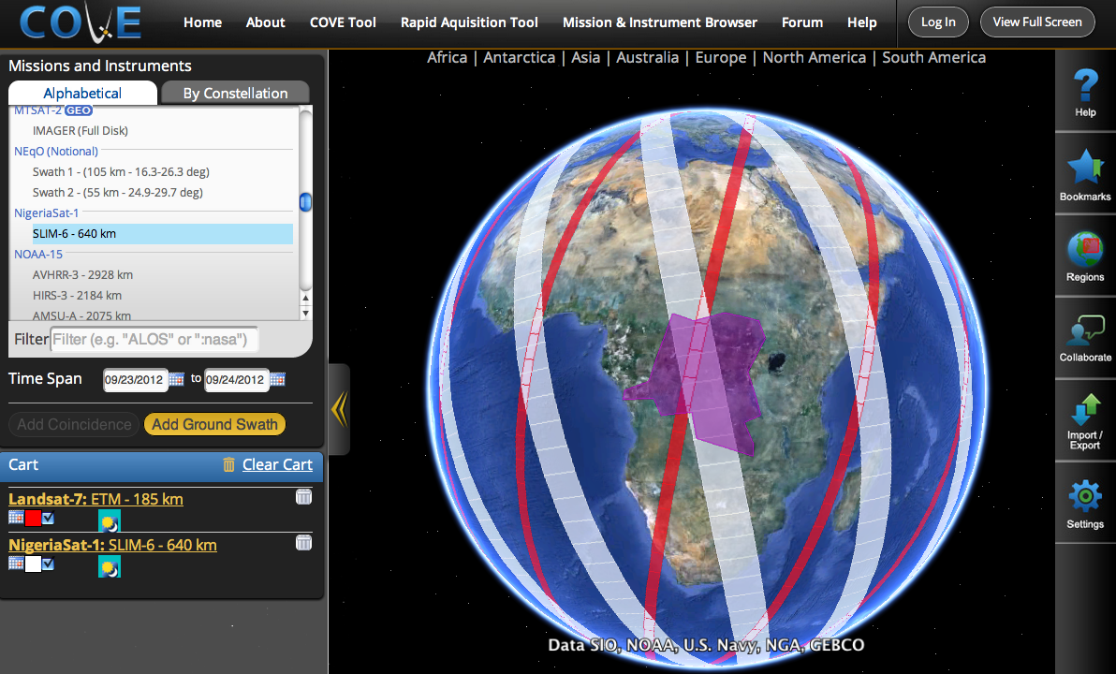
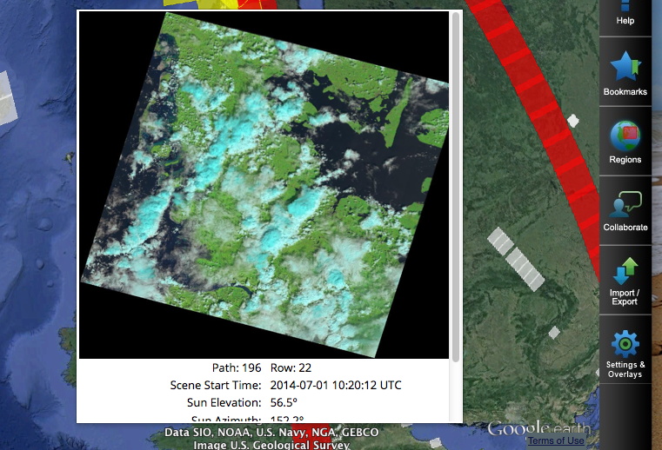
New Features in COVE
240 missions, 647 instruments
New Overlays: Landsat WRS, Sentinel-2 tiles, ASTER DEM.
Future Overlays: GFOI Phenology, GEOGLAM Mission Combination Revisit Analysis
Current Archive Links: Landsat 7/8, SPOT 1-6, Pleaides-1A/1B, Radarsat-2.
Future Archive Links: Envisat, ERS-1/2, TerraSAR-X, TanDEM-X, RapidEye, ALOS-1, Sentinel-1A (?).
www.ceos-cove.org

Slide 5
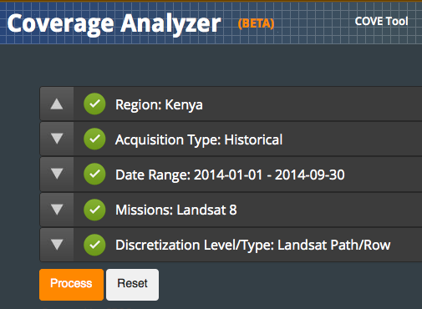
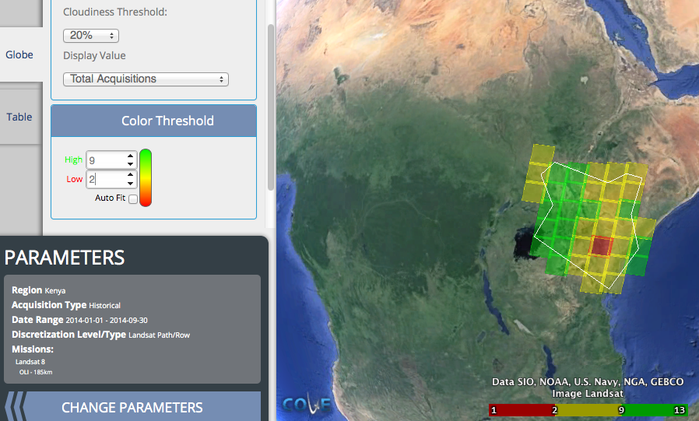
Coverage Analyzer Tool
New release is available!!!
Improved menu selections for Region, Past/Future, Dates, Missions, Discretization.
Improved processing performance.
Output in global or table format.
Selection of cloud filtering, color scaling.
KML and CSV export.
Example on Right >>>
Landsat-8, 2014, <20% cloudy, Kenya

Slide 6
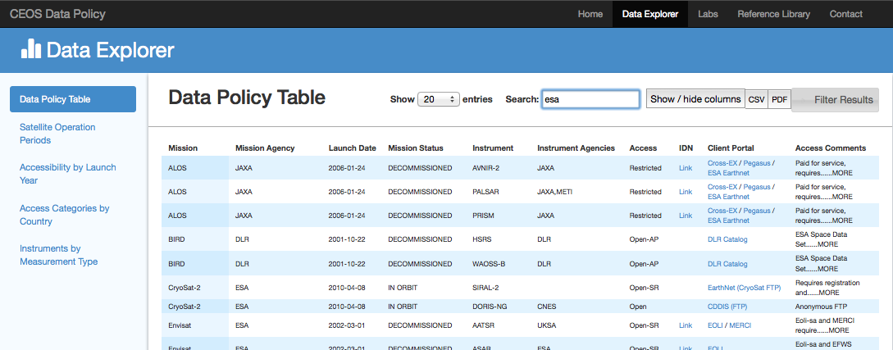
Data Policy Portal
A new release of the Data Policy Portal is available!!!
www.ceos-datapolicy.org
  Data Summary
  Open Access = 73%
  Restricted or Unknown = 27%
  25 countries operating or supporting 313 mission/instrument combinations
  New Features
  Direct links to Client Portals and IDN
  CEOS Interface” column reflects CWIC/FedEO connections
  Added new missions, corrected errors
  Future plans to link with the MIM

Slide 7


Data Services Prototypes
  FAO – Contract between KSAT (Norway) and AMA (SEO contractor) in place (Aug 13) with a prototype delivery in late October.
  Kenya – Landsat data provided to Kenya in June for in-country testing. SEO developing an online version for future testing and working with FAO on a demo. Additional archive analyses provided for Landsat and SPOT back to 2000.
  Colombia – SEO proposal for TanDEM-X datasets (submitted in March) was accepted in June. Data access provided in early October. SEO has downloaded all 24 scenes.
  Asia-Rice – SEO has created an online system with 12+ Radarsat images and the INAHOR processing tool. JAXA is testing internally and will train Indonesia soon. Preliminary issues with poor internet performance due to INAHOR graphics demands. Also considering moving cloud server to Singapore vs. Japan.
  JECAM – Project will start in late 2014 after requirements definition and identification of testing sites. Developing a common user license agreement across all sites.
7

