Slide 1
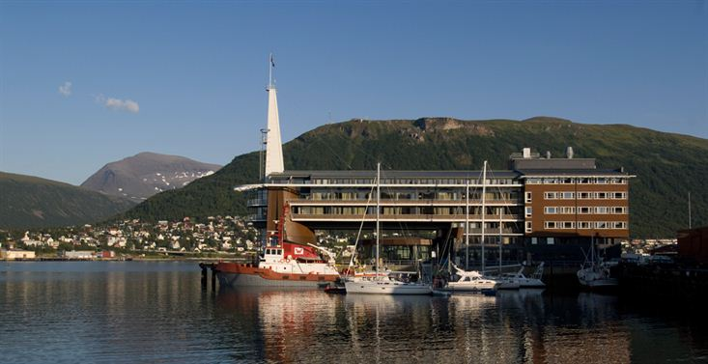

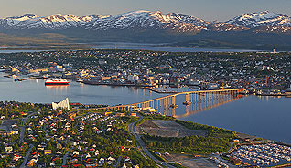
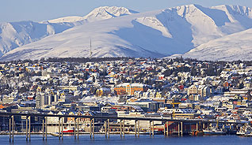
ＣＥＯＳ Ｒｅｓｐｏｎｓｅ ｔｏ
ＧＥＯＳＳ Ｗａｔｅｒ Ｓｔｒａｔｅｇｙ
Ｃｈｕ Ｉｓｈｉｄａ, ＪＡＸＡ
Richard Lawford, IGWCO CoP Chair
CEOS Plenary, Agenda Item 23
Tromsø, Norway
28-30 October 2014

Slide 2
Major Progress to Date
Oct 2012 : CEOS Plenary#26 endorsed CEOS participation to the GEOSS Water Strategy Report development
Nov 2013 : Progress report of the GEOSS Water Strategy Report was made to CEOS Plenary#27
Jan 17, 2014: GEOSS Water Strategy Report was presented at the GEO Ministerial Conference
February 27, 2014: The Director of the GEO Secretariat invited CEOS and other GEO Members and POs to identify recommendations of the report that CEOS would be willing to address.
April 8, 2014: CEOS CEO asked CEOS Members to provide responses for recommendations of the report by Mid-May
May-June, 2014: JAXA, NASA and NOAA responded to the GEO request
Sep 18, 2014: At 2014 CEOS SIT Technical Workshop, it was agreed that a small Water Strategy implementation study team be setup, and should report back to SIT-30.

Slide 3
GEOSS Water Strategy Report- from observations to decision
Background:
The Integrated Global Water Cycle Observations (IGWCO) report was published by IGOS-P in 2004. Shortly thereafter the activities of the Water Cycle theme were imported into the GEO Implementation Plan and managed through the Water Task which has the following target:
By 2015, produce comprehensive sets of data and information products to support decision-making for efficient management of the world's water resources, based on coordinated, sustained observations of the water cycle on multiple scales.
The GEOSS Water Strategy Report provides a strategy for water activities in the 2016-2025 period.

Slide 4
Short Summary of the Report
  Since the proposal to develop the report was adopted by the IGWCO COP in 2012 and supported by CEOS and GEO, the water community spent more than 18 months completing the report.
  The GEOSS Water Strategy updates the status of water observational capabilities and information systems, and provides guidance for the development of observational water programs for the period 2015-2025 .
  In addition, the report identifies a number of recommendations for action by GEO Members and Participating Organizations. Many of these recommendations deal with satellites and fall within the CEOS area of responsibility.

Slide 5
Recommendations for the Priority Areas of the Report
Enhancing User Engagement (8)
B. Expanding data acquisition strategies (3)
C. Advancing satellite data acquisition (10)
D. Strengthening in-situ data acquisition (10)
E. Encouraging and conducting research and product
development (16)
F. Facilitating data sharing and common standards (7)
G. Expanding capacity development (4)

Slide 6
Responses from CEOS to Date
NASA’s responses on 21 May
Regarding water-train satellite constellation, a study should be undertaken to assess the value of coordinated measures to articulate what would bring the most understanding assessment of the global water cycle.
SMAP, leveraging off of SMOS, has some strides in setting down what could be a baseline for a global-scale soil moisture project.
2. JAXA’s responses on 24 May
Regarding water-train satellite constellation, CEOS should discuss whether it will be the best way to address user needs, or other ways will be the best.
JAXA is currently operating GCOM-W, and will operate EarthCARE/CPR and GCOM-C. In addition, the CEOS Precipitation Constellation that JAXA supports as a co-lead is discussing a follow-on mission of the GPM. These missions will contribute to some of the recommendations.
3. NOAA’s responses on 25 June
NOAA is ready to leverage current and future activities (e.g., GOES, POES/JPSS, GOES-R and JPSS) to address some of the recommendations.

Slide 7
Proposed Schedule by IGWCO COP Chair
2014:
15 October: CEOS CEO will submit CEOS inputs to the GEO IGWCO COP Chairman (Richard Lawford)
31 December: GEO IGWCO Chairman will complete the draft GEOSS Water Implementation Plan (WIP) including actions, deliverables, and milestones, along with a proposed tracking system for measuring progress.
2015:
31 January: The Implementation plan will be finalized and submitted to GEO and to CEOS.

Slide 8
Decisions Desired by GEO IGWCO COP Chair
  CEOS expresses interest in the findings of the GEOSS Water Strategy Report and is ready to consider it as one of its primary guidance documents for its future water activities.
  CEOS will consider the recommendations related to the key satellite issues defined in this briefing (plus the other small recommendations) and will assess options and develop plans for addressing them as appropriate. It will report back to the chair of the IGWCO COP by October 15, 2014 on the appropriate recommendations in the GEOSS Water Strategy Report.

Slide 9
Water Strategy Implementation Study Team
2014 SIT Technical Workshop agreed that a small Water Strategy
implementation study team be setup and nominations of the members were requested.
The following nomination has been made:
Jono Ross (GA)
Kerry Sawyer (CEO/NOAA)
Bojan Bojkov (WVCG/ESA)
Selma Cherchali (CNES)
Jared Entin (NASA)
Chu Ishida (JAXA)
Nomination is under consideration by DLR
Nominations from other agencies are requested in order to gain critical mass and broad agency representation to conduct a useful study for the CEOS response to GEOSS Water Strategy Report.

