Slide 1
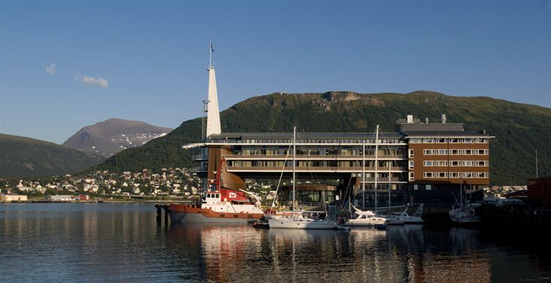
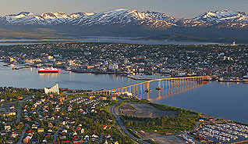
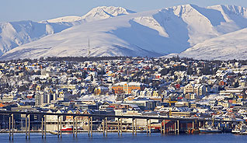
CEOS Strategy for Carbon Observations from Space – Report of Implementation Study Team
Stephen Briggs
ESA
CEOS Plenary, Agenda Item 21
Tromsø, Norway 28-30 October 2014

Slide 2
SUMMARY
History and Background
Establishment of Implementation Study Team
Result of CSIST Analysis
Status as of Plenary 2014
Discussion and way forward

Slide 3
History and Background
GEO Carbon Report developed in June 2010 by team led by Ciais et al. (GCP).
CEOS Strategy for Carbon Observations from Space – written in response to above, completed in March 2014 – Wickland et al.
Proposed results presented to SIT Workshop and CEOS Plenary in 2013.
42 Actions identified in the report for specific response including Action for Carbon Team to manage response via CEOS(/CGMS) Working Group Climate – first discussed at SIT Technical Workshop in September 2013
Issue remained open until April 2014,
At SIT-29:
The CEOS Strategy for Carbon Observations from Space was endorsed during Plenary session
Proposed establishment of a study team to take forward the Actions and also identify formal CEOS mechanism to manage Actions.

Slide 4
Establishment of CEOS Carbon Strategy Implementation Study Team (CSIST)
SIT-29 suggested further study of report to elucidate concrete way forward because of expressed concern about the nature and wording of the recommended actions, noting that several of the more substantive ones were well beyond the scope of what CEOS can or should do.
CSIST set up in May 2014: S Briggs (ESA), K Sawyer (CEO), J Bates (WGClimate/NOAA), C Ishida/M Nakajima (JAXA), A von Bargen (WGCV/DLR), Z Zhu (USGS), D Wickland/C Bognar (NASA), J Ometto (INPE), C Deniel (CNES)
ToR established by CEOS Chair / SIT Chair. Objective to analyse recommendations of Carbon report and propose concrete way forward.
Team led by S Briggs, K Sawyer met 28 July 2014 at ESA Office, Washington DC.
Produced draft spreadsheet of outcomes distributed before SIT Workshop. Documents distributed: ToR, report of progress, spreadsheet.
Further revision of spreadsheets based on discussions with key CEOS personnel

Slide 5
3. Result of CSIST Analysis (i)
Spreadsheet of 42 Actions, based on Table 6.1 of the CEOS Strategy, completed by CSIST. Each analysed for:
Type of action (mission, cal/val, product, ……..)
Action description text
Near/mid/long term action (end 2015, end 2017, >2017)
CEOS lead and contributing entities
Compatibility with available CEOS Resources (Green/yellow/red)
Estimated effort (minor, major, significant new entity/activity)
Linkage to GEO Community of Practice identified
Need for partnerships with external agencies
Items in red above were new analysis of the CSIST; items in blue were originally identified in Table 6.1 but were reviewed and revised, as necessary, by the CSIST.

Slide 6
3. Result of CSIST Analysis (ii)
Spreadsheet identified lead CEOS “Agency” as:
AC-VC: 6 Actions
LSI-VC: 4 Actions
OCR-VC: 4 Actions
WGClimate: 5 Actions
WGCV: 11 Actions
WGISS: 1 Action
SIT: 8 Actions
N/A: 3 Actions

Slide 7
Status as of Plenary
Draft spreadsheet completed at meeting of 28th July and subsequent revisions by email among CSIST
Identified 11 actions which require additional efforts/resources from CEOS Agencies and 3 which are to be directed to other entities.
Discussions with some Carbon team members
Updated spreadsheet circulated by CEO to Plenary participants and CEOS SEC, along with report and ToR of group
Additional comments received after SIT Workshop and incorporated in spreadsheet,
Discussion on way forward to Plenary.

Slide 8
Discussion and way forward
Propose way forward in terms of overall management/governance.
Three options considered:
WGClimate sub-group on Carbon to oversee actions
WGCLImate to oversee actions directly
SIT to provide overview management
Third option proposed to Plenary, with individual actions assigned to CEOS entities (WGs, VCs, SIT) as appropriate
Instruct those entities to include relevant actions in their programmes of work
SIT Chair to report on progress at SIT in March 2015
Thank CSIST members for efforts to respond to task rapidly and effectively

