Slide 1
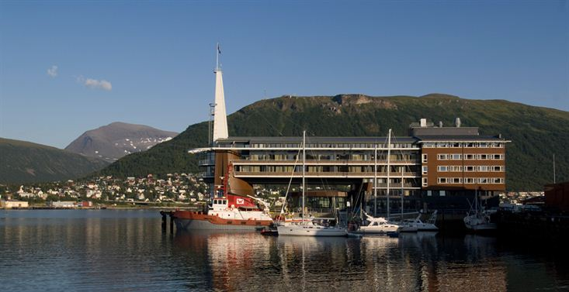

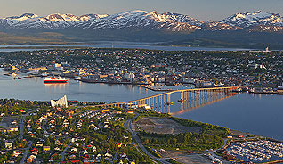
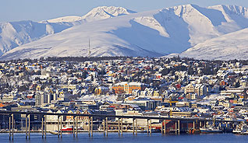
Update on Global Forest Observations Initiative (GFOI) and the Space Data Coordination Group (SDCG)
Stephen Briggs & Stephen Ward
(Ake Rosenqvist, Frank Martin Seifert,
Gene Fosnight, George Dyke)
SDCG EXEC
CEOS Plenary, Agenda Item 20
Tromsø, Norway
28-30 October 2014

Slide 2
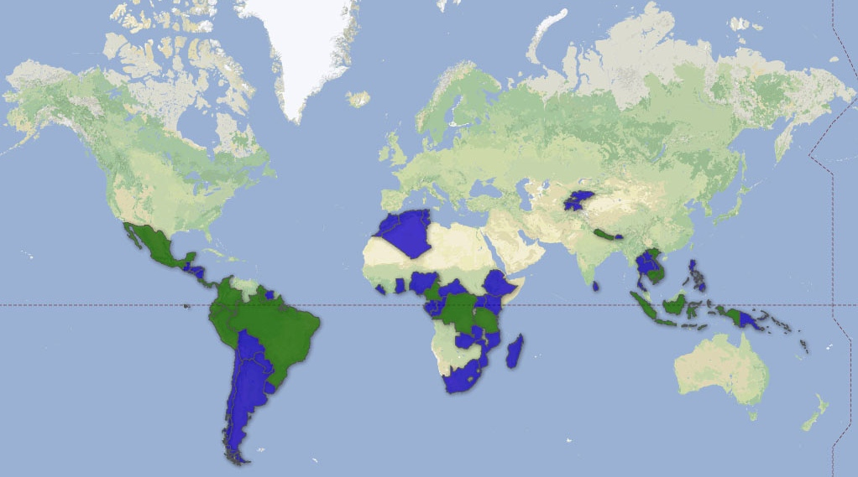

Global Forest Observation Initiative (GFOI)
GFOI Objectives:
to foster sustained availability of satellite and ground observation in support of national forest information systems
to support countries in the use of observations for their national forest information systems
GFOI Country Coverage In 2013 AND 2014
2008 Establishment of GEO FCT task
2009+ FCT demonstration based on NDs
2010 GFOI Concept plan
2011 GFOI Implementation plan
2012 GFOI Start-Up Phase
2013-15 Incrementing coverage
2016+ Operations Phase
Co-leads:
Australia (DOTE)
Norway (NSC)
USA (USGS)
FAO
CEOS (ESA)
www.gfoi.org

Slide 3
Five Pillars of GFOI
Methods and Guidance Documentation (Australia lead)
  Coordinated approach with writing leads, external review and approval
Coordination of satellite data supply (CEOS lead)
  Space Data Coordination Group (SDCG) – ESA, NSC, USGS
R&D on technical challenges (GFOI Office lead)
  Gap analysis, dedicated R&D plan with Priority R&D Topics
  Enhanced cooperation with CEOS space agencies
Capacity Building (US lead)
  SilvaCarbon: focused series of workshops
  Bilateral capacity-building activities
Country engagement
  Delivered via multiple channels – FAO/No, Aus, US, (Clinton Foundation, WB….)
  Key to successful outcomes

Slide 4

2014 Overview
V1 of the GFOI Methods and Guidance Documentation (MGD) developed
  Key GFOI deliverable to governments, next to space data
  Defines how to apply space data for IPCC-compliant MRV
Global Baseline Acquisitions going to plan
  Landsat-7/-8 running well
  Sentinel-1A commissioned
  ALOS-2 commissioned and in CAL phase
  CBERS-4 launch in Dec. 2014
R&D Plan in development
Steady capacity building
In country delivery

Slide 5
Outlook
GFOI Leads propose move of the office to FAO
Should lead to better integration of FAO service delivery with other aspects of GFOI
MGD version 2 (portal)
2nd GFOI Summit
  Sydney, March 2015
  SDCG-7
  Component coordination
Emphasis on outreach & country engagement
  We have GFOI deliverables

Slide 6




SDCG & GFOI Space Data Component Update
28th CEOS Plenary
Tromso, 28-30 October 2014

Slide 7
The Role of SDCG in GFOI
Coordination of satellite data acquisition and supply is fundamental to GFOI objectives and supports all countries’ participation in reporting
Satellite data can provide
  Measurements of forest extent and characteristics
  Support to countries in GHG Reporting
  Independent Verification
2011 plenary endorsed the set-up of the Ad-hoc CEOS Space Data Coordination Group for GFOI to support GFOI, putting emphasis on physical outcomes from CEOS in support of GEO activities.

Slide 8
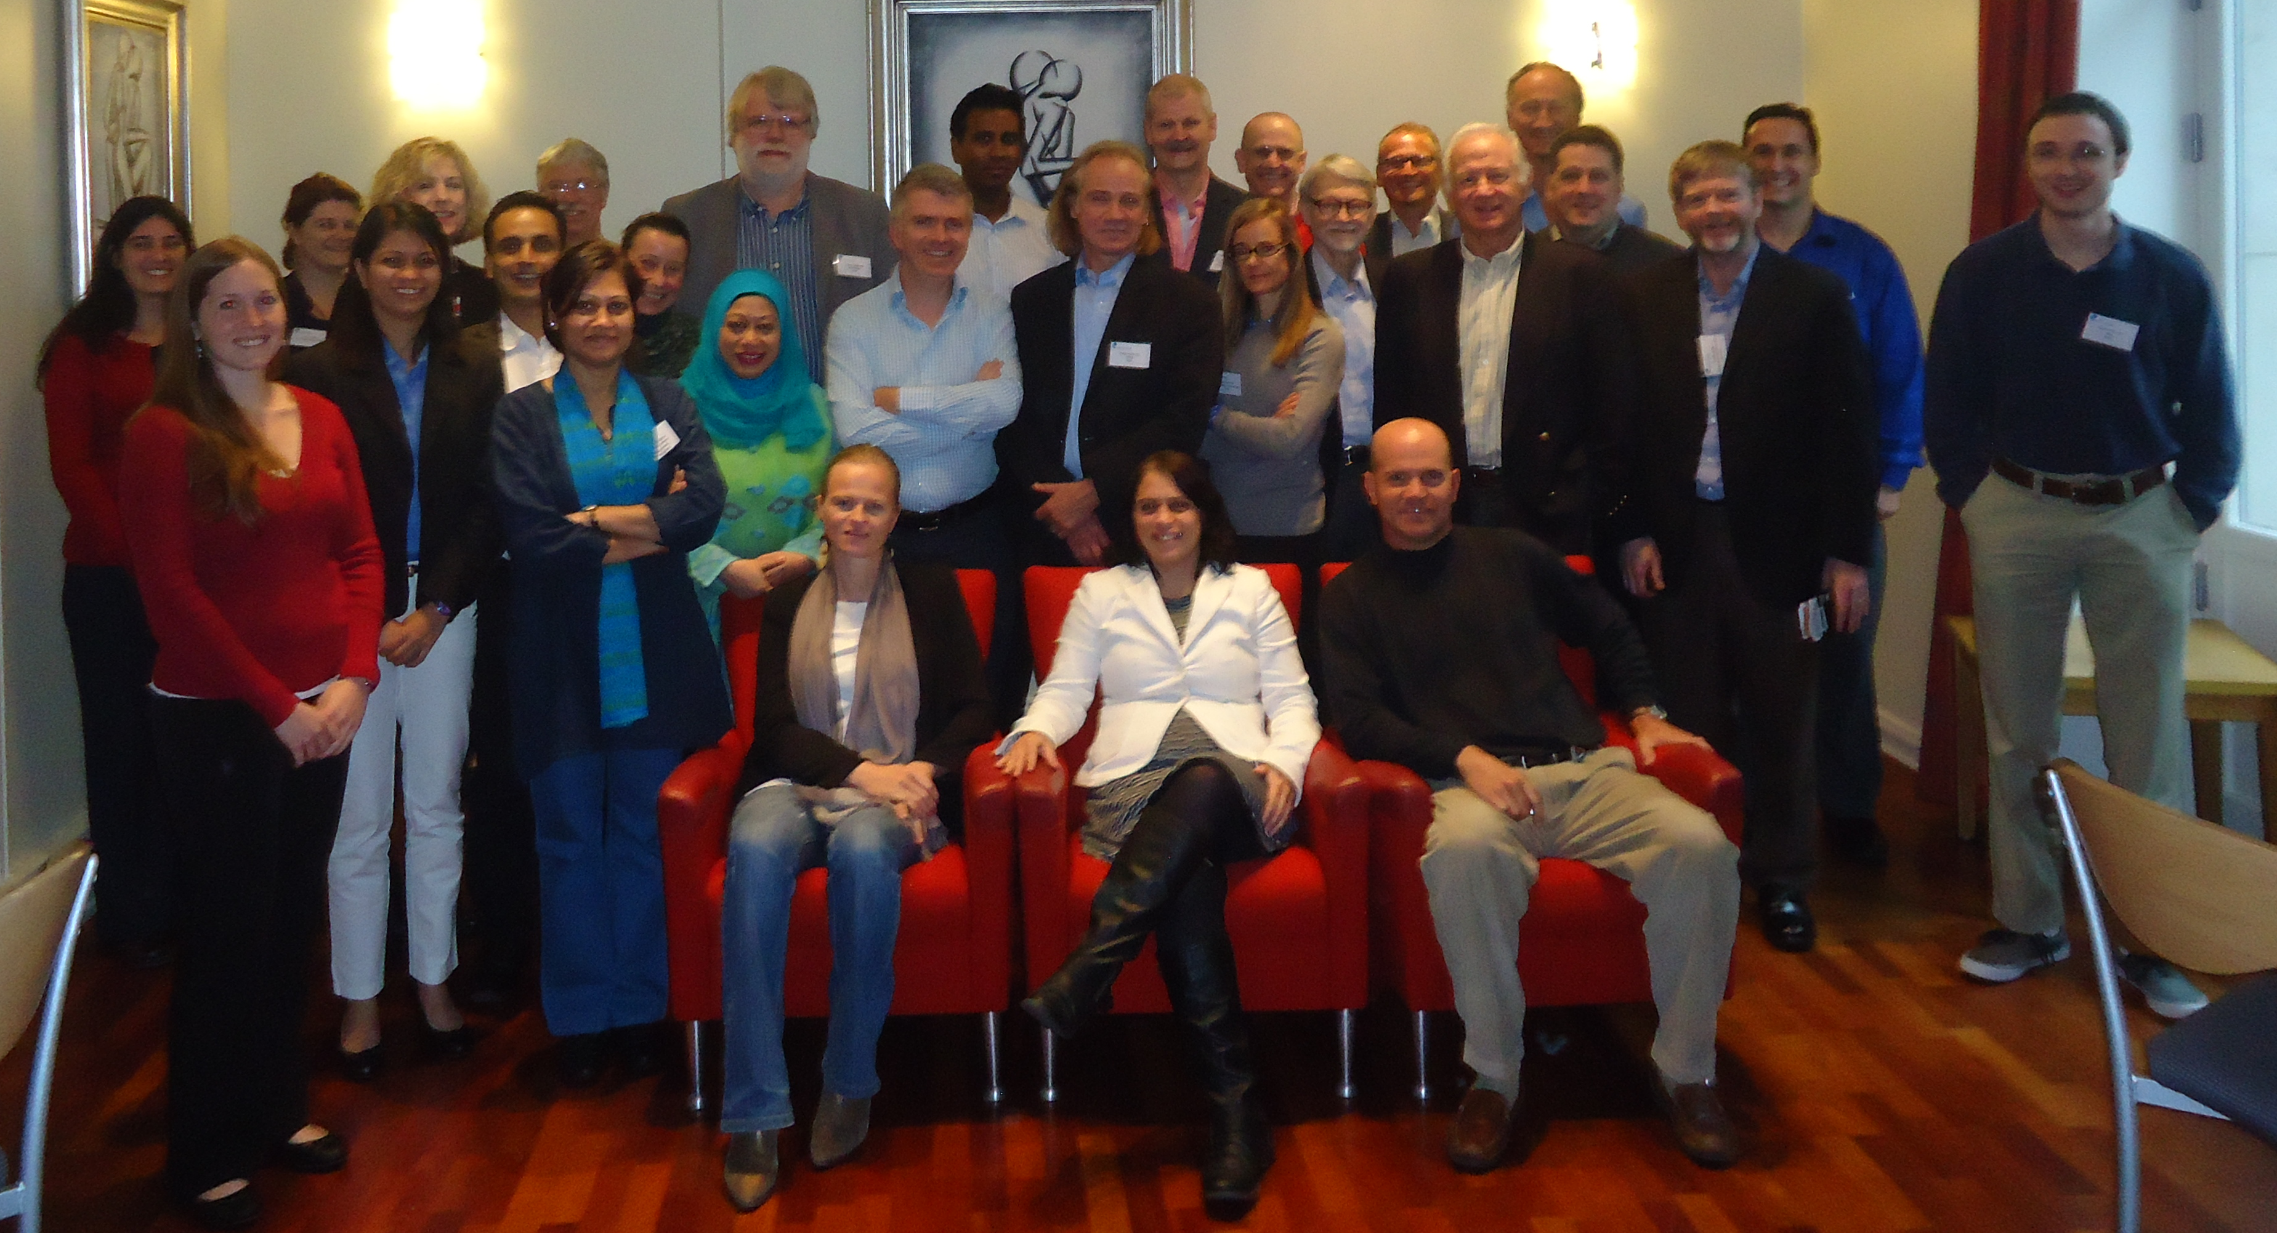
SDCG Set-up
SDCG Co-chairs: ESA, NSC, USGS
SDCG Secretariat: DOTE (Australia)
SDCG Members: ASI, CNES, CONAE, CRESDA, CSA, DLR, INPE, ISRO, JAXA, NASA
Convene biannual meetings of SDCG
  CSA hosted SDCG-1 in March 2012
  USGS hosted SDCG-2 in Sep 2012
  Australia hosted SDCG-3 in Feb 2013
  NASA hosted SDCG-4 in Sep 2013
  ESA hosted SDCG-5 in Feb 2014
  NSC hosted SDCG-6 in Oct 2014
  Australia will host SDCG-7 in Mar 2015
Notes:
.

Slide 9
The CEOS Data Strategy for GFOI
Element 1: A baseline, coordinated global data acquisition strategy involving a number of ‘Core data streams’ that can be used free-of-charge and openly for GFOI purposes. This will involve global, systematic and sustained wall-to-wall acquisitions of forested areas
Element 2: Coordinated strategies for national space data services including historical coverage characterisation, impartial data needs assessment, core data delivery and value adding, …
Element 3: Data supply in support of the GFOI R&D activities, including in support of: the science studies assisting the development and evolution of the Methods and Guidance document for GFOI

Slide 10
Global annual coverages by 2016
of the world’s forested areas
In 2015, expand global baseline coverage to 78 countries
  GFOI Participating Countries, UN-REDD National Programme and Partner Countries, WB-FCPF Participating and Partner Countries, CD-REDD Project Countries (BMU) Coverage by Landsat and Sentinel-1 for 2015
  Early engagement with Sentinel-2 mission planners and scientists
By 2016, full global coverage
  Coverage by Sentinel-1 and -2, and Landsat
  Regional coverage by CBERS-4
  On request coverage by non-core tasking missions
Encourage non-core data providers to release older data to serve as baseline

Slide 11
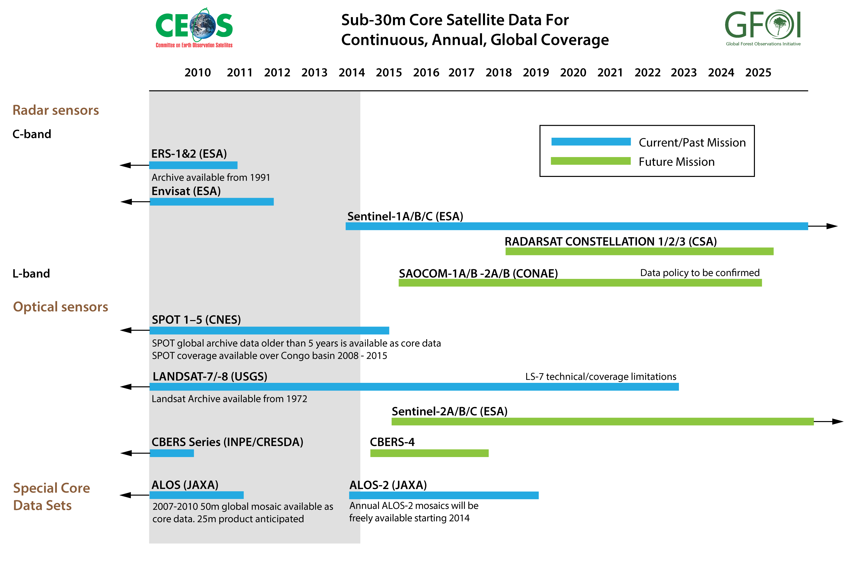
Core Data

Slide 12
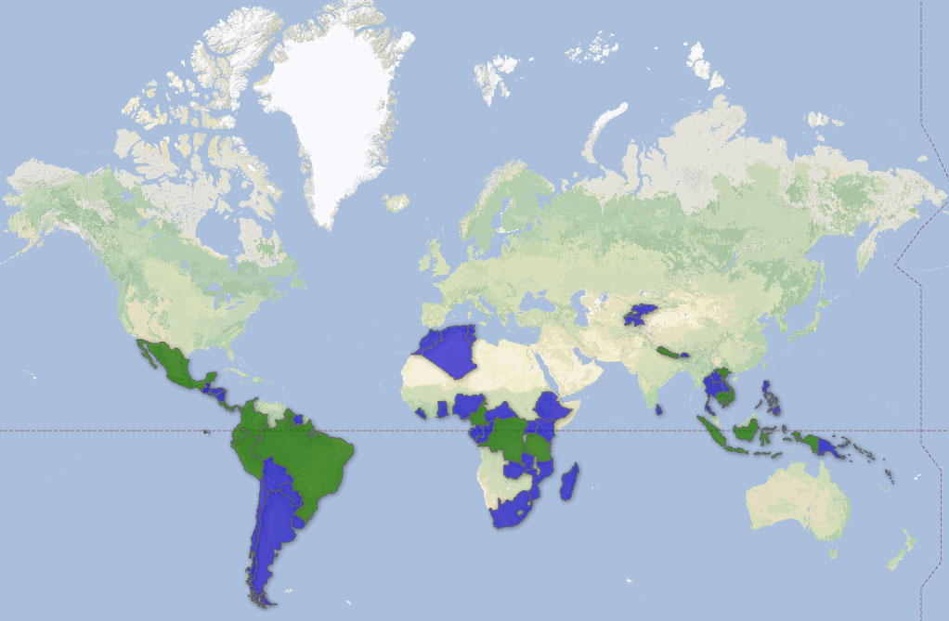
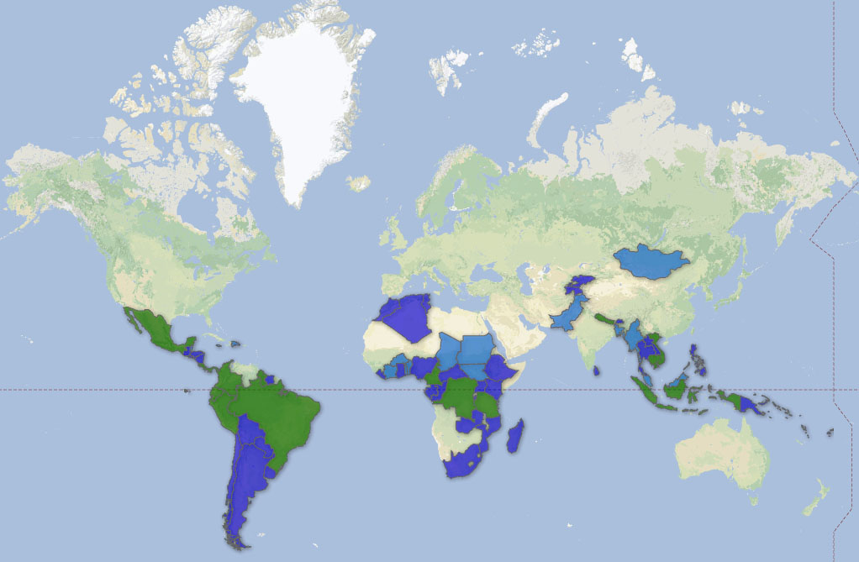
Global Baseline 2015 outlook
Add 17 additional countries in 2015
  Min. requirement: at least one cloud-free annual optical coverage/country
2015 transition year to full global coverage in 2016

Slide 13
Space Data Services
Strategy endorsed at SIT-29, Toulouse
Country support on uptake & application of space data
Archive study, data discovery & supply
Some R&D on potential of ‘Cloud’
  GFOI Space Data Management System (SDMS)
  Important contribution from the SEO
  The Data Cube
  We see broader potential for CEOS
  ESA’s Thematic Exploitation Platform on Forestry

Slide 14
Data Delivery for the R&D Plan
Includes support for science studies assisting:
  The development and evolution of the MGD for GFOI
  Satellite sensor interoperability, Time series consistency, Forest degradation, Validation activities
Main vehicle for support by Contributing Missions (SDCG Element 3)
The R&D plan is being developed through consultations with stakeholders at a series of expert workshops:
Date | Location | Topic
June 10-11 2014 | Woods Hole, MA, USA | Sensor interoperability and complementarity
October 1-3 2014 | Wageningen, Holland | Measurements of forest degradation
February 24-26 2015 | Brisbane, Australia | Above-ground biomass

Slide 15
SDCG 3-Year Work Plan
Aligns Space Data Component with new GFOI Strategy document
Intended to take the Space Data Component through the next phase of GFOI in a well-structured and managed way
Draft progressed @ SDCG-6
Final version for SIT-30

Slide 16
Issues & Concerns
SDCG seeks to consolidate model for in-country delivery via FAO and World Bank
Continuity of Leadership Capacity
  Norwegian funding for Co-Chair ends 31 Dec
  USGS Co-Chair retires 2015
NY Declaration on Forests @ Global Climate Summit
  COP-21 in Paris an important milestone: December 2015
SDCG willing and able to continue as an Ad-hoc CEOS Group for another year
Notes:
Global Climate Summit major outcome was the “New York Declaration on Forests” -endorsed by 30 countries and more than 50 multi-national companies (from food, paper, finances etc.) addressing deforestation and their commitment to reduce/end deforestation with in excess of $1bn in financial incentives aimed at restoring more than 3 million hectares of forest.

Slide 17





Thank you
Thank you for your attention and feedback!
Contact:
Matthew Steventon
matthew@symbioscomms.com
www.gfoi.org
www.ceos.org/sdcg

