Slide 1
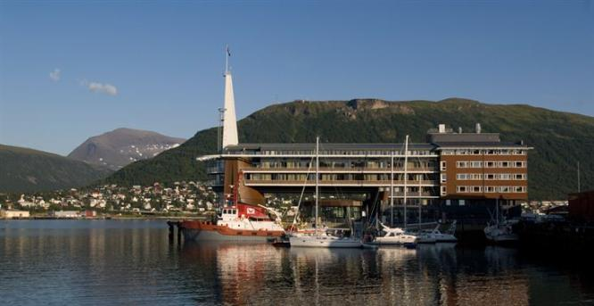
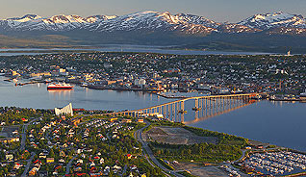
28th CEOS Plenary Session Position Paper and Recommended Way Forward for the LSI-VC
Thomas Cecere, USGS
Jonathon Ross, GA
CEOS Plenary, Agenda Item 19
Tromsø, Norway 28-30 October 2014

Slide 2
Review
Follow-on action from SIT-29, May 2014
Explores “Options on the future of land imaging coordination within CEOS”
Prepared by J Ross (GA), T Cecere (USGS) and S Labahn (USGS)
Presented at SIT Technical Workshop, Sept 2014

Slide 3
Context
Increasing demand for ‘CEOS support’ of land surface imaging activities
Need to justify future option in terms of:
‘Top down’ – Alignment to CEOS objectives
‘Bottom up’ – Practical support from agencies

Slide 4
Review findings
Scope and activity of Working Groups has evolved
Decreasing need for a VC to ‘do everything’
Land surface imaging covers many diverse user communities
User requirements difficult to clarify
Engaging with users across all domains impractical
Ad-hoc teams and existing Working Groups are working well to define ‘user requirements’ collaboratively with communities
Ramp up in ‘data coordination teams’ but not clear:
How activity will be sustained long-term
How to manage competing requests
Long-term impacts on space agencies

Slide 5
Options Assessed
Maintain Status Quo
End-to-end VC
From mission design to the delivery of end-user tailored products and capacity building
Space-segment VC
Mission and data acquisition coordination
Coordination of ‘fundamental’ data products
Multiple VCs
Centered around instrument types

Slide 6
Criteria Used
‘Top down’
‘Bottom up’
How well are the CEOS objectives supported?
How much benefit is there likely to be to internal stakeholders?
How much benefit is there likely to be to external stakeholders?
Does the approach align with the defined roles of Working Groups and Virtual Constellations?
Does it address an unmet need in the existing organisational mechanisms?
Does it address a real and pressing issue that needs action right now?
Do agencies possess the necessary personnel and fiscal resources to support the initiative?
Will a critical mass of key agencies support it, and does it provide feasible avenues for other agencies to participate?
How well does it leverage, and support, existing activities and mechanisms?
Is there a logical pathway to ‘kick off’ and ‘ramp up’ the new initiative?

Slide 7
Survey responses
Representatives from:
ESA
CSA
USGS
JAXA
INPE
CNES
GA
SEO
Diverse Sample of CEOS Players

Slide 9
Option 1 – ‘Maintain Status Quo’
Average ‘Top Down’ Score
Average ‘Bottom-Up’ Score
11 / 50
22 / 50
Top-down
Strongly disagree
Disagree
Neutral
Agree
Strongly agree
Bottom-up
Standard Deviation: 18
Notes:
‘Top down’ perspective:
General perspective that ‘doing nothing’ would be bad for:
CEOS goals
Internal stakeholders
External stakeholders
Roles of Working Groups and Virtual Constellations
‘Bottom up’ perspective
Highly variable results
High standard deviation – some respondents did not believe that this option was worth considering

Slide 10
Option 1 Detailed Scoring

Slide 11
Option 2 – ‘End to end’
Average ‘Top Down’ Score
Average ‘Bottom-Up’ Score
32 / 50
20 / 50
Top-down
Strongly disagree
Disagree
Neutral
Agree
Strongly agree
Bottom-up
Standard Deviation: 20
Notes:
‘Top down’ perspective:
Perceived to provide good support for CEOS objectives
Potential for significant benefits to internal and external stakeholders
Concern about ‘fit’ with other entities
‘Bottom up’ perspective
Consistent view it would be hard to resource
Average score for “Agencies possess necessary resources” is ‘Disagree’

Slide 12
Option 4 – ‘Multiple VCs’
Average ‘Top Down’ Score
Average ‘Bottom-Up’ Score
35 / 50
26 / 50
Top-down
Strongly disagree
Disagree
Neutral
Agree
Strongly agree
Bottom-up
Standard Deviation: 18
Notes:
‘Top down’ perspective:
Solid support
Seen as aligned to the VC / Working Group model
Concern it may not deliver benefits for internal stakeholders
‘Bottom up’ perspective
Good support generally …
But not seen that a ‘critical mass’ of agencies will engage

Slide 13
Option 3 – ‘Space segment’
Average ‘Top Down’ Score
Average ‘Bottom-Up’ Score
38 / 50
32 / 50
Top-down
Strongly disagree
Disagree
Neutral
Agree
Strongly agree
Bottom-up
Standard Deviation: 15
Notes:
‘Top down’ perspective:
Consistent strong support
Noted that may not be quite as much potential benefit for external stakeholders (as option 2)
‘Bottom up’ perspective
Stronger indications of agency support than Option 2
Variable perspectives on ‘urgency’ of the issue being addressed
Lower standard deviation indicating greater consensus

Slide 14
Option 3 Detailed Scoring

Slide 15
Study Team Conclusions
‘Maintaining Status Quo’ was seen as an undesirable strategic move.
An ‘end to end’ VC was not feasible to resource.
Multiple VCs were strategically logical, but practically too difficult, introducing additional stovepipes to overcome.
An emphasis on space segment coordination was well supported:
Aligned to other initiatives.
Feasible to resource.
Benefits internally and externally.
Transition pathway for some tasks currently in ‘ad hoc teams’.
Need to build momentum.

Slide 16
Building Momentum
Immediate areas of focus:
SDCG for GFOI, the GEOGLAM ad hoc WG and Disasters Data Coordination Team have data collection requirements. LSI-VC can add value by offering to:
Identify opportunities for optimization.
Analyze and report conflicts.
Point to come to for advice and guidance.
There are 4 actions for the LSI-VC that came out of the CEOS Study for Carbon Observations from Space Implementation Study Team.
With WGISS/WGCapD/SEO, looking into long term architectures for distribution/processing of data.

Slide 17
Longer-term focus
‘Light touch’ approach justified in the ‘ramp up’.
However …
Need to start putting structure in place for emerging challenges:
Coordination for satellite taskings and product distributions needs to be made ‘business as usual’ even after specific initiatives conclude.
Models need to be scalable for space agencies as new initiatives continue to appear.
Opportunities to leverage new sources of data should be exploited.

Slide 18
FOR DECISION
Recommendation 1:
Agree that the LSI-VC terms of reference be refocussed towards:
Space segment asset coordination and optimization.

Slide 19
FOR DECISION
Recommendation 2:
Agree the LSI-VC ‘ramp up’ phase focus on:
Offering support to data coordination teams:
Identifying opportunities for optimisation.
Analysing and reporting conflicts.
Point to come to for advice and guidance.
The 4 actions notionally flagged for LSI-VC by the CEOS Study for Carbon Observations from Space Implementation Study Team.
With WGISS, looking into long term architectures for distribution/processing of data.

Slide 20
IMPLEMENTATION
Next steps:
Today:
Clarify initial participants.
Identify leadership for LSI-VC.
Next few weeks:
Open discussions with existing data coordination teams to identify desired support.
Open discussions with WGISS/WGCapD/SEO on data distribution/processing architectures.
For SIT-30:
Prepare a revised LSI-VC draft terms of reference, in line with recommended focus, for discussion.

