Slide 1
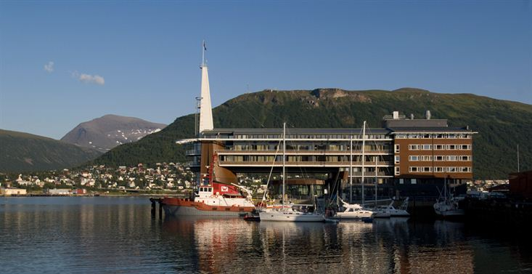

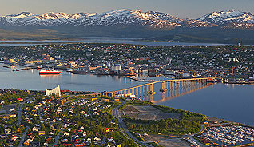
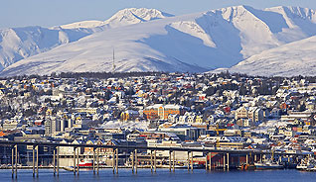
28th CEOS Plenary Session
Report from WG Disasters
Ivan Petiteville
ESA
CEOS Plenary, Agenda Item 16
Tromsø, Norway
28-30 October 2014

Slide 2
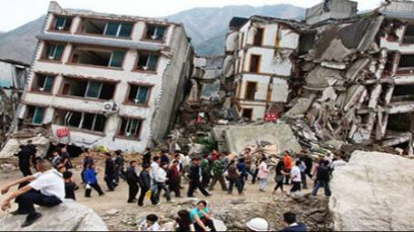
Main Activities in 2014
Floods, Seismic Risks & Volcanoes Pilots
Geohazards Supersites
Recovery Observatory Pilot
Preparations for 3rd UN World Conference on Disaster Risk Reduction (March 2015, Japan)

Slide 3
PILOTS (1/2)
Mono-thematic Pilots projects:
  Currently Floods, Seismic Risks and Volcanoes
  Proposal for a future Landslides Pilot project
Significant progress since approval of pilots (2013 CEOS Plenary)
End of Pilots extended by one extra year, to 2017
Data flow started (ramping up) to all 3 Pilots & Supersites:
  Waiting for Sentinel-1, ALOS-2 data
  First outcomes produced. Examples for 3 Pilots in slides # 27 to 33

Slide 4
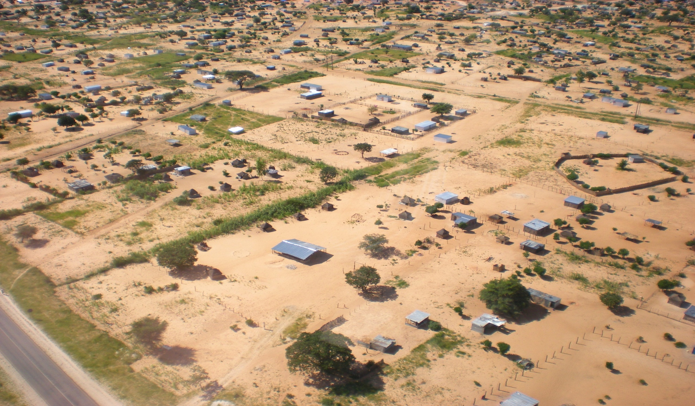

PILOTS (2/2)
Participation of End Users:
Good participation of end users in Floods Pilot (e.g. Namibian Department of Water Affairs and Forestry);
Involvement of VAACs (Buenos Aires and Washington), volcano observatories (several in Latin America) in Volcanoes Pilot will start in 2015.
NASA staff with two Namibian agents (Namibian Department of Water Affairs and Forestry) and one villager
Courtesy NASA.
Notes:
VAAC = Volcanic Ash Advisory Center

Slide 5
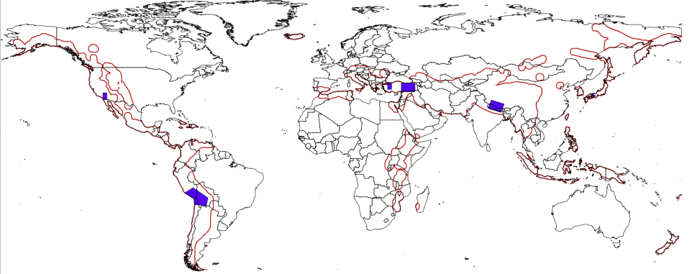
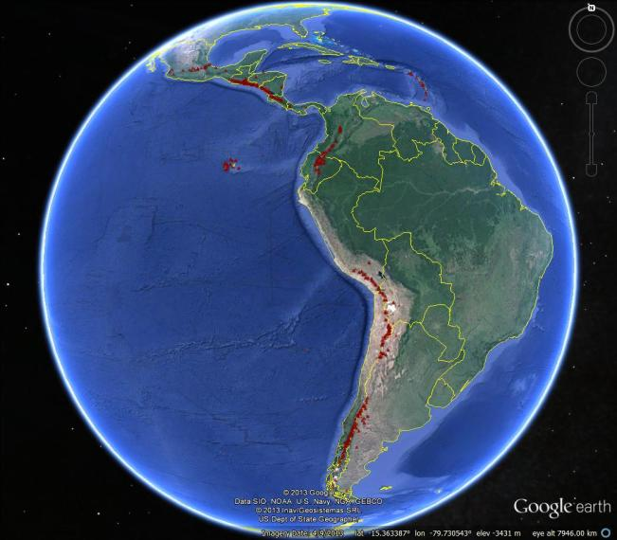
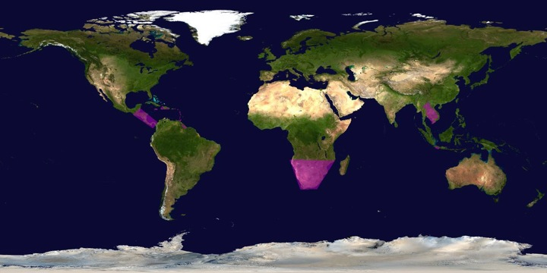
Pilots’ Regional Coverage
Seismic Risks Pilot’s 1st objective is global but demonstrated through a subset of regional sites.
The Floods pilot has a global component in addition to the three regional components
SEISMIC RISKS
VOLCANOES
FLOODS
Notes:
Seismic Risks pIlot: Support the generation of globally self-consistent strain rate estimates and the mapping of active faults at the global scale by providing EO InSAR and optical data and processing capacities to existing initiatives, such as the iGSRM

Slide 6
Pilots and Supersites
Both Volcanoes and Seismic Risks Pilots include “GEO Supersites” activities:
Current Permanent Supersites | Year | Comment
Hawai’I (USA) | 2012 | Outcomes to be assessed in 2015. Satellite data delivered
Iceland | 2013 | Satellite data delivered
Marmara Sea/North Anatolian Fault Zone (Turkey) | 2014 | Satellite data delivered
Mt. Etna Volcano (Italy) | 2014 | Satellite data delivered
Mt. Vesuvius/Campi Flegreii (Italy) | 2014 | Satellite data delivered
new in
2014
new in
2014
new in
2014

Slide 7
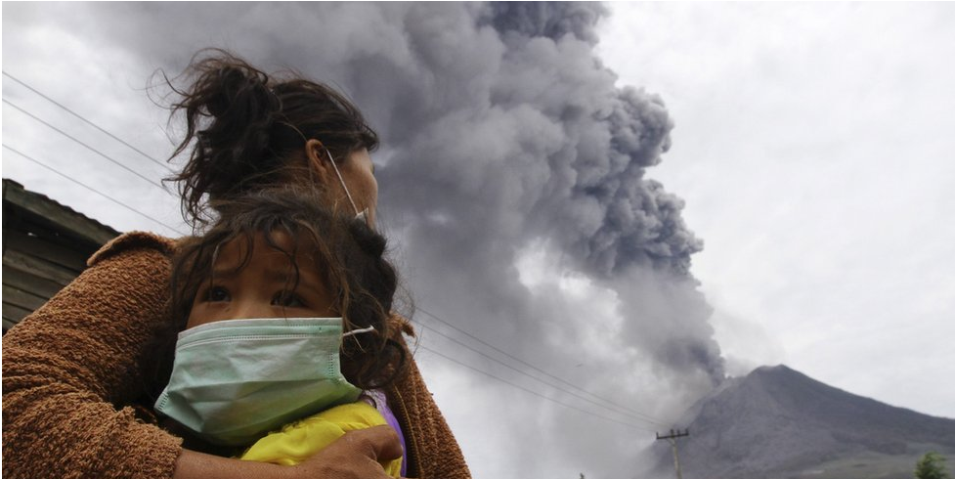
Pilots and Supersites
Current Event Supersites | Year | Comment
Sinabung Eruption (Indonesia) | 2014 | Satellite data provided by both ASI and CSA
Ludian Earthquake (China) | 2014 | Recently accepted by DCT
Napa Valley Earthquake (USA) | 2014 | Recently accepted by DCT
new in
2014
new in
2014
new in
2014
new in
2014
    Improved Selection process for Permanent Supersites accepted at SIT-29
    Improvement of Selection process for Event Supersites and Engagement of End-Users among 2015 priorities of “Supersites Advisory Committee”
Indonesian Mount Sinabung eruption (Sep. 2013)
© BBC News

Slide 8
For decision today
Accept New Zealand Volcanoes as Permanent Supersite and commit data resources
Accept Ecuadorian Volcanoes as Permanent Supersite and commit data resources

Slide 9
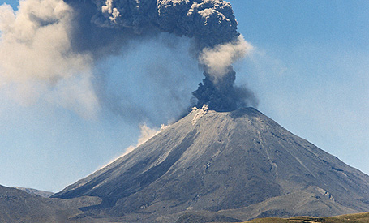
New Zealand Volcanoes
Over 150,000 people at risk
Can affect the population by impacting tourism, agriculture, aviation

Slide 10
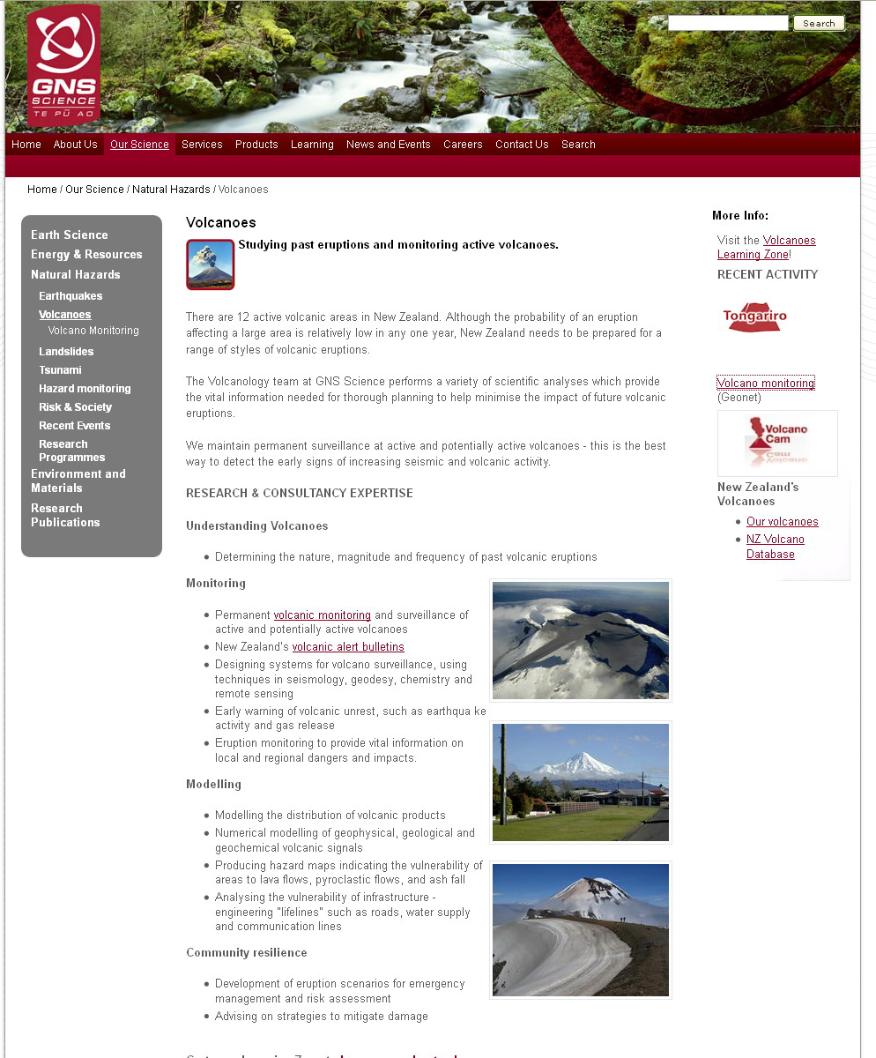
New Zealand Volcanoes Supersite: Team
Supersite team:
Supersite Point-of-Contact (PoC): I. Hamling, GNS Science, NZ
Other teams: Univ. of Texas, USA; Univ. of Tokyo, JP; Victoria Univ., NZ

Slide 11
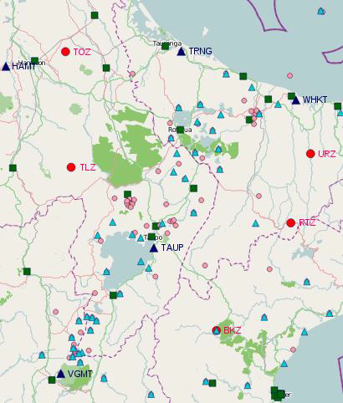
New Zealand Volcanoes Supersite: Resources
Available in situ data:
Seismic waveforms
Strong motion data
GPS data
RT thermal and visible monitoring cameras

Slide 12
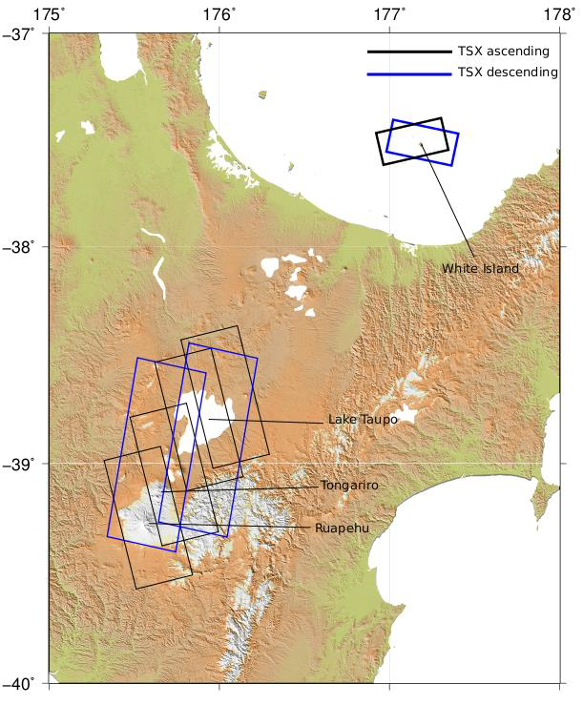
New Zealand Volcanoes Supersite: Needs
EO data are requested for the Ruapehu, Tongariro, Lake Taupo and White Island volcanoes
Coverage needs:
X, C, L band
Ascending and descending passes
Repeat pass ∼11-16 days normally
Possibility to increase repeat pass 1-4 days during eruptions (using COSMO-SkyMed)
Figure shows possible TerraSAR X tracks

Slide 13
New Zealand Volcanoes Supersite: for decision
CEOS accepts the Supersite Proposal and agrees to support it by making available data according to the request in the proposal and up to the limits listed below.
CEOS requests that the Data Coordination Team inform the PoC for the Supersite of this decision and the procedures of ordering and accessing the data
Indicative data resources committed
CEOS intends to support this Supersite with these resources:
  (ASI) Up to 200 products per year until 2016 COSMO/Skymed
  (CNES) tbd SPOT-5
  tbd Pleiades
  (CSA) 60 images from archives (2012-Oct2014) Radarsat-2
  40 images (Oct 2014-2015)
  (DLR) Up to 130 products per year until 2016 TerraSAR-X
  (ESA) complete archive ERS-1, -2, Envisat
  any available acquisition Sentinel-1, -2
  (JAXA) tbd ALOS-2, ALOS-1, J-ERS
  (NASA) any available acquisition EO-1
  tbd ASTER
  (USGS) any available acquisition Landsat 7 and 8

Slide 14
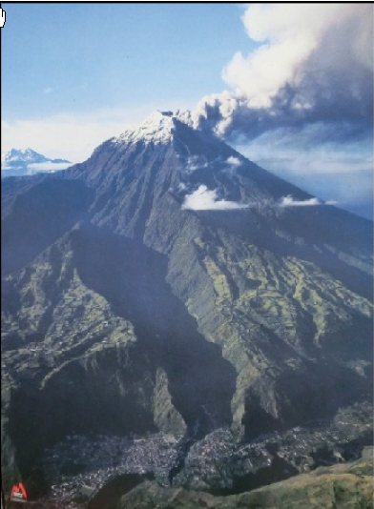
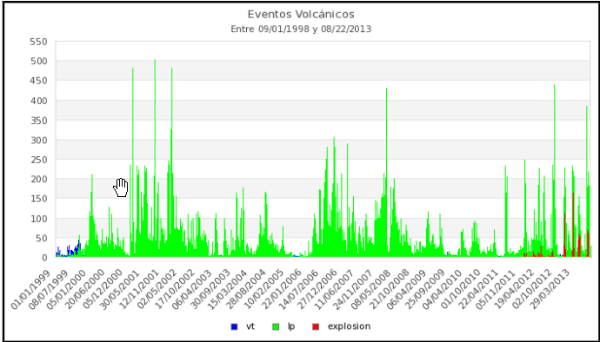
Ecuadorian volcanoes
High hazards for over 130,000 people around Cotopaxi and Tungurahua volcanoes

Slide 15
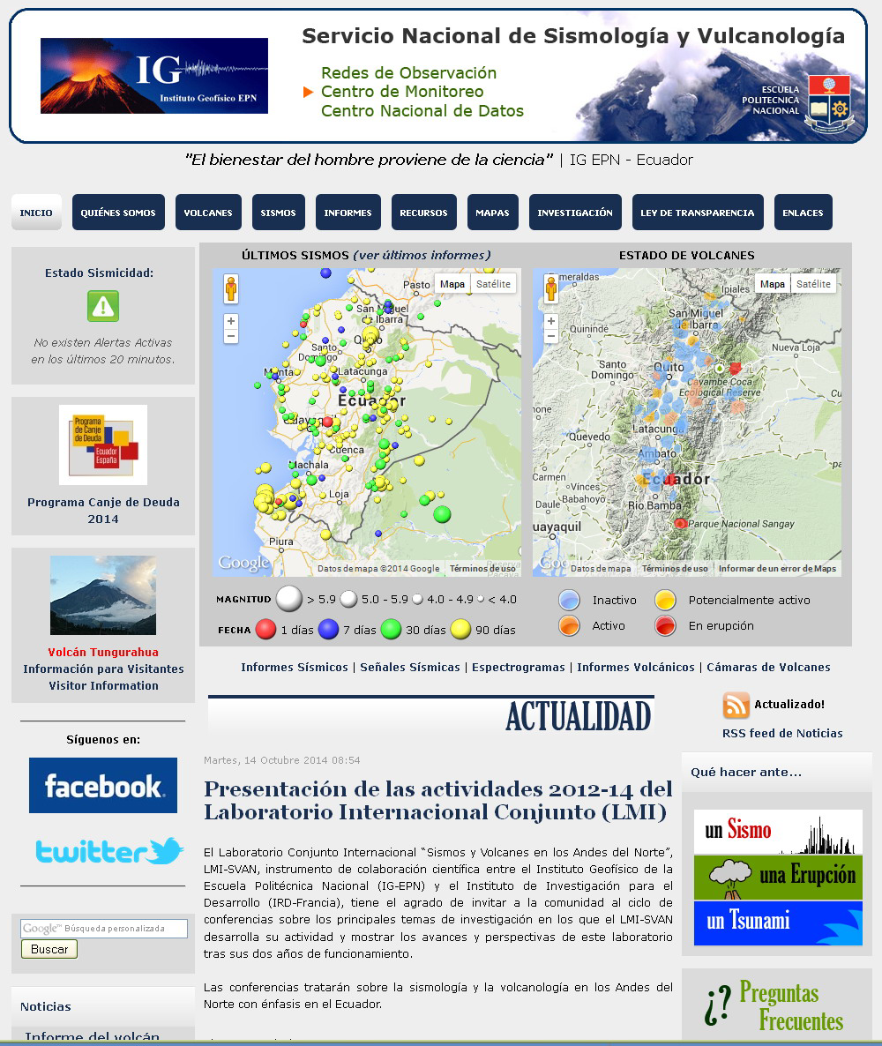
Ecuadorian Volcanoes: Team
Supersite team:
Supersite Point-of-Contact (PoC): P.A. Mothes, IGEPN - Instituto Geofisico Escuela Politecnica Nacional, Quito
Other teams: Univ. of Reading, UK; USGS; Univ. of Bristol, UK; Univ. of Miami, USA

Slide 16
Ecuadorian Volcanoes: Resources
Tungurahua Volcano networks
Available in situ data:
Seismic
GPS (permanent/temporary)
Electronic Distance Meters
Tiltmeters
Geochemical
Cotopaxi Volcano networks

Slide 17
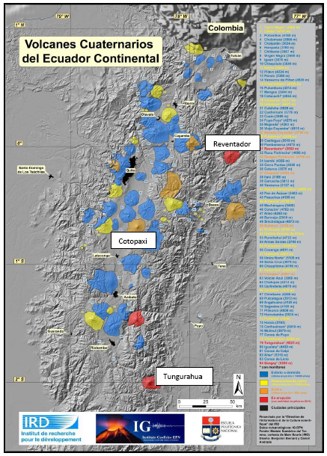
Ecuadorian Volcanoes: Needs
EO data are requested for the Tungurahua and the Cotopaxi volcanoes
Coverage needs:
X, C, L band
Ascending and descending passes
Repeat pass ∼11-16 days normally
Possibility to increase repeat pass 1-4 days during eruptions (using COSMO-SkyMed)
Areas to cover are ∼50 x 50 km

Slide 18
Ecuadorian Volcanoes: for decision
CEOS accepts the Supersite Proposal and agrees to support it by making available data according to the request in the proposal and up to the limits listed below.
CEOS requests that the Data Coordination Team inform the PoC for the Supersite of this decision and the procedures of ordering and accessing the data
Indicative data resources committed
CEOS intends to to support this Supersite with these resources:
  (ASI) 200 scenes/yr until 2016 COSMO/Skymed
  (CNES) 1 coverage per year Pleiades
  (CSA) not requested Radarsat-2
  (DLR) 130 scenes until 2016 TerraSAR-X
  (ESA) complete archive ERS-1, -2, Envisat
  any available acquisition Sentinel-1, -2
  (JAXA) tbd ALOS-2, ALOS-1, J-ERS
  (NASA) any available acquisition EO-1
  tbd ASTER
  (USGS) any available acquisition Landsat 7 and 8

Slide 19
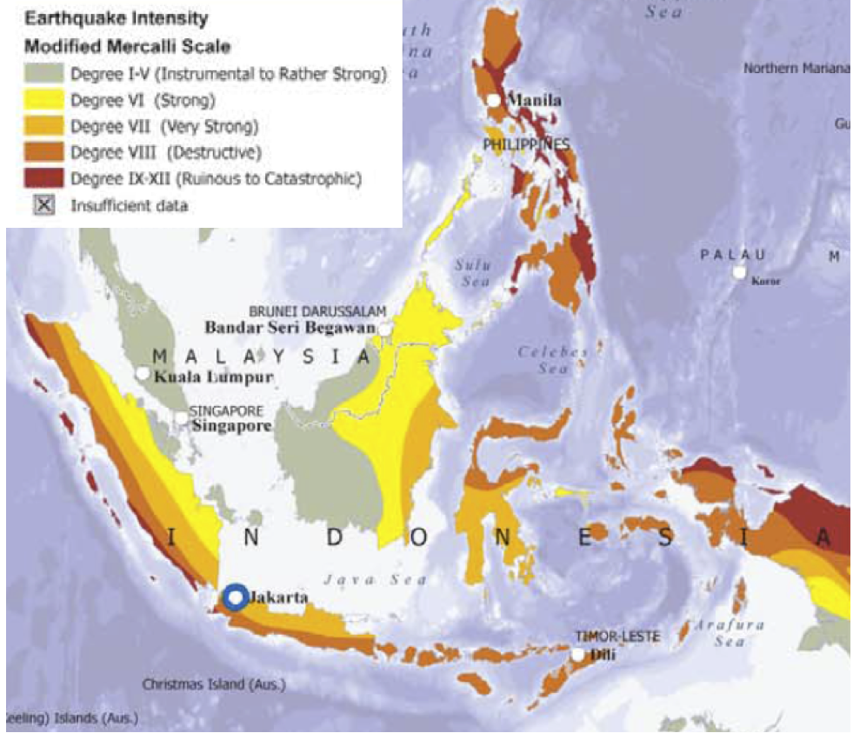
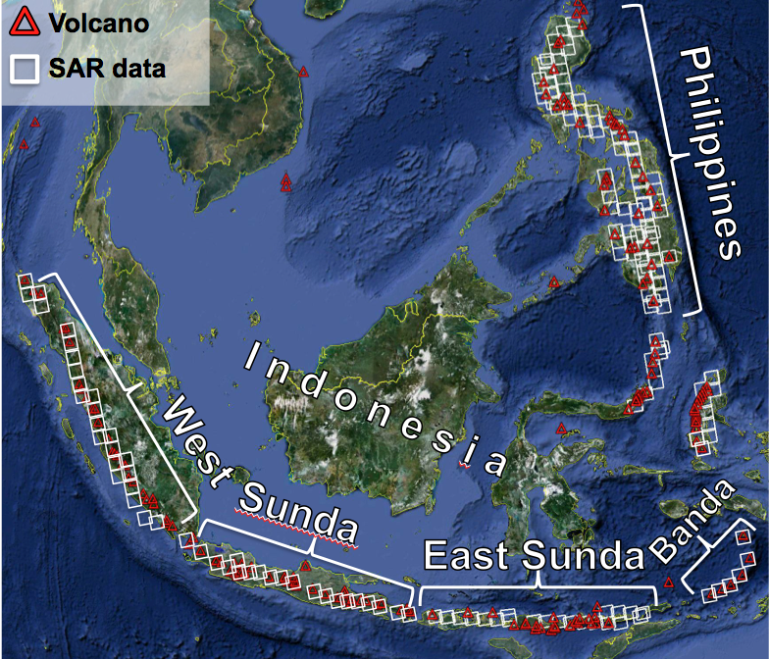
Southeast Asia Natural Laboratory for Geohazards
New draft proposal in S-E Asia including Papua New Guinea,
Recent large eruptions e.g.
  Pinatubo volcano eruption (Philippines, 1991) 3rd largest eruption past century, and
  Merapi volcano eruption (Indonesia, 2010) with 367 fatalities.
Recent destructive crustal earthquakes e.g.
  Philippine fault earthquake (M 7.8 with 1800 fatalities, in 1990)
  Yogjakarta earthquake (M 6.3 with 6000 fatalities, in 2006)
  Sumatra-Andaman subduction earthquake (M 9.3, in 2004), 2nd largest instrumental earthquake ever.
Four scientific objectives: Volcano early warning, Eruption monitoring, Rapid earthquake information and Geodetic monitoring of strain accumulation

Slide 20
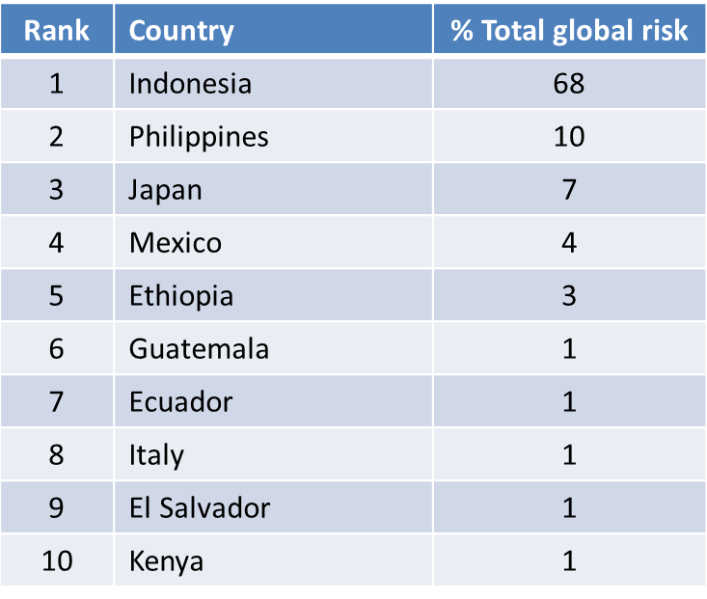
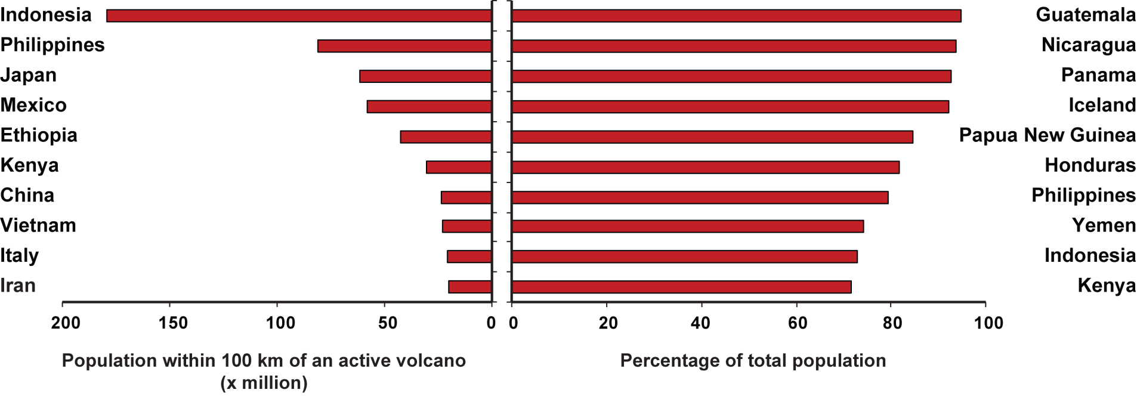
Southeast Asia Natural Laboratory for Geohazards
Indonesia and the Philippines together account for 78% of the global volcanic risk (2013 GAR Report)
© Sarah Brown (University of Bristol) - Use of indicators and indices to assess global volcanic hazard and risk for the Global Assessment Report 2015, presented at CoV8

Slide 21
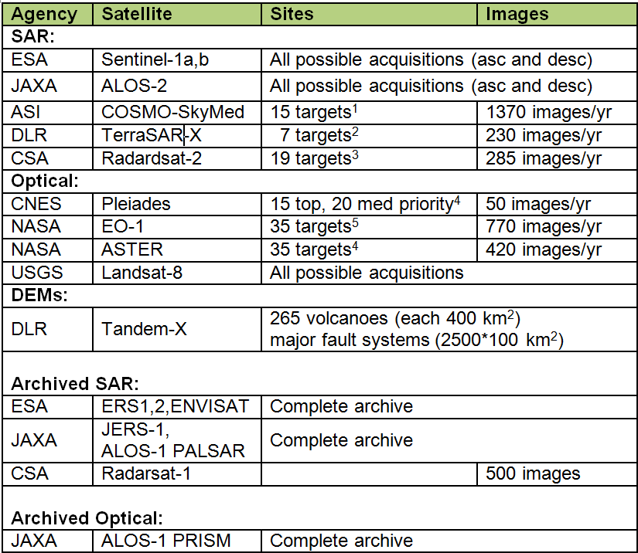
Southeast Asia Natural Laboratory for Geohazards (cont’)
Proposal made by Research Institutes, Observatories, Geohazards Management Agencies from:
  Indonesia, Philippines, Australia, Germany, France, India, Italy,Japan, Luxemburg, Papua New Guinea, Portugal, Saudi Arabia, Singapore, Spain, U.K. and USA
Intention of proposers is to present it a
voluntary commitment at 2015 WCDRR
Being assessed by WG Disasters:
  Current objectives of both Volcanoes and Seismic Risks pilots differ. New proposal should not impact on-going efforts deployed to fulfill initial objectives; still Pilots concept to be demonstrated.
  Provision of feedback / reports from Scientists on data use must be guarantied in regards to the amount of data provided by Space Agencies.
Large amount of satellite optical and radar data requested, comparable to GFOI.

Slide 22
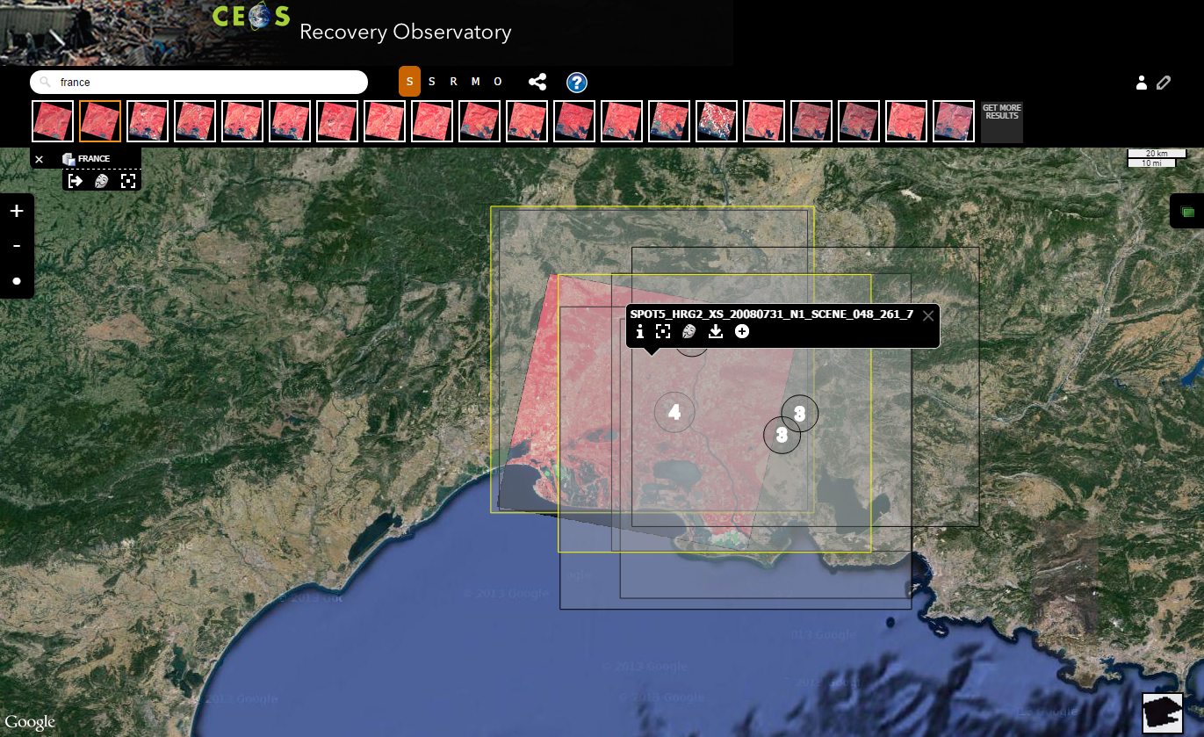
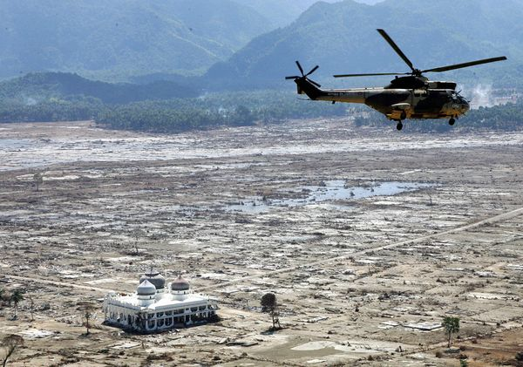
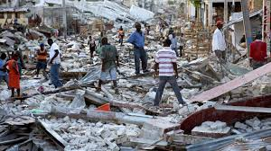
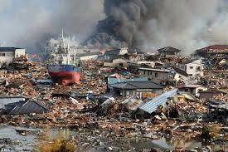
Recovery Observatory (RO)
Implementation of IT infrastructure is progressing
  1st basic version end 2014 (http://dotcloud.akka.eu/RO/ ),
  2nd version in July 2015
Meeting with Stakeholders (UNDP, World Bank, Red Cross, UNOSAT, UNISDR ) to develop institutional relationship and to engage them in the RO triggering process (Geneva, 7 Oct. 2014)
  Strong interest from all in joining the RO and willingness to work with CEOS towards a 'formal' commitment by end 2014 to allow triggering of the RO by 1 January 2015.
Indonesian Tsunami
2004
Haiti Earthquake
2010
Tohoku Tsunami
2011

Slide 23


WCDRR & HFA2
  (More details in Chu’s
  presentation – session # 30)
  Participation in several WCDRR preparatory meetings (e.g. Ministerial Regional meetings, two Preparatory Committee meetings)
  Preparation of CEOS active participation in WCDRR (Request for Accreditation, Working session in Sendai, JAXA-CEOS booth, CEOS EO Handbook Special 2015 WCDRR edition,..)
14-15 March 2015,
Sendai, Japan
  HFA2: Coordinated actions with GEO, UNOOSA, UNITAR for improving draft text. Close relationship with Japanese government.
  1. Support from governments being sought.
  2. Current draft (14 pages) includes one single explicit reference to space EO and several implicit ones applicable to CEOS space agencies
UN Secretary-General Ban Ki-moon with Margareta Wahlström, his Special Representative for Disaster Risk Reduction.
Credits: UN Photo/Evan Schneider
Notes:
UNISDR merged several sessions together. The one prepared by UNOOSA together with CEOS and 15 other co-organisers (see list after) have been merged into a larger Working session on "Innovation and High Technology to Reduce Risk" which contains Earth observation, geospatial information, ICT and robotics.
UN agencies: UNOOSA/UN-SPIDER, FAO, UNITAR/UNOSAT and ESCAP
International Organisations: GEO, CEOS, GFDRR, CAS-TWAS-SDIM, European Space Agency (ESA), Global Facility for Disaster Risk Reduction of the World Bank (GFDRR) and the United Nations Economic and Social Commission for Asia and the Pacific (ESCAP)
Regional Organizations: ADRC
Space Agencies: ESA (Europe), DLR (Germany), JAXA (Japan)
Ministries: MEXT (Japan) and MoDMR (Bangladesh)
Civil Protection Agencies: NDRCC (China), NEC (Dominican Republic)
Academia: Tohoku University / IRIDeS (Japan)

Slide 24
Other Relevant Matters
Outreach:
  Organiser of Side event at “Asian Ministerial Conference on Disaster Risk Reduction” (Bangkok, June 2014)
  Presentations of CEOS activities (and paper) at Davos IDRC, Understanding Risk Haiti (World Bank, July 2014)
WG organisation:
  Former “Supersites Coordination Team” (lead was DLR) responsibilities successfully subsumed in new “Data Coordination Team” (Brenda Jones, USGS is Lead)
  Still vacant positions. On-going actions to find candidates
    Liaison(s) to User Communities
    GEO Disaster Task Coordinator (Letter from CEOS Chair)

Slide 25

Proposed WG Internal Organisation:
Teams & Functions
GEO Secretariat
ESA
WGDisasters
Experts
WG Chair
(single person with secretarial support)
Liaison to GEO Disaster SBA
(single person)
GEO Disaster Task Coordinator
(single person)
Still TBD
WG Vice-Chair (single person)
CSA
Liaison to User Communities
(one or two persons)
Still TBD
NASA & NOAA
ESA & DLR
USGS & ASI
FLOODS
Thematic Team
(2 co-leads + experts)
SEISMIC
RISKS
Thematic Team
(2 co-leads + experts)
VOLCANOES
Thematic Team
(2 co-leads + experts)
…
…
…
CNES
Recovery Observatory Team (1 Lead + experts)
…
2015 WCDRR – HFA2 Team (1 Chair + experts)
JAXA
…
Data Coordination Team (1 Chair + 1 Representative per Space Agency .
Includes the former Supersite Coordination Team )
USGS
…

Slide 26
First results from
Volcanoes, Floods and Seismic Risks
Pilots ….

Slide 27
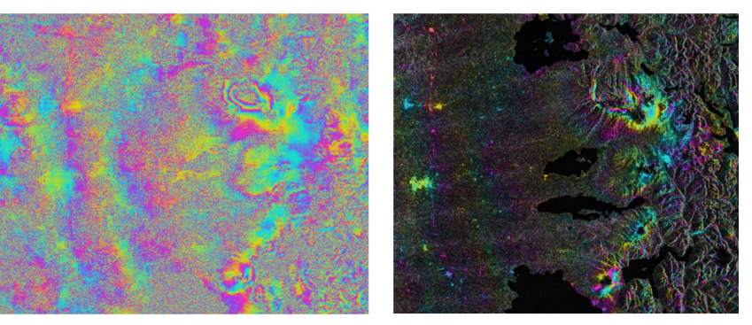
Volcanoes: Objective “A” results
RADARSAT-2 interferogram from Cordon Caulle volcano, Chile, spanning December 12, 2012 – March 27, 2013 (left: phase difference; right: phase difference overlain on amplitude image). The volcano erupted in 2011-2012. This interferogram shows post-eruptive inflation which would not otherwise have been known without the CEOS pilot program.
Figure and … comment !!: courtesy of Matt Pritchard (Cornell University)
Notes:
Cordon Caulle is an active volcano in Chile. The volcano erupted last time in 2011.2012 timeframe
On this volcano data have been already provided by ASI and CSA.
Nine RADARSAT-2 scenes from Cordón Caulle have been processed (spanning dates in 2012-2014, that mean after the eruption) and several show ground uplift after the 2011-2012 eruption, indicating that the magma chamber is re-filling.
This interferogram shows post-eruptive inflation which would not otherwise have been known without the CEOS pilot program.

Slide 28
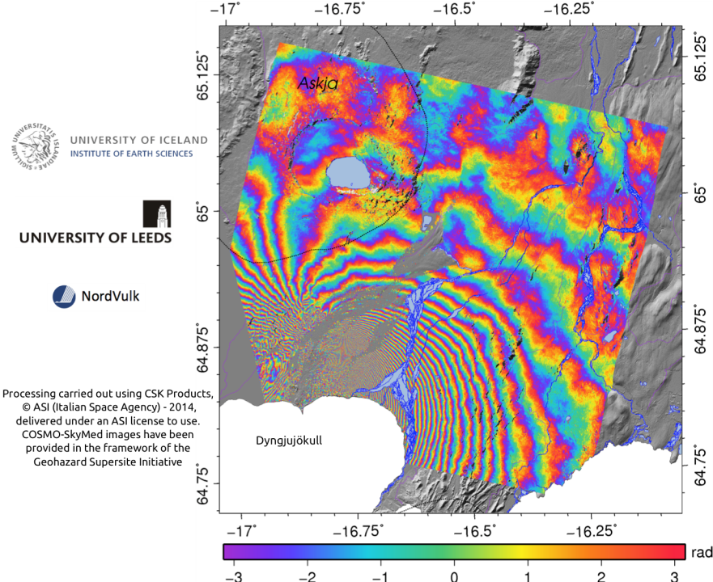
COSMO-SkyMED descending interferogram spanning the period 13th August 2014 - 29th August 2014. Each fringe represents ~1.5 cm of displacement in the satellite's line-of-sight.
Notes:
Bárðarbunga is one of Iceland's most active volcanoes - analysis of tephra from soil profiles suggests a historic eruption frequency of ~5 eruptions/100 years (Óladóttir et al., 2011)
ASI re-tasked CSK satellites in July 2014 at the request of the University of Iceland to commence acquiring both ascending and descending images every 16 days over Bárðarbunga volcano.
Volcanic unrest commenced on the 16th August 2014 and first eruption commenced at 00:02 on the 29th August, during which a small fissure opened in Holuhraun extruding a small basaltic lava flow.
A second fissure eruption commenced on the morning of the 31st August, at 5:15 am. This eruption was accompanied by lava fountains and the extrusion of both 'A'a and pahoehoe lava flows. The eruption is currently ongoing.
COSMO-SkyMED descending interferogram spanning the period 13th August 2014 - 29th August 2014 show surface displacement in the line of sight of the satellite.
Each fringe represents ~1.5 cm of displacement in the satellite's line-of-sight.
This information provide valuable insights into ongoing activity.

Slide 29
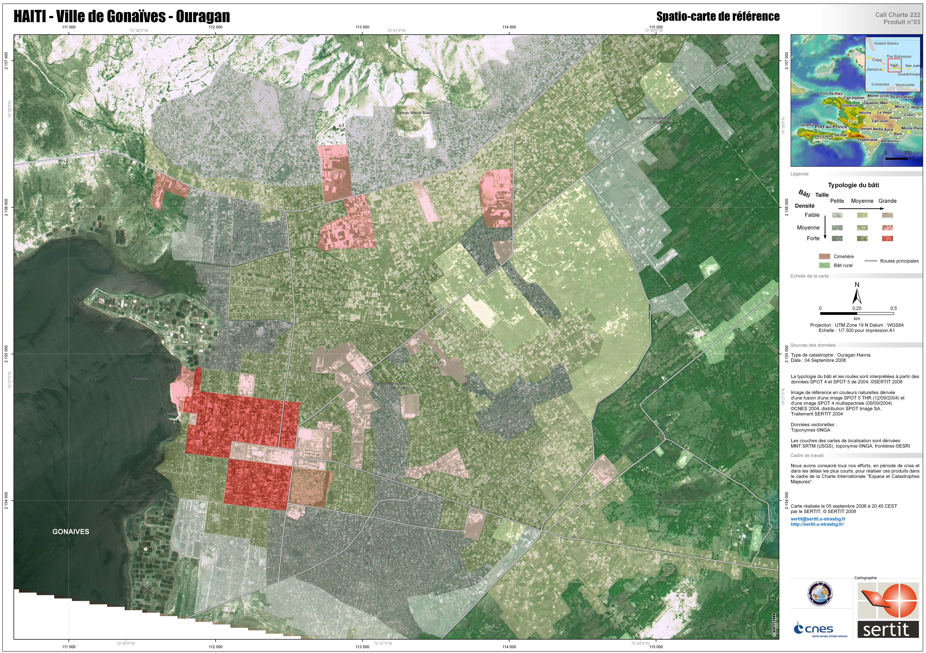




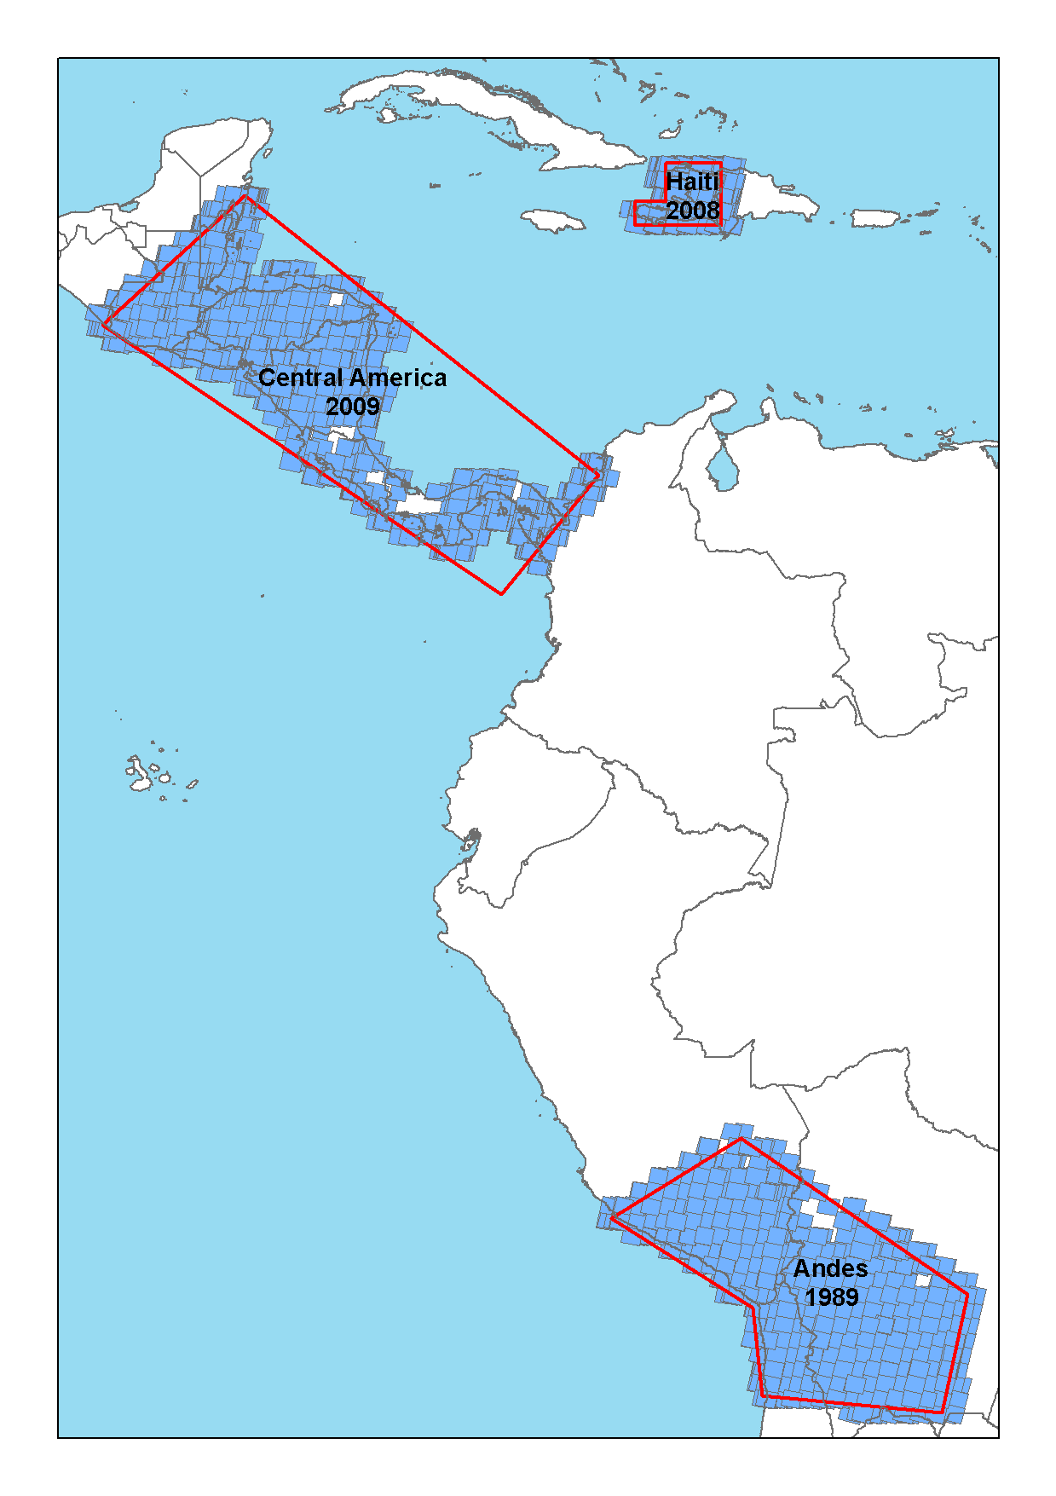
Floods: HAITI
Lead: RASOR/Athena Global/CIMA
Risks: Seismic, landslide and hydro-met event
Importance: model for poor in-situ data and high development interest
Deliverables: multi-hazard risk assessment, integration with operational warning, national risk assessment and prevention products; Work with regional partner CIMH allows roll-out of RASOR to other national civil protection agencies and geospatial organisations
EO Data: optical and SAR
End Users: CNIGS, CIMH, Haiti Civil Protection
Localization map
SPOT World Heritage Archive: 2008 Haiti images for historical flood record; 2009 Central American images
Notes:
Many of the regional flood areas contain multiple disaster risks. The same observations from space can be used to show the different types of risk. Coordination between the various pilot teams ensures optimal look angles and modes are employed on the satellites when possible. This enables data re-use across the various types of risks. Coordination is accomplished within the Flood Pilot thematic team and within the Disasters Working Group. CEOS team members work with non-CEOS entities to accomplish the best observations and generate the most valid products applicable to the range of risks.
Caribbean Institute for Meteorology and Hydrology (CIMH)

Slide 30







Floods: INDONESIA
Internal Lead: RASOR/Deltares
Risks: Three hotspots: Jakarta, Bandung and Cilacap
Storm surge and rainfall-induced flooding, tsunami
Risk is exacerbated by land subsidence
Importance: Densely populated, industrial production
Deliverables: Flooding scenarios, flood extent,
flood frequency, economic quantification of risk
EO Data: DEM, SAR and Optical
End Users: BNPB (National Disaster Management Agency), PUSAIR (Ministry of Public Works)
TanDEM-X 12 M DEM being processed for Jakarta, Bandung and Cilicap coast for accurate flow model
Notes:
The Flood Pilot team members in each region and in the global component work on specific modeling and monitoring product development to link together all the satellite observations and ground information and provide it to local, national, regional, and international agencies in each area. They utilize capabilities within the other CEOS Working Groups to implement appropriate data services, build end user capacity, and ensure products are properly calibrated and validated.

Slide 31
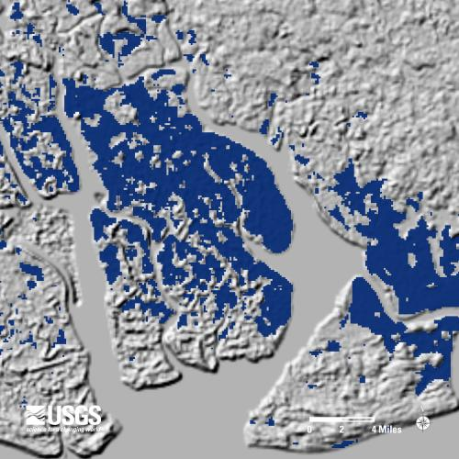
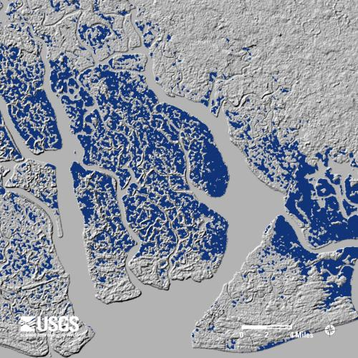
Recent release of 30m-SRTM DEM:
Improved Flood forecasting ?
A screenshot of SRTM elevation data in Niger River Delta, Nigeria. Left, 90-meter resolution; right, enhanced 30-meter resolution. Click the image to access the interactive tool.
Courtesy USGS
Notes:
The Flood Pilot team members work together to incorporate new satellite capabilities and improved data sets to increase the effectiveness and efficiency of the delivered products and services. The release of the 30m SRTM DEM in addition to the new observation data from Sentinel-1 and ALOS-2, targeted data sets from COSMO-SkyMed, Pleiades, Radarsat-2, and other high resolution satellites including data from the International Disaster Charter aids in this goal and are all being fully utilized in this effort.

Slide 32
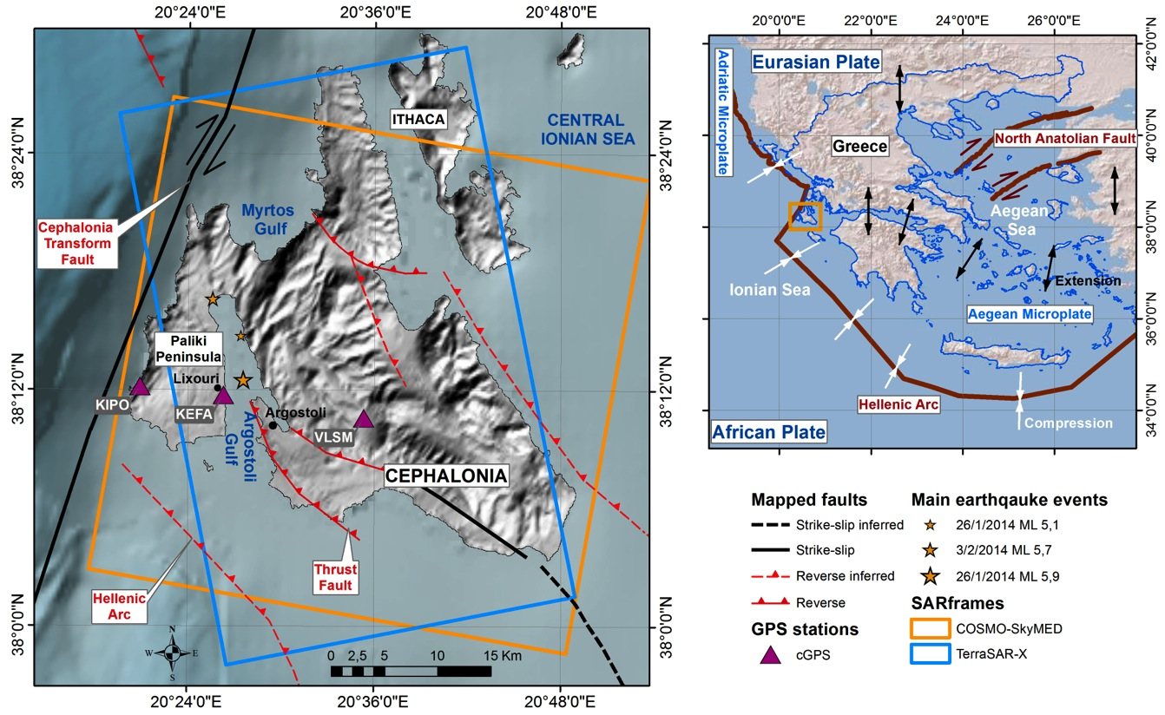
Seismic Risks: 2014 Cephalonia
M_{w} 5.9
3 Feb., 2014
M_{w} 6.0
26 Jan., 2014

Slide 33
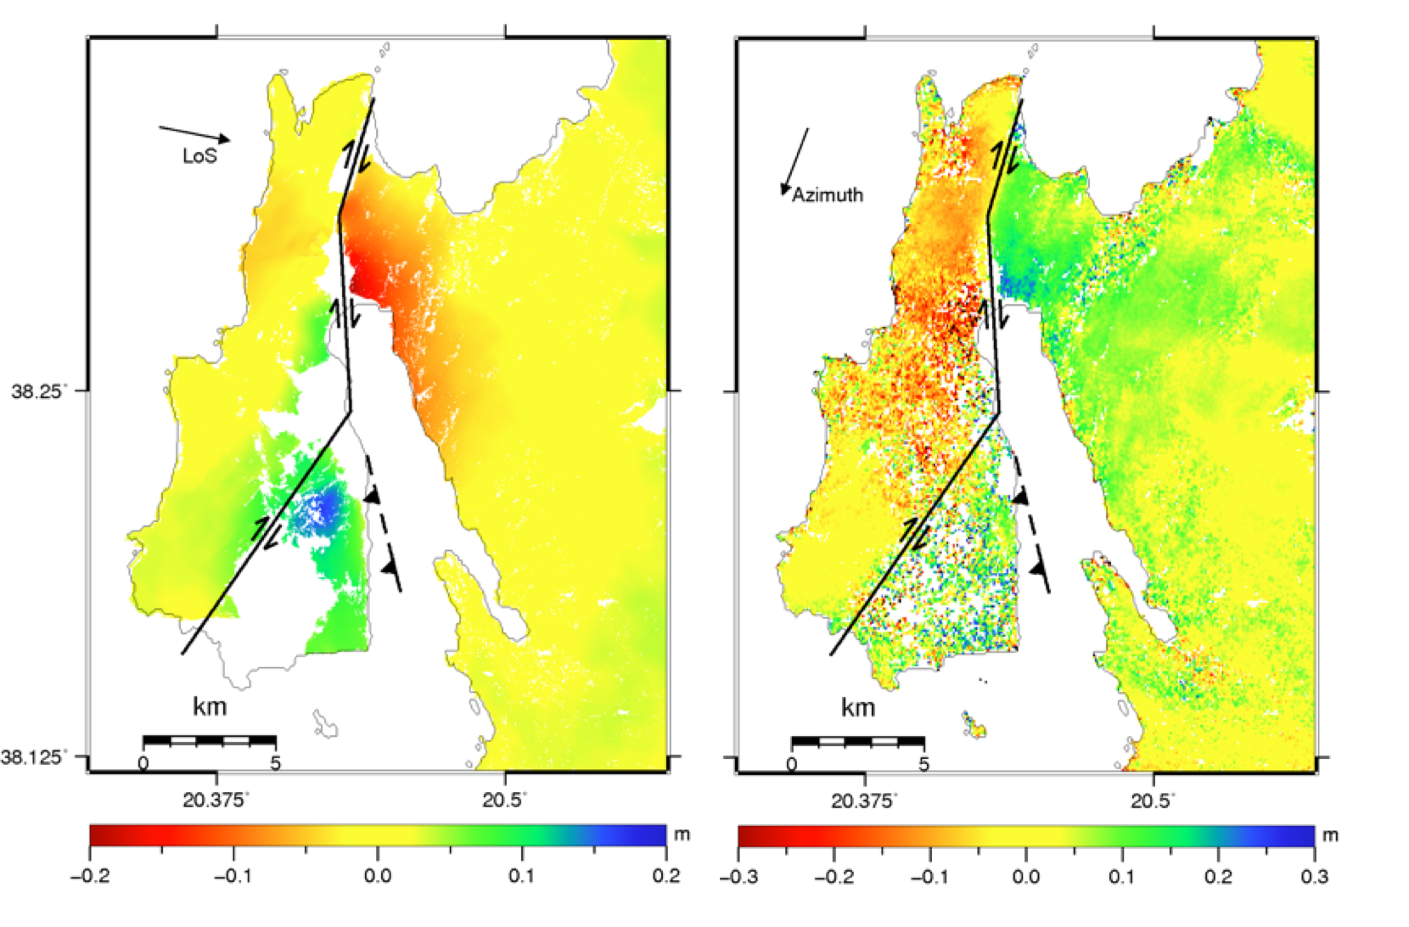
Descending orbit
COSMO-SkyMed DInSAR (15 m)
COSMO-SkyMed MAI (∼100 m)
Merryman et al., in prep.

Slide 34
Conclusions
Projects (Pilots and Recovery Observatory): rapid progress thanks to very good support from space agencies and from high motivation of non-CEOS persons involved (practitioners, end users, major stakeholders)
2015 WCDRR & HFA2: excellent cooperation with other stakeholders involved in particular GEO SEC and several UN Agencies. Good connections with some governments e.g. Japan, South Africa. Difficult lobbying process …. CEOS strategy follows several parallel paths.
2015 start of new era for space agencies in DRR.

Slide 35
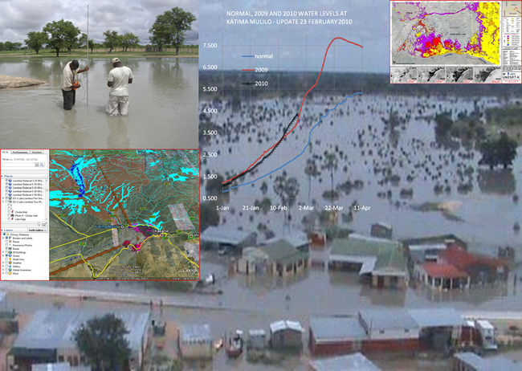
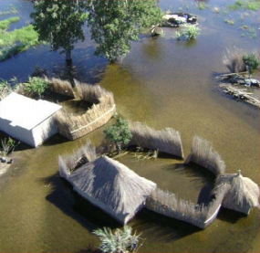
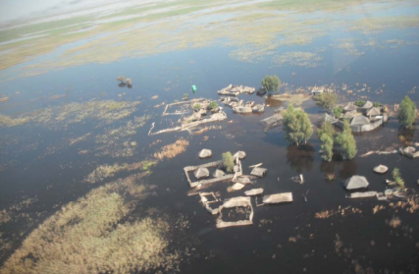
THANK YOU
….
QUESTIONS ?
Floods in Namibia (2009). 50,000 people displaced, 102 died. Courtesy NASA

