Slide 1
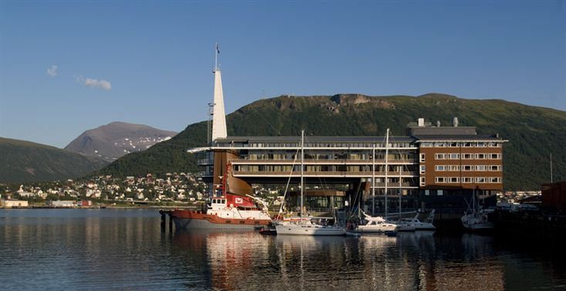
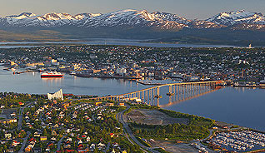
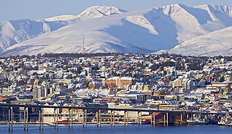
28th CEOS Plenary Session
Report on WGCapD
Eric C. Wood
USGS, WGCapD Chair
CEOS Plenary, Agenda Item 16
Tromsø, Norway 28-30 October 2014

Slide 2
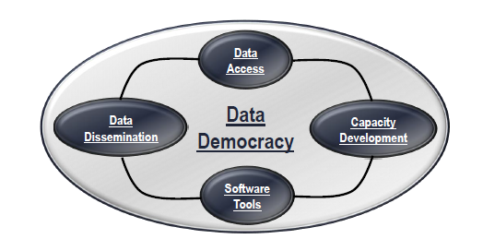
Working Group on Capacity Building & Data Democracy (WGCapD)
2

Slide 3
SIT Actions – WGCapD 2014-15

Slide 4
SIT Actions – WGCapD 2014-15

Slide 5
CEOS 2014 -2016 Work Plan Deliverables

Slide 6
CEOS 2014 -2016 Work Plan Deliverables

Slide 7
WGCapD 3rd Annual Meeting - 2014

Slide 8
WGCapD 4th Annual Meeting - 2015
SANSA will host the WGCapD 4th Annual Meeting
Pretoria, South Africa
March 18-20, 2015

Slide 9
Primary 2014 - 2015 Activities

Slide 10
Capacity and Awareness Building

Slide 11
Online Course Development
DRAFT

Slide 12
2015 - Planned Activities
Expand outreach
WGCapD Newsletter, WGCapD Listserve
Better utilization of WGCapD website pages
Event participation / networking
Webinars (various themes, recorded and archived)
Define themes (connect with VCs and other WGs)
Consolidate lists of potential participants
Promotion through collaborators (e.g., WMO VLAB, UN SPIDER)
Promote new technologically appropriate data visualization and access tools
Strengthen dialog on developing new Capacity Building activities

Slide 13
GEO Capacity Building (ID-02)
Before 2015, GEO aims to:
Enhance the coordination of efforts to strengthen individual, institutional and infrastructure capacities, particularly in developing countries, to produce and use Earth observations and derived information products.
This will be achieved through:
Working with and building on the capacity building efforts of GEO Members and Participating Organizations to further increase synergies and effectiveness of national and international capacity building programs
Enhancing capacity building efforts to ensure the integration of Earth observation-based information systems into daily practices
Members include CEOS.
AfriGEOSS initiative includes capacity building
13

Slide 14
GEO Capacity Building (ID-02)

Slide 15
GEO Capacity Building (ID-02)

Slide 16
Evolution of GEOCAB

Slide 17
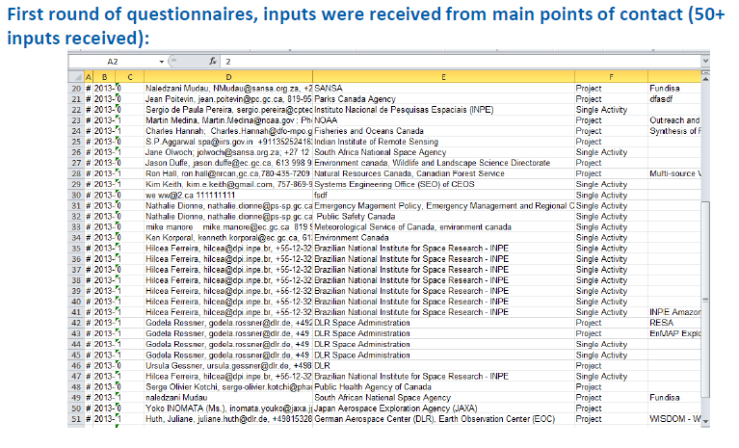
CEOS Contributions to GEONETCAB /GEOCAB

Slide 18
Support to VCs and WGs
Response to Mandates
Initial, recent
SIT Technical Meeting ( Montpellier)
VC/WG Day
Pilots
WGDisasters
Data coordination team
Supersites
Field Pilots (floods, volcanoes)
SST-VC (capturing workshop)
SDCG (data delivery)
WGISS (Big Data, cloud computing)

Slide 19
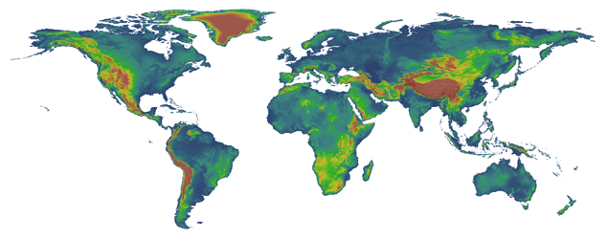
NASA Shuttle Radar Topography Mission
SRTM Release
11 Day Mission to Map the Most of the World in February 2000 on Space Shuttle Endeavor
Collaboration with the US NGA
Produced High Quality Elevation Data
90m Data Available Free Worldwide via USGS
30m Data Available over the United States Only

Slide 20
Initial Efforts to Release SRTM 2 Data
Many attempts to have SRTM 2 data released by NGA to the public for the entire Earth
US consortium of agencies have worked together to secure the release of the data.
CEOS, GEO actively lobbied for the release with NOAA recently serving as the POC for WGCapD
South Sudan and Somalia released as pilot projects

Slide 21
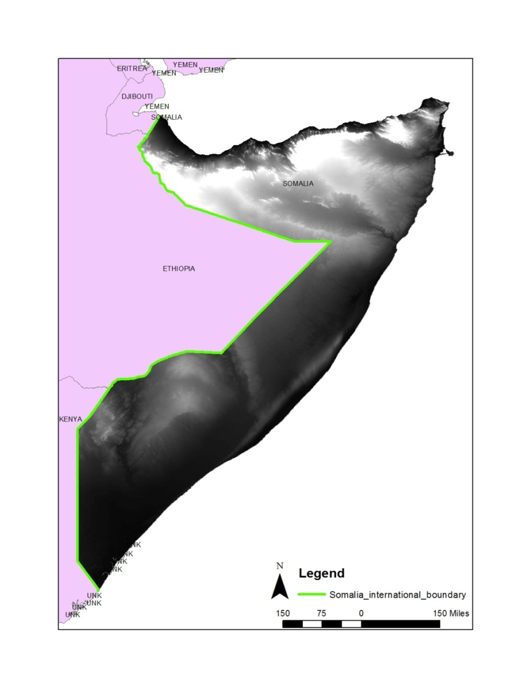
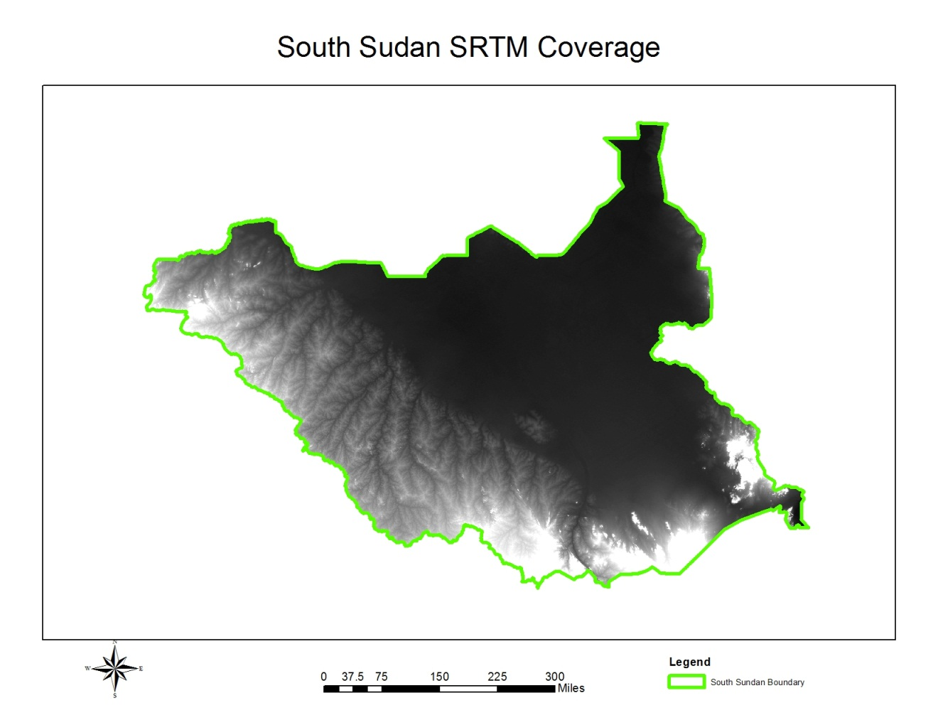
Pilot Data Released for May 2013 Worskhop
Somalia

Slide 22
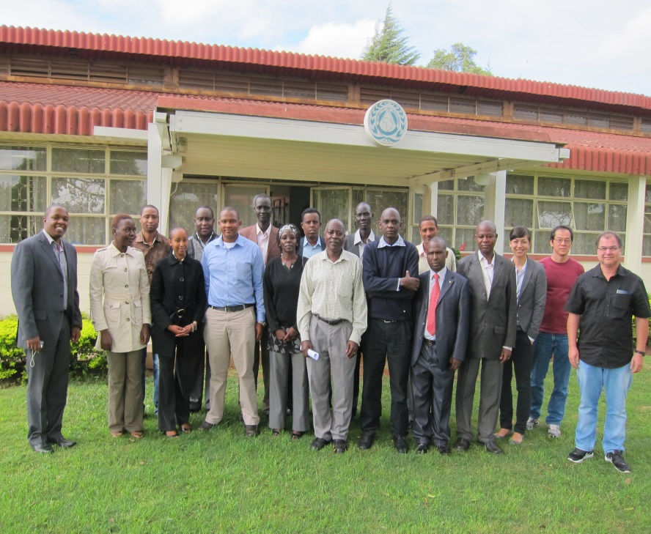
WGCapD SRTM DEM Workshop - 2013
Improved access to global DEM developed on a country-by-country basis
May 6-10: I DEM Workshop held in Nairobi, Kenya, hosted by RCMRD
12 participants (Ethiopia, Somalia, Zambia, Kenya, South Sudan and Uganda).
Instructors were from SANSA, INPE, RCMRD/SERVIR, USGS (virtual), FEWSNET and SWF.
Unique CEOS workshop benefitting people at different levels with varying amounts of resources.
“Lessons-learned” Report available at WGCapD website, link “Documents”:
http://www.ceos.org/wgcapd

Slide 23
SRTM Finally Released – September 2014
SRTM2 Released in UN Climate Summit
SRTM-2 30 meter data released as part of President Obama’s speech at UN Climate Summit on September 23, 2014
UN Side event on September 24, 2014 about The United States’ Efforts to Boost Climate Resilience in Developing Nations included demonstration of Newly Available Elevation Data for Africa
23

Slide 24
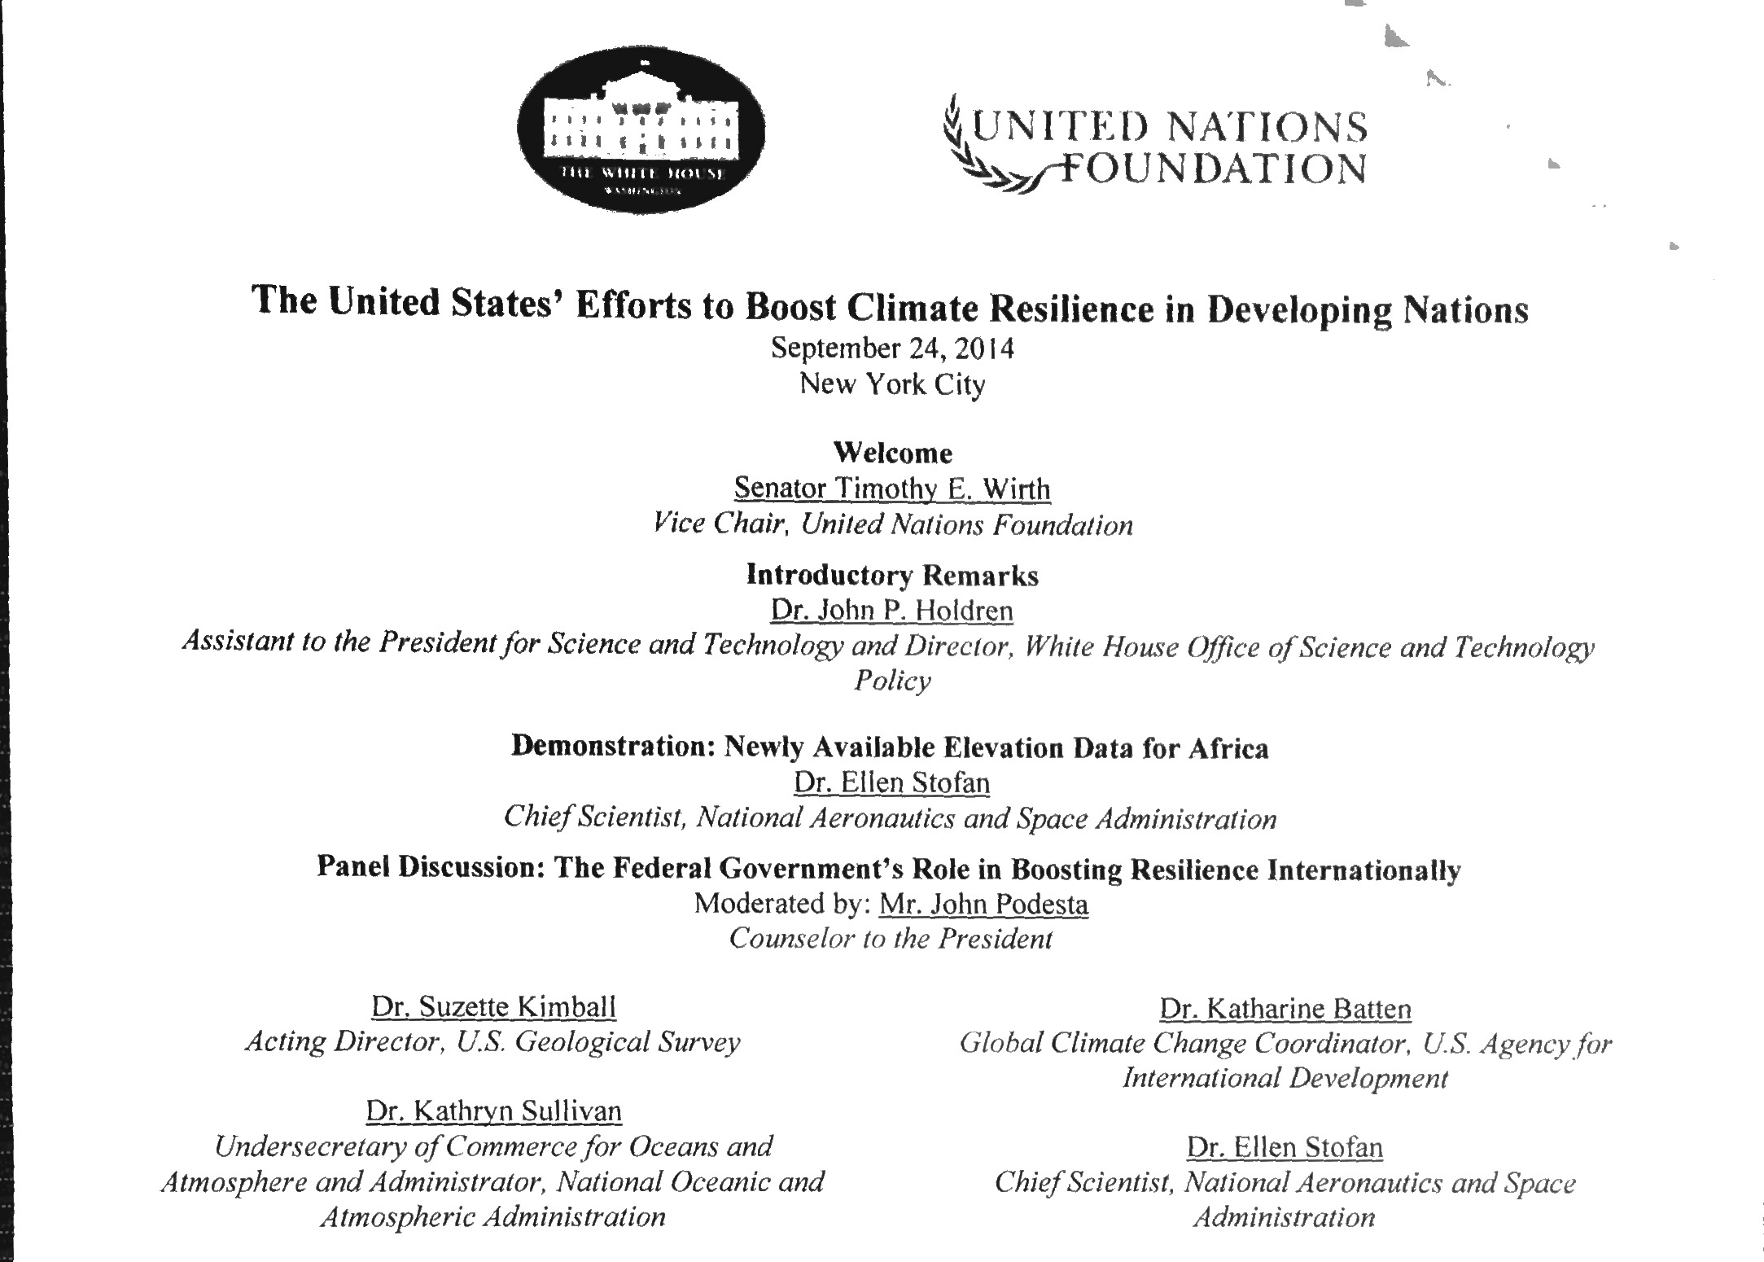
SRTM Highlighted in UN Side Meeting
24

Slide 25
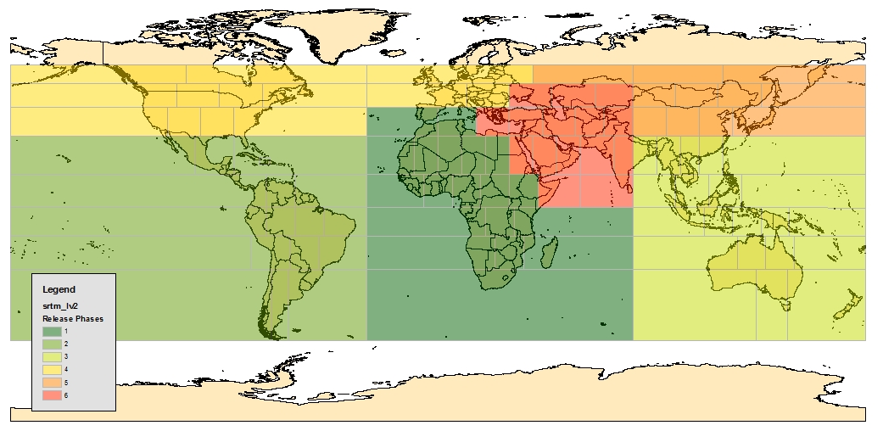
NGA SRTM2 Release Groups 1 - 6
UNCLASSIFIED//FOUO
4
5
6
1
3
2
Group 1: Africa, far SW Europe Group 2: Mexico, Latin America, the Caribbean, S Pacific Isles Group 3: Southeast Asia, Australia, and the W Pacific Isles Group 4: North America and Europe Group 5: N China, Mongolia, Russia. NW Pacific Isles Group 6: Middle East, rest of Africa, and rest of Asia
Group1 – Sep ’14
Group 2,4 – Nov ‘14
Group 3,5 - May ‘15
Group 6 – Aug ‘15
UNCLASSIFIED//FOUO

Slide 26
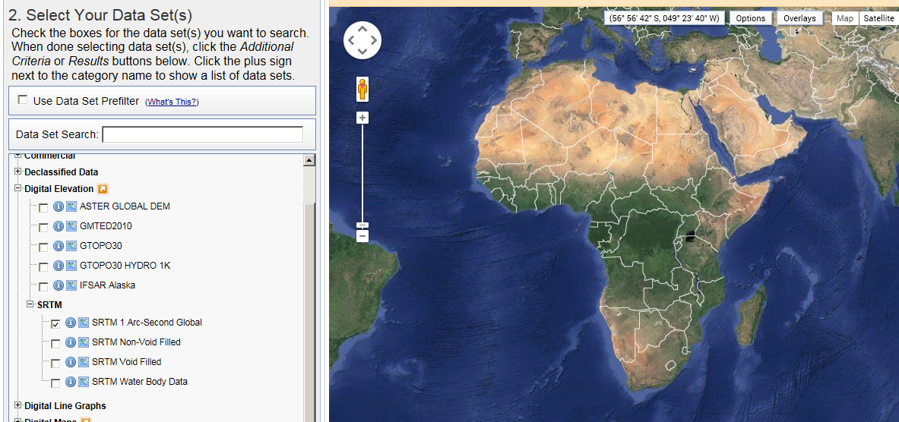
Staging – USGS EROS
Earth Explorer
http://earthexplorer.usgs.gov/

Slide 27
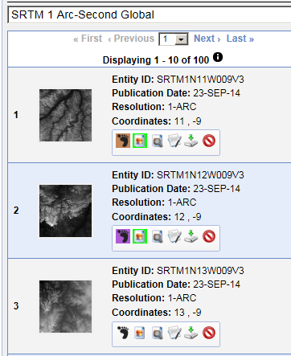
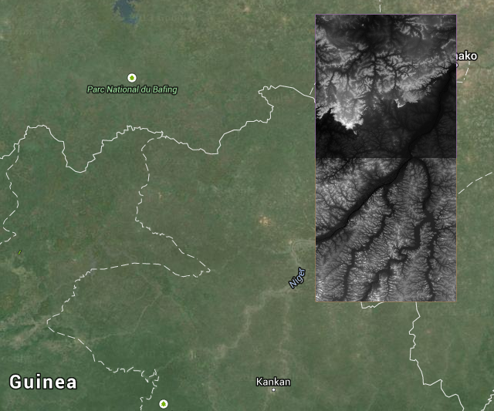
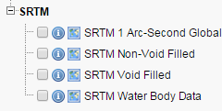
Staging – USGS EROS

Slide 28
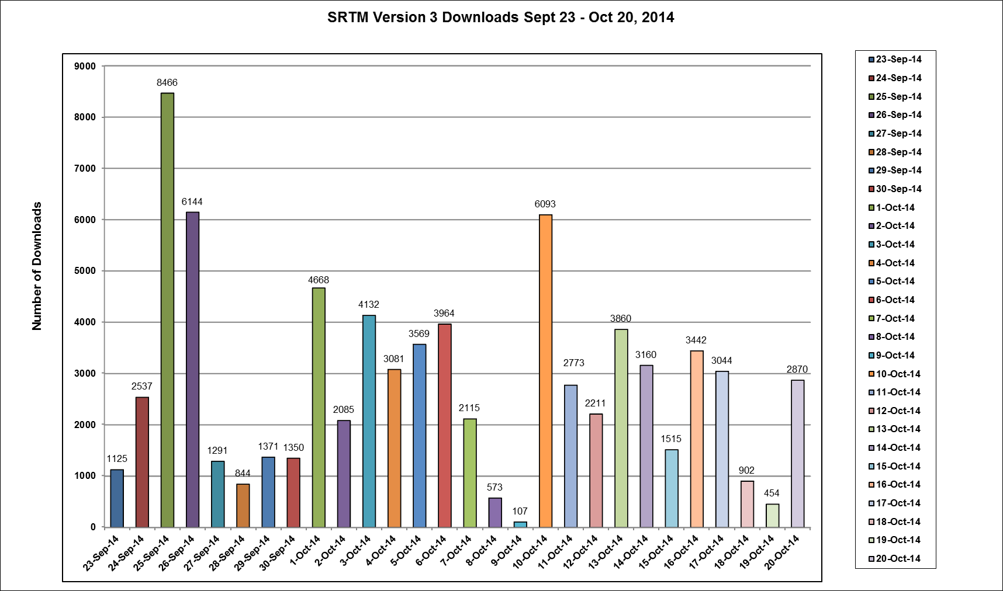
NGA SRTM2 Downloads Sept 23 – Oct 20, 2014
(77,748 downloads by 392 unique users)

Slide 29
NGA SRTM2 Downloads Sept 23 – Oct 20, 2014

Slide 30
Staging – USGS EROS
https://lpdaac.usgs.gov/

Slide 31
Staging – USGS EROS

Slide 32
SERVIR SRTM-2 DEM Project
SERVIR contribution to CEOS WGCapD and USGEO
Will provide newly released datasets and associated materials on physical storage device (e.g. hard drive)
Continental coverage of the SRTM 30 meter DEM for Africa
Data product information (i.e. resolution, geographic information, accuracy, processing level)
Supporting datasets, and derived products, such as land mask and hillshade data
Quick reference materials for data tile selection
Will provide to 20 member countries of the Regional Centre for Mapping of Resources for Development (RCMRD)/SERVIR Eastern & Southern Africa during RCMRD 2014 Conference of Ministers Nov 10–19, 2014. Fulfills obligation to provide data to attendees of the original Nairobi workshop in 2013.
32

Slide 33
CEOS SRTM-2 Workshop
Schedule 2015-16
 | Host
Date | Institution | Location
March 23-27, 2015 | SANSA | Pretoria, South Africa
May, 2015 | CRECTEALC | Puebla, Mexico
Fall, 2015 | ICIMOD/SERVIR | Kathmandu, Nepal
TBD, 2016 | TBD | West Africa

Slide 34
Example from Visualization shown at the UN Side Meeting
“The United States’ Efforts to Boost Climate Resilience in Developing Nations”

Slide 35
Thank you
Eric C. Wood, Chair
USGS
woodec@usgs.gov
Jane Olwoch, Vice Chair
SANSA
jolwoch@sansa.org.za

