Slide 1
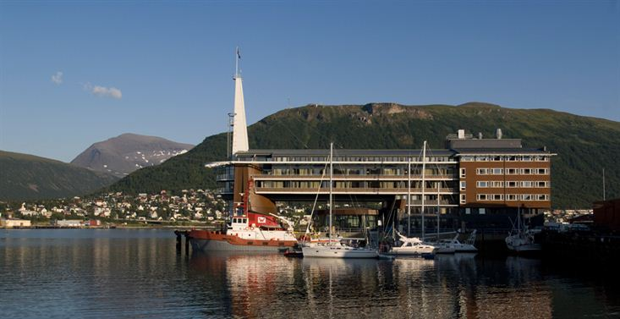

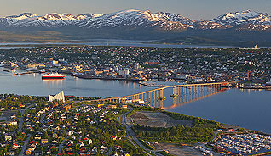
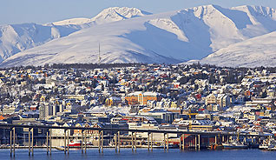
28th CEOS Plenary Session
Report on WGCV
Satish Srivastava (CSA), WGCV Chair
CEOS Plenary, Agenda Item #15
Tromsø, Norway
28-30 October 2014

Slide 2
Presentation Outline
CEOS Plenary Actions and Work Plan Deliverables
WGCV Plenary # 38
  Special Thematic Sessions
  Highlight on WG and VC Interaction
  ISRSE 36 – Special Cal/Val Session
WGCV Vice-chair Nomination

Slide 3
CEOS 2014-2016 Work Plan Deliverables
CEOS 2014-16 Work Plan
  Released on June 4, 2014
  WGCV defined 12 deliverables (CV1 to CV12) under the theme
  “Capacity Building, Data Access, Availability and Quality”
  Working Group synthesized deliverables from each fields of particular interest along with prioritization
Plenary Action 27-21
“WGCV to develop detailed plans for the way forward on the SST Comparison Campaign and SST Operational Validation Project for consideration by SIT-29.”
  In response to the action item deliverables for the CEOS Work Plan has been identified and incorporated (➔ CV-8, see also below)
  Action 27-21 was closed at SIT-29

Slide 4
CEOS 2014-2016 Work Plan Deliverables (II)
Recent WGCV Progress on CEOS 2014-2016 Work Plan Deliverables:
Objective/Deliverable | Projected Completion Date | Status of Progress
CV-3: Workshop on state of the art for pre-flight calibration techniques | Q1 2016 | On-going. Planning initiated; actions identified at WGCV-38 plenary.
CV-5: GSICS cooperation | Q4 2014 – Q4 2016 | On-going. WGCV continued discussions with GSICS in a special session at WGCV-38 regarding potential areas of cooperation. WGCV subgroups took an action to identify and prioritize specific activity areas for interaction with GSICS (by end of Q4 2014).

Slide 5
CEOS 2014-2016 Work Plan Deliverables (III)
Recent WGCV Progress on CEOS 2014-2016 Work Plan Deliverables (…continued):
Objective/Deliverable | Projected Completion Date | Status of Progress
CV-8: Sea Surface Temperature (SST) & Land Surface Temperature (LST) Comparison Campaign Plan | Q2 2014 | On-going. ESA-ITT “FRM4-CEOS” : SI traceability of Fiducial Reference Measurements (FRM) for satellite derived surface temperature product validation including laboratory and field inter-comparison experiment for FRM TIR radiometers Further reporting after ESA ITT completion (Q1/2015).

Slide 6
CEOS 2014-2016 Work Plan Deliverables (IV)
Recent WGCV Progress on CEOS 2014-2016 Work Plan Deliverables (…continued):
Objective/Deliverable | Projected Completion Date | Status of Progress
CV-9: Radiometric Calibration Network (RADCALNET) | Q1 2014 – Q4 2016 | On-going. ESA sponsored activity Database to collect site ground data and associated satellite data is being established. 3 different sides (China, France, USA) are part of project Potential candidates for 4th site under discussion to be linked
CV-11: Validation of terrestrial ECV products | Q1 2015 – Q4 2016 | On-going. WGCV-LPV has updated all Focus area webpages with consistent validation information, including an update of the validation stage, product list, current reference data sets, state of the art validation methods.

Slide 7
Recent and Planned WGCV Plenaries
WGCV-34 - CSIRO/TERN/others, Brisbane, Australia, February 6-10, 2012
Joint WGCV-35 / WGISS-34, NRSC, ISRO, Hyderabad, India, September 24-28, 2012
WGCV-36 – AOE-CAS, Shanghai, China, May 13-17, 2013
WGCV-37 – ESRIN/ESA, Frascati, Italy, Feb 17-20, 2014
WGCV-38 – USGS, NOAA and NASA, College Park, MD, USA
Sep 30-Oct 2, 2014
WGCV-39 – DLR, Berlin, Germany, May 6 -8, 2015
in advance to
ISRSE-36 , Berlin, May 11-15, 2014 (www.isrse36.org)

Slide 8
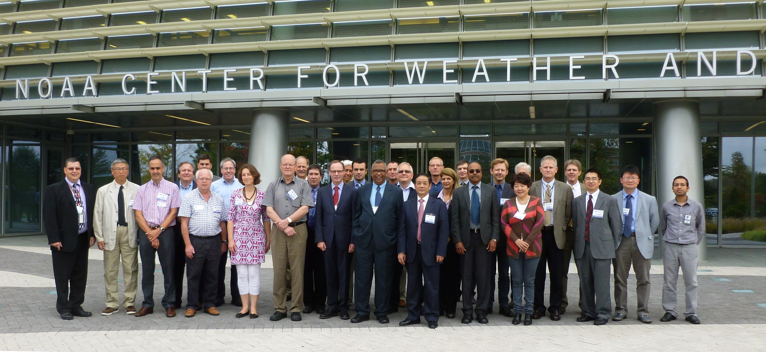
CEOS WGCV Plenary # 38
WGCV-38 Plenary co-hosted by NOAA, USGS and NASA
At NOAA, College Park, MD, USA
September 30th to October 2nd , 2014
41 attendees from 19 organizations
Agenda Topics
Agencies’ Reports
Sub-group Reports
Special Thematic Sessions
Vice-Chair Nomination
Please visit: http://ceos.org/wgcv for meeting documentation

Slide 9
WGCV-38 Plenary Thematic Sessions
Collaborations between VCs and WGCV
  SST-VC: See below.
  ACC-VC: WGCV and VC-ACC to attempt to participate in each others meetings (WGCV-39 and ACC-11) in May 2015.
  P-VC: WGCV to explore areas of contributions on calibration of passive microwave radiometers.
  LSI-VC: WGCV provided feedback on LSI-VC Future Options Analysis
Cross Cutting Activities
  RADCALNET see deliverable CV-9 of CEOS 2014-16 Work Plan
  DEMs / Cloud Masking: AI to define a concrete project set-up
Collaborations with WMO/GSICS (Global Space-based Inter-Calibration System) and GEO
Presentation by GSICS and further discussions on potential interaction with WGCV.
Presentation by GEO for continued interaction

Slide 10
WGCV and VC Interactions
Sea Surface and Land Surface Temperature Cal/Val
Interaction of WGCV and VC-SST
General approach
Concerted effort and communication between WG and VC leads to fruitful results, inclusion of all expertise on objectives common to both.
Experts from VC-SST and WGCV work together to define scope and range of calibration activities and range of conditions to be evaluated, here SST and LST
WGCV also provides guidance on best practises
Example
Sea Surface Temperature (SST) & Land Surface Temperature (LST) Comparison Campaign
(➔ Deliverable CV-8 in CEOS Work Plan)
SST-VC and WGCV collaboration was presented at WG/VC Day and promoted by SIT at the SIT Workshop 2014 as a leading success story.
Action was taken to encourage WG and VC interactions across CEOS.

Slide 11
WGCV-38 Plenary Special Topic
International Symposium on Remote Sensing of Environment (ISRSE-36)
11-15 May 2015, Berlin, Germany
Dedicated Session Organized by CEOS Working Group Cal/Val
Session slot: ~ 90 minutes
Introduction:10 minutes, and; 4 presentations: 20 minutes each
Presentation Titles
An International Effort of Space Agencies for Cal/Val:
CEOS Working Group Cal/Val
(A. von Bargen, DLR, WGCV Chair)
On the Need of Fiducial Reference Measurements and In-situ Datasets for
Satellite Product Validation
(B. Bojkov at al., ESA, Atmospheric Composition Sub-group Chair)
Validation of satellite-derived terrestrial products – international coordination, status, and challenges
(G. Schaepman-Stub et al., U. Zurich, Land Product Validation Sub-group Chair)
A Comprehensive Cal & Val Site for Information Remote Sensing
(C. Li, Chinese Academy of Science, Institute for Opto-Electronic Engineering)
Towards seamless inter-operability between Global EO-derived DEM products: Opportunities and Threats
(J.P. Muller et al., MSSL, Imperial College, Terrain Mapping Sub-group Chair)

Slide 12
WGCV Vice-Chair Nomination
  WGCV at its 38th Plenary has nominated
  Dr. Kurtis Thome / NASA
  for the position of WGCV Vice-Chair.
WGCV requests that the CEOS plenary endorse the nomination of Dr. Kurtis Thome of NASA for the position of WGCV Vice-Chair for the 2014-2016 term.

Slide 13
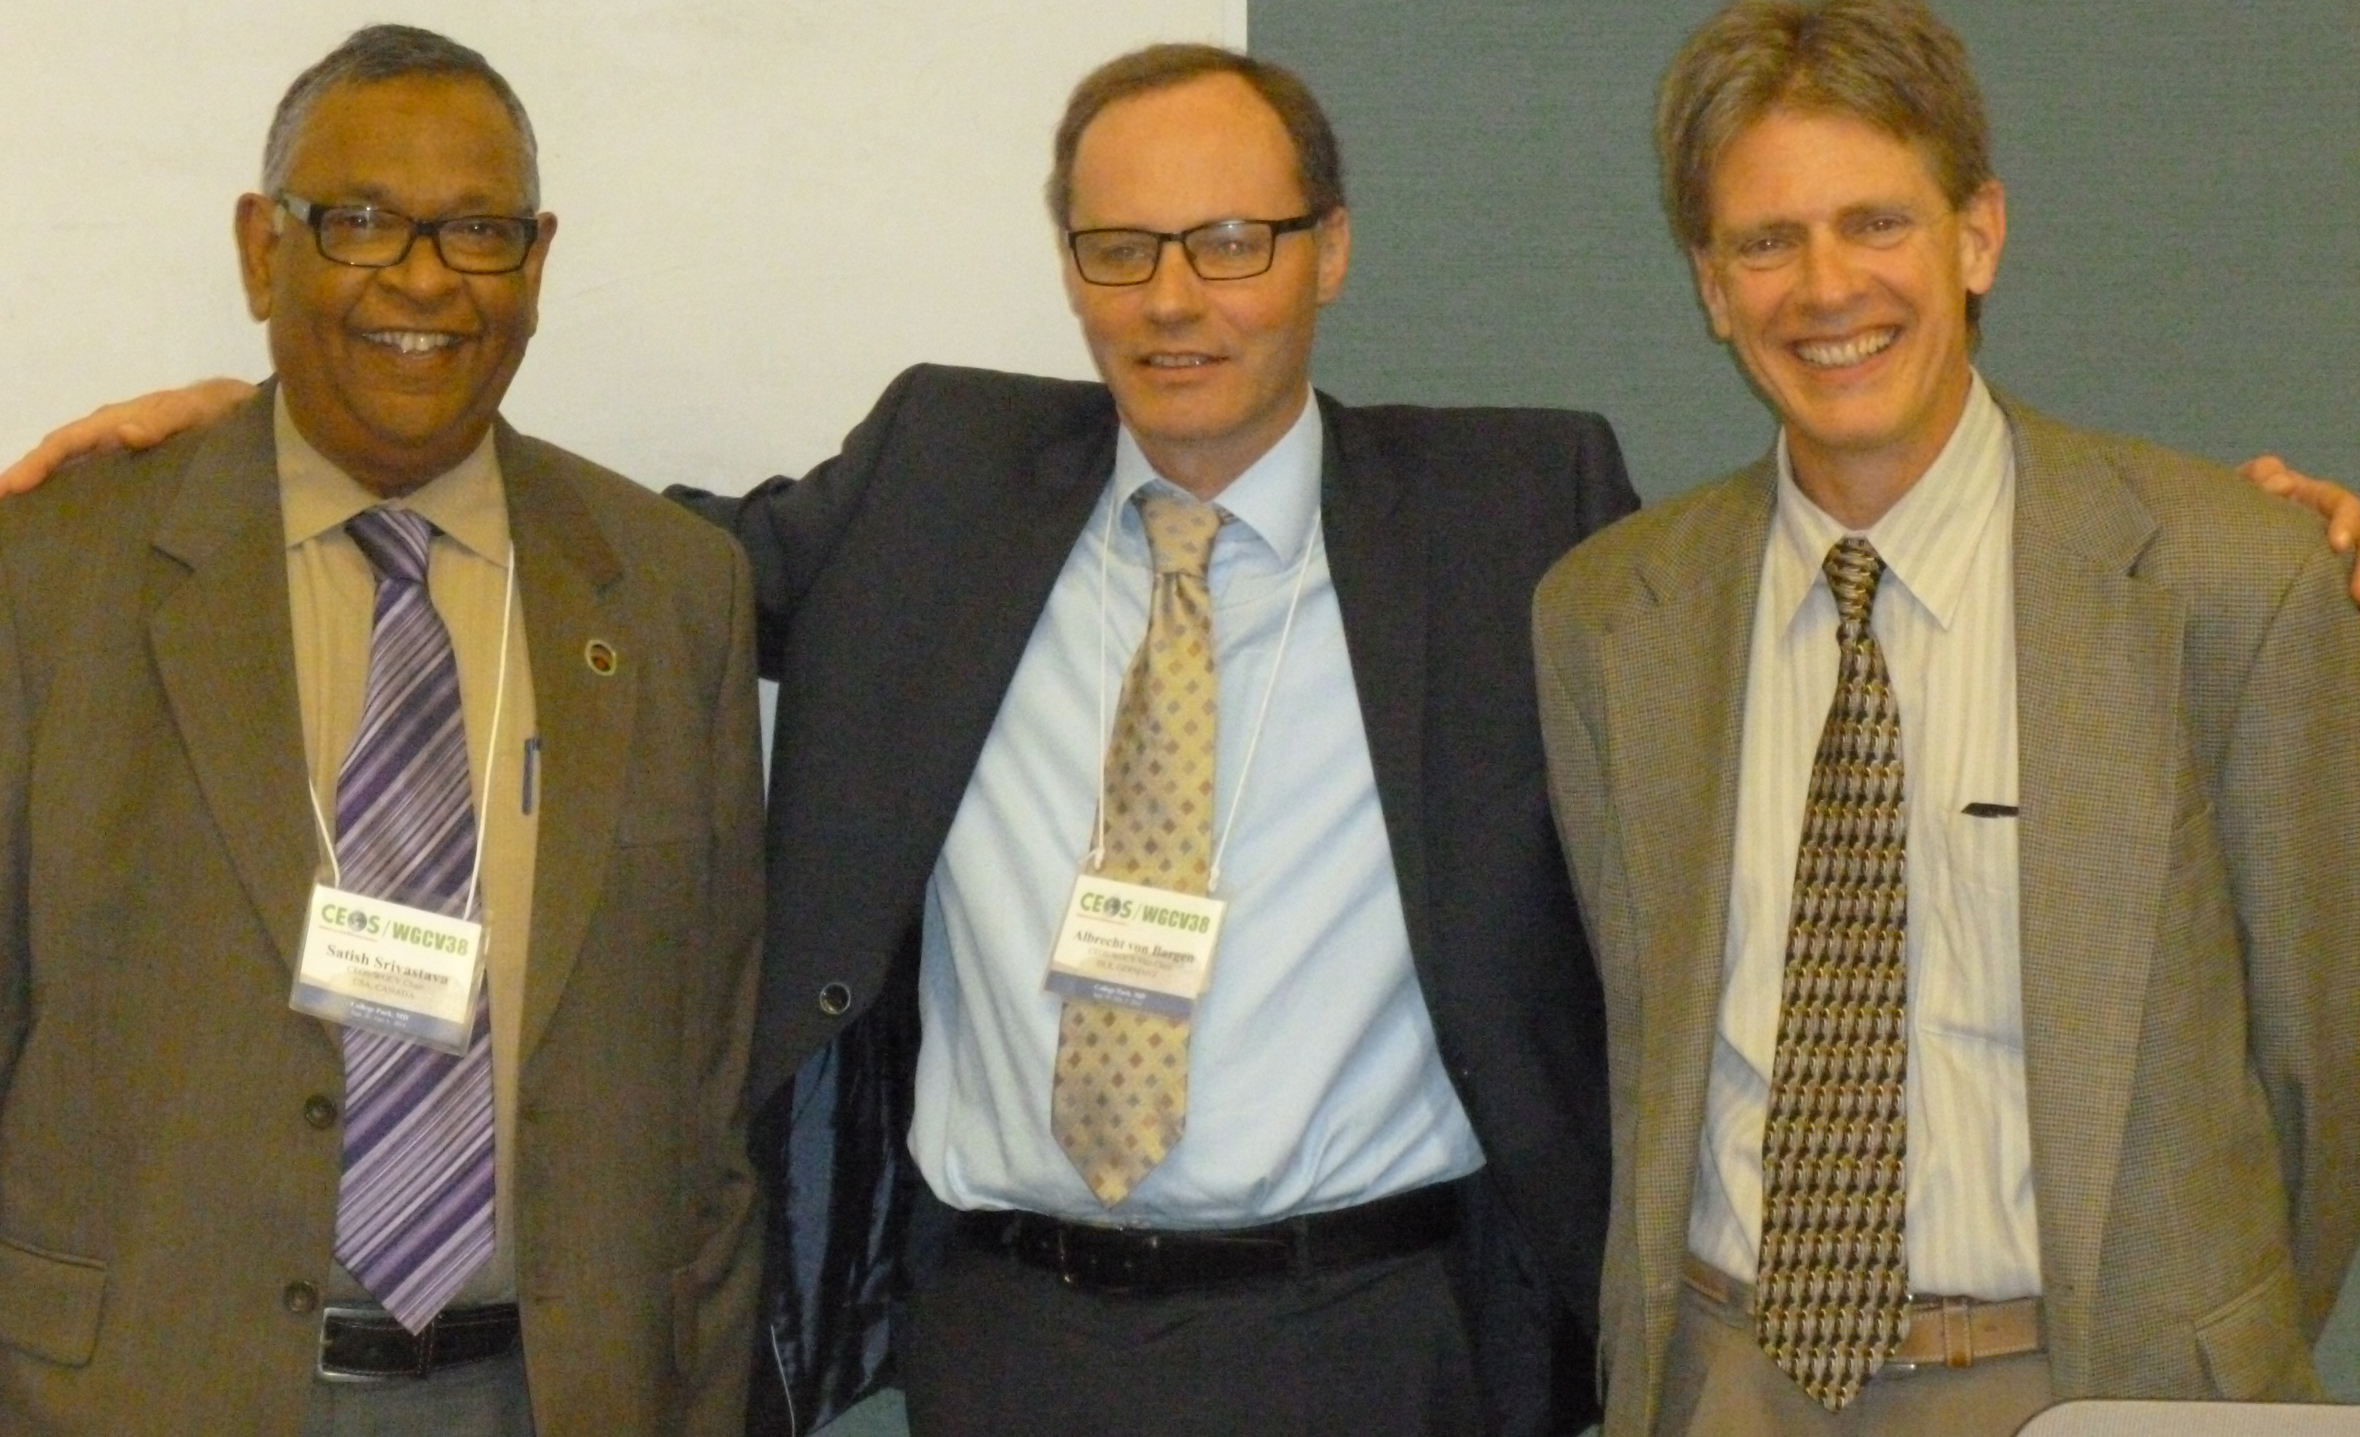
WGCV Chair Transition
WGCV-38, College Park, MD, USA
Satish Srivastava
CSA
Albrecht von Bargen
DLR
Kurtis Thome
NASA
Outgoing Chair
(2012-14)
Incoming Chair
(2014-16)
Incoming Vice-Chair
(2014-16)
(Vice-Chair: 2012-2014)

Slide 14
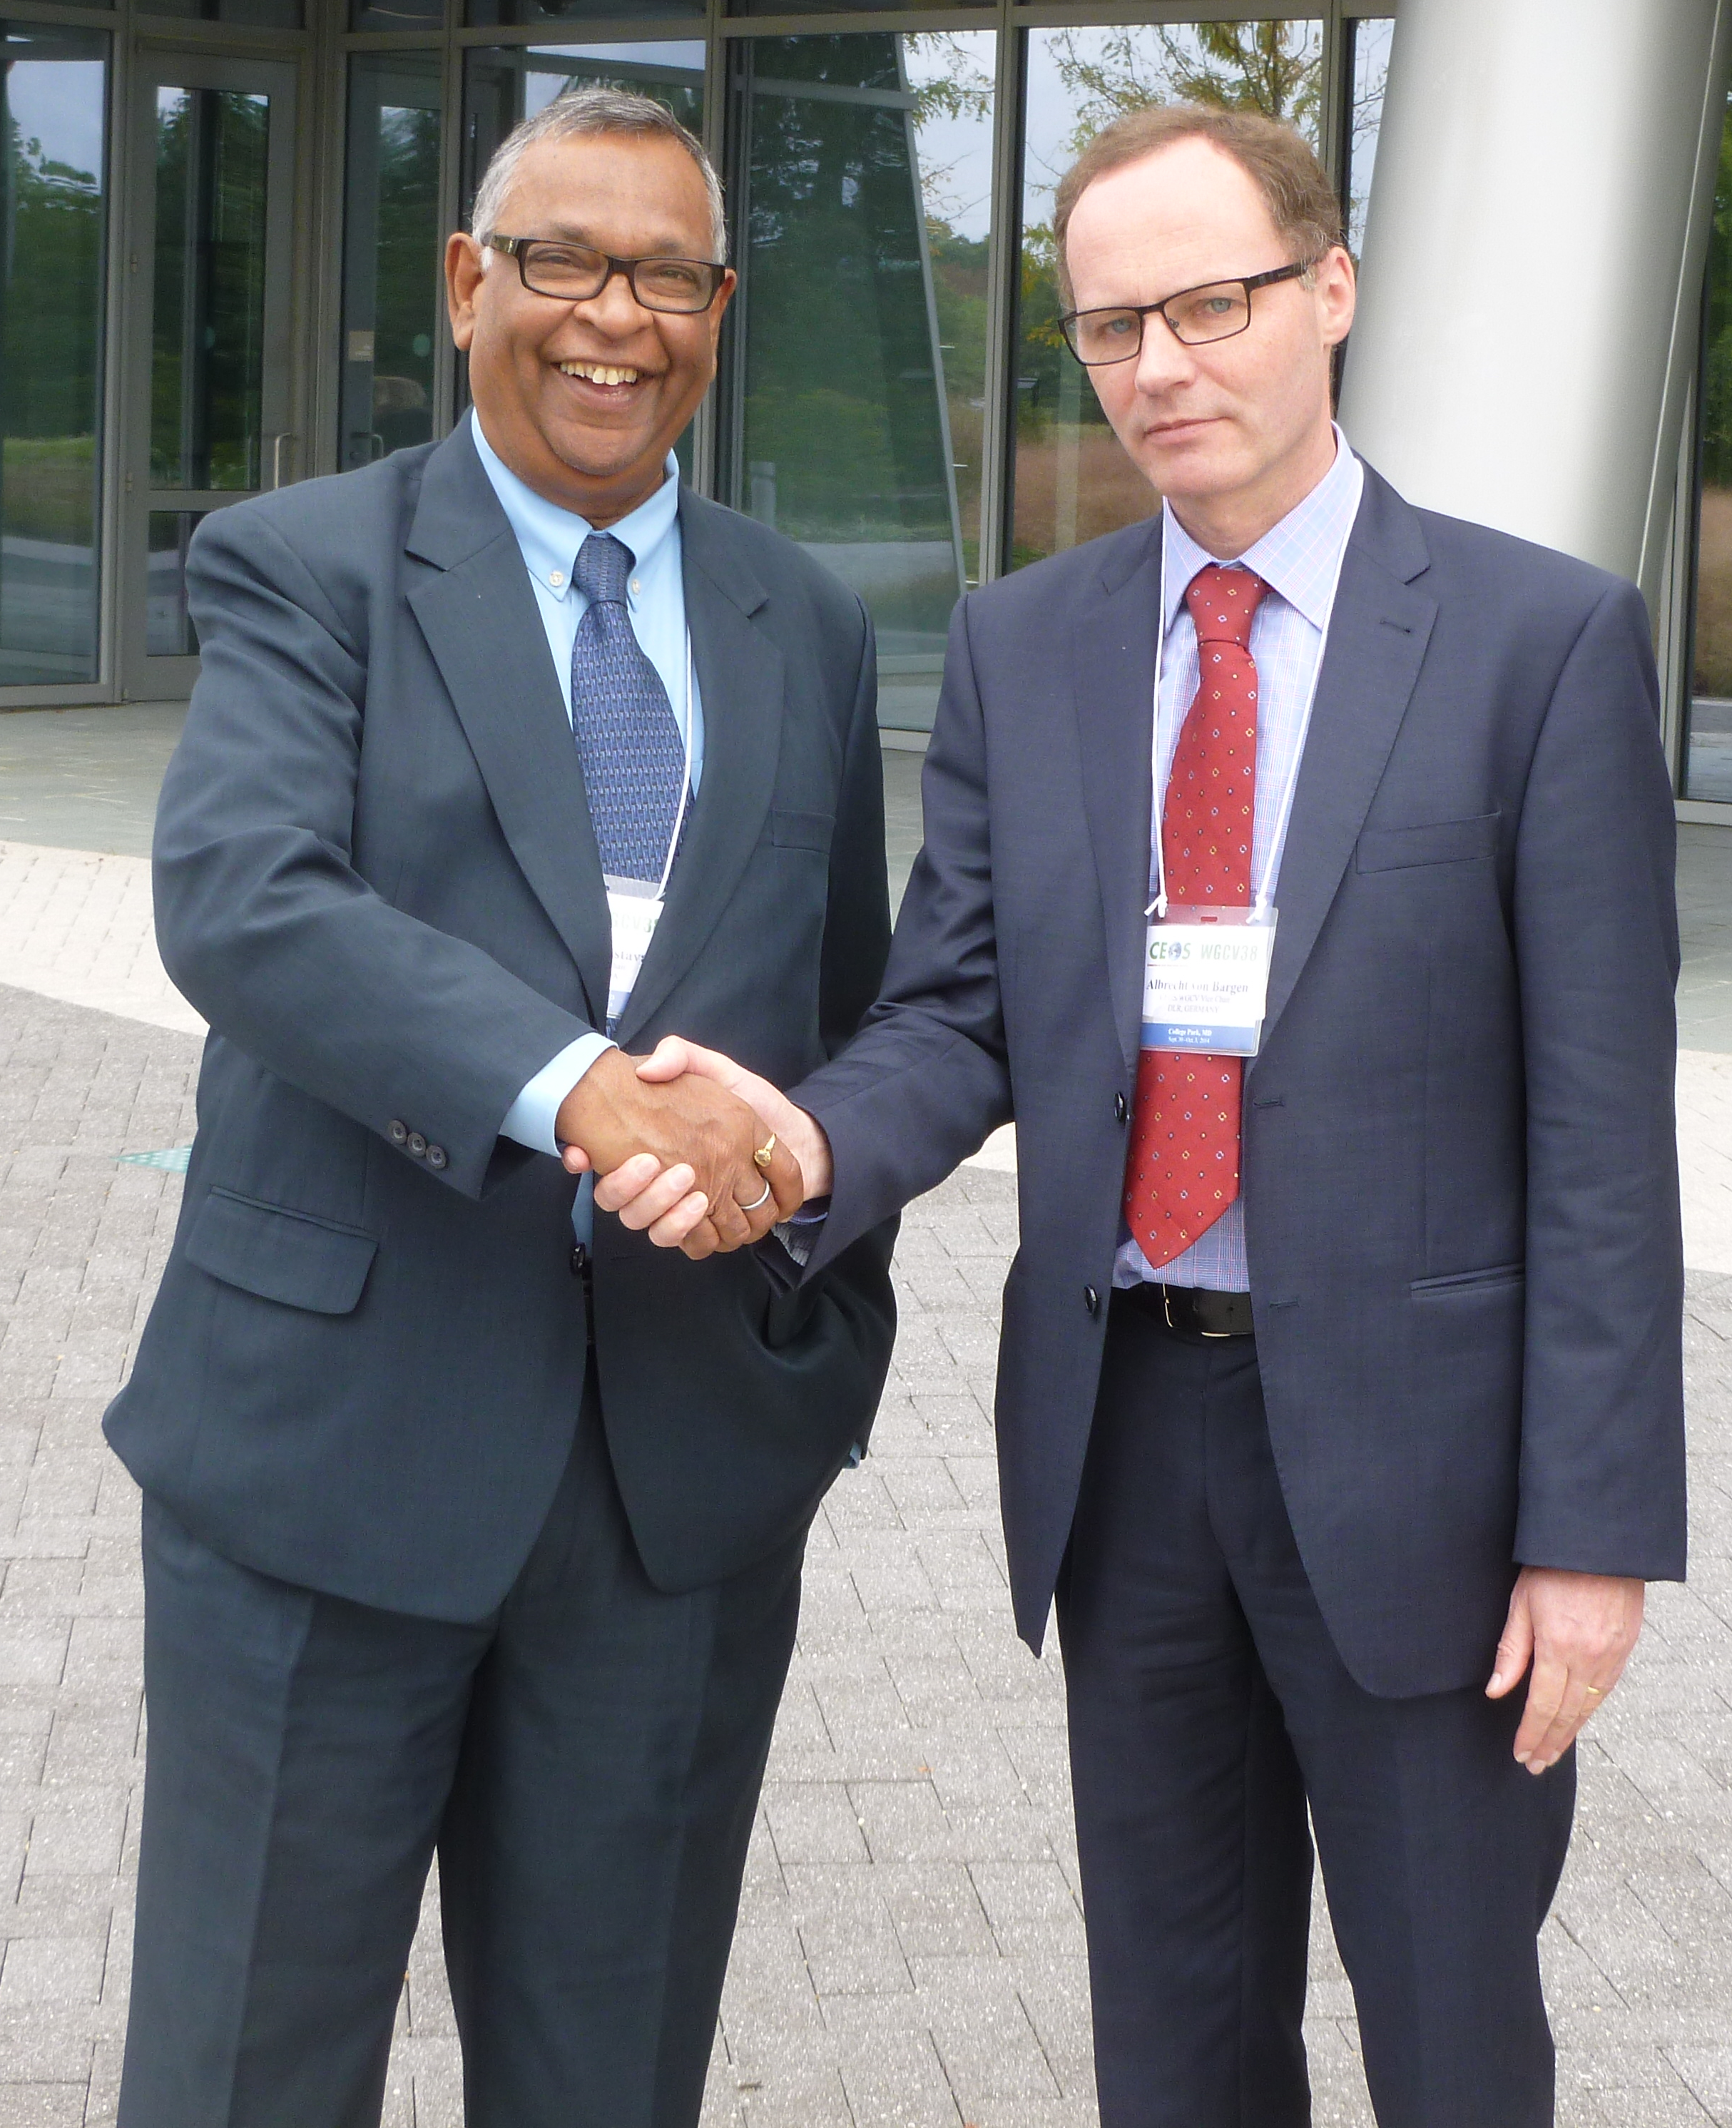
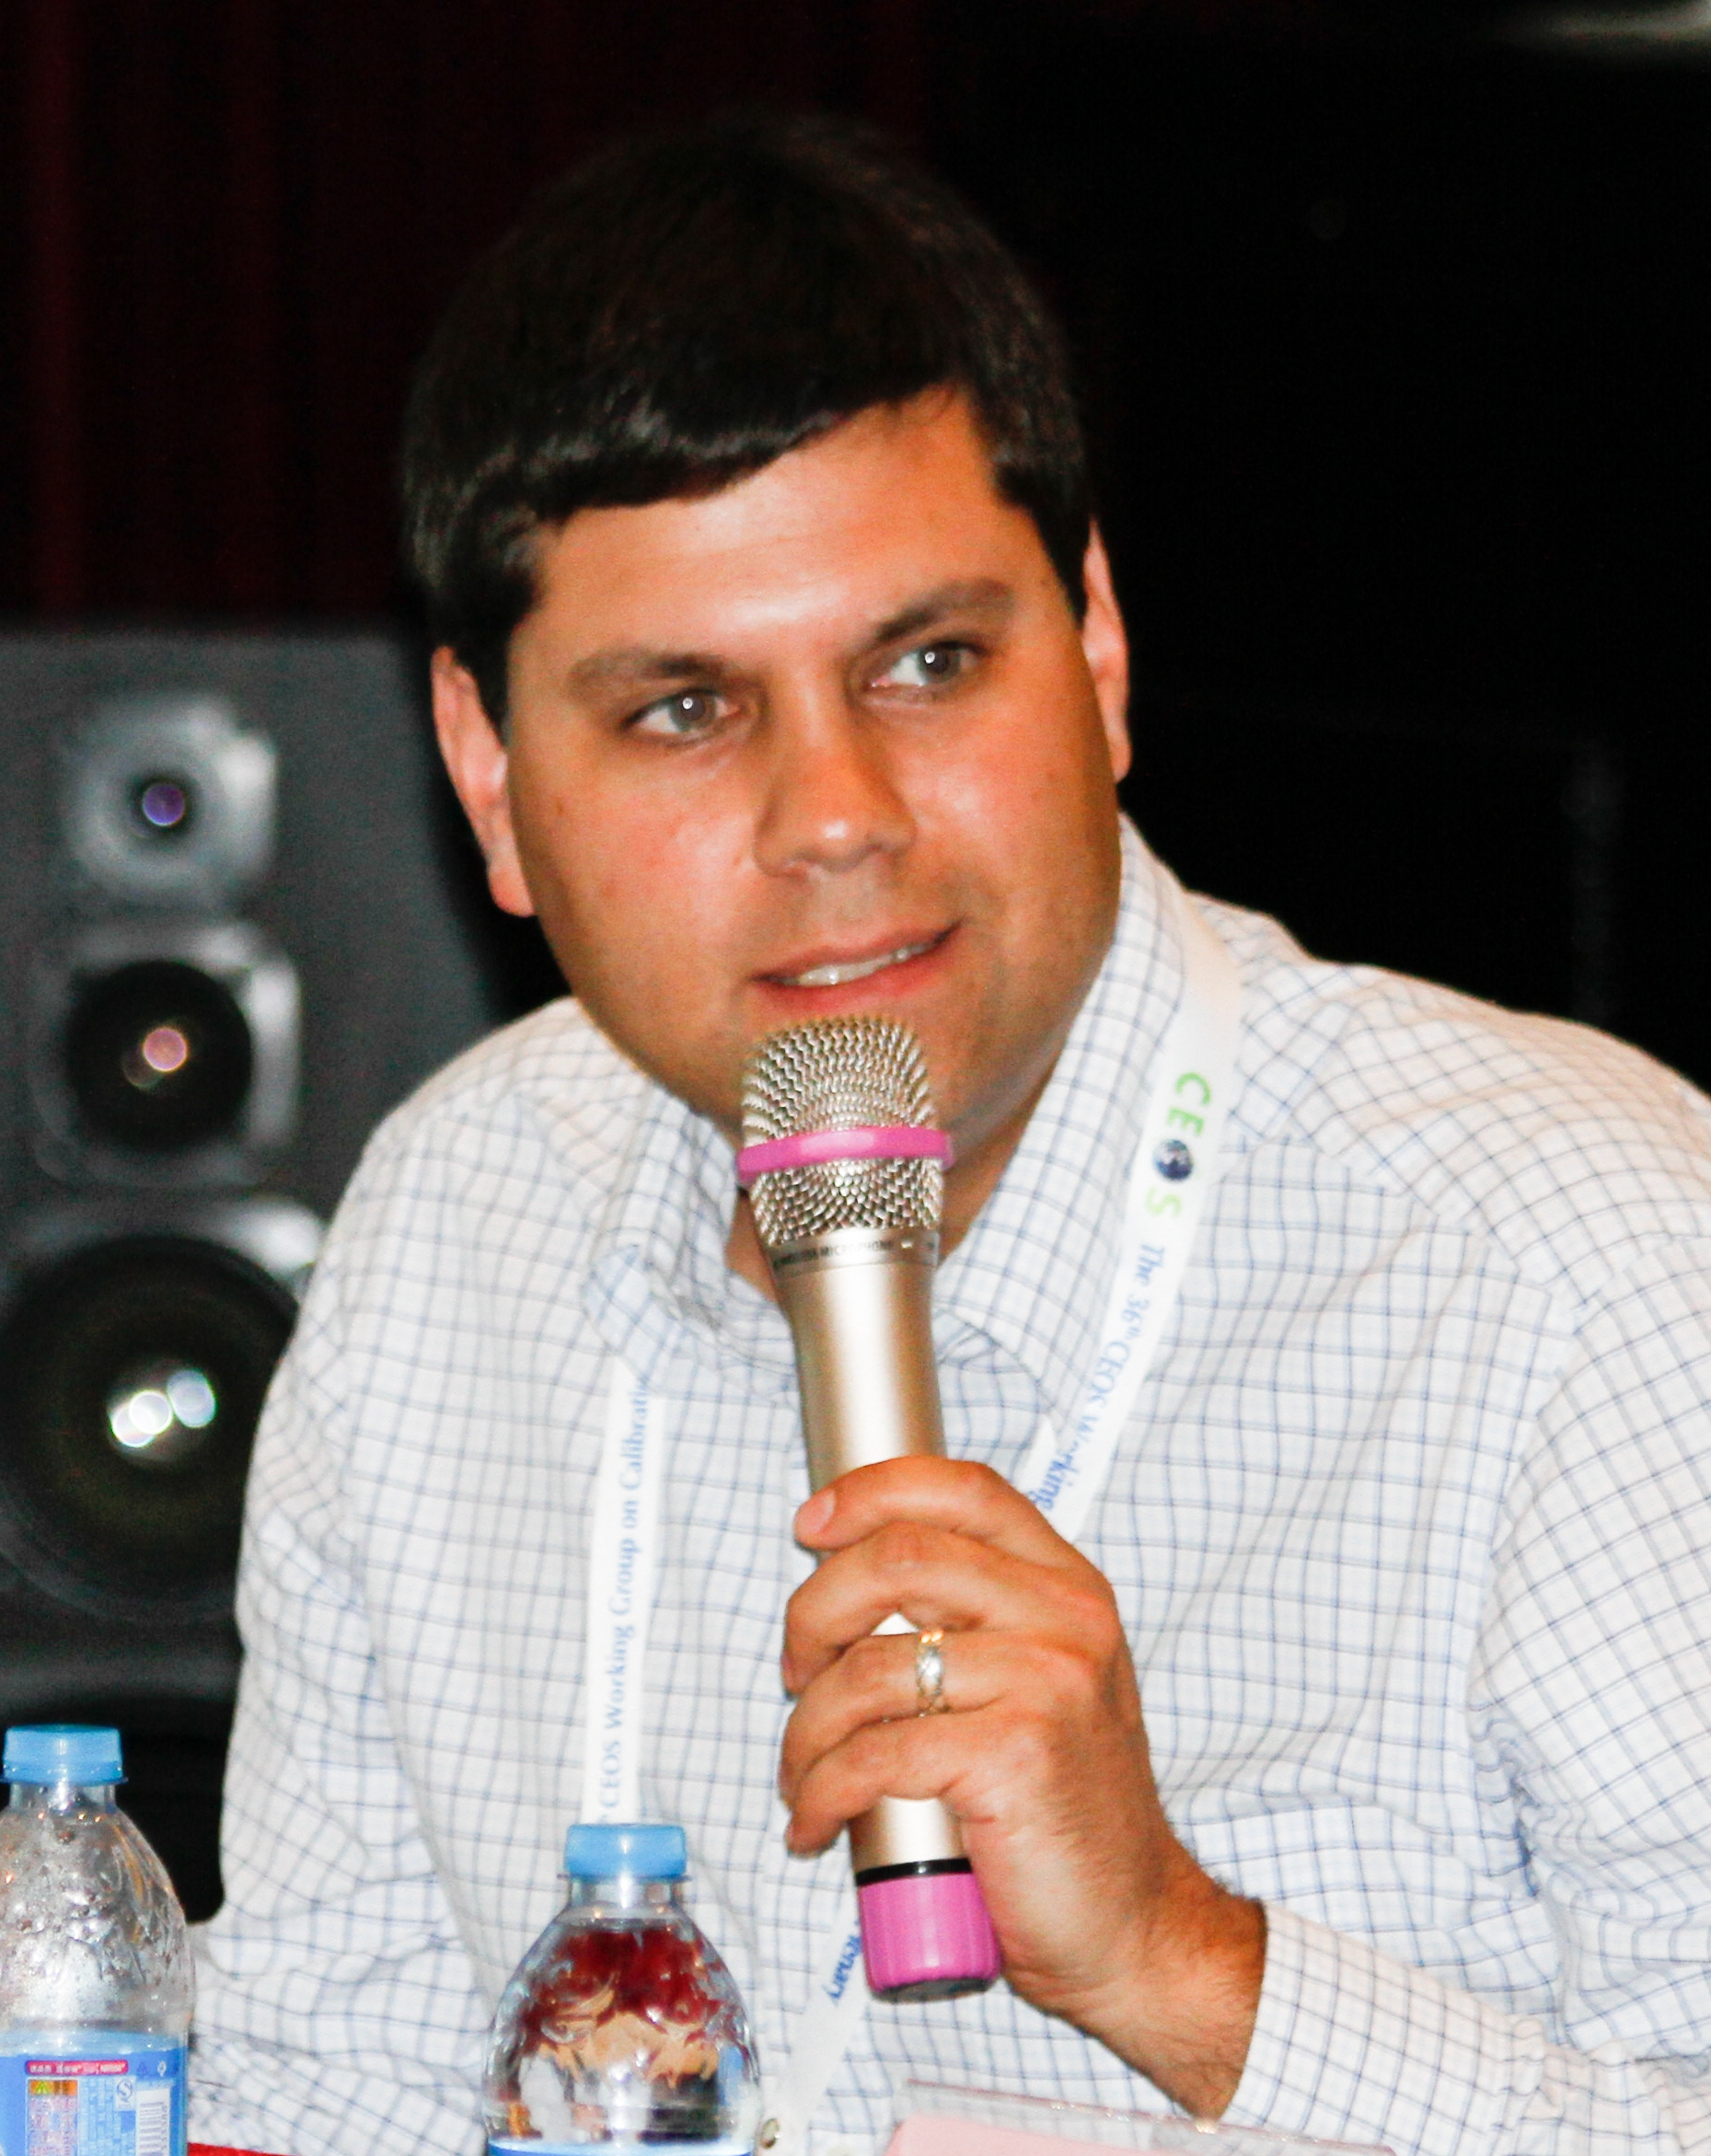
Thank You
A special thank you:
I would like to express my gratitude to the CSA for my nomination as Vice-Chair/Chair and the support provided to me as well as to the WGCV Secretariat during my tenure.
My thanks are also due to the members of our WGCV for their many contributions and technical interactions.
To Albrecht von Bargen of DLR for his services as Vice-Chair (2012-14).
  His contributions to many of the working group and CEOS level files are greatly appreciated. WGCV will be in very good hands under his leadership as Chair.
To Eric Arsenault of the CSA for his term as WGCV Secretary.
  He was instrumental in keeping track of all WGCV activities, preparing plenary meetings and minutes along with responding to various CEOS requests.
Albrecht von Bargen, DLR
WGCV Vice-Chair (2012-14)
Eric Arsenault, CSA
WGCV Secretariat (2012-14)
Thank you for the opportunity to serve as the WGCV Vice-Chair/Chair!

