Slide 1
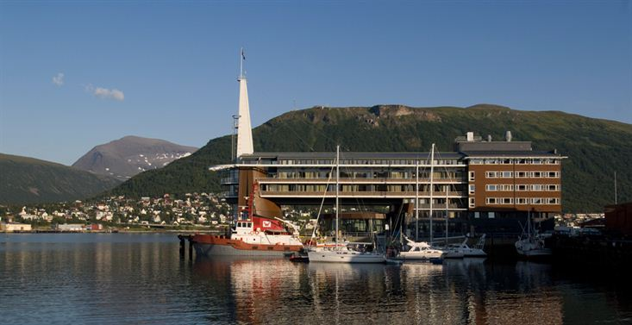

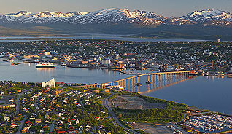
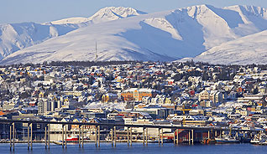
WGISS
Working Group on Information Systems and Services
Richard MORENO
CNES
WGISS report, Agenda Item 14
Tromsø, Norway
28-30 October 2014

Slide 2
Summary
Interoperability Interest Group
Technology Exploration Interest Group
Data Stewardship Interest Group
GEO
Recovery Observation Infrastructure Project

Slide 3





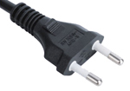






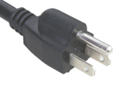



Interoperability Interest group
Opensearch
CWIC
FedEO
IDN

Slide 4
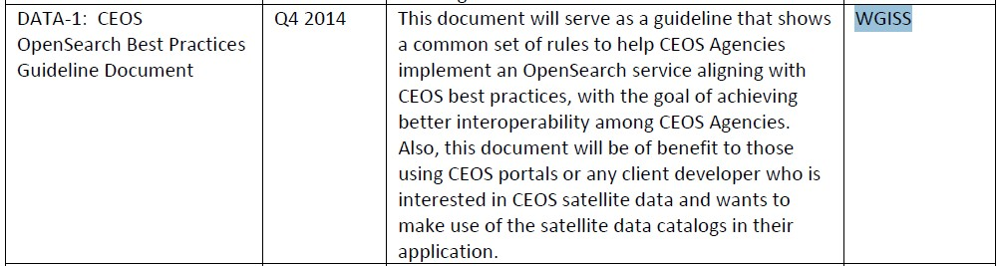


Opensearch
What is CEOS opensearch ?
  Standard for interoperability (discovery and access of data)
  Now an OGC standard
  Shared by all CEOS/WGISS agencies

Slide 5

Opensearch
CEOS opensearch
  Applied by most of CEOS agencies
    Including CWIC and FedEO federations
  Lightweight, simple and low entry cost
CEOS Opensearch Best Practice document
  Reference document for implementation
  Will be open to public comment for 1 month from beginning of November
CEOS opensearch Workshop for developers
  During last WGISS meeting in Moscow from 28th Sept to 3rd Oct
Provides search and access to
  ~ 2500 data collections
    with over ~80 million granules
  Will increase : ISRO, JAXA, EUMETSAT, CHINA, ROSCOSMOS

Slide 6
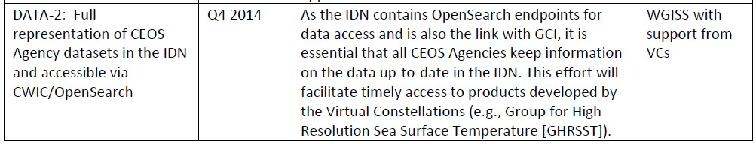
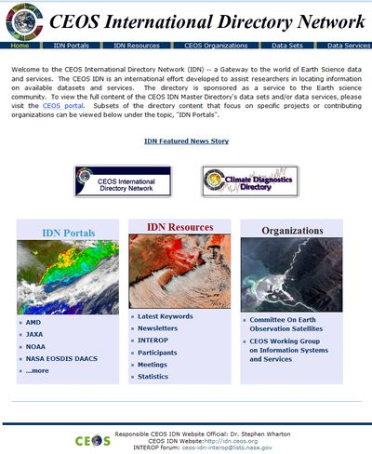
IDN
On going action with support of all CEOS agencies.

Slide 7

Technology Exploration Interest Group

Slide 8
Technology Exploration
Purpose : to serve as a forum for exchange of technical information and lessons-learned experience about current and trending software technologies, services and other WWW / Internet related software technologies.
The primary goals of the Technology Exploration Interest Group are to:
  give CEOS/WGISS members opportunities to collaborate and discuss present and future technology solutions;
  to research technologies that can help the Earth observation community be flexible and adaptable in their IT infrastructure;
  help facilitate CEOS/WGISS understanding of all generations of technology and support the implementation of both legacy and leading edge technologies into Earth observation data systems;
  promote technologies in CEOS/WGISS that prove beneficial to the Earth observation community.

Slide 9
Technology Exploration
Side meeting at the Plenary
  WGISS organized a side meeting at the Plenary in Tromso called “Emerging Technologies”.
  This meeting has highlighted a few key emerging technologies that have been discussed during recent WGISS Technology Exploration sessions.
    Big data
    Cloud computing,
    …
  The goal was to explain how these technologies have the potential to change the way agencies operate.
White paper
  The Technology Exploration Interest Group has developed a white paper summarizing the discussions held at past WGISS meeting Technology Exploration sessions on the topics of Big Data, Cloud Computing, Semantics and Virtualization.

Slide 10

Technology Exploration
The Technology Exploration Interest Group is developing a web page to advertise resources from the WGISS agencies concerning the following themes:
  Search & Order,
  Data Handling,
  Subsetting & Filtering,
  Geo-location, Re-projection & Mapping
  Data Visualization& Analysis
They are also developing a web page to advertise open source software and to promote software reuse.

Slide 11
Data Stewardship Interest Group

Slide 12
DSIG - Data Stewardship
Scope of this interest group
  Focus on Data, Metadata and Product Topics Including:
  Long-Term Archive Strategies
  Data Formats
  Data Preservation
  Data Lifecycle Concepts
  Archive Media

Slide 13
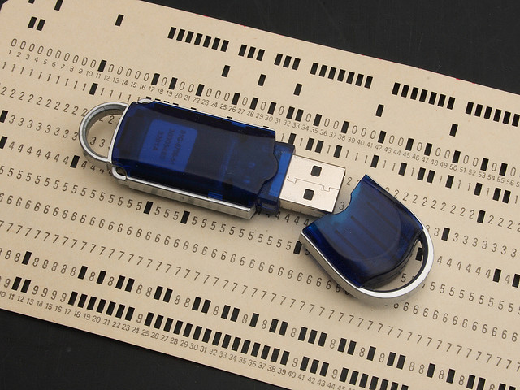
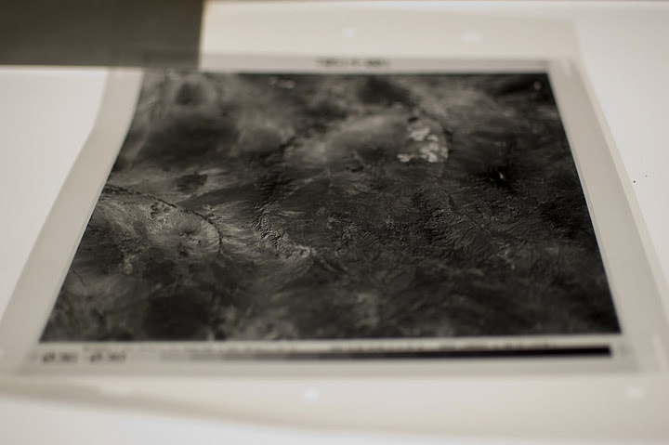
DSIG - Data Stewardship
Started drafting of Best-practices/recommendations on:
  Preservation Workflow
  Persistent Identifiers
Started updating of CEOS Purge Alert procedure and mailing list

Slide 14
GEO

Slide 15
GEO
Data Management Principles Task Force:
  Mirko Albani (ESA - WGISS) & Richard Moreno (CEOS - WGISS) members of the task force
  drafted a set of high level common GEOSS Data Management Principles covering the entire data life cycle from planning, to acquisition, quality assurance, documentation, access, archiving and preservation
  Will be reported at next GEO XI Plenary
  Next Steps should focus on the generation of more practical Implementation Guidelines

Slide 16
GEO
Component IN-02-C1 : Advances in Life-cycle Data Management) Task Sheet
  Task Sheet on GEO Secretariat Web site after GEO XI Plenary will be reviewed :
    For simplification and better clarity
    to align participation, activities and outputs with some WGISS activities : DSIG, Opensearch

Slide 17
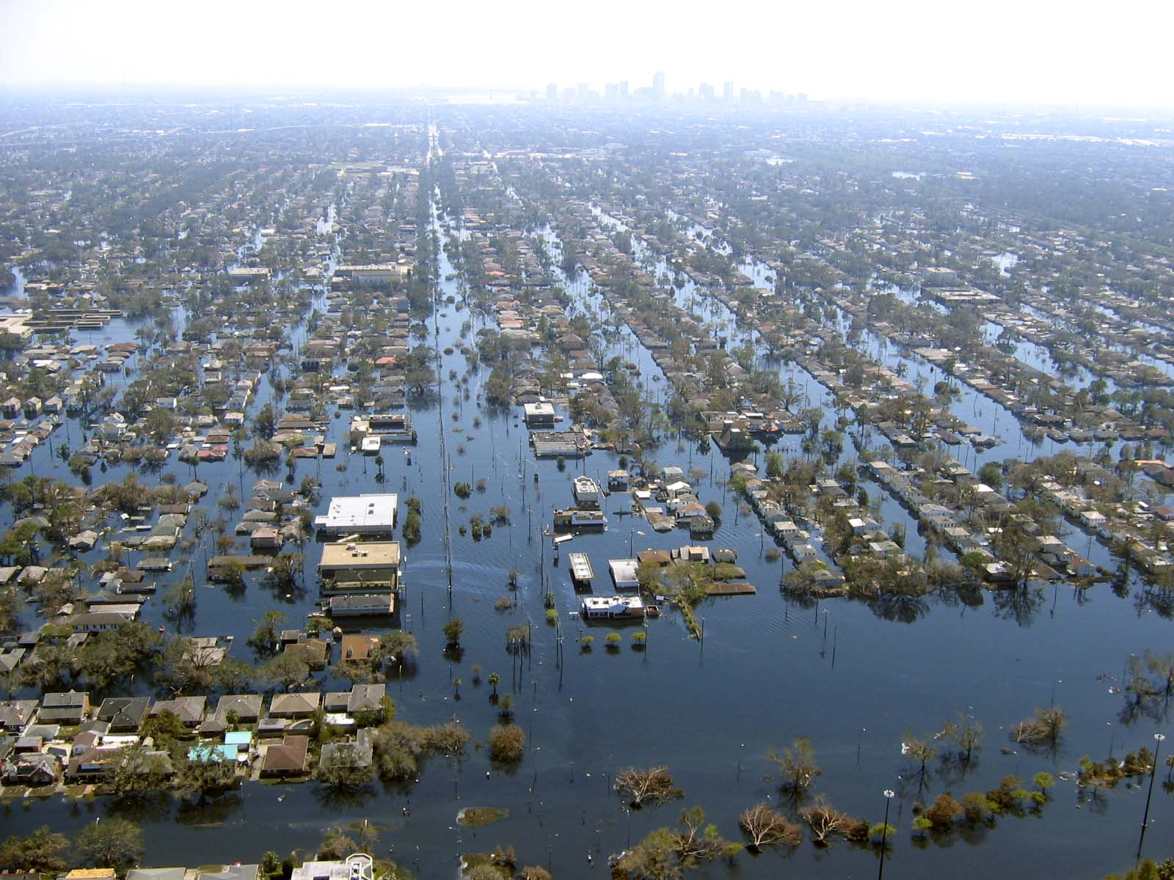
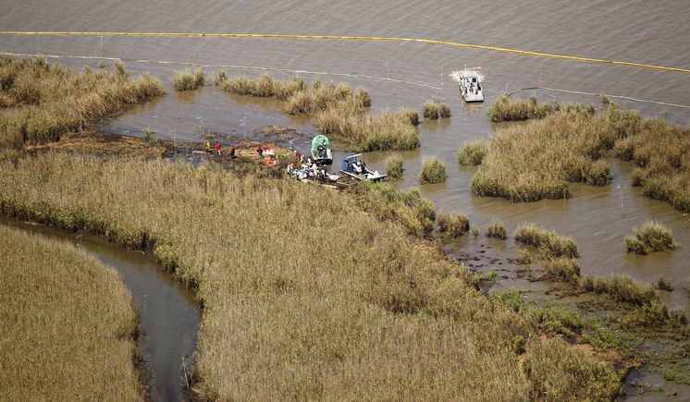
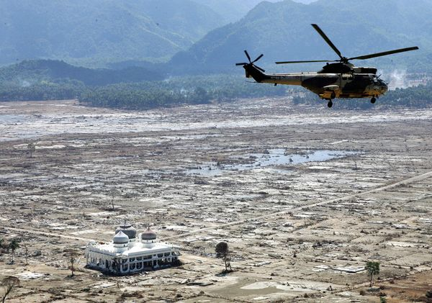
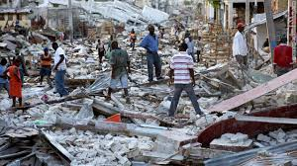
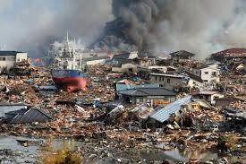
Recovery Observatory Infrastructure Project
Hurricane Katrina
2005
Deepwater Horizon
2009
Indonesian Tsunami
2004
Haiti Earthquake
2010
Tohoku Tsunami
2011

Slide 18
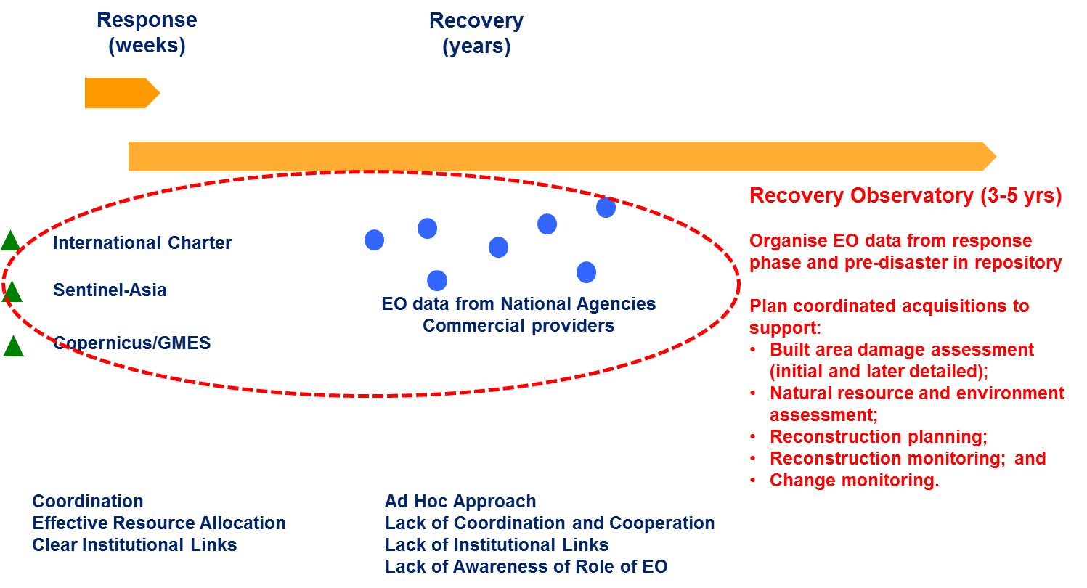
Recovery Observatory
Example of WGISS support to other WGs : WG Disasters

Slide 19
Scope of Recovery Observatory Infrastructure
Roadmap :
  Version 1 basic & usable : end of October 2014 : NOW
  Version 2 : complete – end of July 2015
Scope of the WGISS activities
  Development and support for usage
Out of scope
  Governance
  Hosting (Hardware)
  Exploitation
  Maintenance ?

Slide 20
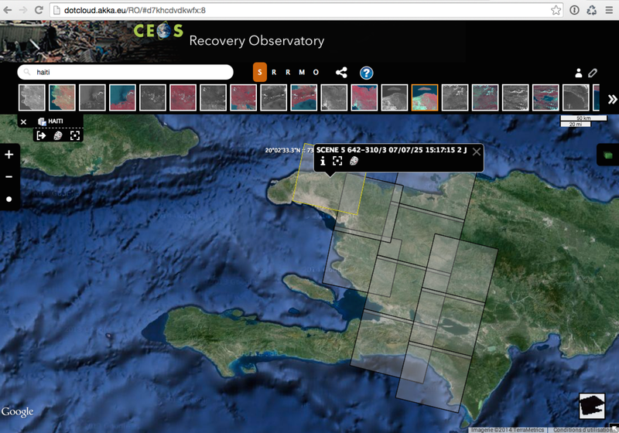
Recovery Observatory Infrastructure V1

Slide 21
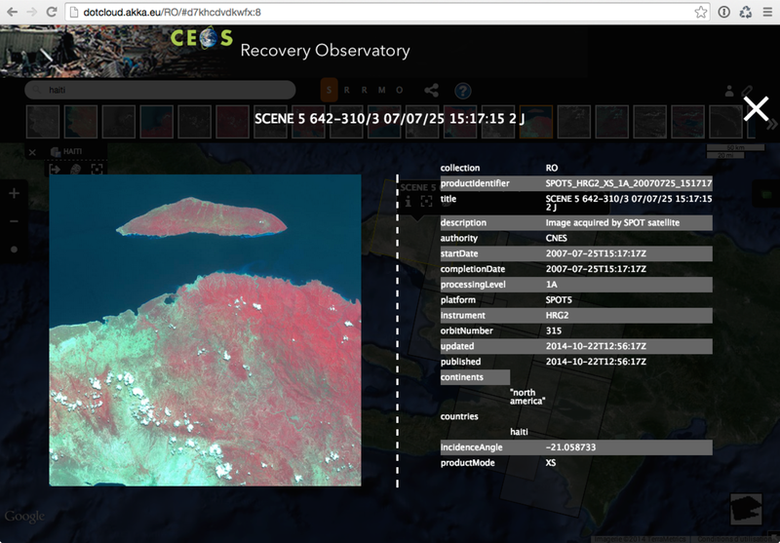
Recovery Observatory Infrastructure V1

Slide 22






Special thanks to
      NASA for hosting WGISS 37 in Florida in spring 2014 and for assuring the vice-chairmanship up to 2015 and then chairmanship up to 2017
      ROSCOSMOS & Russian Space Systems for hosting WGISS38 in Moscow in Fall 2014
      ESA, for assuring the vice-chairmanship in 2016/2017 and the chairmanship in 2018/2019
      JAXA for hosting the next WGISS39 in Tsukuba in spring 2015
      UKSA for hosting WGISS40 in Harwell in Fall 2015
      Kerry for the invaluable assistance provided during these last years

