Slide 1
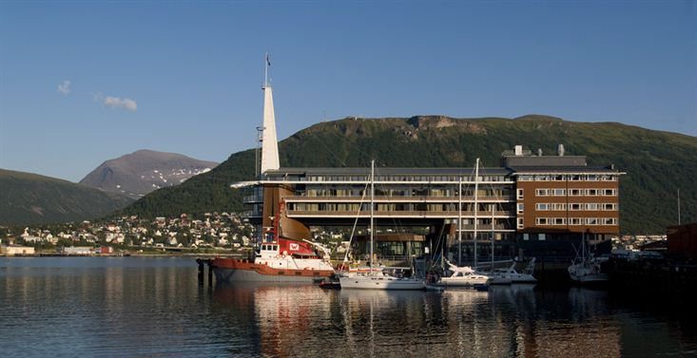
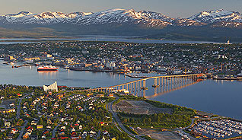
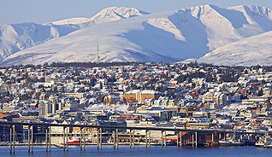
28th CEOS Plenary Session
John Bates
NOAA
CEOS Plenary, Agenda Item 13
Tromsø, Norway 28-30 October 2014

Slide 2
CEOS-CGMS Working Group on Climate
Review of Work Plan
Clarifying Roles and Responsibilities in Flow of Requirements to Products and Services
Establishing Action Groups for ECV Assessments and Defining ECV Gap
Architecture Applied to Climate Services

Slide 3
WGClimate Work Plan
WGClimate was the trial Working Group for the new form of the CEOS-CGMS 3-year Work Plan
Activities include Climate Monitoring, Research, and Services (CMRS)
Coordinate development of Climate Data Records (CDRs) and related datasets addressing Essential Climate Variables (ECVs) established by the Global Climate Observing System (GCOS)
Continue cooperation with Group on Earth Observations (GEO), Global Climate Observing System (GCOS), and the World Meteorological Organization (WMO), in the development of a space-based system to support climate information and adaptation

Slide 4
Flow of Requirements to Products & Services
 | Carbon Cycle | Water Cycle | GFCS Theme
ECV Precipitation | Priority 2 | Priority 1 | Priority 3
ECV CO2 | Priority 1 | Priority 3 | Priority 2
ECV… | Priority 1 | Priority 2 | Priority 3
USERS
Physical ECVs
Climate Services
ECVs/CDRs
UNFCCC
NEEDS
Consolidated
Requirements
WGClimate
GCOS

Slide 5
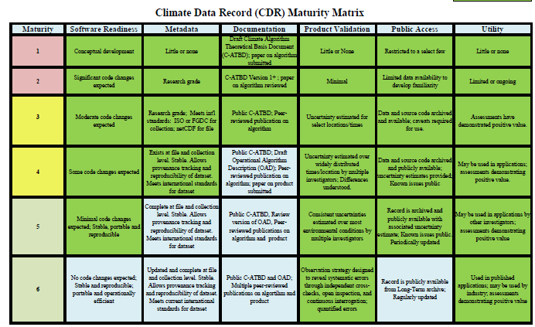
Flow of Requirements to Products & Services
Example Precipitation
Precipitation monitoring essential for use in agriculture, forestry and water resource management
USERS
ECVs/CDRs
UNFCCC
NEEDS
Variable/ Parameter | Horizontal Resolution | Vertical Resolution | Temporal Resolution | Accuracy | Stability
Precipitation | 25km | N/A | Monthly (resolving diurnal cycles and with statistics of 3 hourly values) | max(10% of daily totals; 0.1mm) | 5% of daily totals (regional scale)
Consolidated
Requirements
WGClimate
GCOS

Slide 6
WGClimate Work Plan Elements
CMRS-1: ECV inventory – ECV inventory status reviewed and Version 1 under configuration management
Status – 80% Complete - Issue identified need to fix ECV/CDR pairs and establish version control – Complete, however, took more time than anticipated
CMRS-2: Gap analysis – Define reference process for gap analysis and necessary tools to support this
Status - Delayed one quarter – 2 WGClimate Action Groups to form
ECV Assessment Action Group – Lead John Bates
ECV Gap Definition Action Group – Lead Pascal Lecomte
CMRS-3: Action plan – Identify actions Space Agencies can take to mitigate any gaps –
Status – Delayed one quarter – Dependent on CMRS-2 being complete
CMRS-9: Update of ECV inventory, gap analysis and action plan (version 2) – The above sequence forms the basis for an ongoing analysis cycle, in agreement with the new GCOS plans
Status – On schedule

Slide 7
First 3 CMRS Actions Form a Cycle
CEOS ECV Inventory
CMRS-1
Reference Assessment
Process
CMRS-2
ECV Gap
Analysis
CMRS-2
Mitigation
Plan and
Action Plan
CMRS-3

Slide 8
CMRS connected to user applications and decision support
CMRS-4: Case studies linking CDRs to societal applications and informed policy decisions – Identify examples from current work and map it to the Climate Monitoring Architecture
Status – On Schedule for Q1 2015 – A WMO writing team has a draft outline and several case studies. Mark Dowell and Stephan Bojinski are leading effort
CMRS-5: Contributions to the Global Framework for Climate Services (GFCS) – Work to identify existing examples of Climate Services that can be applied or adapted to the GFCS focus areas
Status – On Schedule - Bates participated in the GFCS Implementation Coordination Meeting in September 2014
Consider combining with CMRS-4

Slide 9
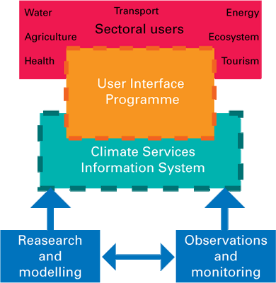
What are Climate Services? GFCS Model

Slide 10
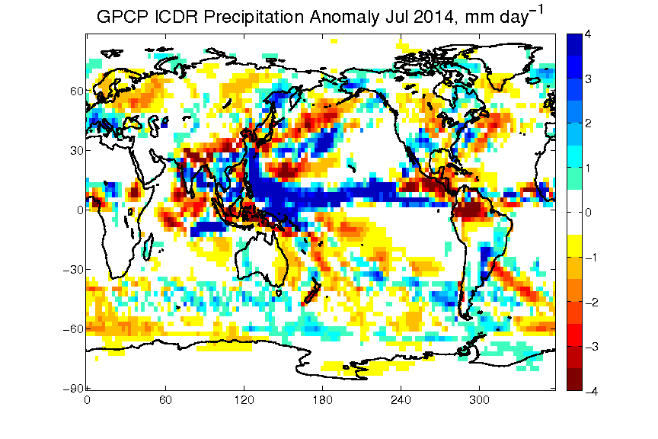
Climate Record Creation, Applications, and Decision Making Examples
EVC/CDR Mean -Precipitation 1979-2013
Interim CDR - Precipitation anomaly excess/deficit for July 2014
Climate Information Record - Standardized Precipitation Index for July 2014

Slide 11
CMRS Important Interactions with External Communities
CMRS-6: Report to UNFCCC Subsidiary Body for Scientific and Technological Advice-Research and Systematic Observation (COP-20; SBSTA-RSO 41) 2014
Status – Complete – Report provided to SBSTA Oct 3
CMRS-7: Report to GCOS implementation plan activities accomplished by Space Agencies on climate observations and additional activities leading to COP-21
Status – Starting Nov 2014- Specific actions will be followed; COP-21 activities are starting
CMRS-8: Incorporation of in situ data holdings within the ECV inventory – Status – Reworking - reuse original ECV questionnaire framework. Data base analysis and follow up will not be done by CEOS

Slide 12
WGClimate - Other Business
Governance – WGClimate is taking nominations for Vice Chair. Please contact John Bates or Pascal Lecomte if anyone is interested.
2014 Climate Symposium – Highly successful meeting with a wide range of discussions on CDRs and applications to climate services
Our Common Future under Climate Change Conference leading into COP-21 is in Paris 7-10 July 2015 (The conference website at: http://commonfuture-paris2015.org/ )

Slide 13
Conclusions
WGClimate has worked to:
Clarify Roles and Responsibilities in Flow of Requirements to Products and Services
Establish Action Groups for ECV Assessments and Defining ECV Gap
Work to Apply the Architecture Climate Services

Slide 14
CEOS-CGMS Working Group on Climate

