Slide 1
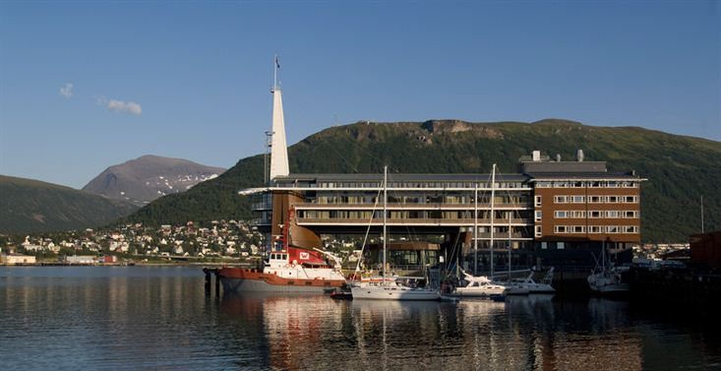
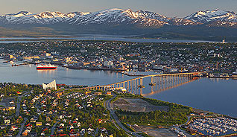
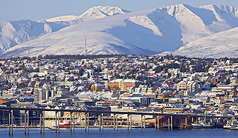
28th CEOS Plenary Session
Barbara J. Ryan
GEO Secretariat
CEOS Plenary, Agenda Item 11
Tromsø, Norway 28-30 October 2014

Slide 2
The GEO Strategic Plan 2016-2025: Implementing GEOSS
The GEO Strategic Plan 2016-2025:
Implementing GEOSS

Slide 3
GEO to 2025 - Context
In response to Ministers’ request at the 2014 Summit, the GEOSS Implementation Plan Working Group (IPWG) was mandated to draft Implementation Plan for the next decade
The IPWG is comprised of 25 members, from the five GEO caucuses. Four co-chairs, one of from a developing country
The document, a Strategic Plan, goes beyond the actual implementation of GEOSS and speaks to the function/actions of GEO

Slide 4
Overview of the Strategic Plan
Draft outline contains early considerations on next ten years of GEO action. Will be presented by IPWG to GEO-XI Plenary (Geneva) for discussion and guidance
The IPWG has respected foundational pieces, including “the 2014 GEO Ministerial Declaration;” and the “Vision for GEO 2025”, adopted by GEO-X Plenary

Slide 5
Strategic Objectives and Areas of Action
To successfully fulfill its Purpose during 2016-2025, GEO will actively advocate for the value of Earth observations as the foundation of environmental information, engage with stakeholder communities to address every-day societal challenges, and deliver critical data, information and knowledge to inform decision-making. Collectively, these three areas of action will constitute the scope of GEO’s activity
One Strategic Objective for each area, with Specific Targets and Deliverables for 2016-2025
ADVOCATE
ENGAGE
DELIVER

Slide 6
GEO Strategic Plan: Outline
Introduction: provides information on lessons learned over the past 10 years and cites guiding principles (what remains, what should be improved, what is new). The introduction bridges the gap between then and now. It motivates the new plan
Purpose, Scope and Strategic Objectives: highlights that the Scope of GEO’s activity goes beyond facilitating GEOSS, introducs the three Action Areas: Advocate. Engage. Deliver. Also, high-level political messages in form of Strategic Objectives are presented
Areas of Action / Core Functions: defines the Core Functions of GEO in the context of the three Action Areas
Targets and Deliverables for 2016-2025: To be completed over the coming year, outlines the specific targets for each Area of Action, in line with the three Strategic Objectives described in section 2 and refers to the respective Core functions

Slide 7
GEO Strategic Plan: Outline (cont’d)
Management: Defines how the implementation of GEO activities will be managed. Differentiates the six different ways by which GEO implements its functions and distinguishes how they are managed
Governance: Defined as the decision-making process(es) within GEO, and refers to the organizational bodies mentioned above. The governance “structure” interfaces with the management of implementation described above
Resources through 2025: IPWG proposes Programme Proposals for the GEO Flagships as one element of a strengthened resourcing framework for GEO. For resourcing the GEO Trust Fund, IPWG requests guidance, e.g. an indicative scale of contributions
Getting to Action - Timetable of Implementation

Slide 8
What is New in the IPWG Proposal
Areas of Action
Explicit introduction of “knowledge” as a key deliverable
Specific recognition of GEO Global/Regional initiatives, identified as “GEO Flagships”, Explicit reference to GEOSS Data Management Principles
Revisit SBAs definition, from the user angle
Management:
A new Management Framework, to strike a balance between flexibility and structure, based on six different mechanisms, each different in terms of management and resourcing: decisions of GEO, Community Activities, GEO initiatives, GEO Flagships, GEO Cross-cutting activities, and GEO Secretariat activities
Delegated authority from Plenary to subsidiary bodies to facilitate decision-making
Governance and Resourcing:
IPWG will propose options to ensure efficient and timely GEO decision making
IPWG will propose solution on how to put GEO on a more sustainable footing, in particular on how to secure specific contributions from Members and POs at the time an activity is initiated and how to establish a robust budget connected GEO Trust Fund activities

Slide 9
GEO-XI Plenary
13-14 November 2014
Geneva
http://www.earthobservations.org

