Slide 1
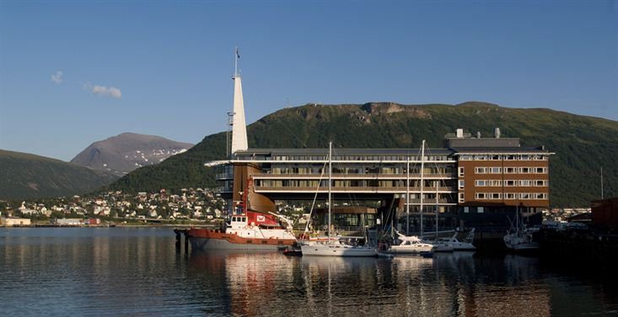
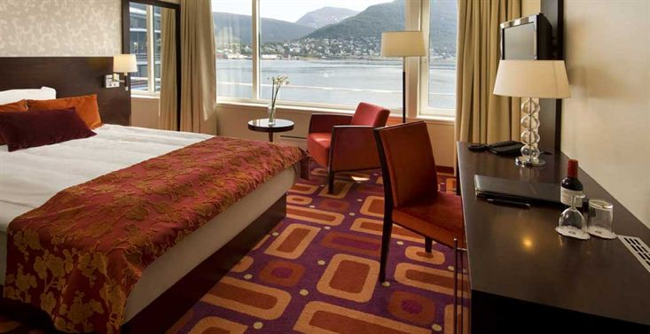
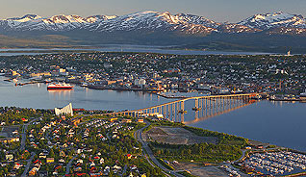
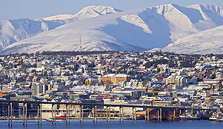
28th CEOS Plenary Session
Dr. Reinhard Schulte-Braucks
Head Copernicus Infrastructures
European Commission
CEOS Plenary, Agenda Item 10
Tromsø, Norway 28-30 October 2014

Slide 2
Copernicus current status
Five Milestones reached:
Budget of € 4.3 Bn for 2014-2020
Full, free and open access to data
Successful launch of Sentinel 1A
First images presented to the press
Legal basis for the programme adopted
Notes:
Budget of 4.3 bn should be sufficient to cover the operational activities 2014-2020. Need for close cooperation with ESA who will fund development of next generation of Sentinels.
Full, open, and free-of-charge access to Copernicus data and information is crucial for success of the programme. Free data & information is equivalent to public, taxpayer-financed infrastructure, on which private sector can build commercial downstream applications => major enabler for creation of jobs and growth. "F.o.f." principle also key for data uptake by public authorities, media and interested citizens in EU, and for intl. Partners and global scientific community who are eagerly awaiting the Sentinels. However, some influential European industry actors opose the f.o.f. policy as detrimentarl to competition and destroying business cases, and a review clause on it is included in the Copernicus Regulation.
Launch of S 1-A with Soyuz from Kourou = major success for EU Space & high-tech industry. ESA did a sterling job in developing the Satellite and flying the challenging debris-avoidance manœuvre in the early lauch phase. => [if time allows: some words on increasing risk of space debris, our current dependency on US, and strategic importance for EU to tackle SST…
Legal base: Difficult discussions with Council and EP on Copernicus Regulation (initially not included in COM's MFF proposal…) , but outcome is a workable compromise, actually reached in record time. Regulation provides the necessary political, legal and financial security for the Programme => key factor to start private sector's investment.
First images from S-1A = stunning ! Excellent quality, exceeds our expectations. => Showcase for EU's high-tech savoir faire… Warning: these are radar images that will never be as beautiful and colourful as optical images, but are actually more usefule for scientific/policy analysis purposes.

Slide 3
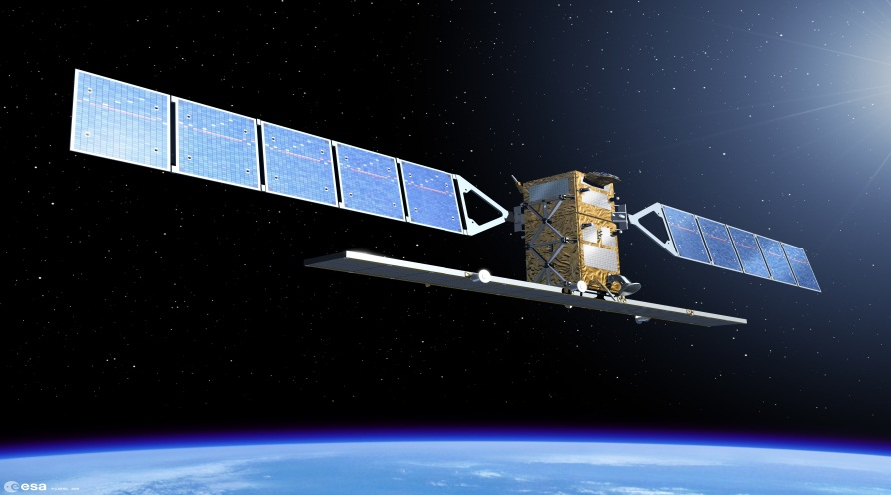
Space Segment
First Sentinel satellite was launched on 3 April 2014; operational since Oct 2014
By the end of 2020, 8 Sentinel satellites will be in orbit, providing most of the data needed by the Copernicus services
Where no Sentinel data are available, the programme buys Earth observation data from other satellite data providers
Notes:
Copernicus' operational phase starts now, building on the success and experience of the previous GIO (GMES Initial Operations) programme. User requirements and data-buy arrangements are in place, but our (EU-owned) Sentinels will deliver more and better data with unpredecented volume. => A quantum leap for EU Earth Observation. A key element of Copernicus is ensuring the smooth dissemination of this huge volume of data, making the EU as a major global player/owner in Earth Observation data.
External data-buy will continue, but decrease as Sentinels become operational in 2015-2016 ff. However, some gaps will remain (high-resolution imagery) as Copernicus was not (!) designed to fill them.

Slide 4
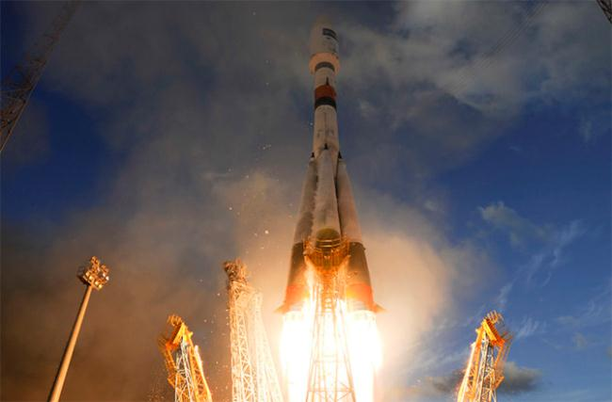
Sentinel-1A launched
Launch from Europe’s Spaceport
in Kourou, French Guiana, on April 3

Slide 5
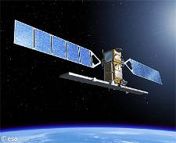
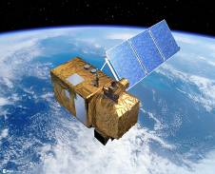
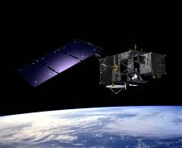
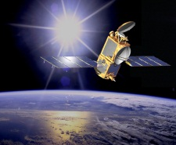
Sentinels
Each Sentinel is technically different to meet the needs of the 6 services
Sentinel 1 – radar imaging
All weather, day/night applications
Sentinel 2 – Optical imaging
Land applications: urban, forest, agriculture,..
Sentinel 3+6 – Ocean and global land monitoring, high precision ocean altimetry
Sentinel 4+5 – Atmosphere composition monitoring, from a geostationary (-4) and a polar orbit (-5)
Notes:
Important to underline that Copernicus is :
A custom-built, comprehensive, cutting-edge Earth Observation system, that puts EU in class of its own (in many aspects even better-performing than civilian US satellites…)
Satellites and types of images are mutually reinforcing, idem for space- and in-situ data.
A key difference between different Sentinels is their orbits, allowing for different types of observations and revisit times of an inidividual spot on the globe.

Slide 6
Sentinel Deployment
Schedule
Notes:
It is important that due to the inherent nature of space operations, only an indicative schedule can be given, rather than definite launch dates. It is extremely rare in the filed of space that any satellite is launched according to a schedule initially foreseen; and it is also impossible to predict the real lifetime of a satellite. Thus, this planning has to be regarded as preliminary/indicative only.
6 more launches foreseen for 2015 / 2016
ESA has an overall great track-record in satellite development, but nevertheless there is an inherent risk of delays and malfunctions, both for the development of satellites (high-tech, custom-built, unique), launchers (long experience, but narrow slots, bottlenecks, and no 100% success guarantee), and flights (space debris, space weather). => As commercial insurance premiums are prohibitive, we continue current the 'self-assurance' approach, based on two flight units per Sentinel mission, as well as the development of recurrent Units.
Political risks re. Launchers and ITAR (US export control regime) issues, in parricular regarding the current political situation vis-à-vis Russia. => for the time being, potential issues are under control: US has announced to pursue constructive attitude. But need to keep evolving situation under review.

Slide 7
Data Dissemination
Two complementary approaches:
Bringing the data to the user: web portal, mirroring of the data – high bandwidth connection needed (e.g. Geant)
Bringing the user to the data: cloud computing ('hosted computing‘) – upgrade of the Copernicus core ground segment needed

Slide 8
Data Dissemination
dissemination
network
Internet
available
to anybody
Copernicus services
internal
circulation
network
Cloud – big data
Int. partners
Others
SMEs
EU/MS Public bodies
Scientific communities
Notes:
Challenges of 'Big Data': Copernicus will generate 8 Terabyte of data per day, when fully operational. => need for adequate capacities to receive, process, disseminate and archive this information avalanche.
COM, together with ESA and EUMETSAT, is tackling the issue proactively, so as to guarantee reliable & uninterrupted access 24/7/365.
Need for cohenrent and comprehensive architecture.
Scalable infrastructure, hosted processing, cloud applications.
Unkonwns: speed and scope of user-uptake, both for data and services. => need to remain flexible and responsive.

Slide 9
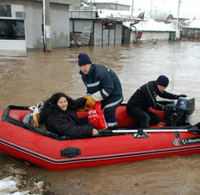
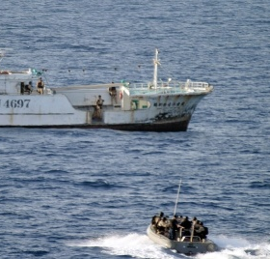
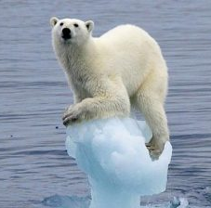
Copernicus services
Services monitoring Earth systems
Land Monitoring
Marine Monitoring
Atmosphere Monitoring
Horizontal services
Emergency Management
Security
Climate Change
Output: Value-Added Information

Slide 10
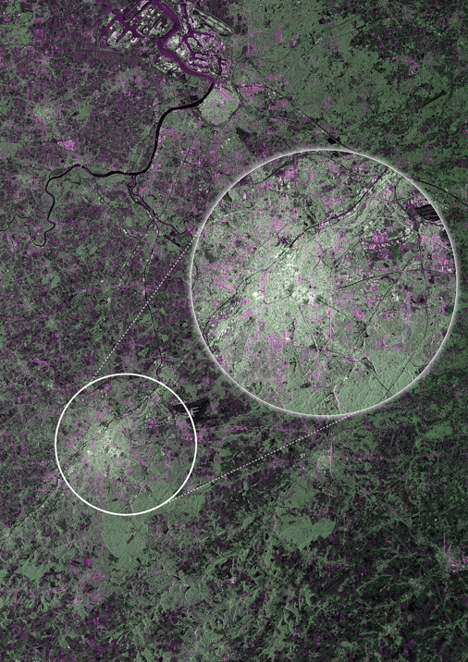
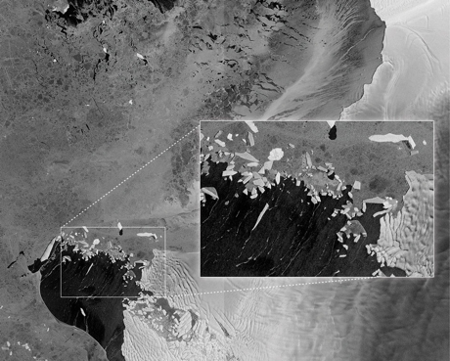
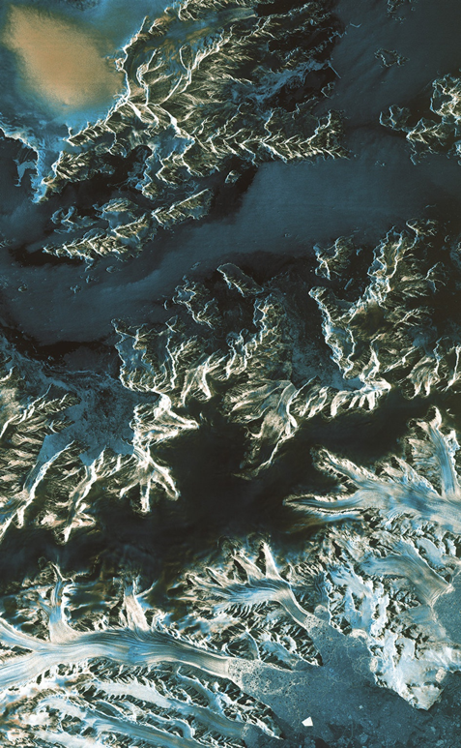
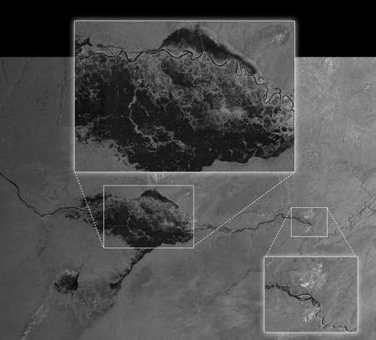
Sentinel 1 first images

Slide 11
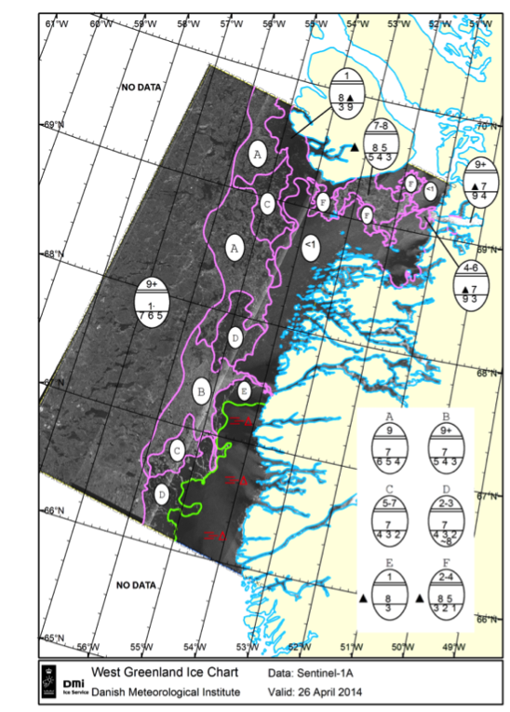
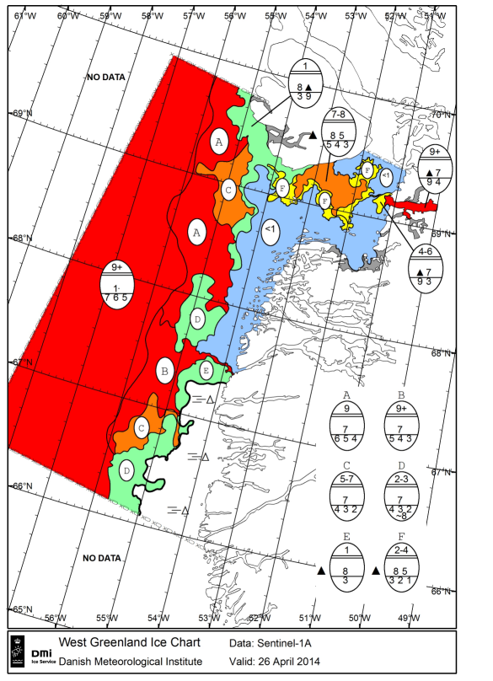
SEA-ICE APPLICATIONS WITH SENTINEL-1A DATA
The first Sentinel-1 sea-ice chart
Courtesy of DMI, MyOcean
S1A image20140426
10:10 UTC,
EWS, HH

Slide 12
Copernicus
Thank you for your attention
Reinhard.Schulte-Braucks@ec.europa.eu
Website: http://copernicus.eu
Facebook: CopernicusEU
Twitter: @Copernicus EU

