Slide 1
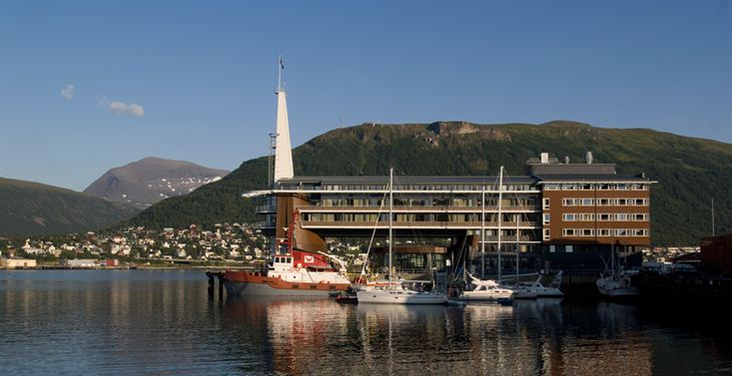
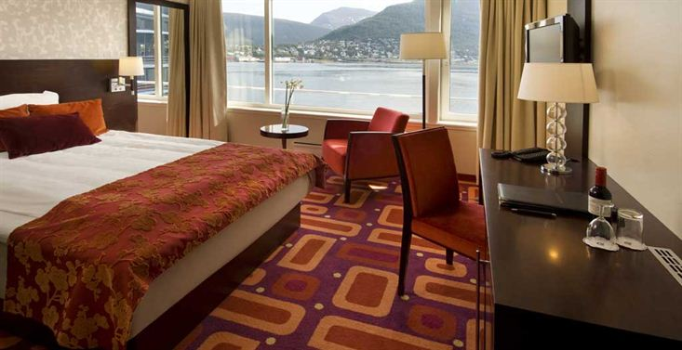
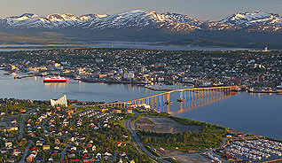
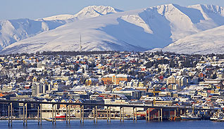
28th CEOS Plenary Session
Alain Ratier
EUMETSAT
CEOS Plenary, Agenda Item 5
Tromsø, Norway 28-30 October 2014

Slide 2
Introduction of the Tromsø Statement
A draft Tromsø statement has been developed that looks forward to CEOS’s contributions to significant events in 2015, i.e.:
COP-21 in France
WCDRR in Japan
GEO 2015 Ministerial
The format and introductory content takes benefit from the Montreal Statement
A first draft of the statement was released for initial comments on 23 October, and has now been updated
Based on feedback received under this agenda item, the statement will be further updated and presented for endorsement under agenda item 31 tomorrow

