Slide 1
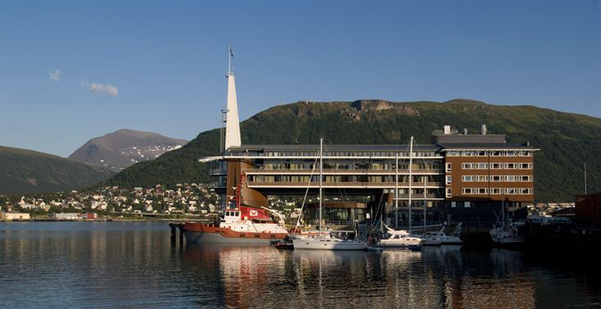
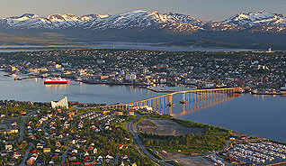
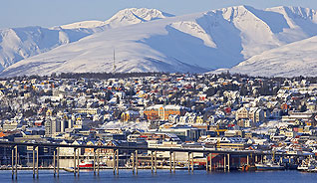
Status of Actions Arising from Previous CEOS Plenaries
Kerry Ann Sawyer
CEOS Executive Officer (NOAA)
CEOS Plenary, Agenda Item 4
Tromsø, Norway 28-30 October 2014

Slide 2
Status of CEOS 26th and
27th Plenary Actions
Six Actions were carried over from 26th CEOS Plenary
Twenty-three Actions from 27th CEOS Plenary
ALL
CLOSED
Satellite data to secure a prosperous and sustainable future for humankind

Slide 3
Please open Word Document, if Plenary desires:
4_Sawyer_vWord 10.25.14
Satellite data for societal benefit

