Slide 1
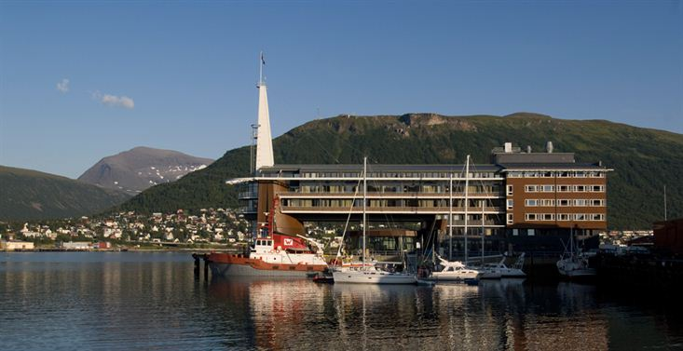
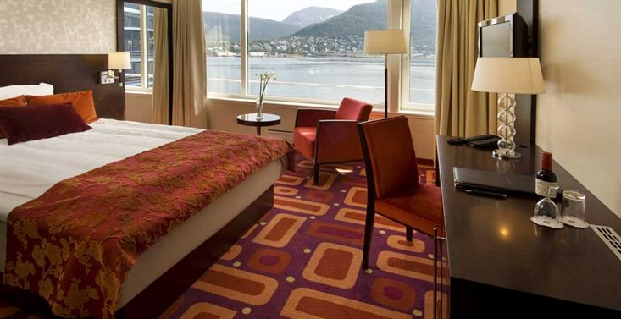
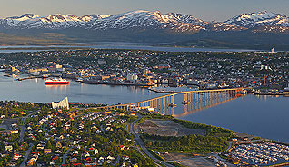
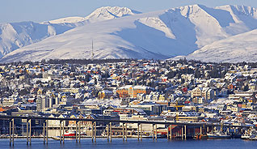
28th CEOS Plenary Session
Alain Ratier
EUMETSAT
CEOS Plenary, Agenda Item 2
Tromsø, Norway
28-30 October 2014

Slide 2
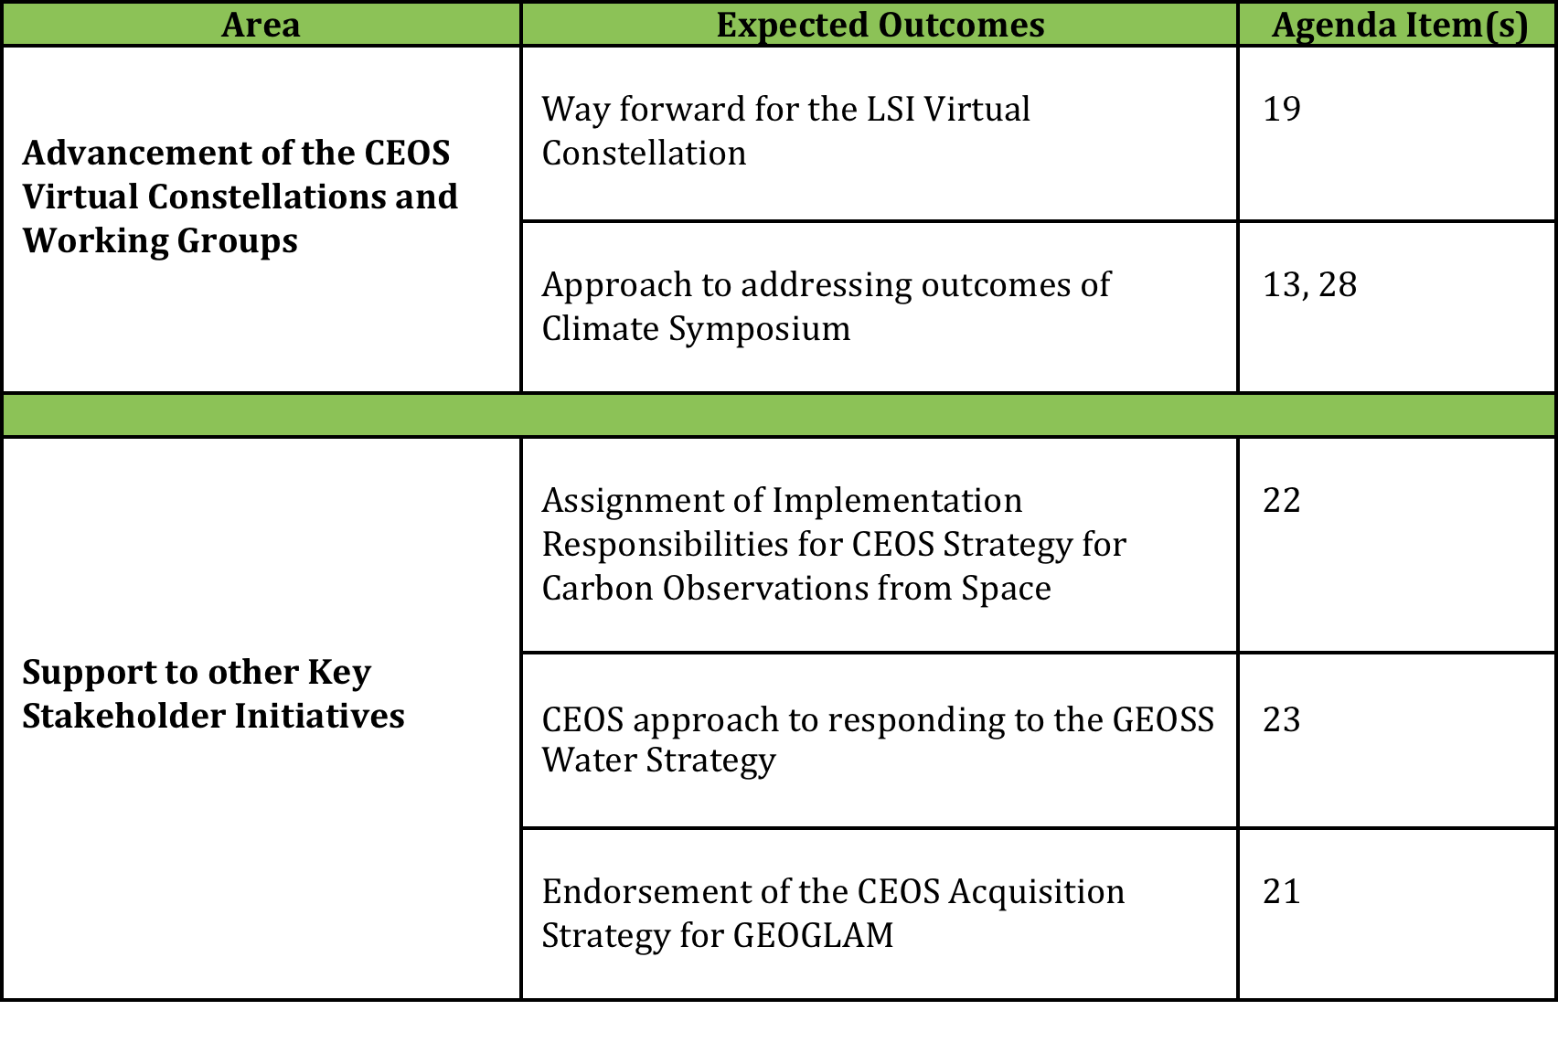
Chair Perspective on 28th CEOS Plenary

Slide 3
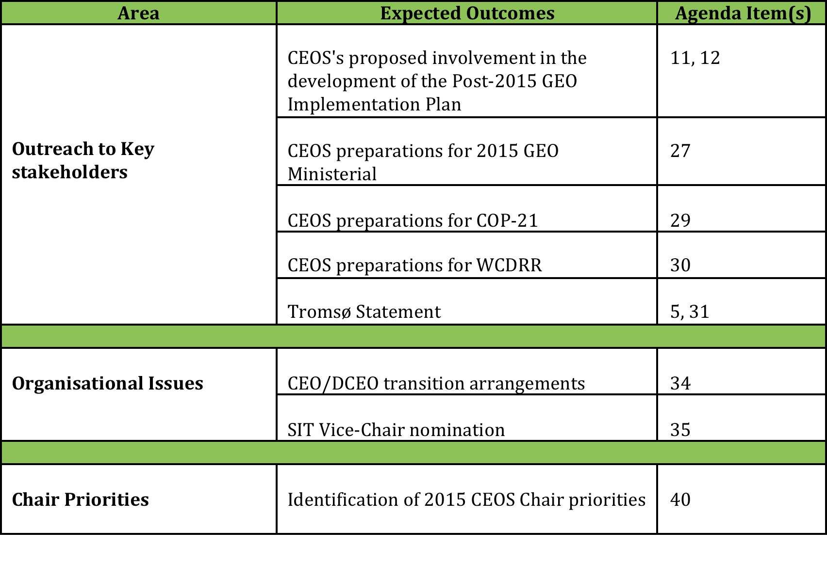
Chair Perspective on 28th CEOS Plenary

