Slide 1
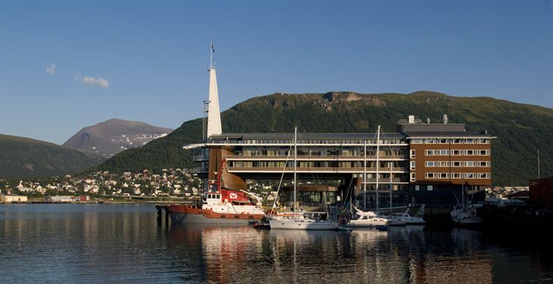
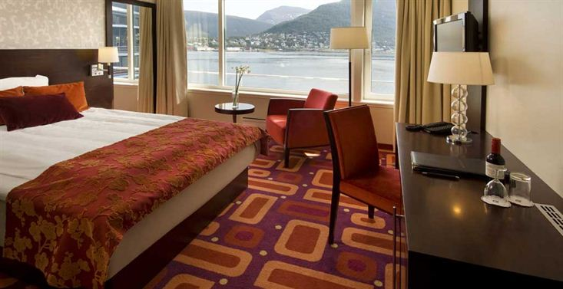
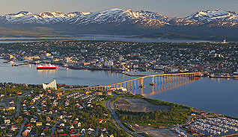
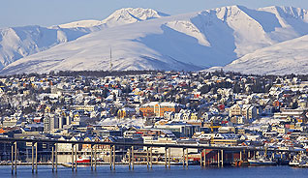
28th CEOS Plenary Session
Alain Ratier
EUMETSAT
CEOS Plenary, Agenda Item 1
Tromsø, Norway 28-30 October 2014

Slide 2
Welcome and opening session
Welcome and Opening Session
1 | Welcome and Opening Remarks Welcome and Introduction (CEOS Chair) Opening Remarks: (Bo Andersen, Director General, Norwegian Space Centre) (Jens Sunde, Deputy Director-General, MET Norway) Tour-de-table | 09:00-09:15

