Slide 1
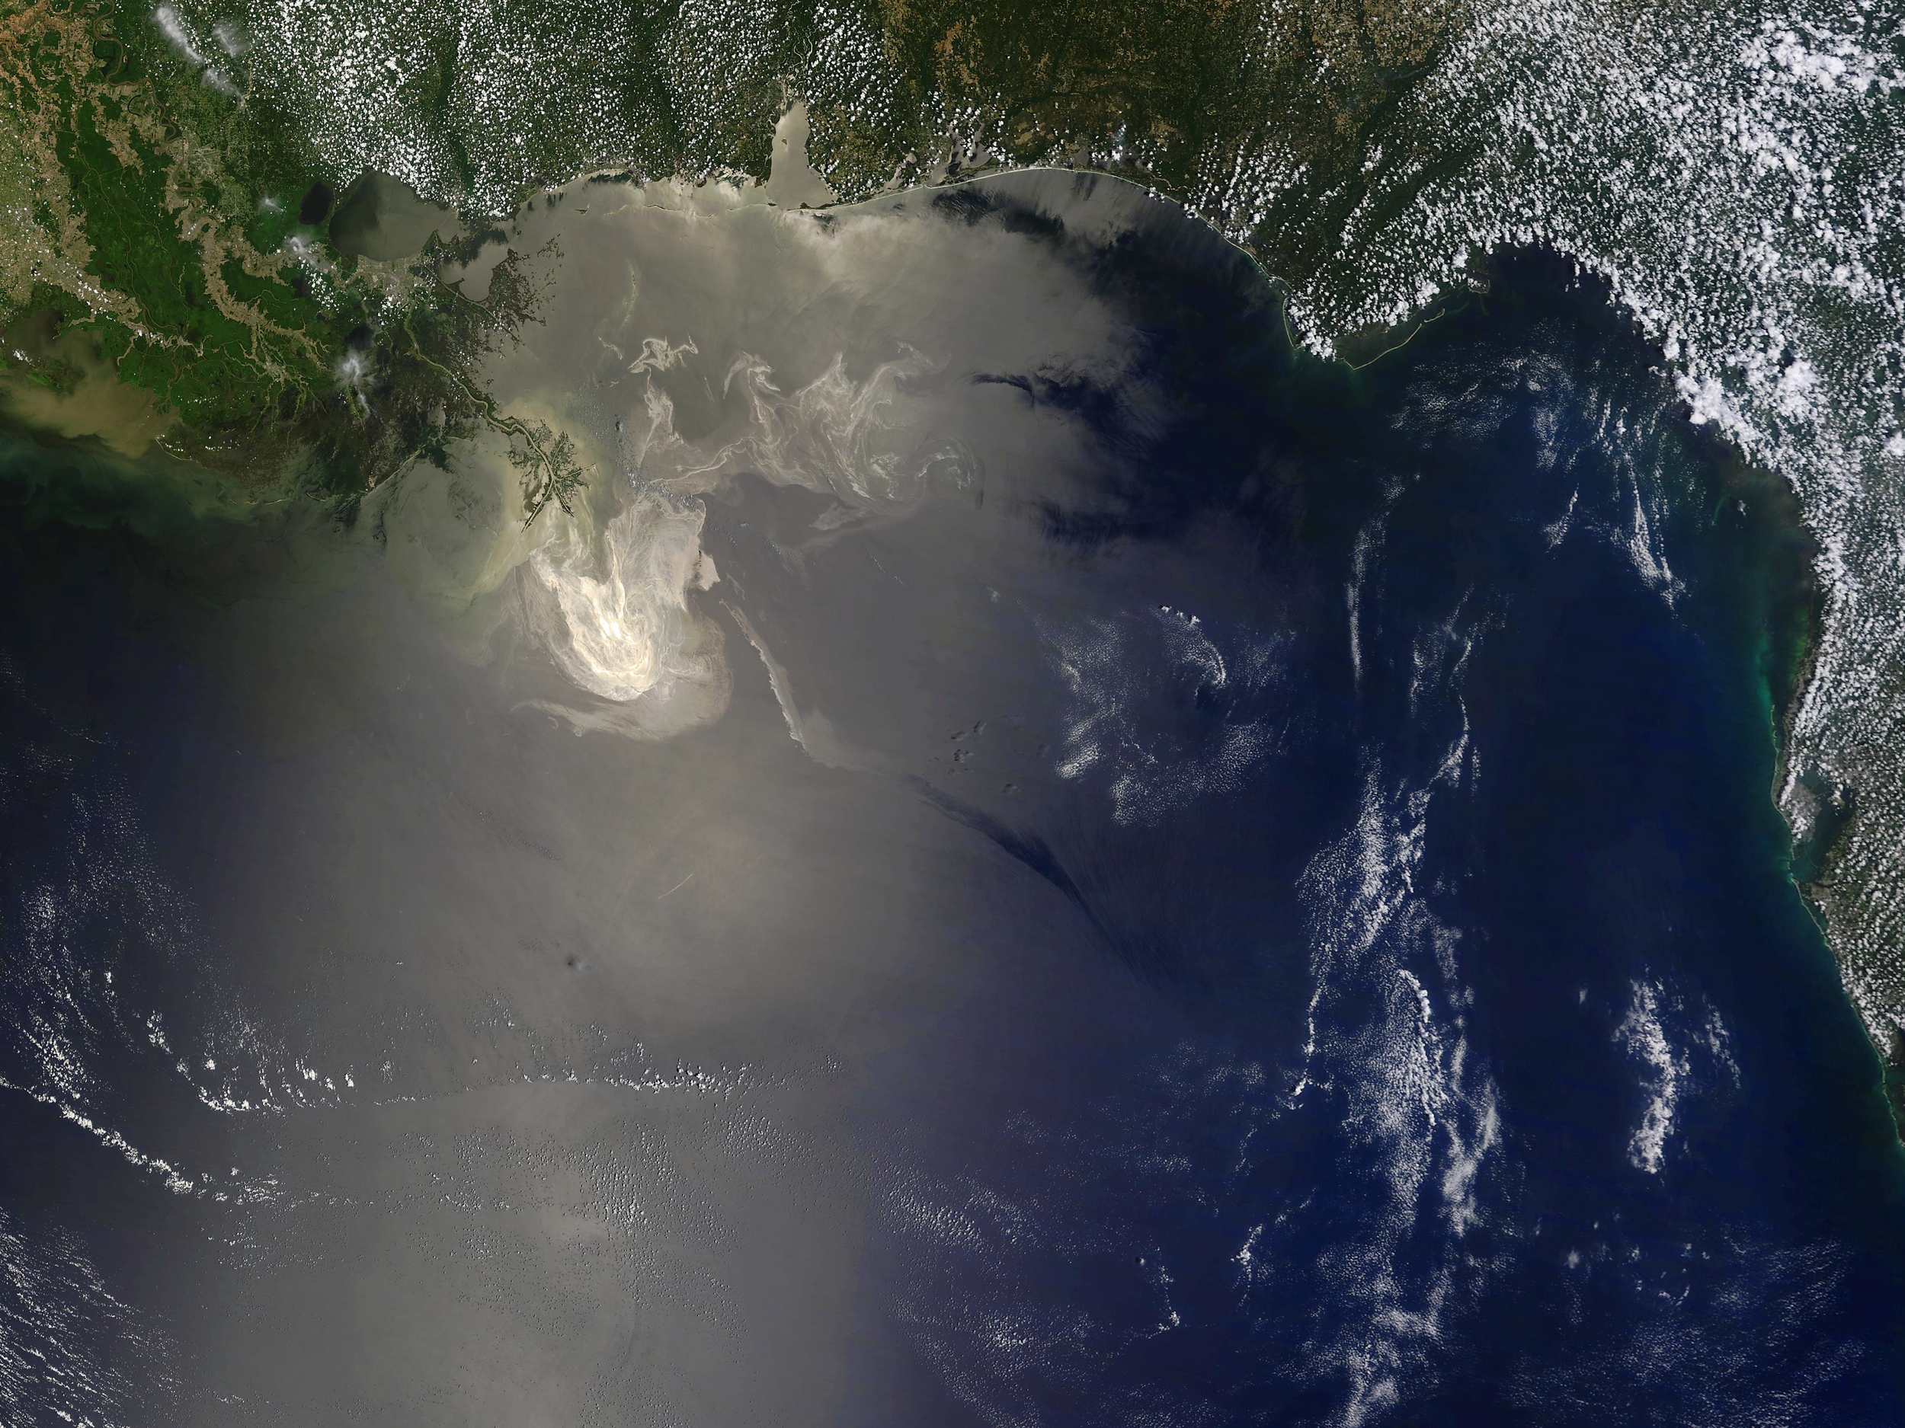
NOAA Satellite and Information Service
Update to CEOS Plenary
Mary Kicza
NESDIS Assistant Administrator
November 6, 2013

Slide 2
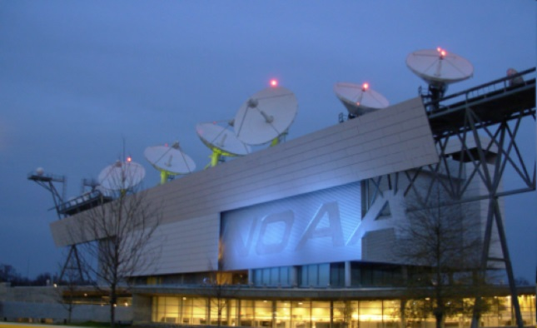
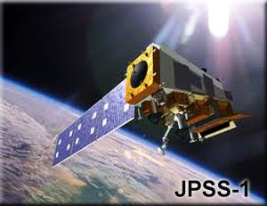
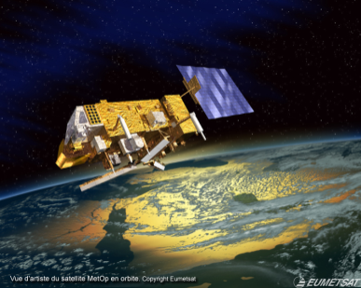
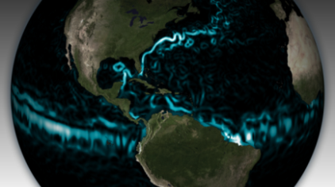
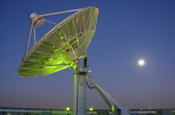
NOAA Satellite and Information Service
Photo Courtesy of: Michael A. Stewart
Operating the current fleet of U.S. operational environmental satellites
Developing next generation operational satellites
Jason
Leveraging partnerships to fulfill key requirements
Promoting full and open data sharing
Notes:
International partnerships to highlight:
Jason (emphasizing Jason in affiliation with OSTM and the CEOS OST VC)
EUMETSAT IJPS and working toward JPS
GCOM-W1/AMSR
Cospas-Sarsat
ARGOS

Slide 3
Recent Developments
NOAA is currently funded under a continuing resolution
No new funding above FY 2013, no new program starts, but Congress specifically recognized the importance of NOAA’s satellites
JPSS and GOES-R received special exemptions, allowing NOAA to reallocate funds to maintain expected launch dates
NOAA continues to make strong progress
Maintaining 24x7 satellite operations, product development, processing and distribution
All JPSS-1 instruments and the spacecraft primary structure are built
GOES-R ABI and EXIS instruments are complete, SEISS and SUVI will be soon
Jason-3 core instruments have been integrated on the spacecraft and testing has begun
In the midst of a difficult budget environment, NOAA is committed to preserving core functions while focusing on key mission areas and providing strategic investments for new activities.
Notes:
On October 16, 2013, the U.S. Congress passed a continuing resolution (CR) to fund the government through January 15, 2014. Under a CR, all programs, including NOAA satellites, are provided the same funding levels received last year and no new programs are started. JPSS and GOES-R received special exemptions, allowing NOAA to reallocate its funds to maintain their expected launch dates. Budget cuts associated with “sequestration” remain in effect. The U.S. Congress and President are beginning negotiations on a budget for the rest of Fiscal Year 2014 (through September 2014).

Slide 4
NOAA CEOS Activities
NOAA continues its commitment to/engagement in CEOS activities
Developing Jason-3 satellite, in collaboration with partners, in support of CEOS Ocean Surface Topography VC
Co-leadership of Ocean Surface Vector Winds, Ocean Color and Sea Surface Temperature VCs; involvement in Blue Planet initiative
Vice-chairs Climate and Capacity Building WGs, leading development of ECV and Capacity Building Inventories
Supports development of CEOS WGISS Integrated Catalog (CWIC) and its interoperability within CEOS and GEO
Active support of water cycle, carbon and disaster risk management activities
Represents CEOS in GEO Post-2015 and GEO Ministerial WGs
Provides CEOS Executive Officer

Slide 5
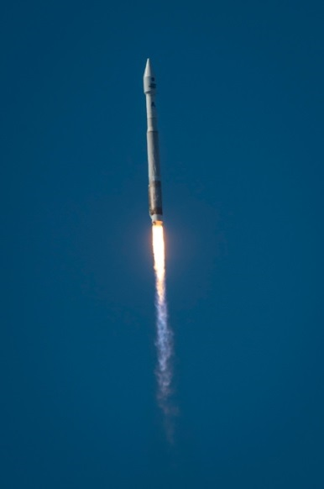
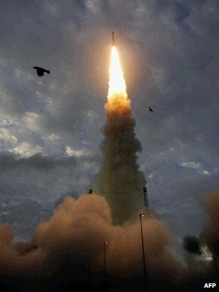
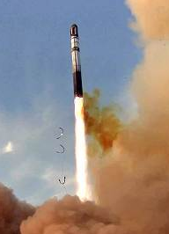
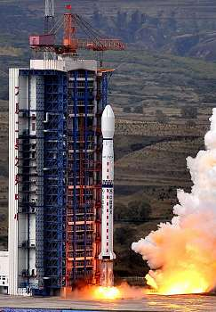
Importance of Partnership
Congratulations to all Members that successfully launched Earth observation satellites this year!
India/France – SARAL
India – INSAT-3D
China – FY3C
Korea – KOMPSAT-5
ESA – PROBA-V
Russia – Resurs-P
NASA/USGS – Landsat-8

