Slide 1

CEOS PLENARY
– Netherlands Activities
Agenda item: 37
Joost Carpay, Netherlands Space Office

Slide 2
Contents
Current and past activities
  Sciamachy/OMI/TROPOMI line of optical instruments
  PanelSAR
  Miniaturisation
  Satellite data portal (Copernicus preparation)
  G4AW: application development for food security and water management
    Partnering with developing countries, aimed at information provision to farmers there.

Slide 3
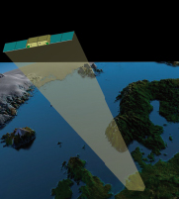
PanelSAR
  Optimum combination of SWaP (Size, Weight and Power) for a space-based SAR solution.
  Continuous Wave (CW) Radar -> less power than “pulse” radars
  For small satellite deployment, highly competitive and ‘mission enabling’ cost.
    <150 kg
  Commercial (user-driven / design to cost) focus
  High-resolution
  >3 (5) year design lifetime

Slide 4
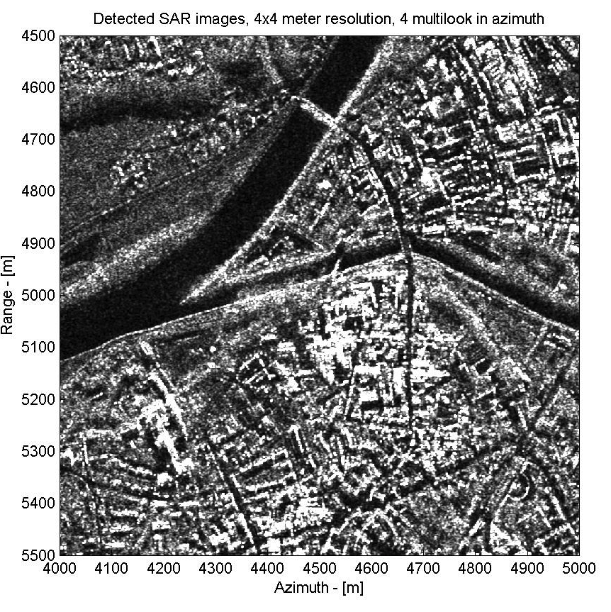
PanelSAR Characteristics (I)
Sensor positioning: Multi-Mode, High-resolution, targeting 2-4m ground resolution
High performance for inSAR
(short wavelength = sub mm resolution, but higher constraints on space platform and orbit)
Modes: Stripmap, ScanSAR/TOPSAR and Spotlight (beam steering)
mono-static and bi-static mode (iFMCW and full FMCW mode)

Slide 5
PanelSAR Characteristics (II)
Modes & Imaging capability (3m x 1m x 10cm array antenna as hosted payload in-orbit demonstration) :
- Stripmap: Swath width ~15 km, 4m resolution
- ScanSAR ~55 km, ~10 m resolution
- Spotlight: ~3-4 km, ~2 m resolution
Typical applications (X-band):
  High resolution, all-weather imaging
  Interferometry (subsidence, structural monitoring)
  Water management, flood detection and monitoring
  Ocean, tide/current monitoring
  Agricultural monitoring
  Infrastructure monitoring
  Ice monitoring
  Maritime surveillance (extended swath)

Slide 6
PanelSAR Characteristics (III)
To be developed as part of ESA PRODEX
Scientific PFM, but commercial opportunity
Flight opportunities under investigation
  One in advanced stage but suboptimal

Slide 7
Miniaturisation of instruments
General miniaturisation technology: integrated instruments
Current ideas:
  Hyperspectral imager
  Small spectrometers
  TIR imager
  Laser altimeter
Cooperation for Flight Opportunies sought

Slide 8
Backup slides on TROPOMI/Sentinel 5p

Slide 9
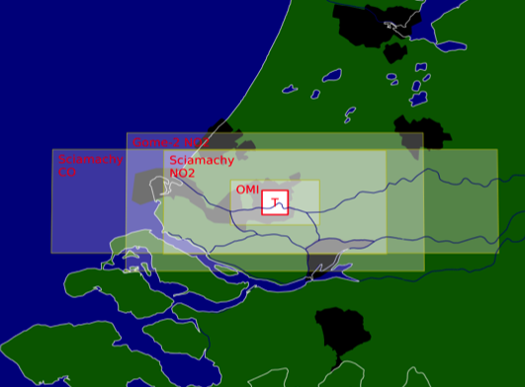
TROPOMI
Continuity of GOME(2)/SCIAMACHY/OMI/TROPOMI
Building Climate Records
TROPOMI
GOME
GOME-2
SCIAMACHY
OMI
TROPOMI
S4/UVN
S5/UVNS
1990
2000
2010
2020
2030
2040

Slide 10
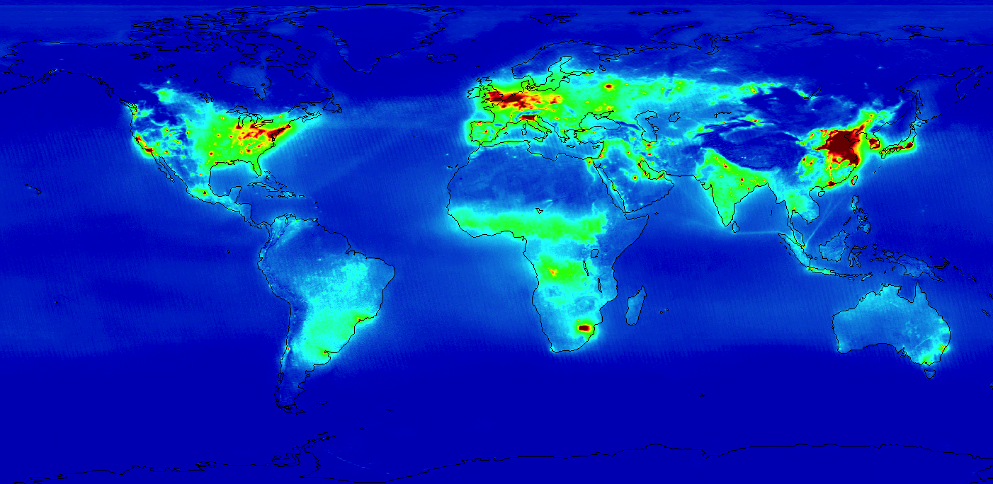



TROPOMI
Nitrogen dioxide 2005-2009 measured with OMI

Slide 11
TROPOMI
TROPOMI in phase C/D
Part of Copernicus Space Segment
Close cooperation with ESA
Launch 2015

