Slide 1



Updates from NSMC/CMA
Item 37
Wei Caiying, Zhang Jiashen, Yang Lei and Fan Jinlong
National Satellite Meteorological Center
China Meteorological Administration

Slide 2
Contents
  FY- 3C: Successful launch of the operational satellite
  FY- 2: Intensified observations up to every 6 minutes
  GSICS: Achievement in CMA
  CHARTER: Supported flood monitoring in NE China

Slide 3
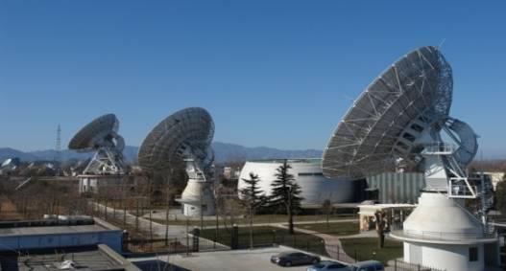
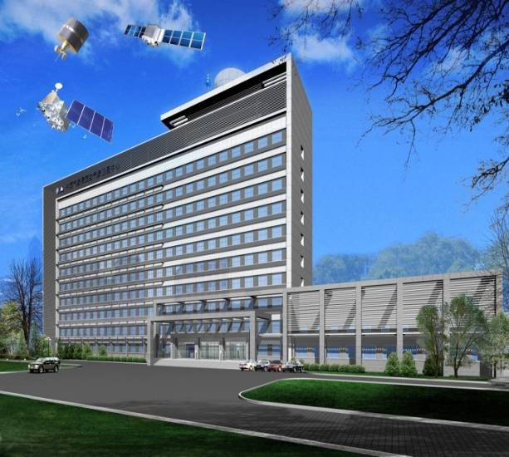
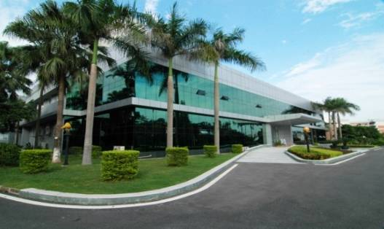
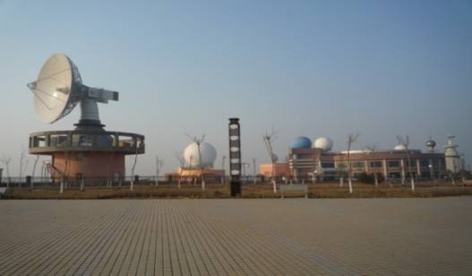
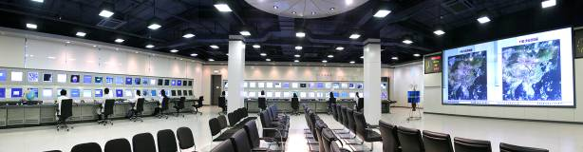
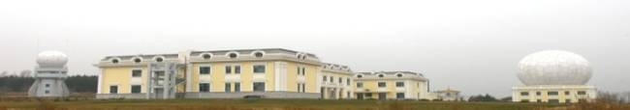
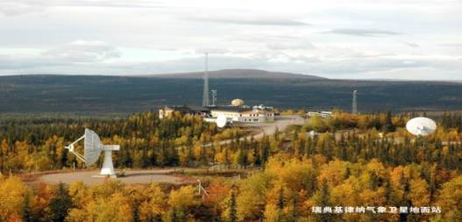
NSMC/CMA
founded in 1971
Program planning for development of Chinese meteorological satellites;
Development and construction of ground segment;
Acquisition, process, dissemination of meteorological satellite data;
Provision of nationwide services of satellite data, information and product;
Space weather monitoring, forecast and services since 2002.
Beijing
DPC@NSMC
Guangzhou
Urumuqi
Jiamusi
KIRUNA

Slide 4
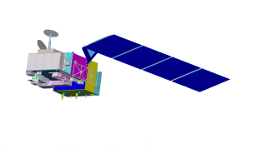
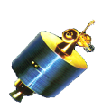


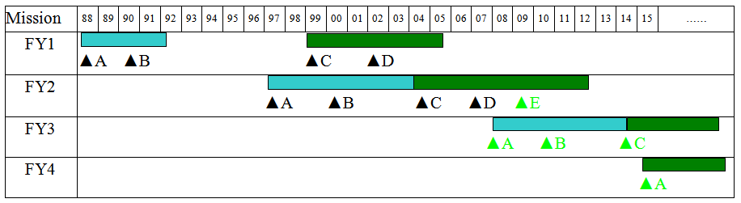
Road Map of FENGYUN Satellites by 2020
2014FY-2G
2015FY-3D(Op)
2013FY-3C(Op)
2015FY-4A (R&D)
2012FY-2F
2010FY-3B (R&D)
2016FY-2H
2008FY-2E
2017FY-3E(Op)
2008FY-3A (R&D)
2018FY-RM(R&D)
2018FY-4B (Op)
2019FY-3F(Op)
2022FY-RM2
2021FY-4C(Op)
Interferometer
4
Notes:
4

Slide 5
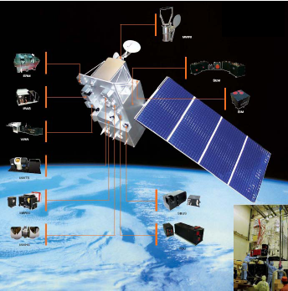
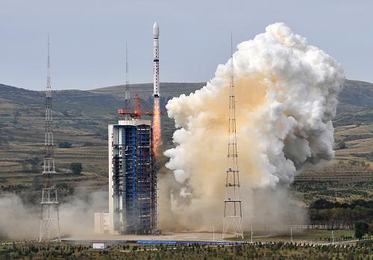
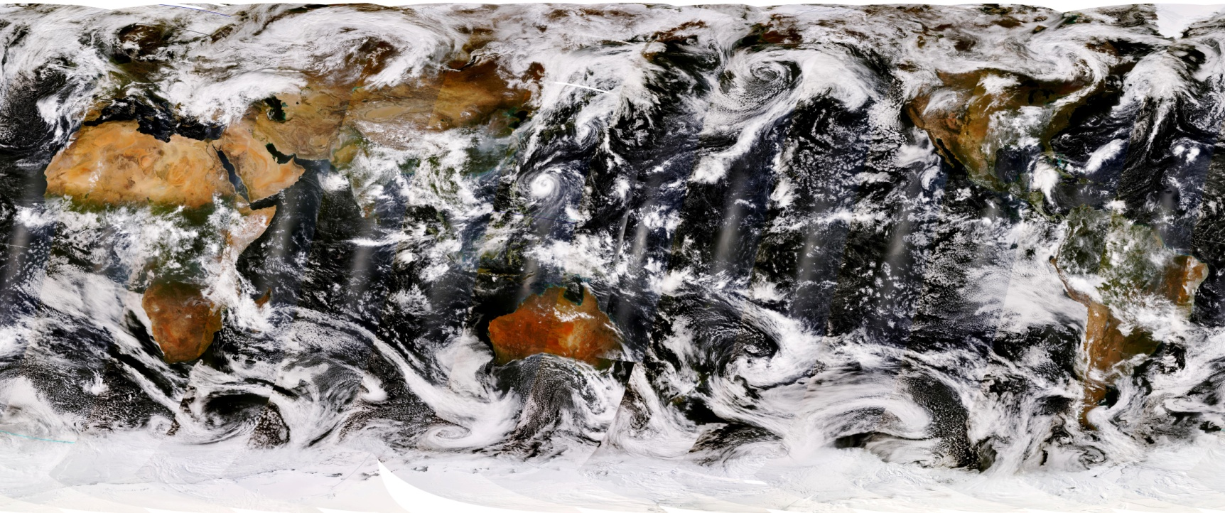
New Launch of FY3C
FY-3C was successfully launched on 23 Sep. 2013, and is in the testing stage so far.
Source: internet
FY-3A was launched in 2008,
FY-3B was launched in 2010.

Slide 6
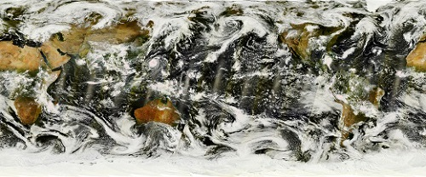
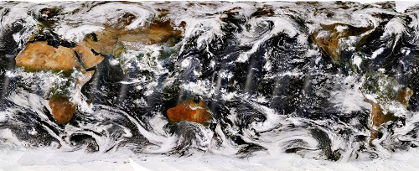
Samples of the first images of FY3C
FY-3C VIRR globle mosaic
Instruments onboard FY-3A,3B and 3C:
VIRR (Visible and Infrared Radiometer)
MERSI (Medium Resolution Spectral Imager)
IRAS (Infrared Atmospheric Sounder)
MWTS Ⅱ (Microwave Temperature Sounder Ⅱ)
MWHS Ⅱ (Microwave Humidity Sounder Ⅱ)
SBUS (Solar Backscattering UV Sounder)
TOU (Total Ozone Unit)
MWRI (Microwave Radiation Imager)
ERM (Earth Radiation Measurement)
SEM (Space Environment Monitor)
SIM Ⅱ (Solar Irradiation Monitor Ⅱ)
GNOS (GNSS Occultation Sounder)
FY-3C MERSI globle mosaic

Slide 7
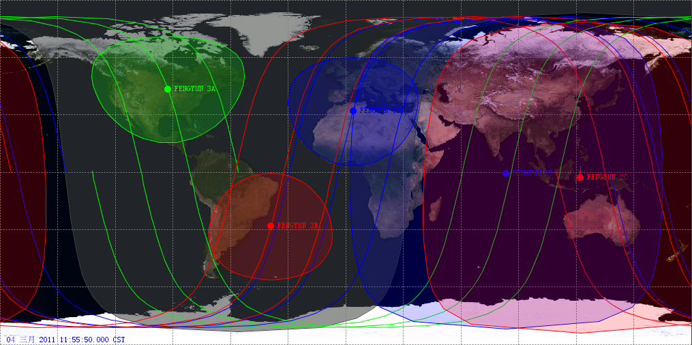
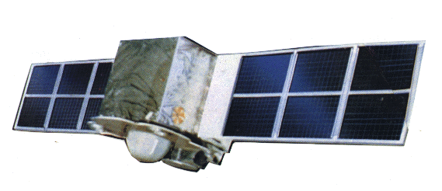
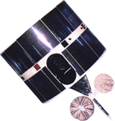
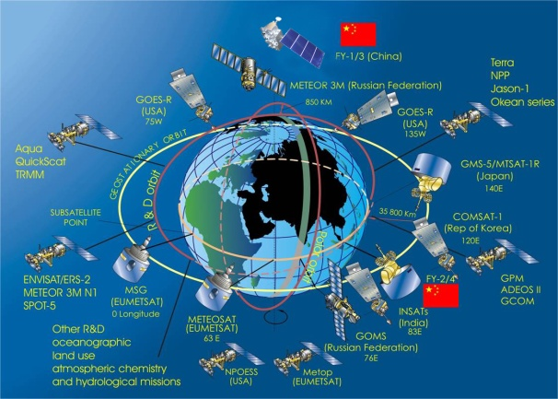
Contribution to the GEOSS
FY-3A
FY-3C
FY-2F
112
FY-2D
86.5
FY-2E
105
FY-2C
123.5
FY-3B

Slide 8
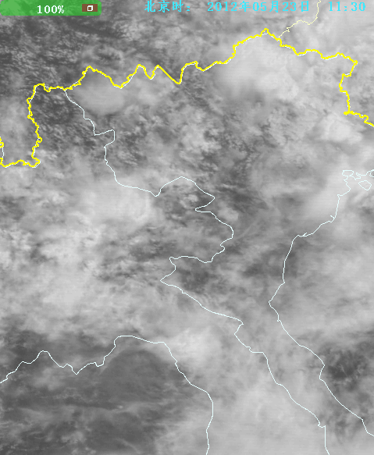
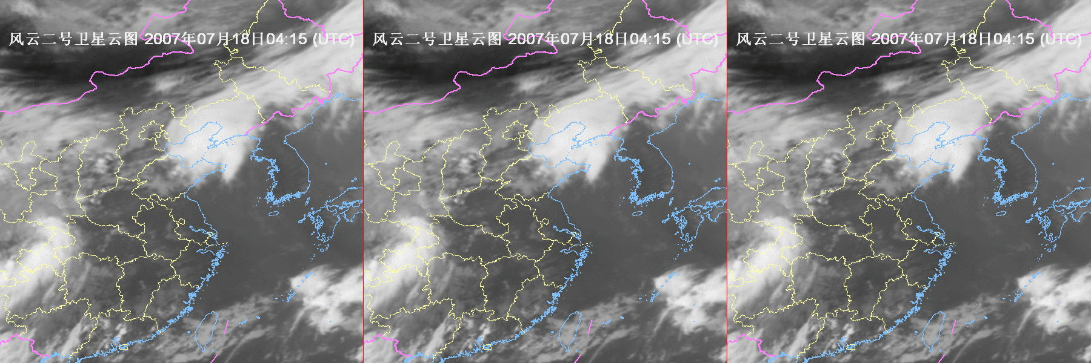
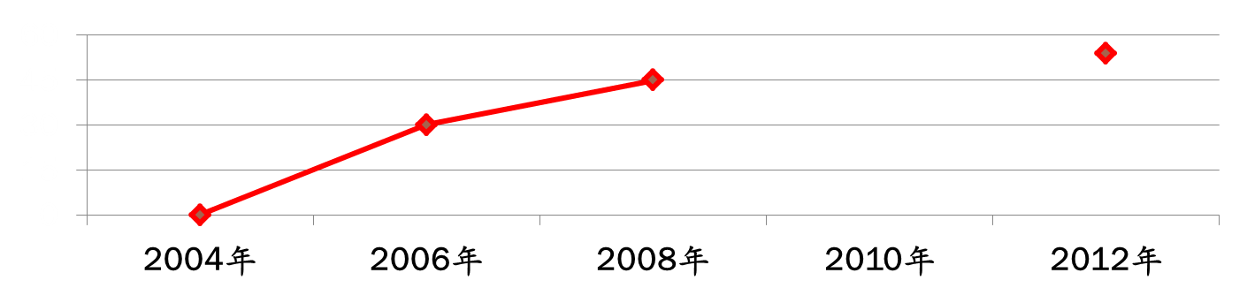
FY2 Observations for disaster weather
Intensified observations up to every 6 minutes during the flood season since 2012
6 min.
60 min.
30 min.
15 min.
0
15
30
45
60
(minutes)

Slide 9
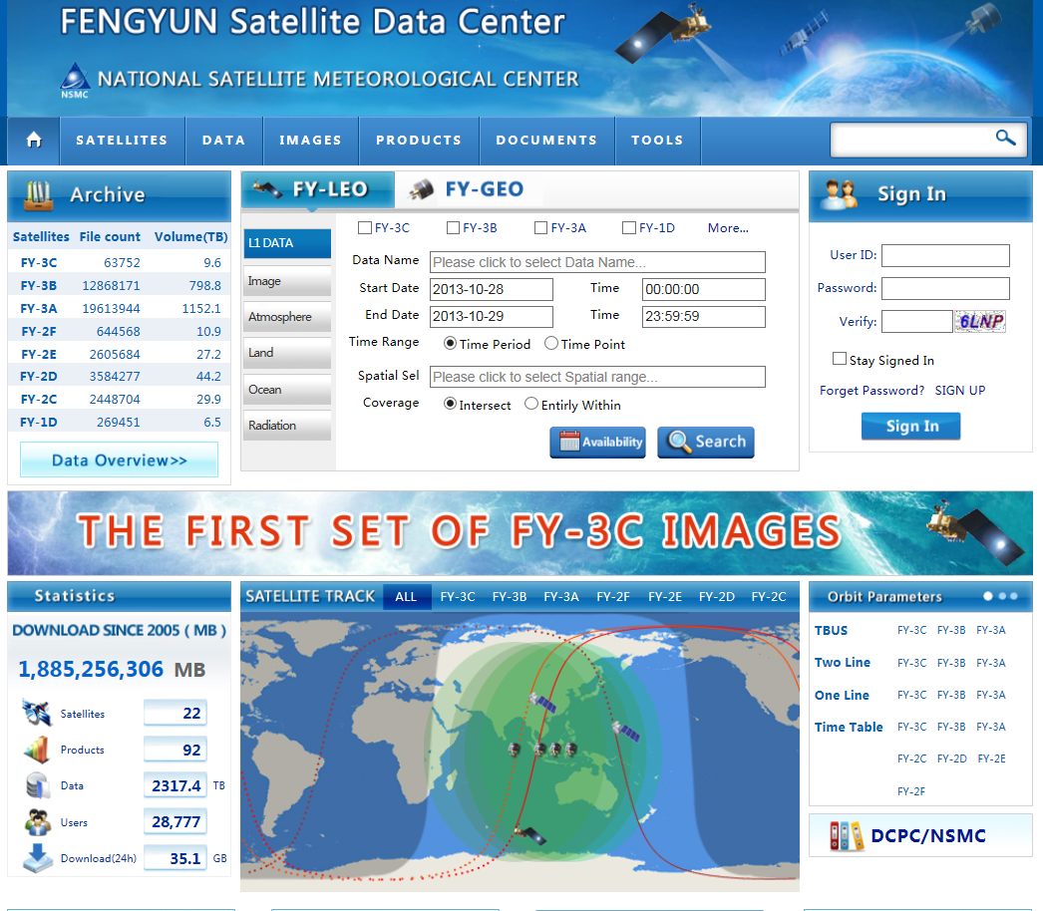
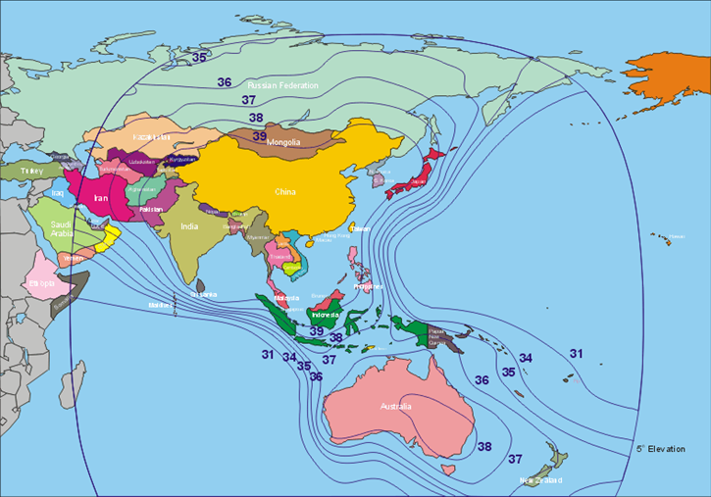
Data Collection and Production Center Services
Coverage of CMACast
Web link
http://satellite.cma.gov.cn/portalsite/default.aspx?currentculture=en-US

Slide 10
CMA GPRC GSICS Implementation
2009: FY-2C/2D GSICS IR calibration experiment using the AIRS and IASI since Oct., 2009. Development of onboard half-optical BB calibration model based on GSICS reference standard.
2010: FY-3/MERSI/VIRR/IRAS LEO-LEO intercalibration began to be established based on AIRS/IASI/MODIS.
2012: FY-2D/2E operational calibration monitoring test using GSICS IR calibration since May, 2011. FY-2E GSICS GEO-LEO IASI results has become the operational input of L1 calibration LUT instead of AVHRR/HIRS since Jan 12, 2012. FY-2D GSICS has incorporated into operation since April, 2012
2012: FY-2F operational calibration has been based on onboad blackbody and moon observation with diurnal change since July, 2012. GSICS calibration is still used to monitoring the calibration bias using AIRS/IASI or CrIS.
2013: GSICS calibration become the baseline method of calibration monitoring and correction for all FY series sensors (FY-2D/2E/2F, FY-3A/3B)
Retrospectively: Recalibration for FY-2C/2D/2E and FY-1C/1D is conducted based inter-calibration using AIRS and IASI.

Slide 11
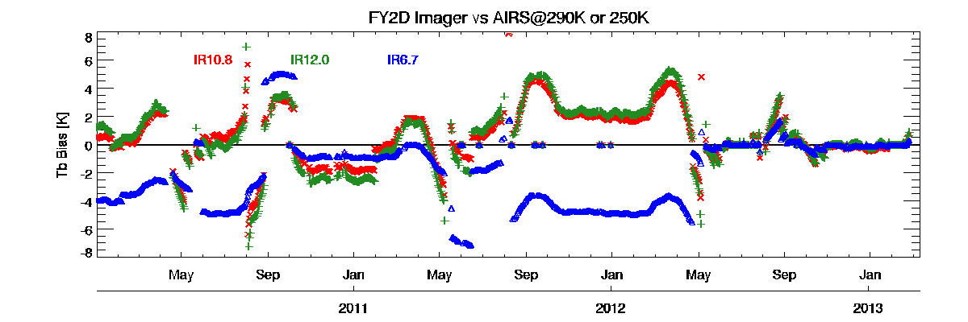
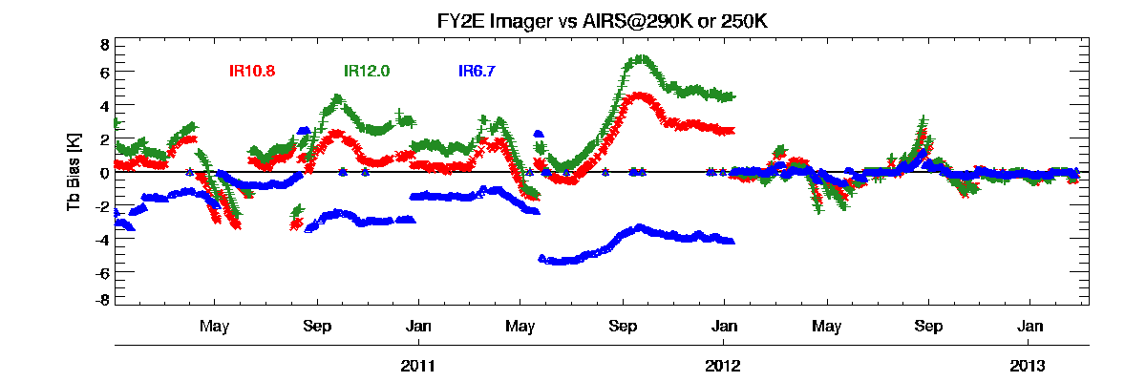
Significant improvement to FY-2D/2E Cal Based on GSICS reference
FY-2 vs AQUA/AIRS
Operational calibration of FY-2D/2E was upgraded using GSICS inter-calibration algorithm in 2012-04 and 2012-01 separately. The calibration biases were sharply decreased, and reduced to about 0.5~1K@290K (@250K）without eclipse period.
Before upgrade, calibration bias of FY-2D was about 1~2K@290K in split window channels, and 3~4K@250K in WV channel. Tbb bias presents a significant cyclical fluctuation ,and reaches 4-6 K every September during the Autumn eclipse phase.
Before upgrade, calibration bias of FY-2E was about 1~3K@290K in split window channels (IR2 is larger than IR1). TBB bias in WV channel@250K is similar large as FY-2D but without seasonal fluctuation.
Eclipse Phase
Time series of calibrated TBB bias for IR1~3 channels vs AQUA/AIRS
reference scenes (290 K for IR1 and IR2, 250 K for IR3).

Slide 12
Nonlinear Evaluation of FY3 VIRR by IASI InterCal
FY3A/VIRR
Large Nonlinearity of FY-3A/VIRR
leads to significant error of BTD11-12
FY3A/VIRR
FY3B/VIRR
Nonlinearity of FY-3B/VIRR is much smaller than FY-3A
FY3B/VIRR

Slide 13
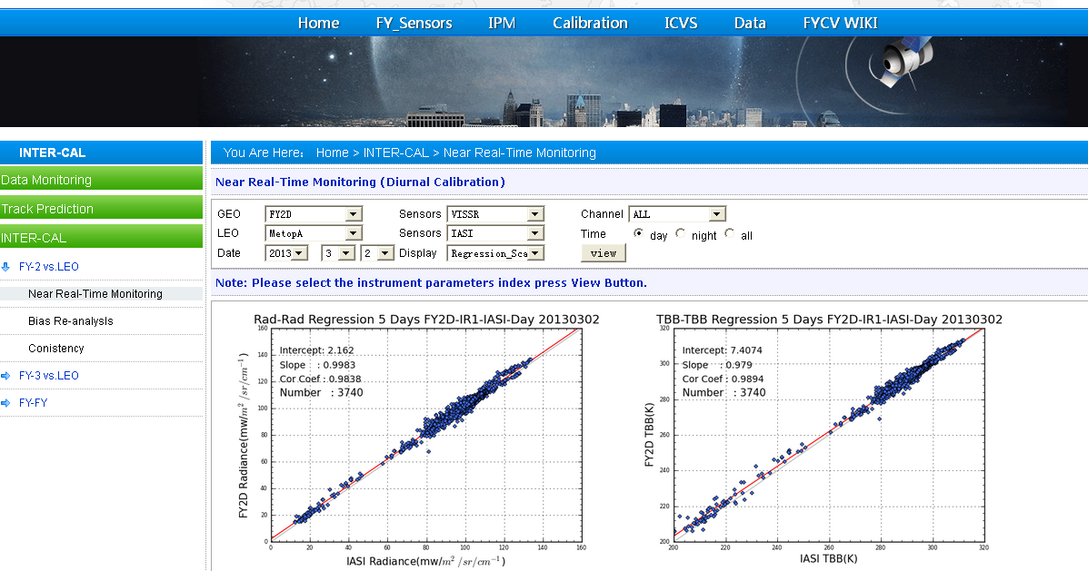
http://giscs.nsmc.cma.gov.cn

Slide 14
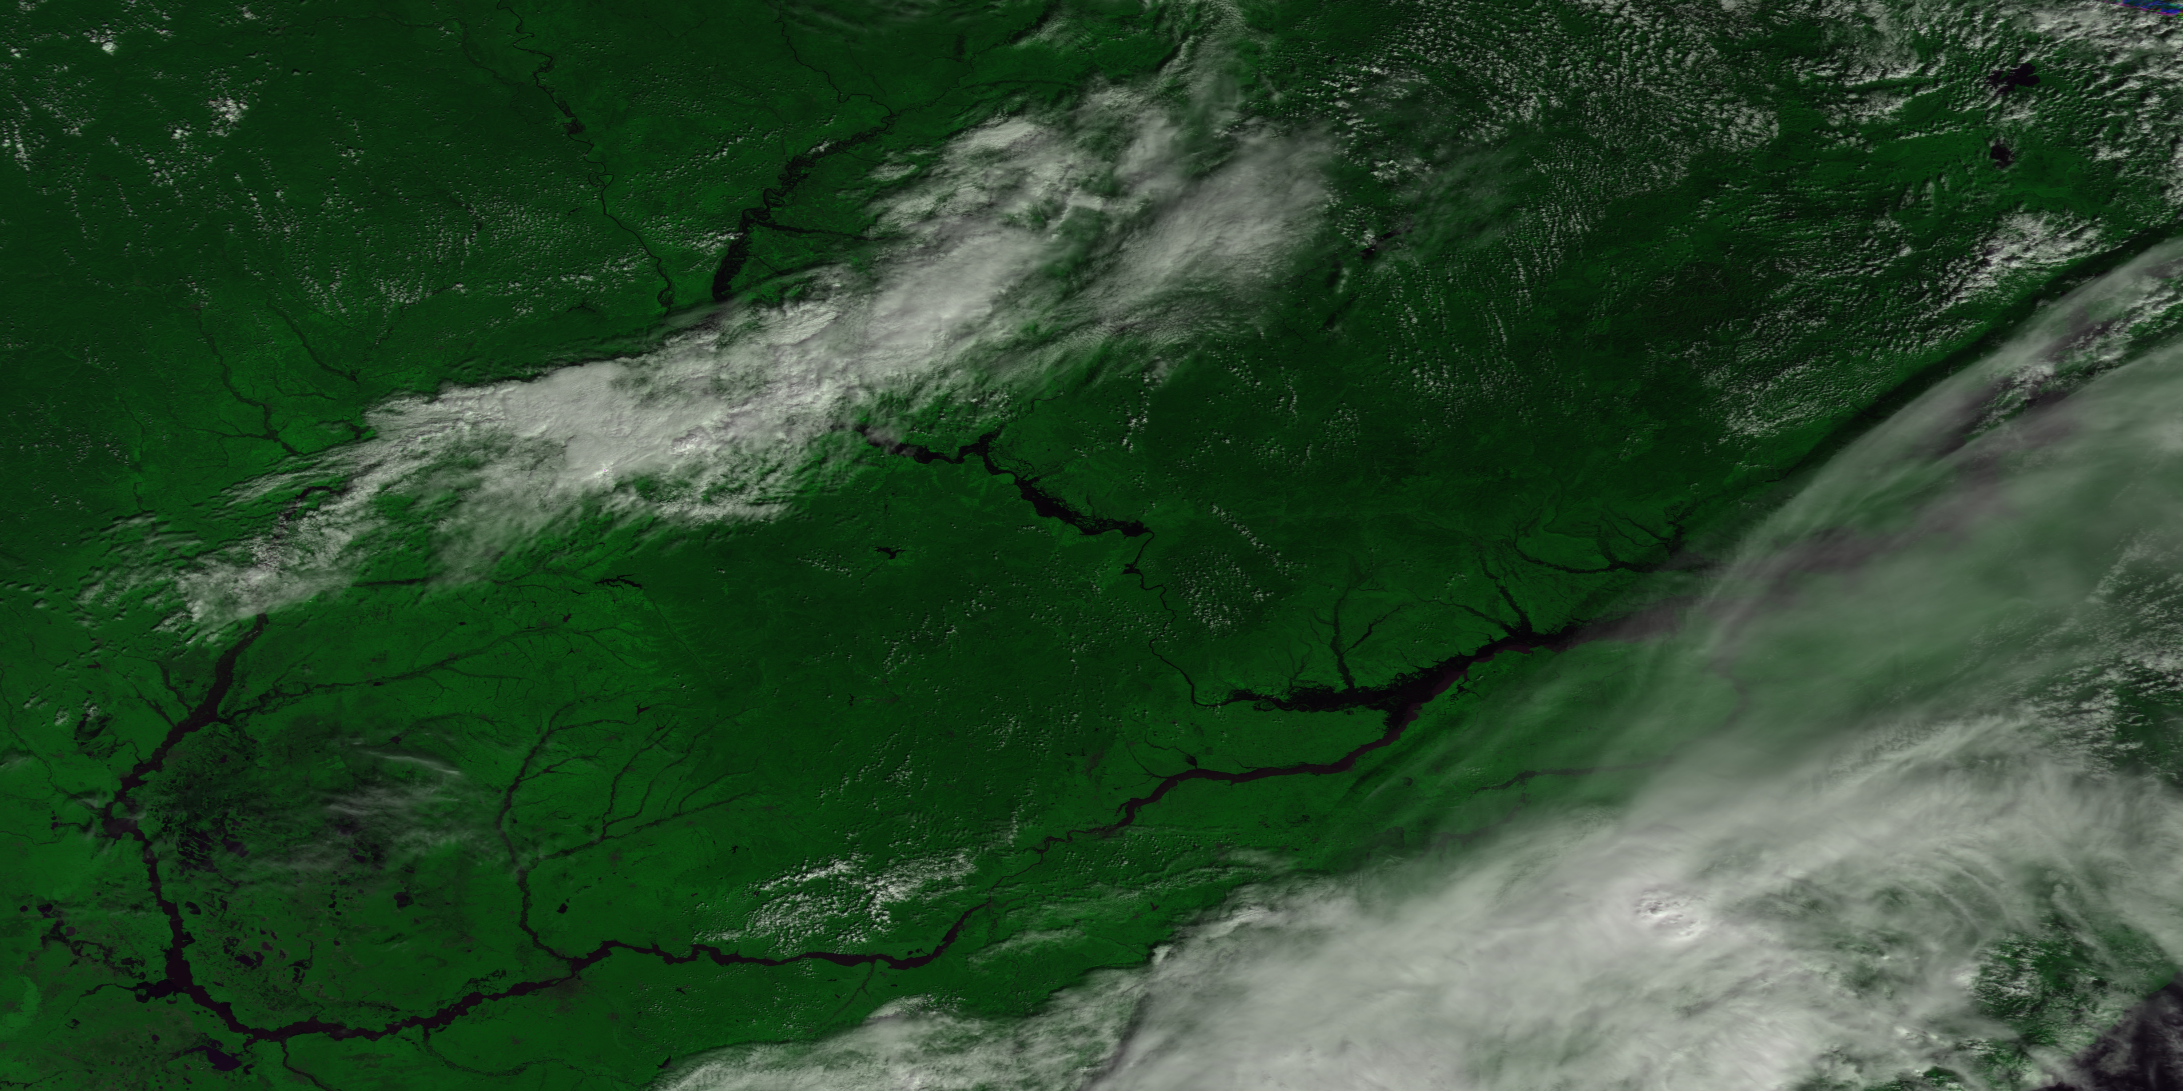
CHARTER - Flood monitoring
Satellite data received for the CHATER Call_447
Satellite/Sensor | Scenes | Provider
Landsat-8 | 483 | USGS
WorldView-1/Quickbird
NASA-ISS
RADARSAT-2 | 5 | CSA
TerraSAR-X | 9 | DLR
SPOT-5 | 3 | CNSA
DMCii | 3 | DMC
RISAT-1 | 10 | ISRO
Resourcesat-2 AWIFS | 1
FY3A MERSI 250m - 20130826

Slide 15
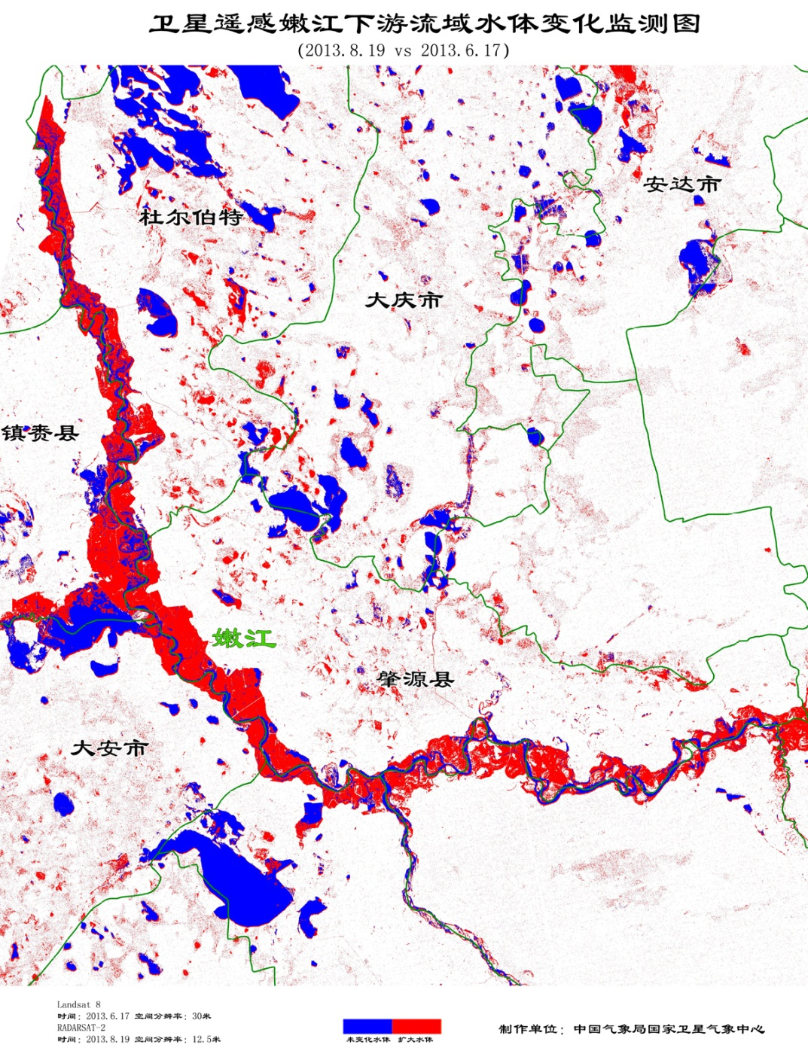
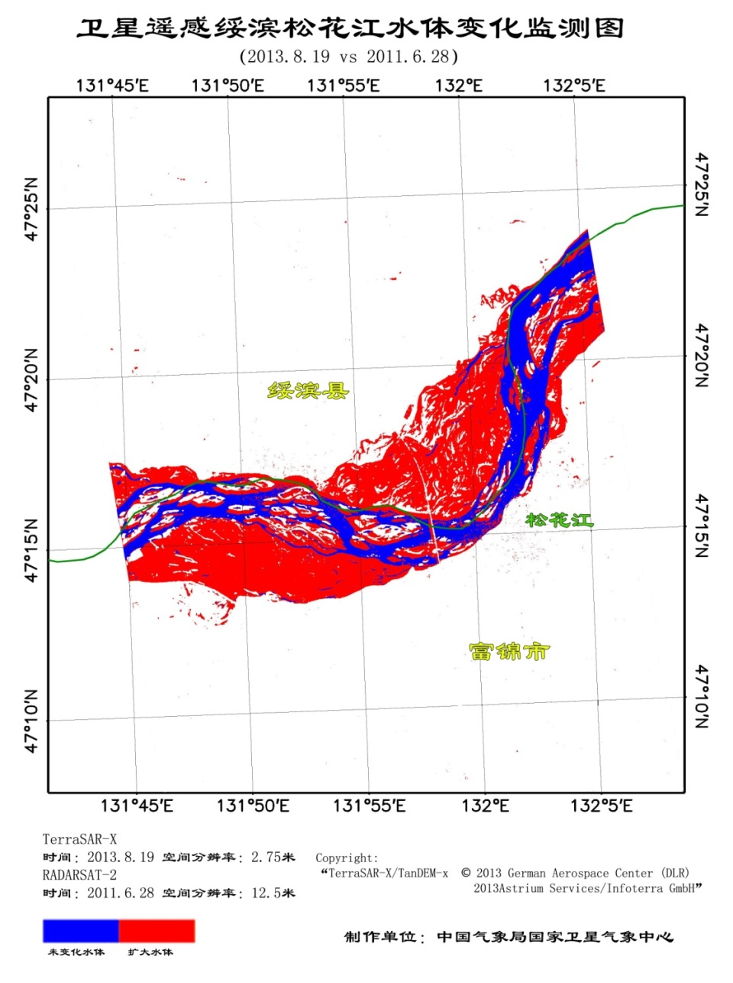

Slide 16
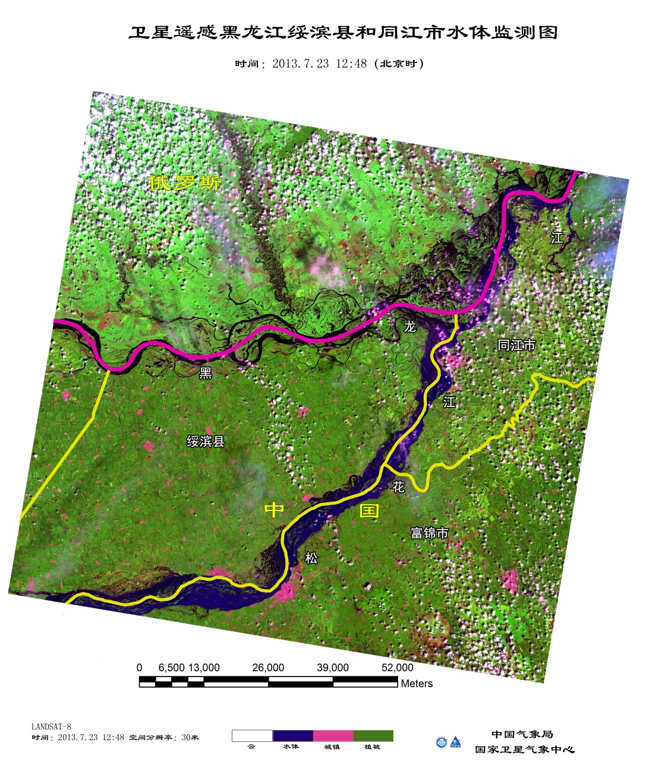
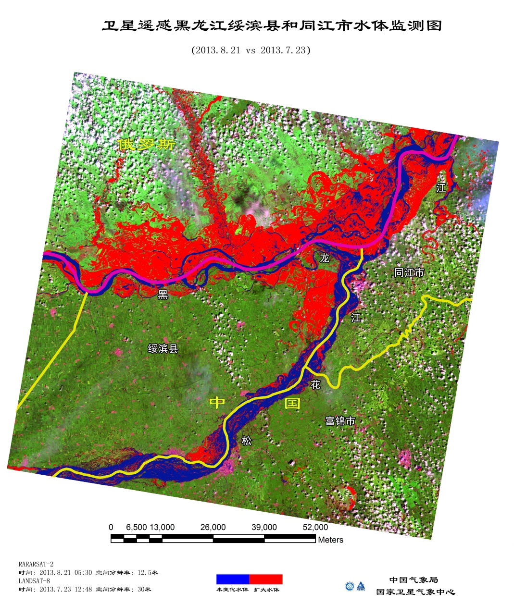

Slide 17
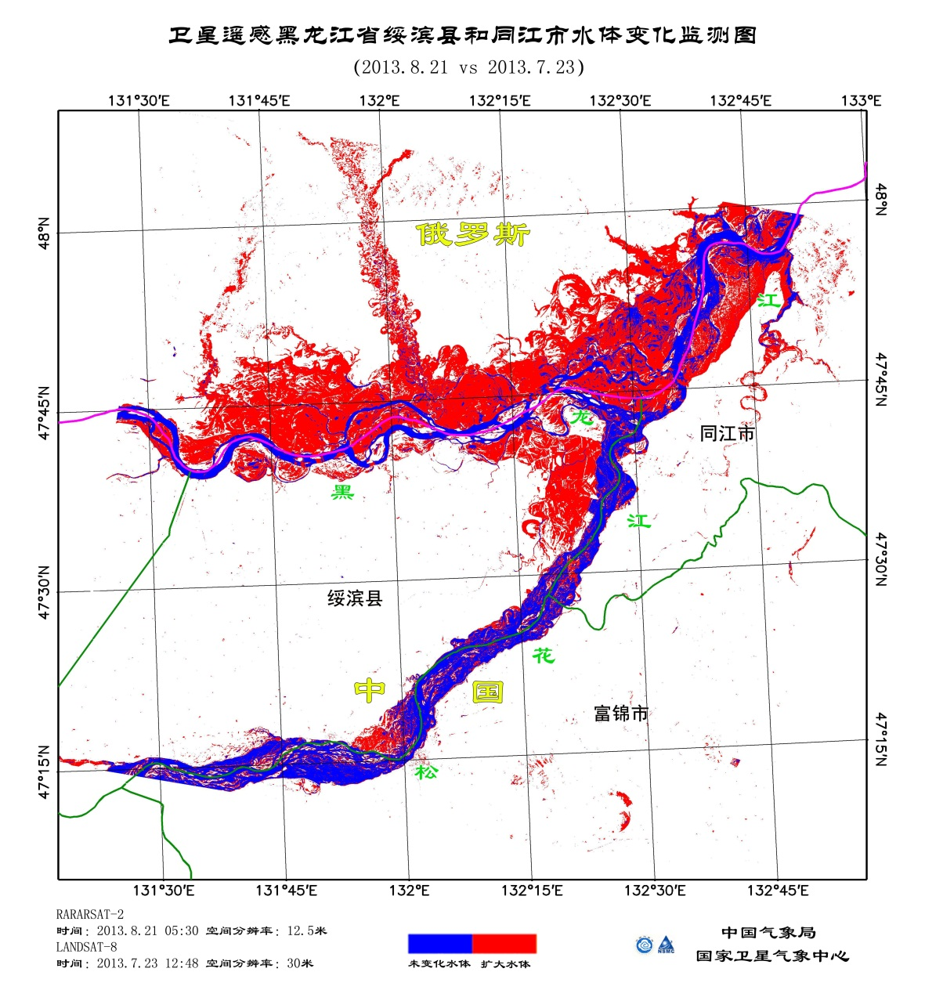
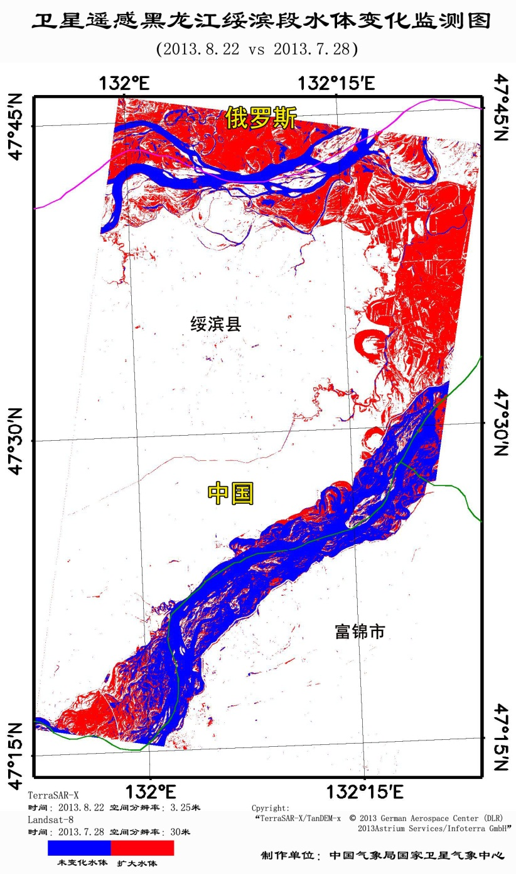

Slide 18
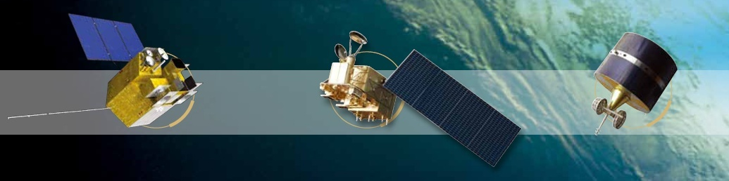
Thank you for your attention!

