Slide 1

CEOS PLENARY
Earth Observation Activities @ INPE
Hilcéa Ferreira
Agenda Item 37

Slide 2
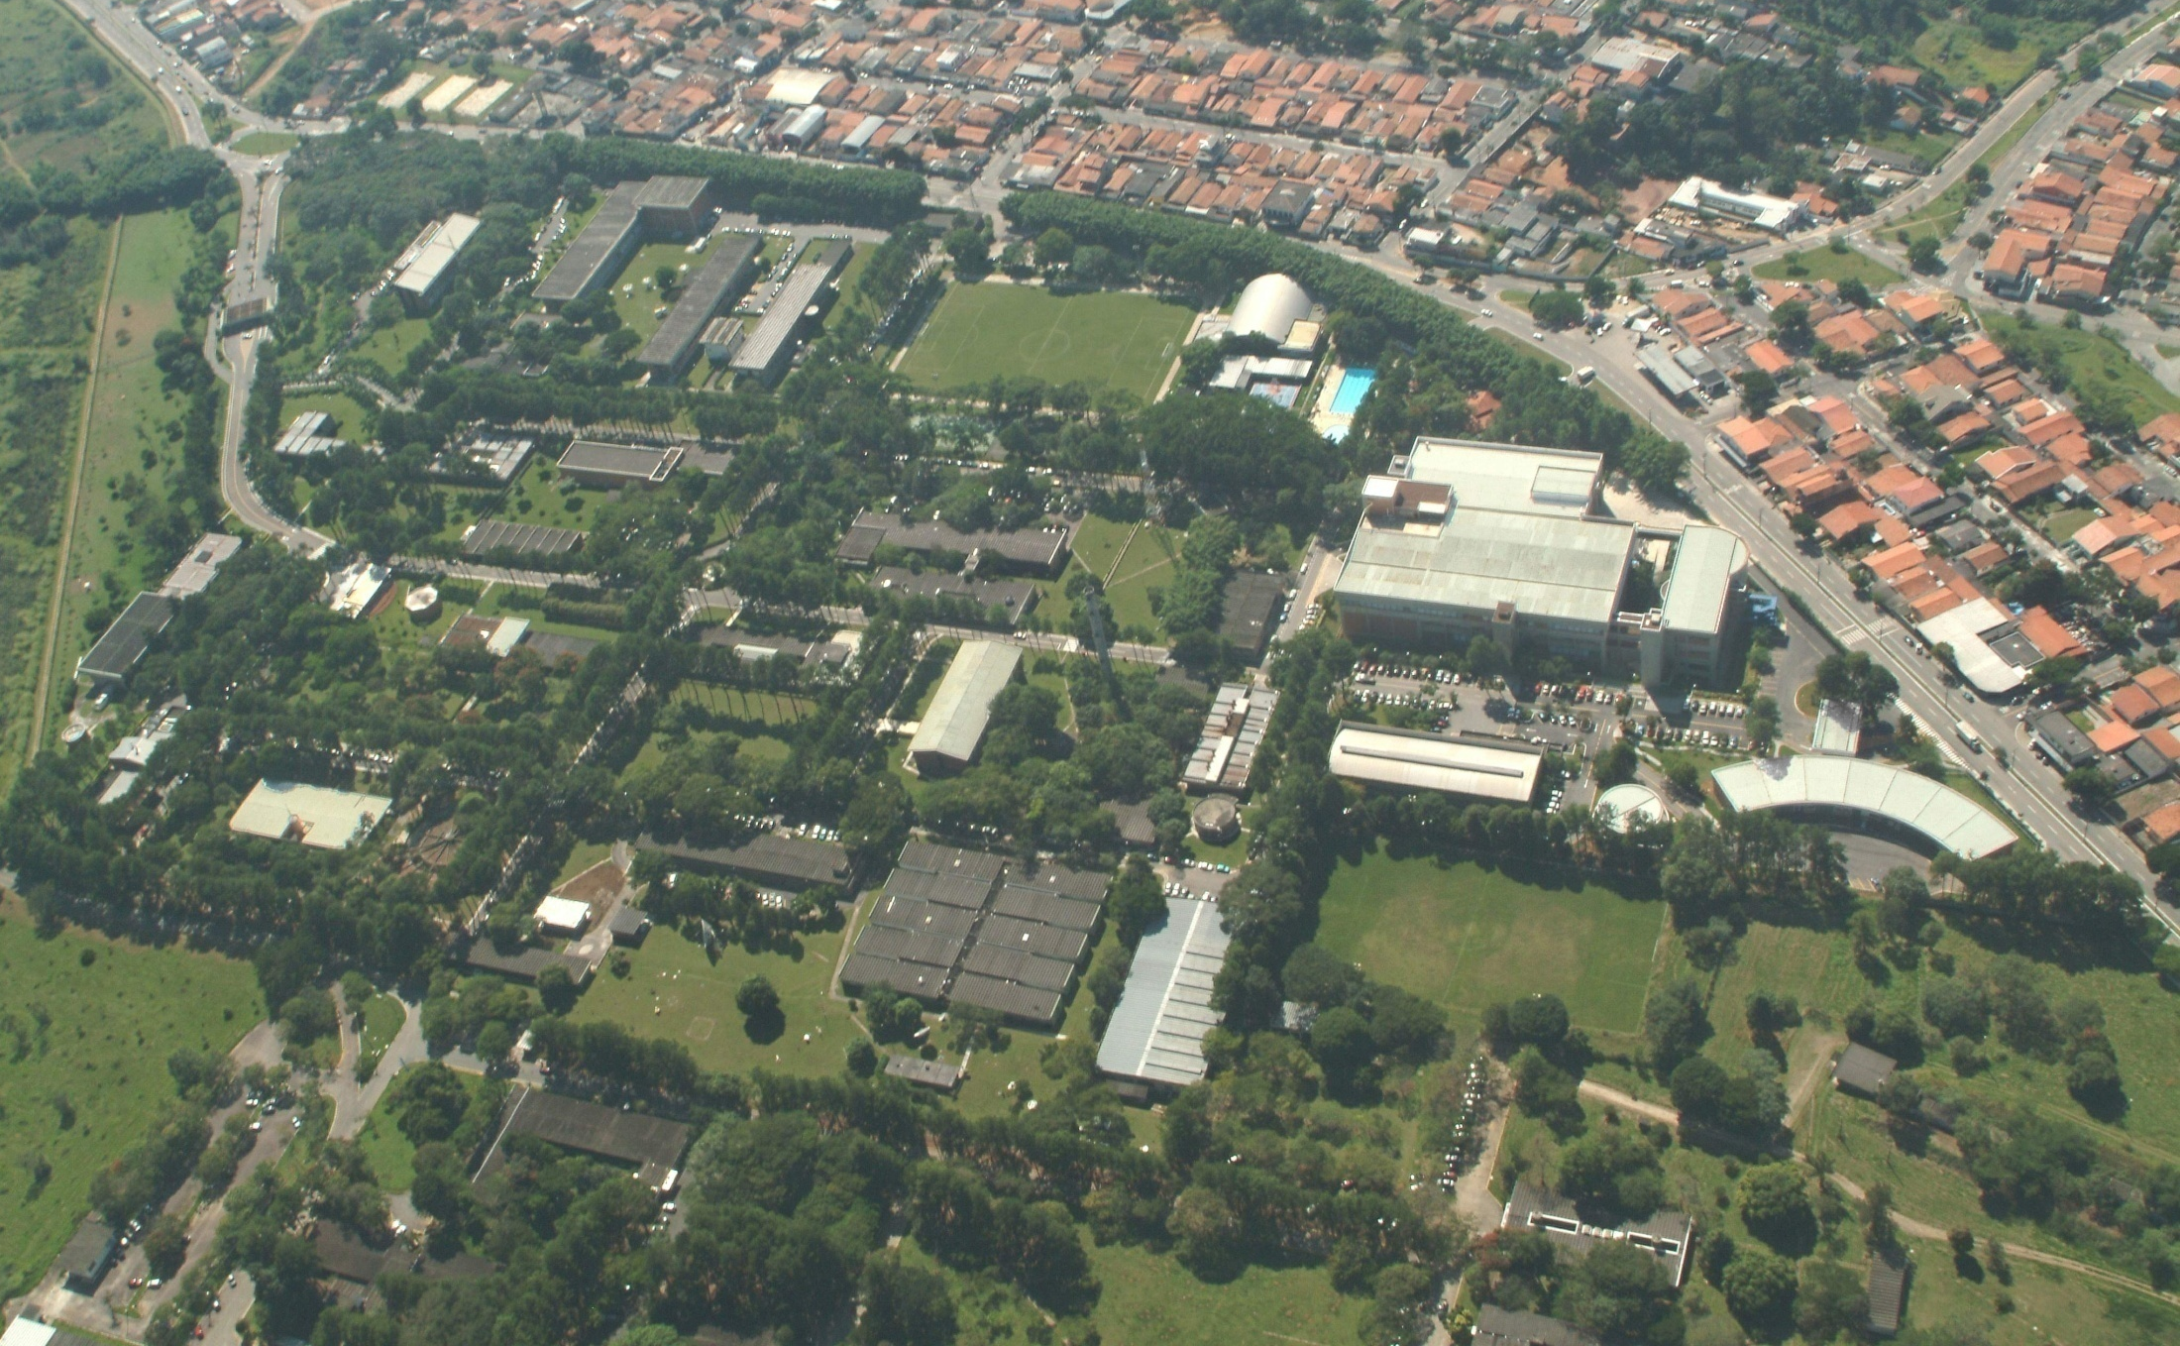
National Institute for Space Research – Brazil
Headquarters in São Jose dos Campos, SP

Slide 3
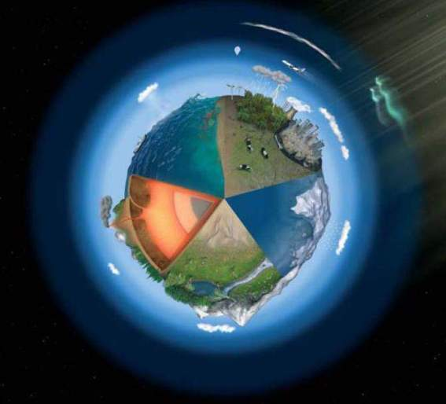
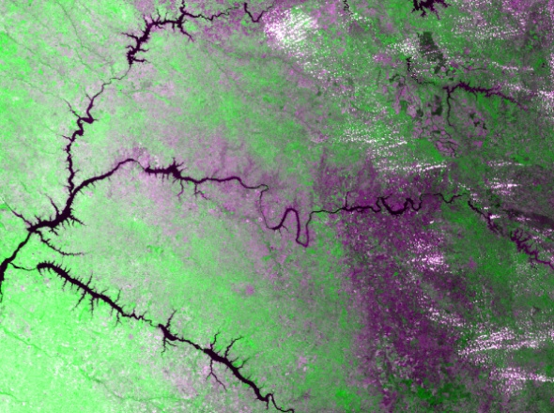
INPE – Main Areas
Space and Atmospheric Sciences
Space Engineering and Technology
Earth Science Systems
Weather Forecast and Climate Studies
Earth Observation

Slide 4
Organizational Chart
General Director
…
Center for Weather Forecast
and Climate Studies
(CPTEC)
Earth Observation
Directorate (OBT)
Image Processing
Division
Remote Sensing
Division
Satellite and
Environmental Systems
Division
Operations
Division
Remote Sensing
Data Center
Modeling and Development
Division

Slide 5
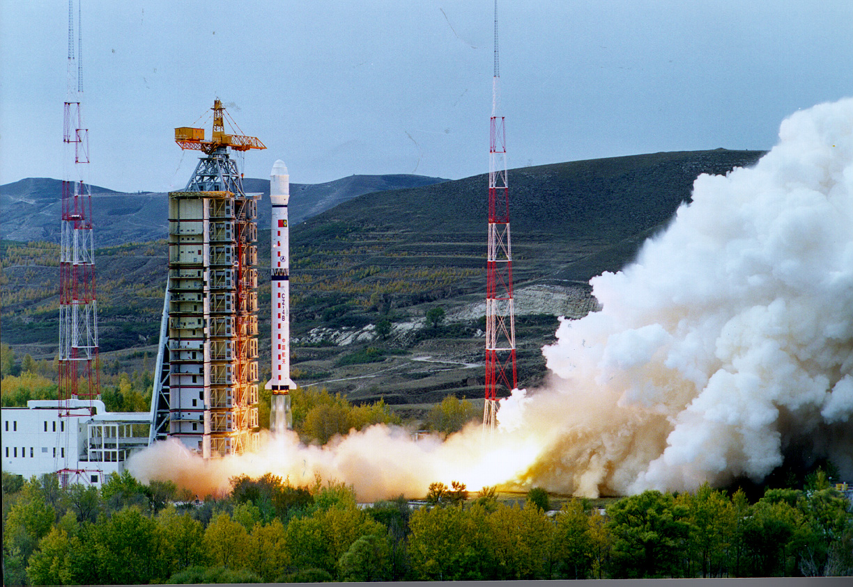
Main Updates: CBERS-3
  CBERS-3 Launch – December 09, 2013
  Taiyuan Satellite Launch Centre, China
  CBERS1 CBERS2 CBERS2B
  Oct 1999 Oct 2003 Sep 2007

Slide 6
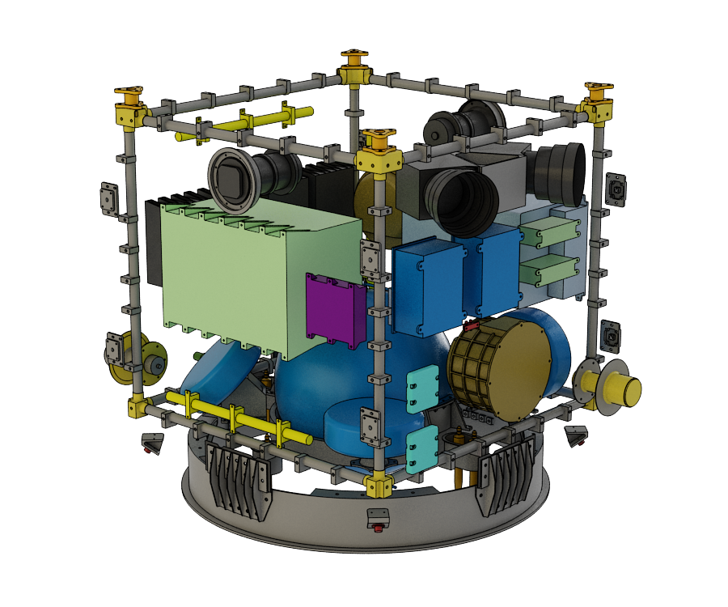
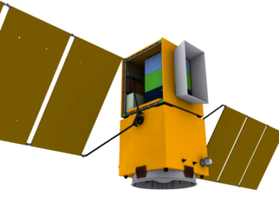
Main Updates: Amazonia -1
  AMAZONIA – 1
  Remote Sensing Satellite
  Multi-Mission Platform - MMP
  Scheduled to be launched in 2016

Slide 7

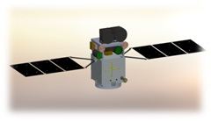
Main Updates: SABIA-Mar
  SABIA-Mar - Argentinean-Brazilian Satellite of Environmental Information of the Sea focused on ocean surface monitoring
  Multi-Mission Platform - MMP
  Brazilian Space Agency (in Portuguese AEB) and the National Commission for Space Activities (in Spanish CONAE)
  December 2013: Final revision of Phase A (Preliminary Requirements Review)
  Launch in 2018-2019

Slide 8
Main Updates: Sentinel Mission
  Sentinel Mission
  Willingness and interest in hosting the necessary facilities for the downlink of data/products from the new Sentinel satellites constellation
  Offering new state-of-the-art remote sensing products to the Latin America community
  Improving our monitoring power of sensitive biomes: tropical rain forest and Cerrado (Brazilian savannah), the coastal zone and inland water bodies and urban development.
  Sentinel 1 – Ship-detection technology in partnership with the Brazilian Navy
  Sentinel 2 – Deforestation monitoring and detection
  Sentinel 3 – Monitoring of aquatic systems, floodplain in Amazonia

Slide 9
  Thank you
  Hilcéa Ferreira
  hilcea@dpi.inpe.br

