Slide 1
CEO Report on Future CEOS Activities and Interactions
Agenda item: 36
Kerry Ann Sawyer, CEOS Executive Officer

Slide 2
Potpourri of Future CEOS Activities
Three-year CEOS Work Plan and other relevant documents
Prep for GEO-X Plenary and Ministerial
Key CEOS Stakeholder Meetings
Succession Planning for CEO (and DCEO?)

Slide 3
Three-Year CEOS Work Plan
The last of the CSS Strategic Documents
Under direction of the CEOS Chair and in consultation with CEOS leadership, the CEO develops the CEOS Work Plan (three-year longevity, updated annually).
Use the Montreal Statement as a basis for CEOS priority objectives for 2014 and 2015-2016
Retains original intention to provide overall guidance for CEOS on expected outcomes for CEOS and its stakeholders

Slide 4
Three-Year CEOS Work Plan
Timeline:
Mid-November: begin gathering inputs and prepare a draft outline of the document; work with Working Group Chairs, VC Co-Leads, and Ad hoc Team leads to identify key objectives and activities for 2014, 2015-2016 (many thanks to Satoko who has already provided WGISS inputs).
Late-December: have a draft version of the document prepared and share with the CEOS Secretariat.
Mid-January: participate in the GEO Plenary meeting where I will capture GEO's priorities for the coming three years.
Early February: CEOS-GEO Coordination meeting will occur where we will discuss both CEOS and GEO priorities and identify synergies where CEOS can support GEO; share the draft Work Plan with GEO.
Early February: after the Coordination meeting, revise and update the Work Plan to reflect outcomes from the January GEO Plenary and the February CEOS-GEO Coordination Meeting.
Late February: have the CEOS-GEO Actions (virtual) meeting and share the draft Work Plan with the Working Groups, VCs, and Ad hoc teams; receive comments from entities.
Final revision to the document, incorporating any edits received from the CEOS-GEO Actions meeting.
Mid-March - publish the final version of the CEOS Three-year Work Plan.

Slide 5
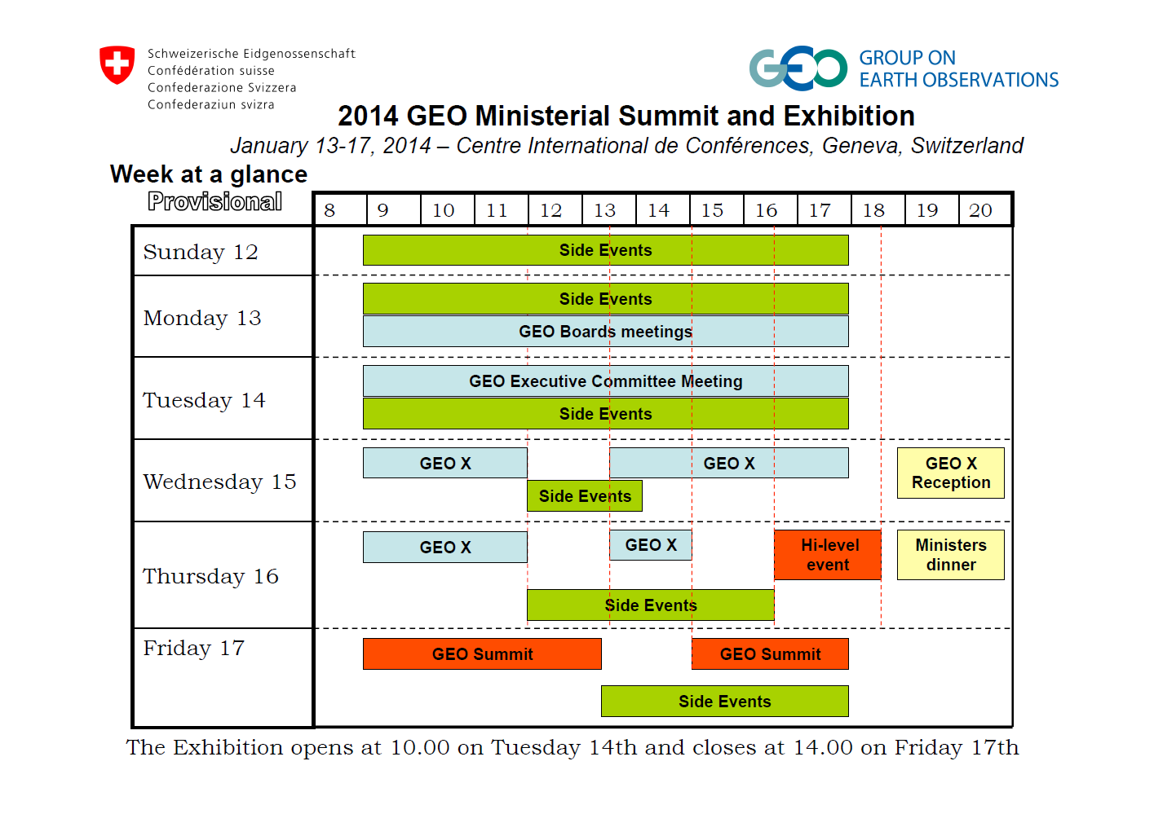
Prep for GEO-X and Ministerial
Will be hosted by Switzerland and to take place at the International Conference Centre Geneva (CICG) 12-17 January 2014
Head of CEOS Delegation: A. Ratier
Delegations lists due to GEO Secretariat 15 Nov – please contact CEO if wish to be on CEOS delegation
We will have a CEOS exhibition booth, funded by EUMETSAT, with new SEO/NASA hyperwall
CEO will begin preparing Plenary Statements shortly

Slide 6
Key CEOS Stakeholder Meetings
Month | Stakeholder Meeting | CEOS Engagement
January | GEO-X Plenary and Ministerial | CEOS Chair, SIT Chair, CEO, SEO
May | CGMS-42 | WGClimate
May/June | GEO Work Plan Symposium | CEO
July | IGARSS-2014 | ??
September | 65th IAC | CEOS Chair
October | Climate Workshop | CEOS Chair, WGClimate, ??
December | UNFCCC COP-20/SBSTA-41 | ??
Are there other meetings?

Slide 7
CEOS Calendar
CEOS Calendar (www.ceos.org
CEOS Events
GEO Events
Related Events
Action to CEOS Agencies to please inform CEO of attendance at meetings so that, if required, attendee may act or listen on behalf of CEOS
Ensure CEOS is represented at key meetings

Slide 8
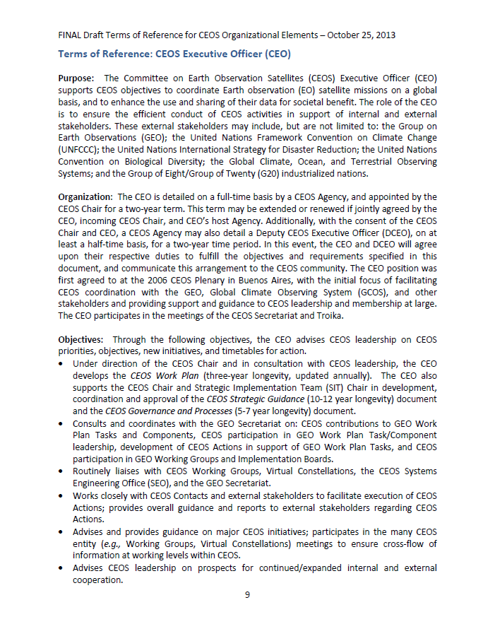
Succession Planning for CEO and DCEO
Current CEO’s term expires 1 December 2014
There is not, nor has there been, a Deputy CEO since 1 December 2012
CEO has a brand new ToR
Now OPEN

