Slide 1
CEOS Systems Engineering Office (SEO) Report
Agenda item: 33
Brian Killough, NASA, CEOS SEO
CEOS Plenary, November 5-6, 2013

Slide 2


2013 Accomplishments
  Kim Keith … Continued support for the CEOS website and mailing lists, development of outreach materials and videos, COVE testing and data acquistion analyses for GFOI and GEOGLAM, WGCapD training for Africa, GFOI training and capacity building with SilvaCarbon.
  Shelley Stover … Supported WGClimate (ECV Inventory), MIM Database (with ESA), Disasters (gap analyses), Carbon Task Force (gap analyses).
  Data Acquisition Planning and System Analyses (historical coverage, cloud probabilities, mission combination analyses) for GFOI and GEOGLAM.
  Worked with WGISS to maximize the impact of CWIC, provide an interface with GEO, and manage CWIC development contracts with NASA/NOAA. Completed a Data Policy Study and Portal.
  Enhanced COVE tool to improve support of GFOI and GEOGLAM. Conversion to Spanish, connections to data archives.

Slide 3
Major SEO Initiatives for 2014
  GEOGLAM and GFOI: Continued support for data acquisition planning and supporting systems analyses.
  Development of a “Coverage Analyzer” tool to support GFOI and GEOGLAM for assessment of historical coverage.
  Development of a Satellite Data Delivery Mechanism for cloud-based storage, processing and distribution of country-specific data for forest cover reporting. Cooperative development with UN-REDD, NSC, SDCG for GFOI.
  Enhancement of the COVE tool by adding more missions, instruments and modes and adding connections to mission data archives. Targeting archives from CSA (Radarsat), ESA (many past missions), CNES (SPOT, Pleiades), DLR (TSX, TDX).
  Outreach support for several major meetings using the CEOS Hyperwall (large video wall). Including the 2014 GEO Ministerial Meeting and the 2014 IGARSS Conference. Develop outreach materials and expand the impact of CEOS.

Slide 4
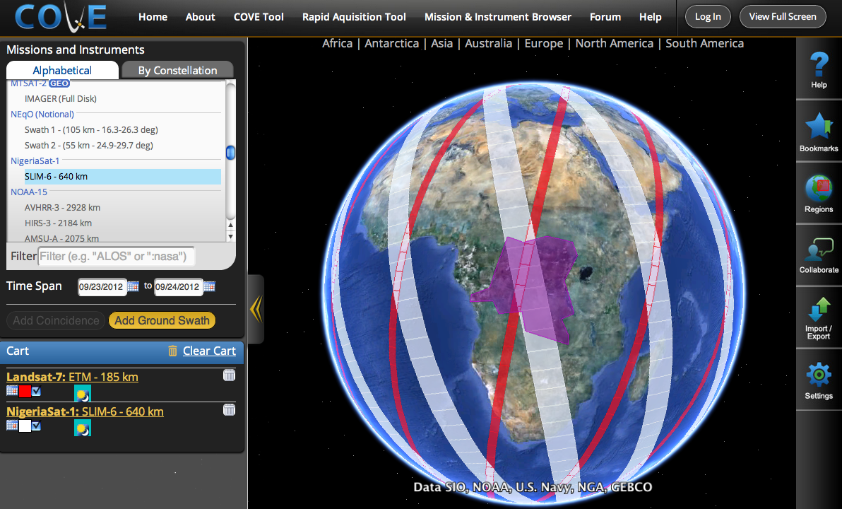
CEOS Visualization Environment (COVE)
www.ceos-cove.org
Browser-based tool using Google-Earth to display satellite coverage swaths and calculate coincidence scene locations.
Mission database:
127 missions, 267 Mission-Instrument combinations
Coming in 2014 … Links to data archives from CSA, ESA, RapidEye, DLR, CNES and more.
Did you know ....
There are 1046 Earth orbiting missions
There are 109 active CEOS missions

Slide 5
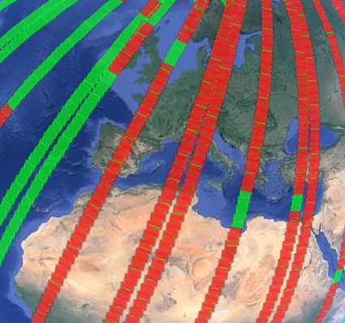
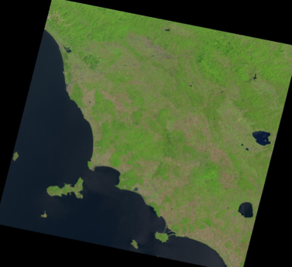
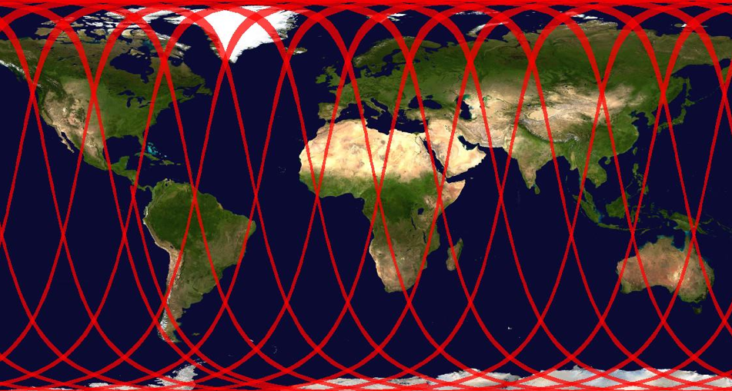
New Features in COVE
Landsat 7 and Landsat 8 Actual Acquisitions. Clicking on any actual scene retrieves the browse image.
2D global output in JPEG format.
Export screen contents to KML for viewing in Google Earth or sending to others.
Overlays ... GlobCover, MODIS Land Cover Classification (LCC), Cloud Cover (global monthly statistics), Precipitation (global monthly statistics).
Conversion to Spanish.
Landsat 8, Aug 1-3, over Europe
Green (potential), Red (actual)
Browse image ... over northern Italy on Aug 3
2D global map of Radarsat-2 (W3 mode) coverage on Aug 1

Slide 6
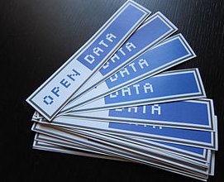
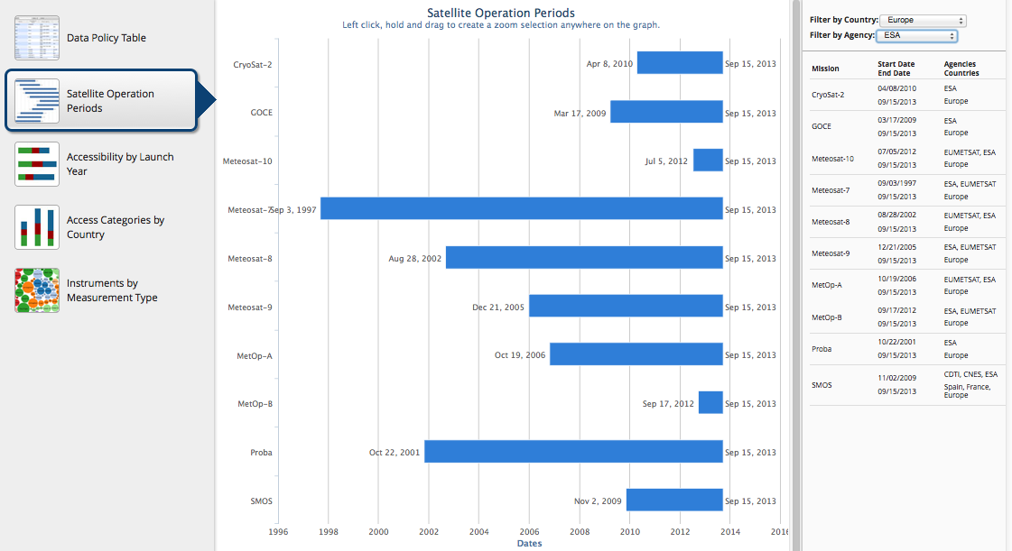
Data Policy Study and Portal
  107 Missions,
  292 Mission-Instrument Pairs,
  from 26 CEOS Agencies
  Open (no registration) = 47%
  Open (simple registration) = 21%
  Open (advanced approval) = 5%
  Restricted = 22%
  Unknown = 5%
  (mostly China missions)
  Comments
  73% of CEOS mission data
  is OPEN and accessible. This includes all missions since 2000.
  New Data Policy website available at:
  http://www.ceos-datapolicy.org/
  Discussing future plans to link the policy information to the MIM.
Other Categories
(current missions only)
  DataCORE = 33%
  IDN Portal = 45%
  CWIC = 27%
Thanks to WGISS for their excellent feedback and guidance during the data exploration period and tool development.

Slide 7



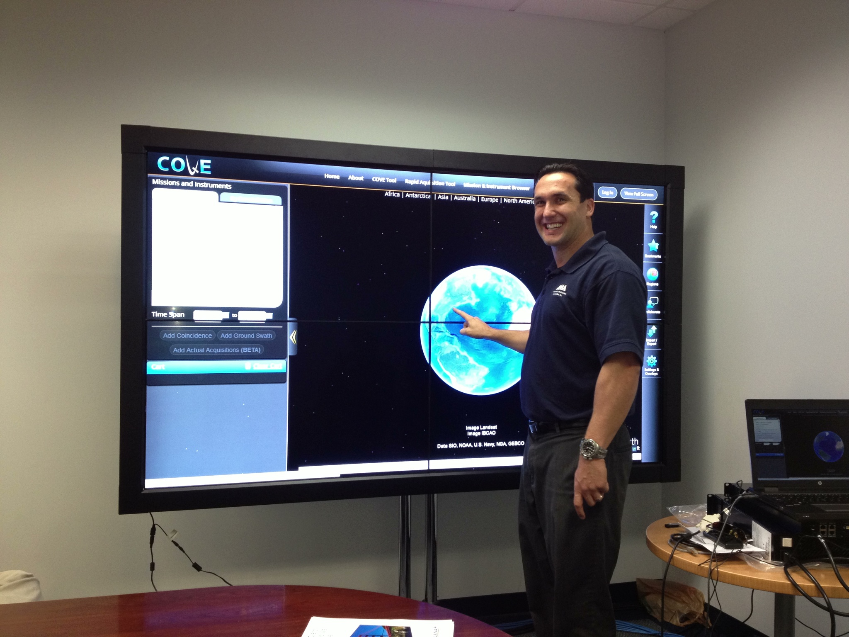
Outreach
  Outreach is important for CEOS. We know the benefits of coordinated efforts, but others may not understand.
  The SEO has invested in a new “CEOS Hyperwall” to maximize the impact of our CEOS work at large meeting venues. Please visit the new system in the meeting lobby and give us your feedback.
  You can help improve the CEOS social media presence by choosing to “like” our Facebook page. We may also consider a Twitter presence in the future.

