Slide 1
CEOS PLENARY Working Group on Capacity Building and Data Democracy
Agenda item: 32
Hilcéa Ferreira, INPE
Jacob Sutherlun, NOAA

Slide 2
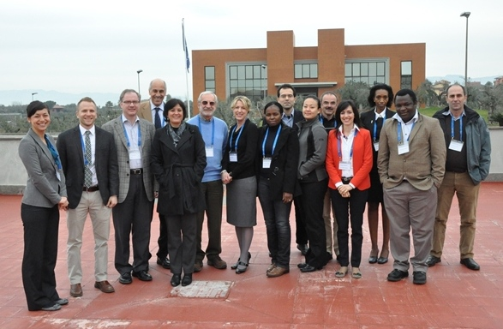
2013 Accomplishments
2nd meeting of WGCapD was held in Frascati, Italy, from March 4-6, 2013:
17 Participants: INPE, NOAA, CEOS CEO, CEOS SEO, DLR, ESA, GEO, SANSA, SWF, UNESCO, UNOOSA
11 Virtual Attendees: INPE, IRD, ISRO, NASA, UCAR, USGS

Slide 3
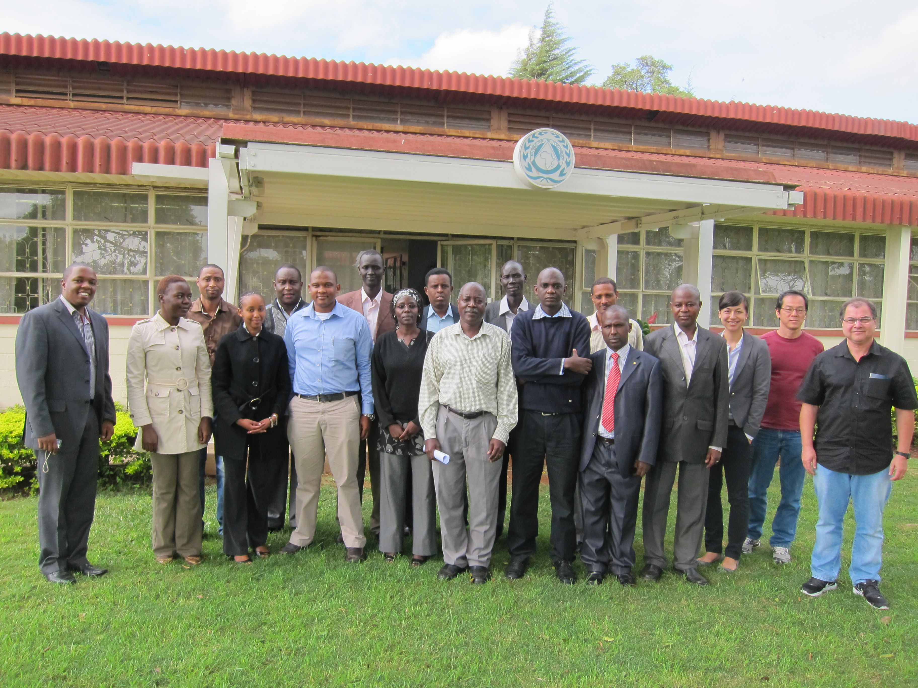
2013 Accomplishments
Improved access to global DEM developed on a country-by-country basis
May 6-10: I DEM Workshop held in Nairobi, Kenya, hosted by RCMRD
12 participants (Ethiopia, Somalia, Zambia, Kenya, South Sudan and Uganda).
Instructors were from SANSA, INPE, RCMRD/SERVIR, USGS (virtual), FEWSNET and SWF.
Unique CEOS workshop benefitting people at different levels with varying amounts of resources.
“Lessons-learned” Report available at WGCapD website, link “Documents”:
http://www.ceos.org/wgcapd

Slide 4
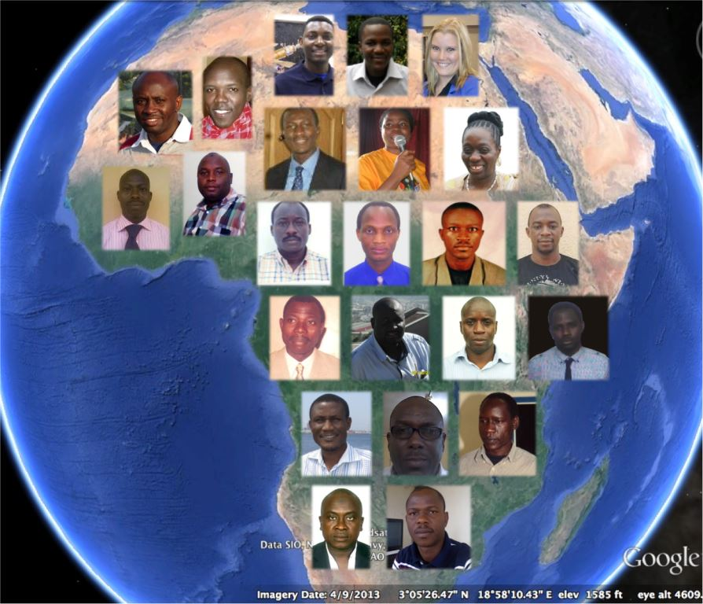
2013 Accomplishments
Remote-sensing E-learning course
July, 2013: e-learning course was finished and the final grades were compiled: from 30 students enrolled, 16 have successfully completed the course (55%).
From the 13 that have failed, 5 of them have not really participated but 8 of them, although not really handing in assignments, have checked TelEduc almost every week, mainly the Readings Tool, and participated in the web-sessions.
Certificates issued by INPE and sent to students by FEDEX.
Course Materials organized into a WIKI: http://wiki.obt.inpe.br/doku.php?id=e-learning
Evaluation report available!

Slide 5
2013 Accomplishments
E-learning course: Lessons learned
Plans to have a follow-up survey in December to ask each of the students (graduated or not) if they have used any of the things they learned in the classroom!

Slide 6
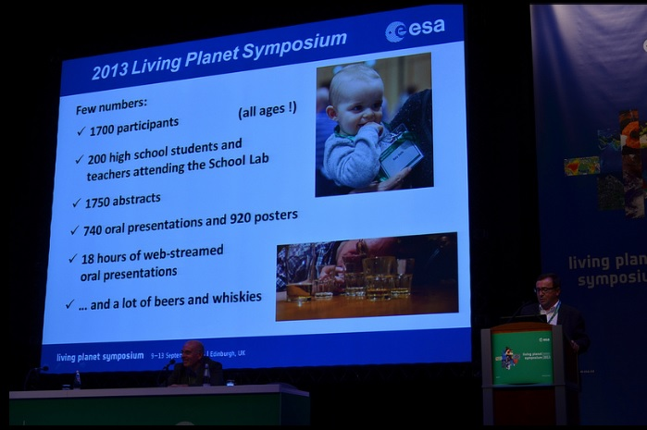
2013 Accomplishments
Practical EO Education for Students and Teachers
Education Stand during ESA Living Planet Symposium, with support of ESA, UK and DLR.
9-12 September, 2013 Edinburgh, UK
200 High School Students and Teachers
Hands-on activities and learn about science and technology behind Earth Observation.

Slide 7
2013 Accomplishments
CB Inventory Project
First round of questionnaires, inputs were received from main points of contact (50+ inputs received):

Slide 8
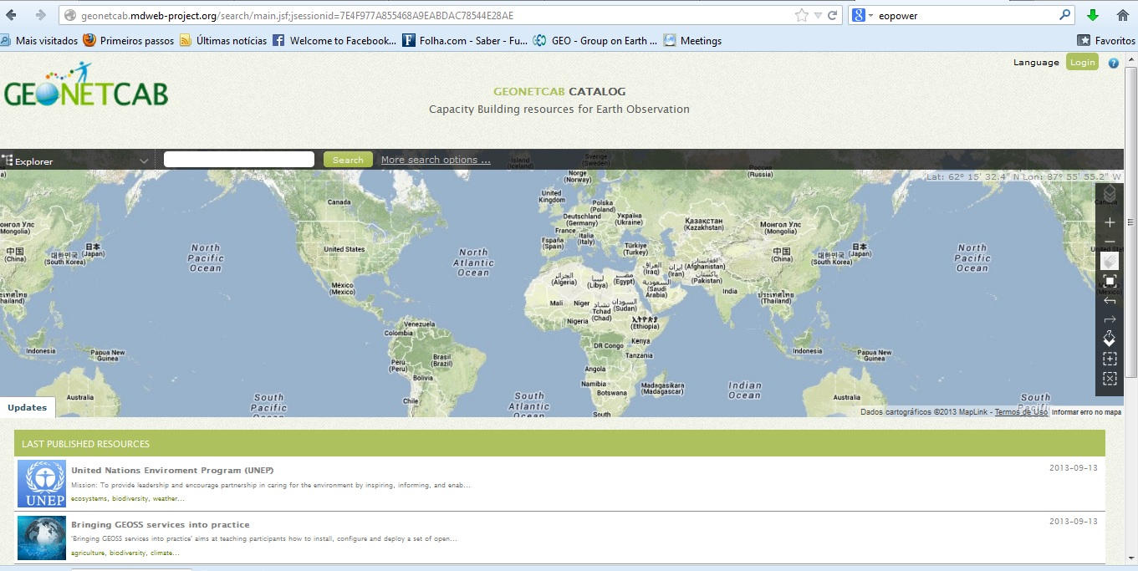
2013 Accomplishments
CB Inventory Project
Partnering with the GEONetCab and EOPower (Earth Observation for Economic Empowerment) FP7 European Projects
Planning a side event during GEO Ministerial Plenary in Geneva (13-17 January, 2014) Information from inventory will be adjusted to fit the standards of GEONetCab portal.
Will demo portal at side event

Slide 9
2013 Accomplishments
DRM Pilots(Support to Capacity Building Activities)
WGCapD is really involved with the Floods Pilot and here it seems that we can add value.
Expand the reach of some workshops, involving some partners that have a lot of experience with these pilots such as Stu Frye and Nancy Searby, from NASA. Coordination with SERVIR. Two main activities are programmed for the next months:
Workshop on the Use of Space Science and Technology for the Prevention of and Response to Disasters in Mesoamerica - 19 – 22 November 2013, Tuxtla Gutiérrez, Chiapas, México
Partners: CRECTEALC, SWF, NOAA, GEO and others.
Preparations for invitations for participants and potential instructors
Flood and Drought Monitoring and Modeling, Namibia (January, 2014)
Partners: NASA and SANSA (INPE is willing to contribute)

Slide 10
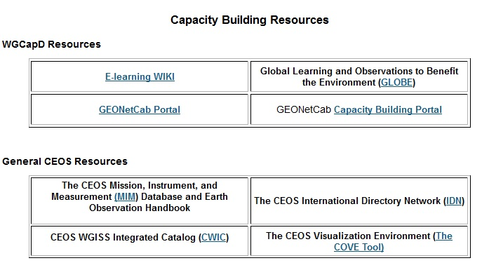
2013 Accomplishments
Outreach Activities:
Improving contents of our website: Resources Link
CB Inventory Project showcase during GEO Ministerial/Plenary.
Participation in main events: UN/IAF Conference, IAC
WGCapD Short Video

Slide 11
Way forward...
How can we define success? How can we measure the impacts of our trainings/workshops in the countries and communities?
Inclusion of a Monitoring and Evaluation Component into training initiatives.
Community building: creating a BLOG or Facebook community.
Seeking opportunities to connect workshop and other training initiative participants with existing CEOS and GEO projects. Train them on the technical side and then give them contacts to start the process in their own country
Notes:
Design some metrics: what is working and what is not, regarding CapD activities and projects. We have to be able to MEASURE IMPACT of CapD activities somehow. Besides interaction and cooperation, how are we really delivering CB? How these workshops and trainings have lifted up the capacity of the country where they were held?
This would be discussed with participants at the beginning of each initiative so they would be aware that they were being asked to assist us in evaluating their experience; and that we would be following up with them concerning implementation of the workshop content within their respective organizations.

Slide 12
I wish success to WGCapD new leadership!

Slide 13
Thank you!
Hilcéa and Jacob
hilcea@dpi.inpe.br

