Slide 1


Report on the first 3 years of the CEOS Working Group on Climate
Mark Dowell and John Bates

Slide 2
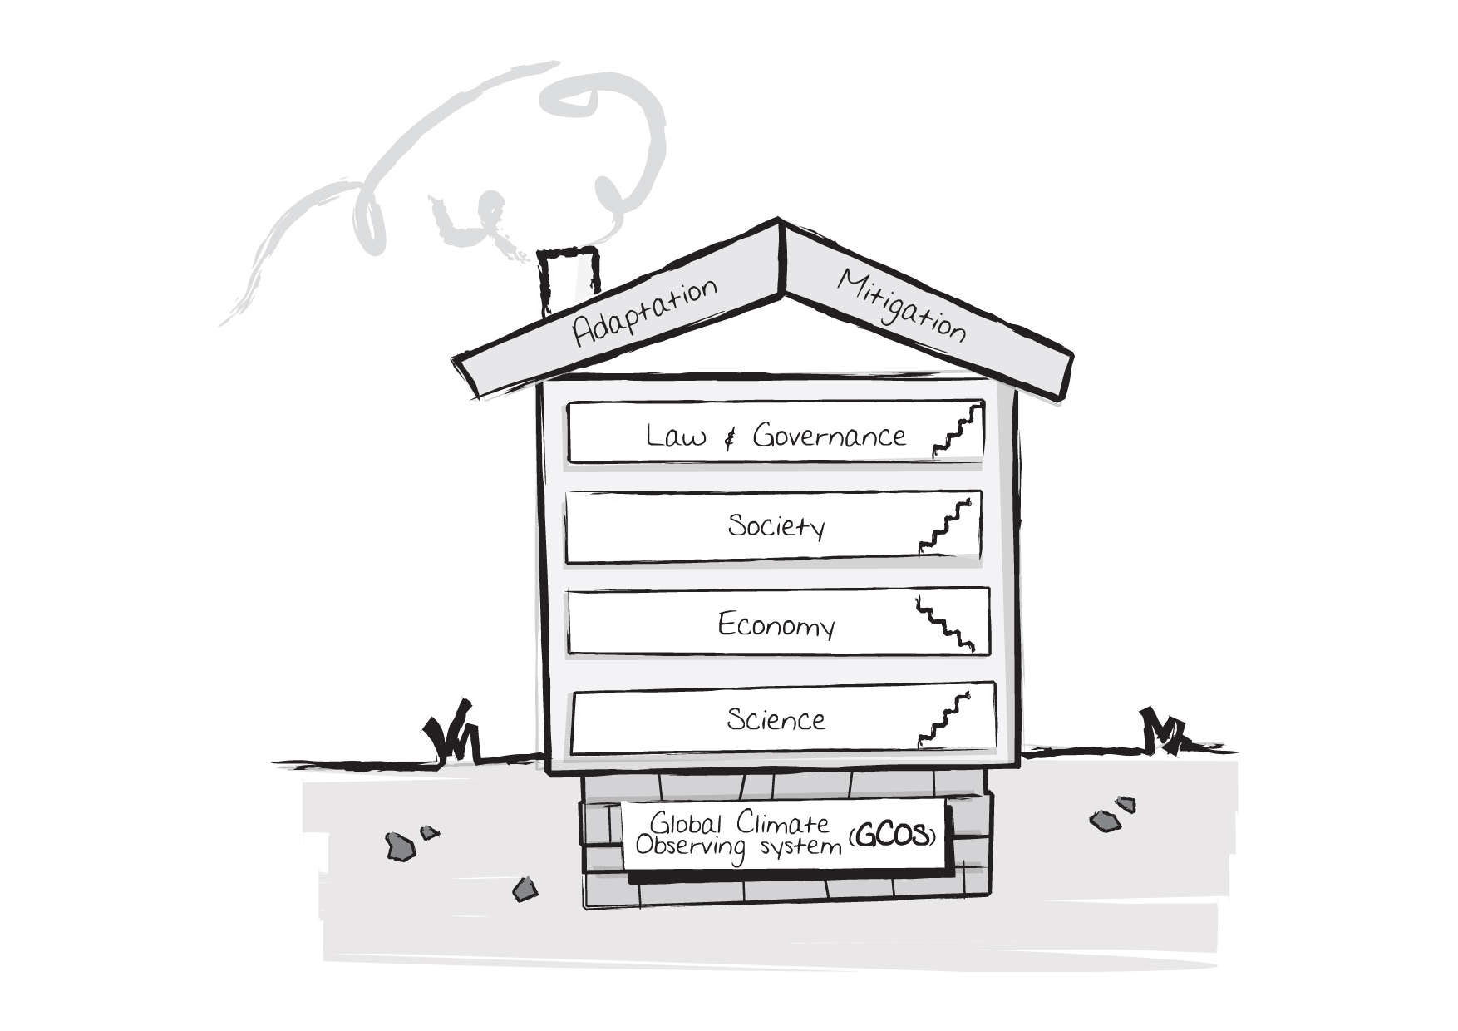
Observation: Foundation of Science & Services
Climate House
WITH
Observations
Guidance / Knowledge
Information services
Science Assessment
In-situ & Space data
Adapted from
DiploFoundation
Climate Change Building
M. Doherty Doha 12/2012

Slide 3

Observation: Foundation of Science & Services
Climate House
WITHOUT
Observations
Courtesy Marco, ESA

Slide 4
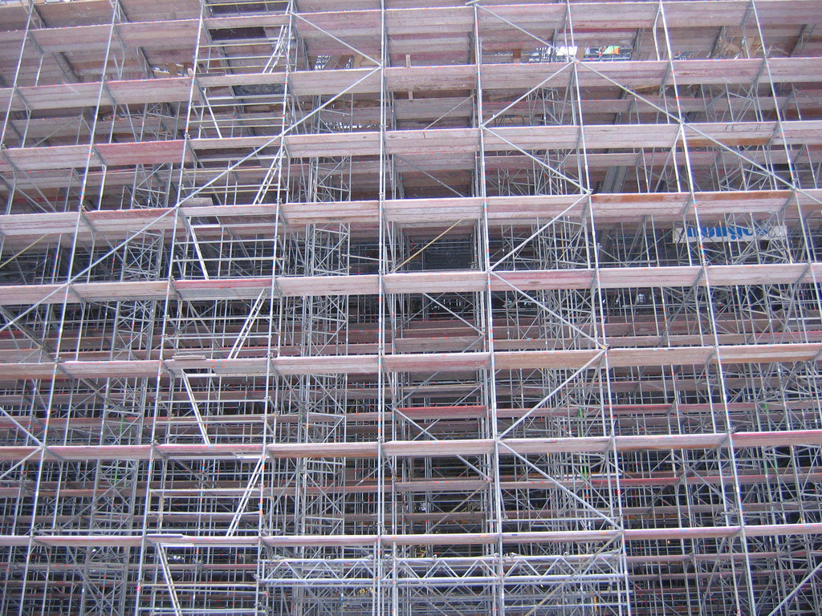
We need Scaffolding

Slide 5
WGClimate 2012-2013
  WGClimate 3-year outcomes
    Provision of a structured, comprehensive and accessible view as to what Climate Data Records (CDRs) are currently available,
    Creation of the conditions for delivering further CDRs,
    Optimization of the planning of future satellite missions and constellations to expand existing and planned CDRs, both in terms of coverage and record length, and to address possible gaps with respect to GCOS requirements.
  Accomplishments since the 2012 Plenary
    CEOS response to GCOS IP presented to COP-18/SBSTA-37
    Climate from Space Week in Geneva in February
    Published ‘Strategy Towards an architecture for Climate Monitoring from Space’ jointly with CGMS
    Completed first ECV inventory questionnaire
    Coordinated revised Terms of Reference between CEOS and CGMS

Slide 6
Addressing recent issues
Carbon Task Force Report Recommendations
  WGClimate are reviewing the report, to provide feedback, by the November 25th deadline
  We propose to initiate an fixed-term task within WGClimate, to identify where/if the CTF report recommendations could be addressed within CEOS – by September SIT Workshop 2014
Broadening CEOS’ reporting to SBSTA-RSO
  Based on a request from SBSTA at COP-17 December 2012
  Broaden our periodic reporting to RSO sub-committee on all “activities undertaken my space agencies on topics of interest to the Convention” (e.g. to REDD+ and on Carbon)
  This should not be seen as requiring additional work…
  WGClimate can act as interface by taking advantage (and acknowledging) effort of other existing CEOS “products” i.e. CTF Strategy report, relevant strategy documents from GFOI

Slide 7
Terms of Reference
The CEOS Climate Working Group will:
  Review and assess, on behalf of CEOS, the generation of Fundamental Climate Data Records (FCDRs) and derived Essential Climate Variable (ECV) climate products supported by Member space agencies, complementary with existing entities and roles;
  Contribute to the review of compliance of satellite missions and products with the GCOS Climate Monitoring Principles and with the “Guideline for the Generation of Datasets and Products meeting GCOS Requirements” (GCOS-143);
  Identify multi-agency implementation teams for each product and review their actions, and ensure that a coherent implementation plan exists for each and every product taking full account of other pertinent international initiatives such as SCOPE-CM and science programmes;
  Make recommendations to the above teams and receive recommendations from them, for transmission to CEOS Agency Principals;
  Ensure coherence of climate product generation supported by space agencies, including with other relevant international initiatives, in particular SCOPE-CM, and);
  Undertake any other relevant activities as instructed by CEOS Chair.

Slide 8



First new CEOS Standing WG in 10 years
WGClimate was endorsed as a full CEOS WG (joining WGISS, WGCV and WGCapD) and will coordinate and encourage collaborative activities between the world’s major space agencies in the area of climate monitoring
The Mission of the Working Group Climate (WGClimate) is to facilitate the implementation and exploitation of Essential Climate Variable (ECV) time-series through coordination of the existing and substantial activities undertaking be CEOS member agencies. This includes the numerous iterative steps involved in the creation of ECVs and ensuring ECV life cycle information is gathered, organized, and preserved for future generations.
Chair of CEOS WGClimate
Mark Dowell (EC/JRC)
Vice Chair John Bates (NOAA/NCDC)

Slide 9
Architecture
ECV Inventory
ECV Assessments
Metrics
WGClimate

Slide 10
Research AND Operations
A holistic view of the interdependency of research and operations needed for sustained and routine climate monitoring.

Slide 11

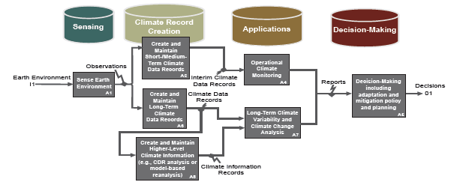


Architecture for Climate Monitoring
‘Strategy Towards an architecture for Climate Monitoring from Space’ jointly with CGMS and WMO
  Report can be found on the CEOS WGClimate web site (also on CGMS and WMO)
  Published 2013
  Foundation for the Observation and Monitoring Pillar of GFCS

Slide 12
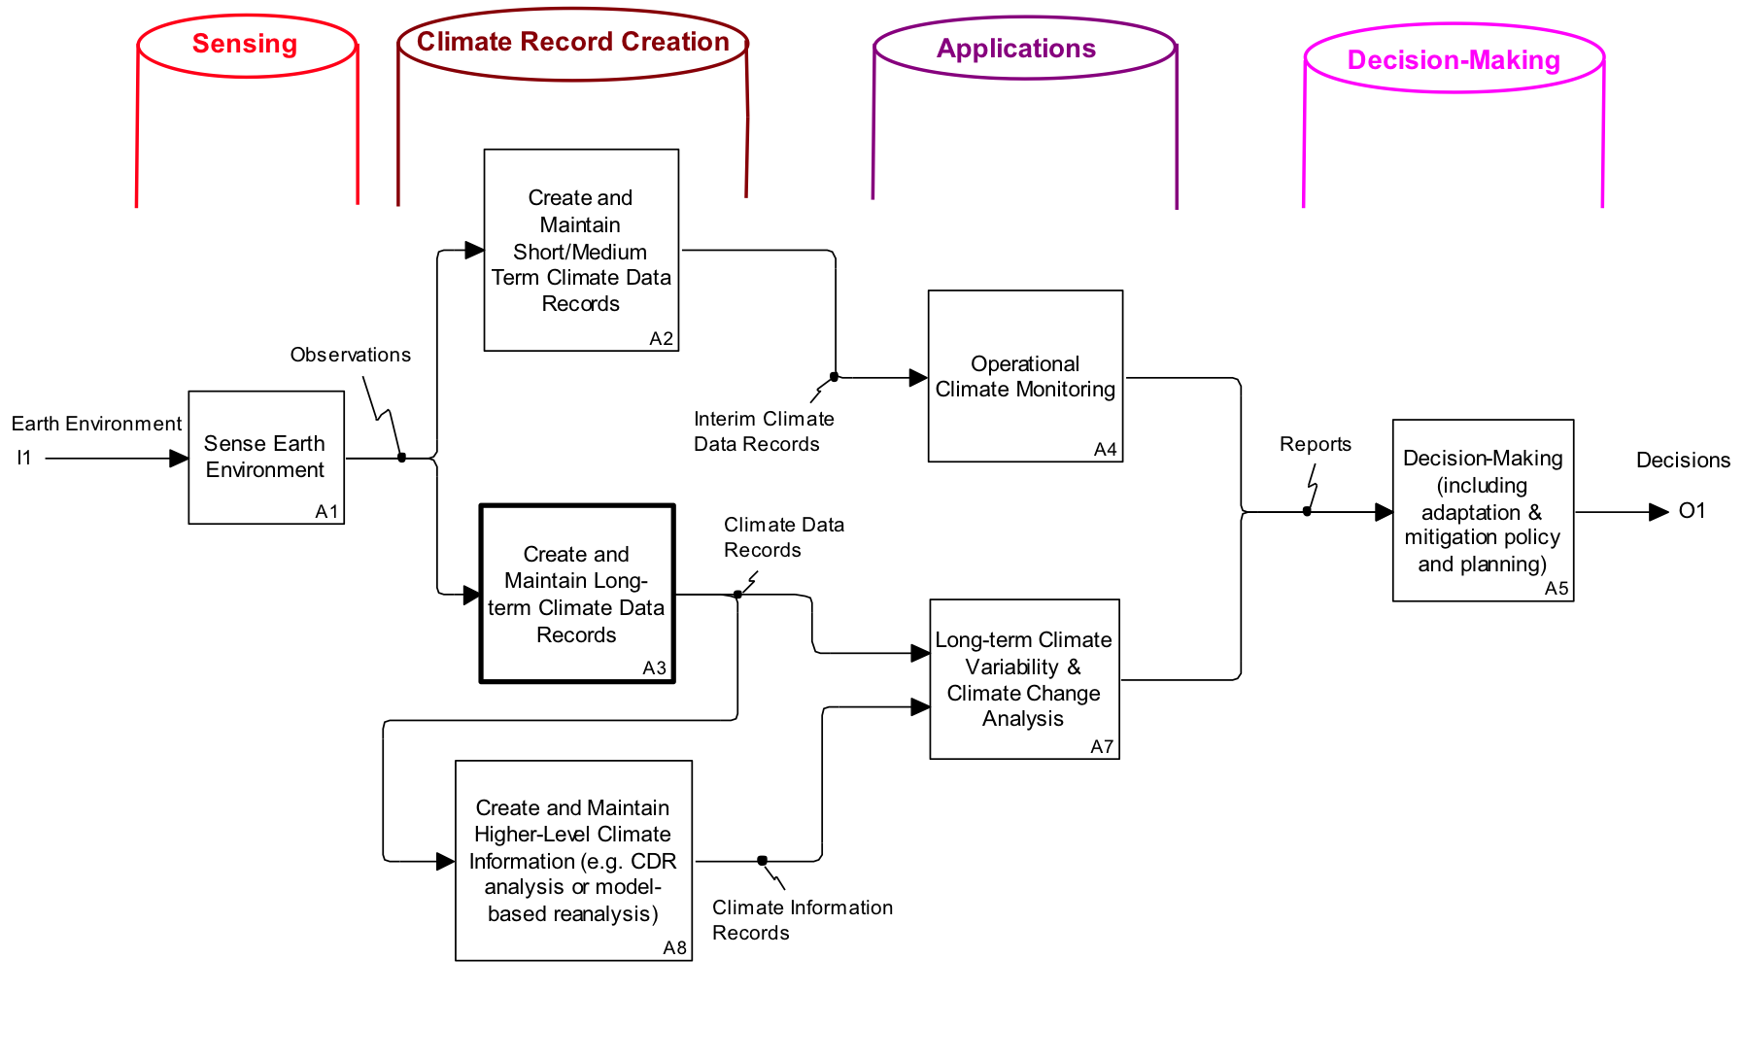
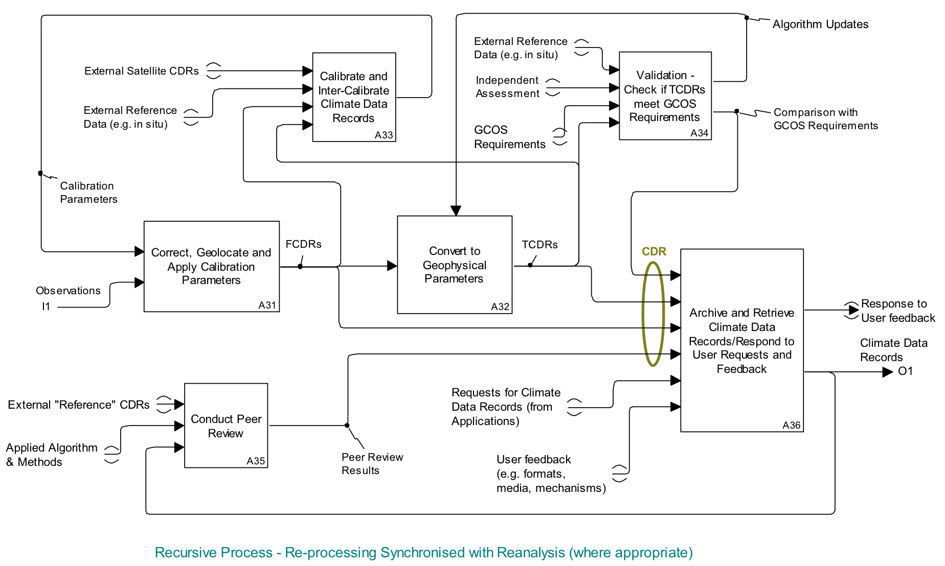
Logical representation
Traceable to GCOS Guidelines and GCOS Climate Monitoring Principles
Traceable from ECV Inventory and physical representation of Climate Monitoring Architecture

Slide 13
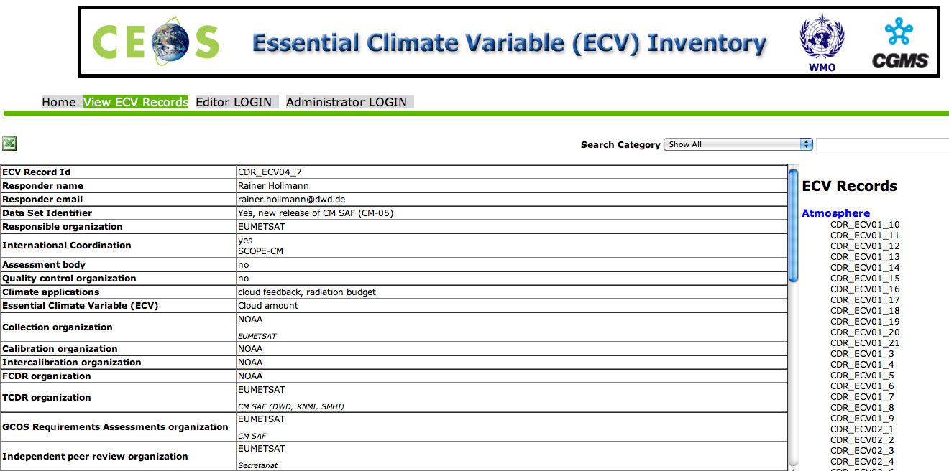
ECV Inventory http://www.ecvinventory.com
Continued joint CEOS-CGMS-WMO activity
~220 entries, good representation across domains
Potential for gap analysis to distinguish what is being observed but not used
Quality control assessing completeness, consistency checks
ECV-Inventory will remain continuously open for submissions
Snapshots will be taken at specific time interval and analysed

Slide 14
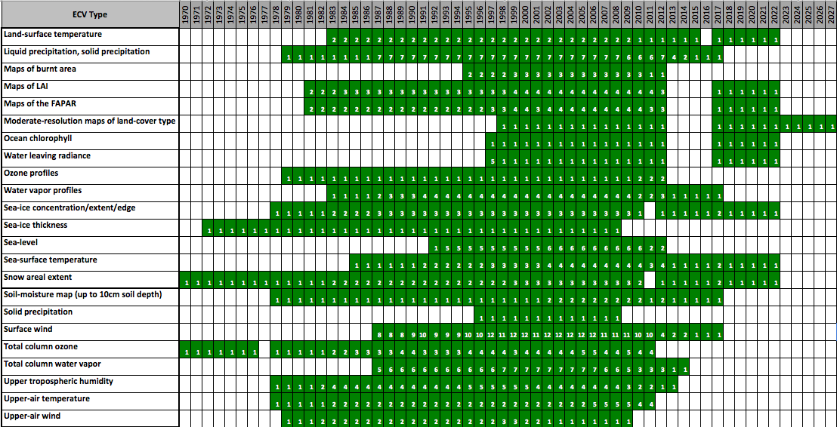
ECV Inventory Statistics – ECV Timelines

Slide 15
Others using the ECV Inventory
Assessment of ECV datasets via GCI – Analysis of GEOSS resources accessibility related to the GCOS Essential Climate Variables
  EC-JRC used the CEOS ECV inventory as the basis for their study to determine real accessibility of datasets (how direct was data access).
  Conclusions:
    60% of the ECVs-related resources were registered in the GCI as GEOSS Data CORE and that only 8% of them did not provide distribution information.
    For ECVs, there is good availability and accessibility to the key data resources needed to support applications.

Slide 16
WGClimate
Additional Achievements by the end of 2013 (1/2)
Coordination with CEOS Virtual Constellations & CGMS International Working Groups & SCOPE-CM regarding ECVs
Domain | Essential Climate Variables
Atmospheric (over land, sea and ice) | Surface wind speed and direction; precipitation; upper-air temperature; upper-air wind speed and direction; water vapour; cloud properties; Earth radiation budget (including solar irradiance); carbon dioxide; methane and other long-lived greenhouse gases; and ozone and aerosol properties, supported by their precursors.
Oceanic | Sea-surface temperature; sea-surface salinity; sea level; sea state; sea ice; ocean colour.
Terrestrial | Lakes; snow cover; glaciers and ice caps;, ice sheets; albedo; land cover (including vegetation type); fraction of Absorbed Photosynthetically Active Radiation (FAPAR); Leaf Area Index (LAI); above-ground biomass; fire disturbance; soil moisture.

Slide 17
Architecture Road Map
Define, Validate and Obtain Consensus on Overall Approach (including logical representation)
Short-term
(within 2 years)
Current status
Describe Current and Planned Implementation Arrangements (ECV-by-ECV) within an Inventory
Medium-term
(2-4 years)
Use the Inventory to Develop a Coordinated Action Plan to Address Identified Gaps/Shortfalls

Slide 18
Balance of priorities of Architecture work for 2014
Emphasis on completing first version of ECV Inventory, performing first complete gap-analysis at a ECV product level, start definition of action plans on options to address gaps
Parallel initiative: building up the “right-hand side” of the Architecture - the link to Applications and Policy requirements.
  Called for in Strategy Report
  Initial activity applying case studies to the logical architecture.
  Examples at global, regional and national scales
  Compatible with GFCS
  Strong WMO engagement
  Maybe a activity where “smaller” CEOS Agencies are interested to engage

Slide 19
Links to WCRP/GCOS initiatives
There is an opportunity to consider a central “database” of ECV product metadata
CEOS-CGMS-WMO maybe the the best “resourced” opportunity for this – BUT this should not negate the potential for multiple interfaces to this database
CEOS-CGMS-WMO Inventory needs to:
  Verify consistency of GCOS/WCRP questionnaire with ECV Inventory [Done… almost]
  On in-situ ultimately CEOS & CGMS could provide the infrastructure/database but GCOS/WCRP Panels, WCRP & WMO would be responsible for soliciting in-situ contributions (i.e. handholding)

Slide 20
CEOS-VCs & ECV Assessments
Ultimately existence of an assessment should be indicated in the ECV Inventory but assessment itself would remain independent
Need to also be clear on differences between system metrics (e.g. maturity matrix) and data assessments – two orthogonal axes.
Desirable roles/responsibility:
    Someone to provide “blueprint”/protocol for assessments, i.e. WCRP-WDAC (benefitting from experience with GEWEX, SPARC) – but with input for external expert groups
    Domain specific competence/scientific bodies (e.g. GHRSST, IOCCG, OST-ST, OSVW-ST) together with CEOS VCs undertake individual assessments
    CEOS WGClimate to ensure assessment have resources, where appropriate thorough CEOS member agencies
    GCOS/WCRP Panels to provide review of assessments

Slide 21


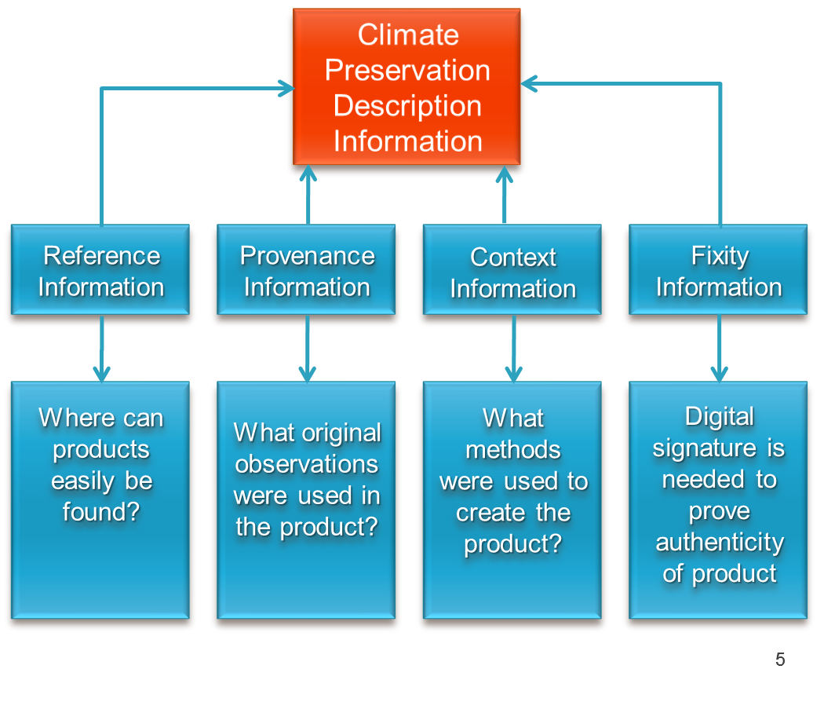
Metrics: Maturity Matrix
Ultimate ambition – define CEOS “endorsed” Maturity metrics
Starting point - NOAA effort - Bates and Privette 2012
Task within WGClimate, to review/modify => improve (?)
One size may not fit all
It is as much a tool to monitoring progress as it is to provide a snapshot of current capability
Source J. Bates

Slide 22

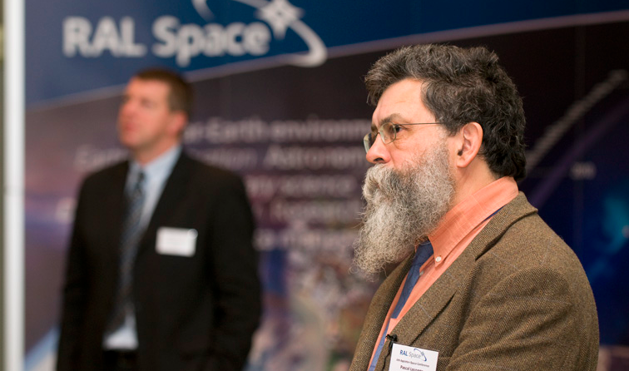
Strong future leadership for Climate coordination
CEOS WGClimate started a vice chair selection process in March 2013
A sole nomination was received (Pascal Lecomte ESA) which was confirmed by his Agency Principal
CGMS Plenary was notified of this ongoing leadership selection process – and accepted that this would be an acceptable transition arrangement for the proposed Joint Working Group on Climate
From November 2013: John Bates NOAA will assume Chair and Pascal Lecomte ESA will assume Vice Chair

Slide 23
Personal Conclusions
People are the your most important asset – treasure them
The external community values CEOS’ opinion (stamp of approval)
The dedicated CEOS staff (CEO, SEO) are of fundamental importance not only for the CEOS and SIT Chairs, but also for the working level activities
Timely feedback from CEOS Principals and poc on requests, recommendations and deliverables for WGs and VCs is critical
Internal coordination most effective through cross-representation WG-WG & WG-VC
External coordination takes a lot of effort, but in many case is necessary: be selective, but where appropriate consider formal relationships
Always ask: what is the added value of this being a CEOS activity
Domain specific Architecture, had demonstrated to be a highly effective, may have potential as a process beyond Climate
All agencies, regardless of size, or if they operate climate “missions” have a role to play in the development of the Architecture for Climate Monitoring
There are domain level inequalities – Terrestrial domain (maybe general)

Slide 24
Personal Thanks
To my colleagues in EC-JRC and EC- DG ENTR for the opportunity to take on this role
To Stephen Briggs, for the foresight and initial support in advocating closer international coordination on Climate activities
To the SEO & MIM Teams for technical support and advice
To the fabulous CEOs the cornerstones of CEOS (Ivan, Tim & Kerry)
To my sounding board: Pascal, Rob & Joerg …
To my colleagues in WGClimate and the adhoc group for the Architecture for Climate Monitoring for their patience, and equal doses of enthusiasm and competence
To the CEOS and SIT Chairs over the last 3 years and to CEOS Principals for their persistent support and interest in advancing the climate coordination activities
To the incoming Chair of the Working Group Climate and the best Vice Chair ever BONNE CHANCE JOHN !

Slide 25

It’s been a ride !

Slide 26
For Decision
Issue – Decision to adopt, unamended, the revised Terms of Reference for a Joint CEOS-CGMS WGClimate and the proposed transition arrangement
Options
  Adopt revised Terms of Reference for a Joint CEOS-CGMS WGClimate (minor changes can be accomplished by the joint WGClimate if needed)
  Amend revised Terms of Reference for a Joint CEOS-CGMS WGClimate and return them to CGMS for consideration
Revised ToR have been adopted by CGMS Plenary and CEOS SEC – EUMETSAT to comment
Thanks to SEC members, CGMS members and particularly EUMETSAT for their help on this issue

Slide 27
Joint Working Group on Climate
The over-arching goal of the CEOS/CGMS Working Group on Climate (WG Climate) will be to improve the systematic availability of Climate Data Records through the coordinated implementation, and further development of the architecture for climate monitoring from space.
More specifically, the coordination shall be designed to achieve three main objectives:
Provision of a structured, comprehensive and accessible view as to what Climate Data Records are currently available from satellite missions of CEOS and CGMS members or their combination;
Creation of the conditions for delivering further Climate Data Records, including multi-mission Climate Date Records, through best use of available data to fulfil GCOS requirements (e.g. by identifying and targetting cross-calibration or re-processing gaps/shortfalls );
Optimisation of the planning of future satellite missions and constellations to expand existing and planned Climate Data Records, both in terms of coverage and record length, and to address possible gaps with respect to GCOS requirements.

Slide 28
New CGMS nominated members
CMA: Fan Jinlong, fanjl@cma.gov.cn
JMA: Yasushi Izumikawa, satellite@ml.kishou.go.jp
KMA: Inchul SHIN icshin@korea.kr
ROSHYDROMET: Alexey Rublev alex.rublev@mail.ru

