Slide 1

27th CEOS PLENARY
GEOGLAM Status Update
Agenda item: 24
Michel Deshayes, GEO Secretariat
on behalf of GEOGLAM

Slide 2
Outline
Context & mandate
Objectives, structure & work plan
Accomplishments
GEOGLAM & CEOS collaboration
Current and future challenges
Conclusions

Slide 3
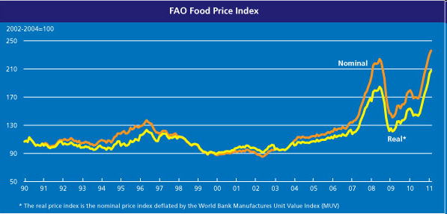
GEOGLAM Context
G20 Agriculture Priority (2011)
“ We, the G20 Agriculture Ministers, meet today to address the issue of food price volatility with the ultimate objective to improve food security and agree on an “Action Plan on food price volatility and agriculture” that will be submitted to our Leaders at their Summit in November 2011.”
(introduction of the “G20 Agriculture Action Plan”, June 2011)
At risk :
Access to food for populations
Investment in the agricultural sector (increase production by +70% over 2010- 2050)

Slide 4
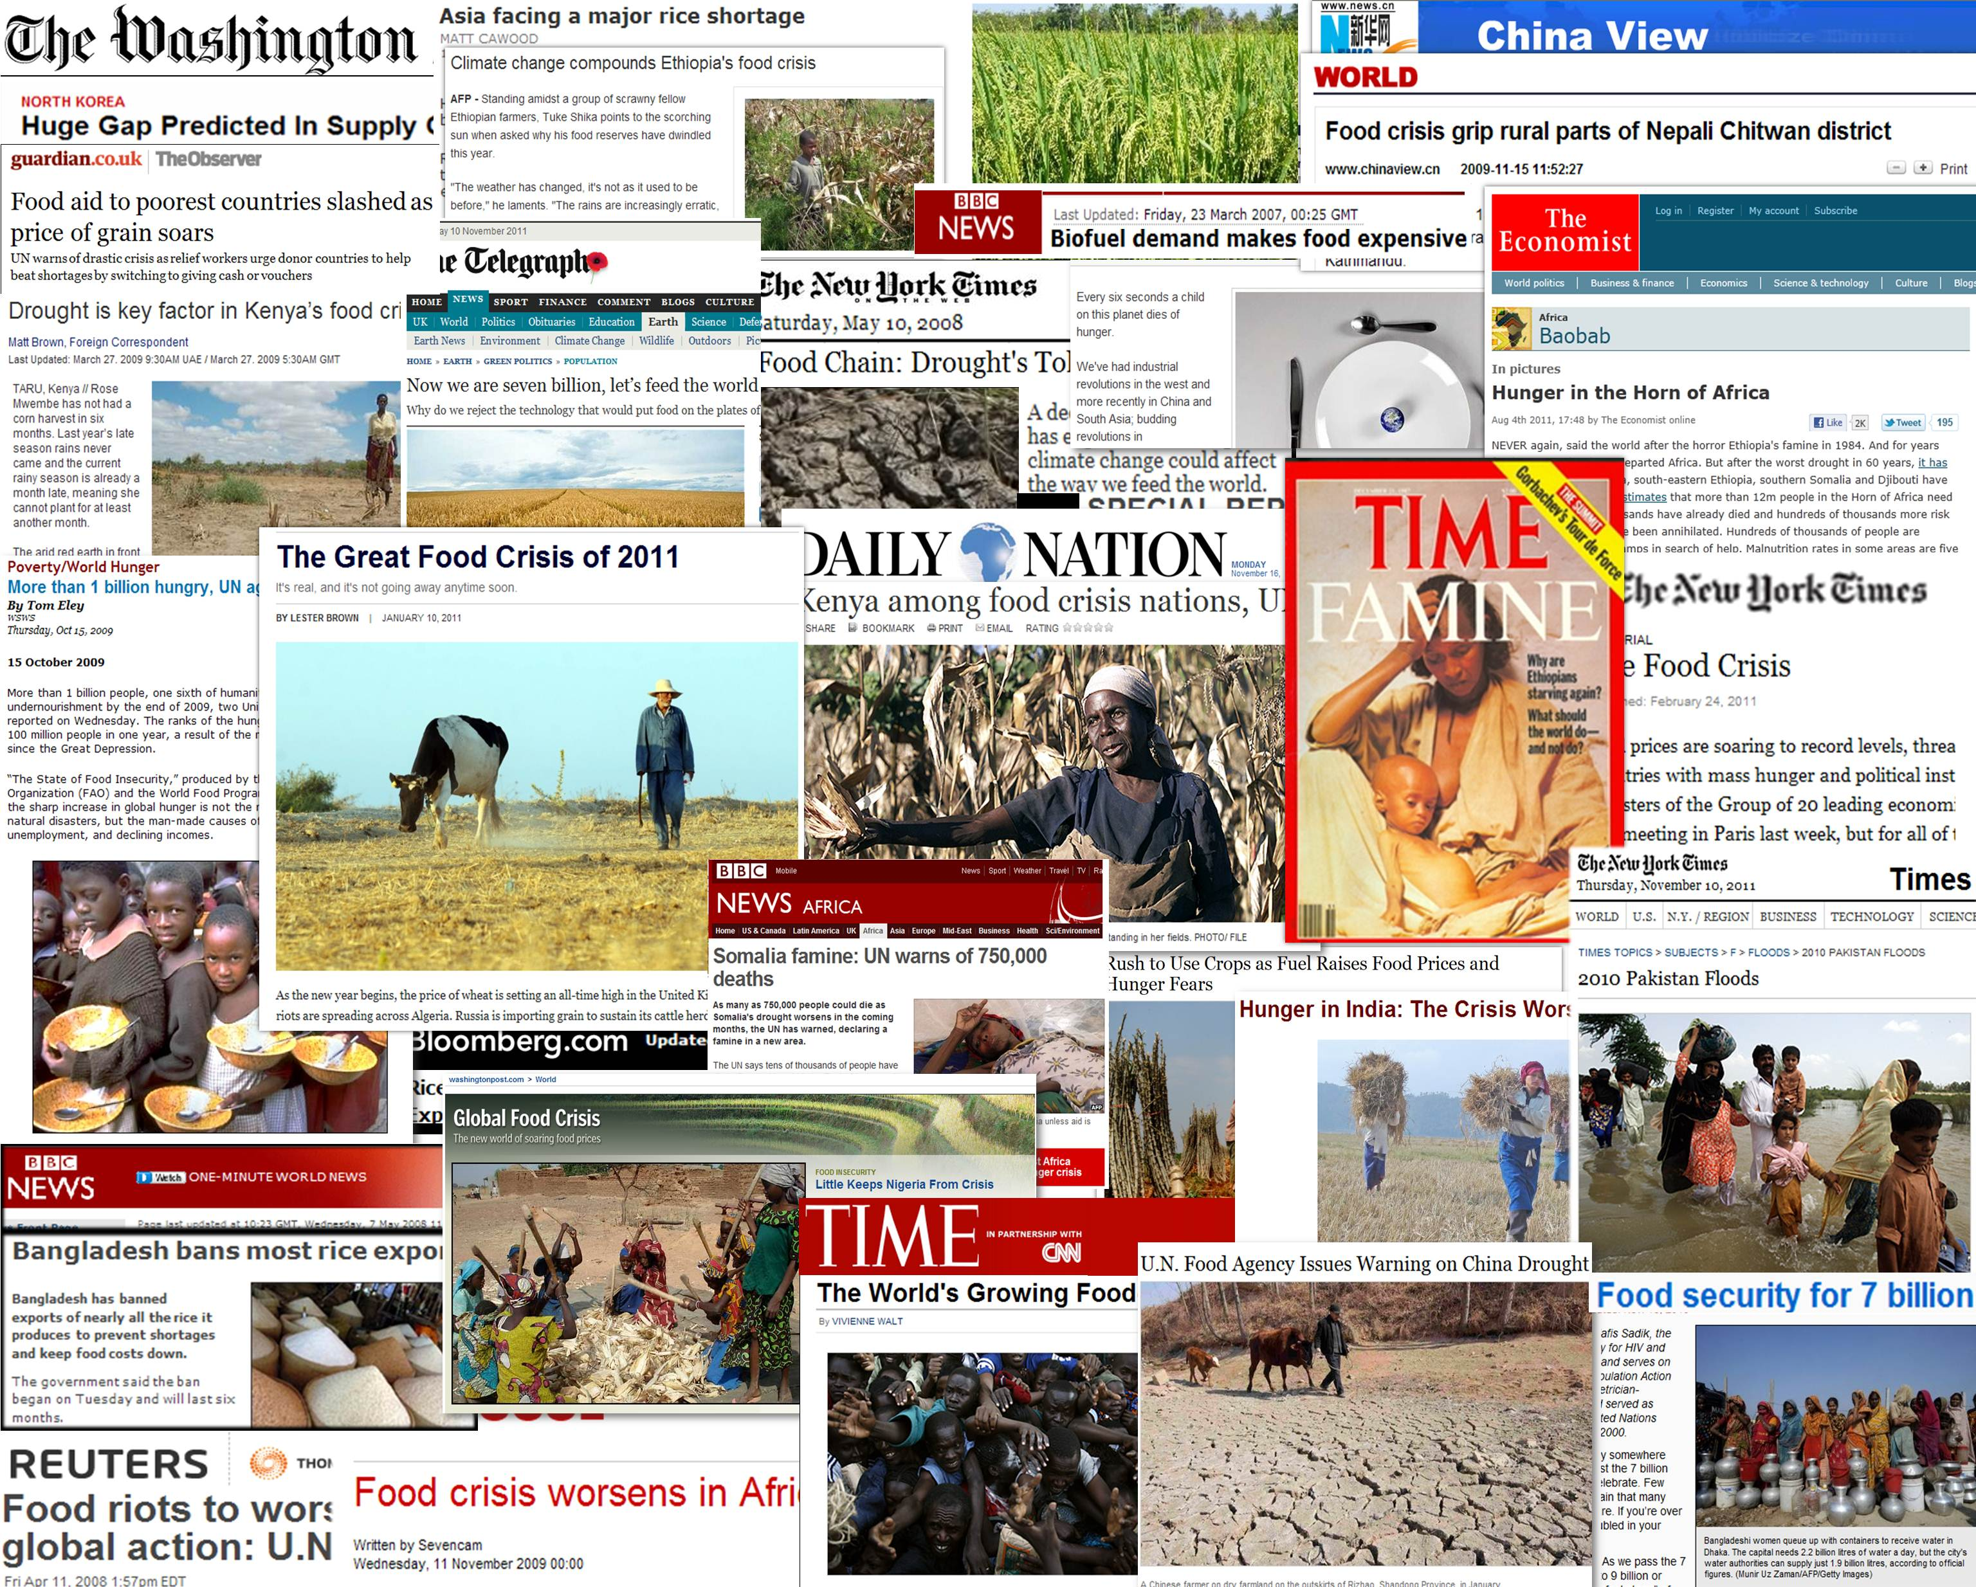
GEOGLAM Context
G20 Agriculture Priority (2011)
Food price dynamics is not crop specific
Corn
Societal impact is worldwide
Soyabeans
Wheat

Slide 5
GEOGLAM Official Mandate:
G20 Final Declaration – Cannes, Nov. 2011
G20 Final Declaration – Cannes, Nov. 2011
44. We commit to improve market information and transparency in order to make international markets for agricultural commodities more effective.
To that end, we launched:
The "Agricultural Market Information System" (AMIS) in Rome on September 15, 2011, to improve information on markets ...;
The "Global Agricultural Geo-monitoring Initiative" (GEOGLAM) in Geneva on September 22-23, 2011. This initiative will coordinate satellite monitoring observation systems in different regions of the world in order to enhance crop production projections and weather forecasting data.

Slide 6
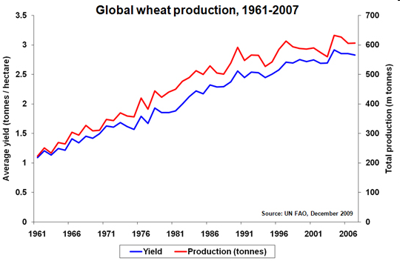
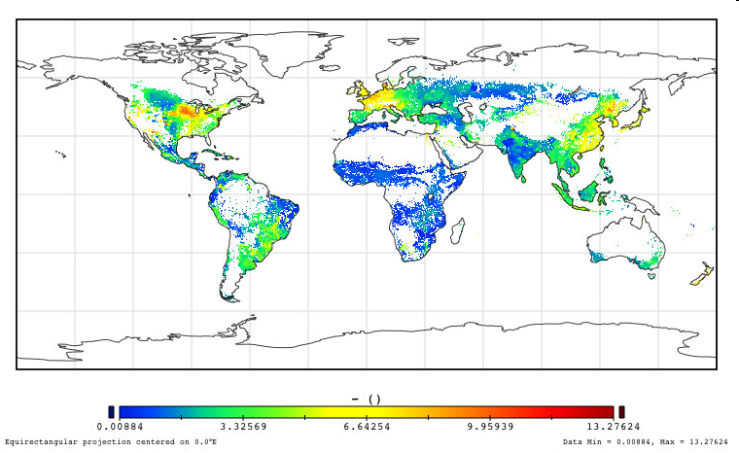
GEOGLAM and AMIS
GEO-GLAM
AMIS : improve information on markets (FAO)
GEOGLAM : improve information on supply (GEO)
Supply
Price
Demand
Policies
Finance
Trade
Stocks
AMIS

Slide 7
GEOGLAM Objectives & Scope
Objectives : To strengthen the international community’s capacity
to produce and disseminate relevant, timely and accurate information and forecasts
on agricultural production at national, regional and global scales,
through reinforced use of Earth Observations.
GEOGLAM is a « coordination program », aiming at
supporting, strengthening and articulating existing efforts
developing capacities and awareness at national and global level
improving availability and open access to data and
disseminating information

Slide 8
GEOGLAM Structure & Work plan
GEOGLAM Steering Committee
Including G20 Donor representation, program stakeholders
Program Coordination office
+ Secretariat
Implementation Group
consisting of Implementation Team leads
Global / Regional System of Systems
main producer countries, main commodities
2. National capacity development
for agricultural monitoring using EO
3. Monitoring
countries at risk
food security assessment
4. EO data coordination (w. CEOS)
5. Method improvement through R&D coordination (e.g. JECAM)
6. Data products and information dissemination
Tasks
Tasks
Tasks

Slide 9


























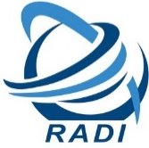



















GEOGLAM Community of Practice
Open Community made up of international and national agencies concerned with agricultural monitoring including Ministries of Ag, space agencies, universities, & industry

Slide 10
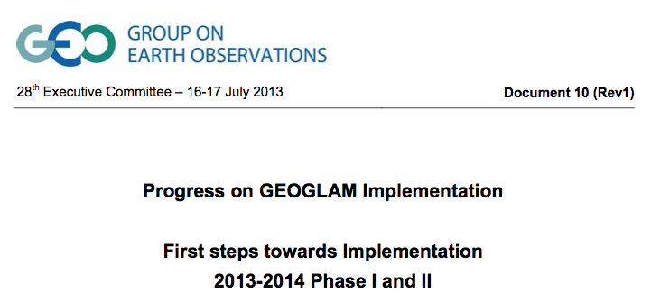
GEOGLAM Accomplishments
July 2013 : GEOGLAM Implementation Plan
endorsed by
GEO Executive Committee
Summer 2013: Global Crop Outlooks for AMIS
  Combining satellite and in-situ inputs with international expertise
  October 2013: AMIS delegates broadly supportive of ongoing AMIS-GEOGLAM collaboration
Notes:
HERE WE CAN INCLUDE AN IMAGE OF THE CROP MONITOR
TITLE SHOULD BE THE CROP MONITOR

Slide 11
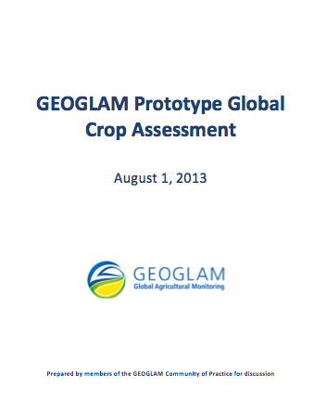
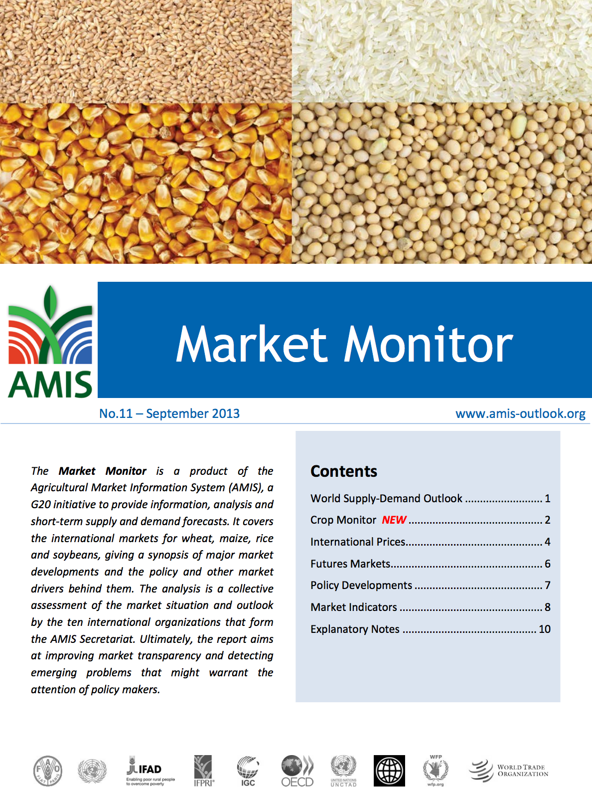
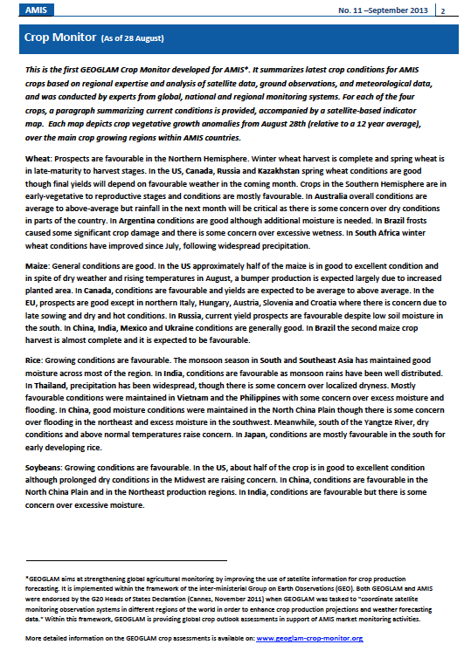
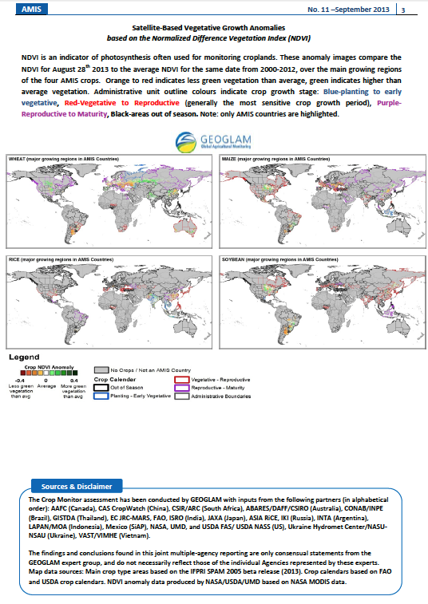
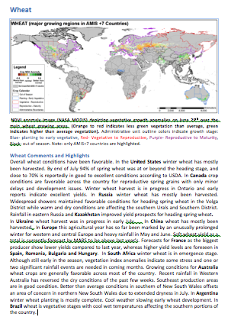
GEOGLAM Accomplishments
AMIS Market Monitor
Prototype : August
Final version, 1st edition: September
Notes:
I would add to the top of the list the Crop Monitor- saying it is operational and provided to AMIS
You could also change the order, so first show the list of accomplishments with the crop monitor as one, and then give the example after

Slide 12
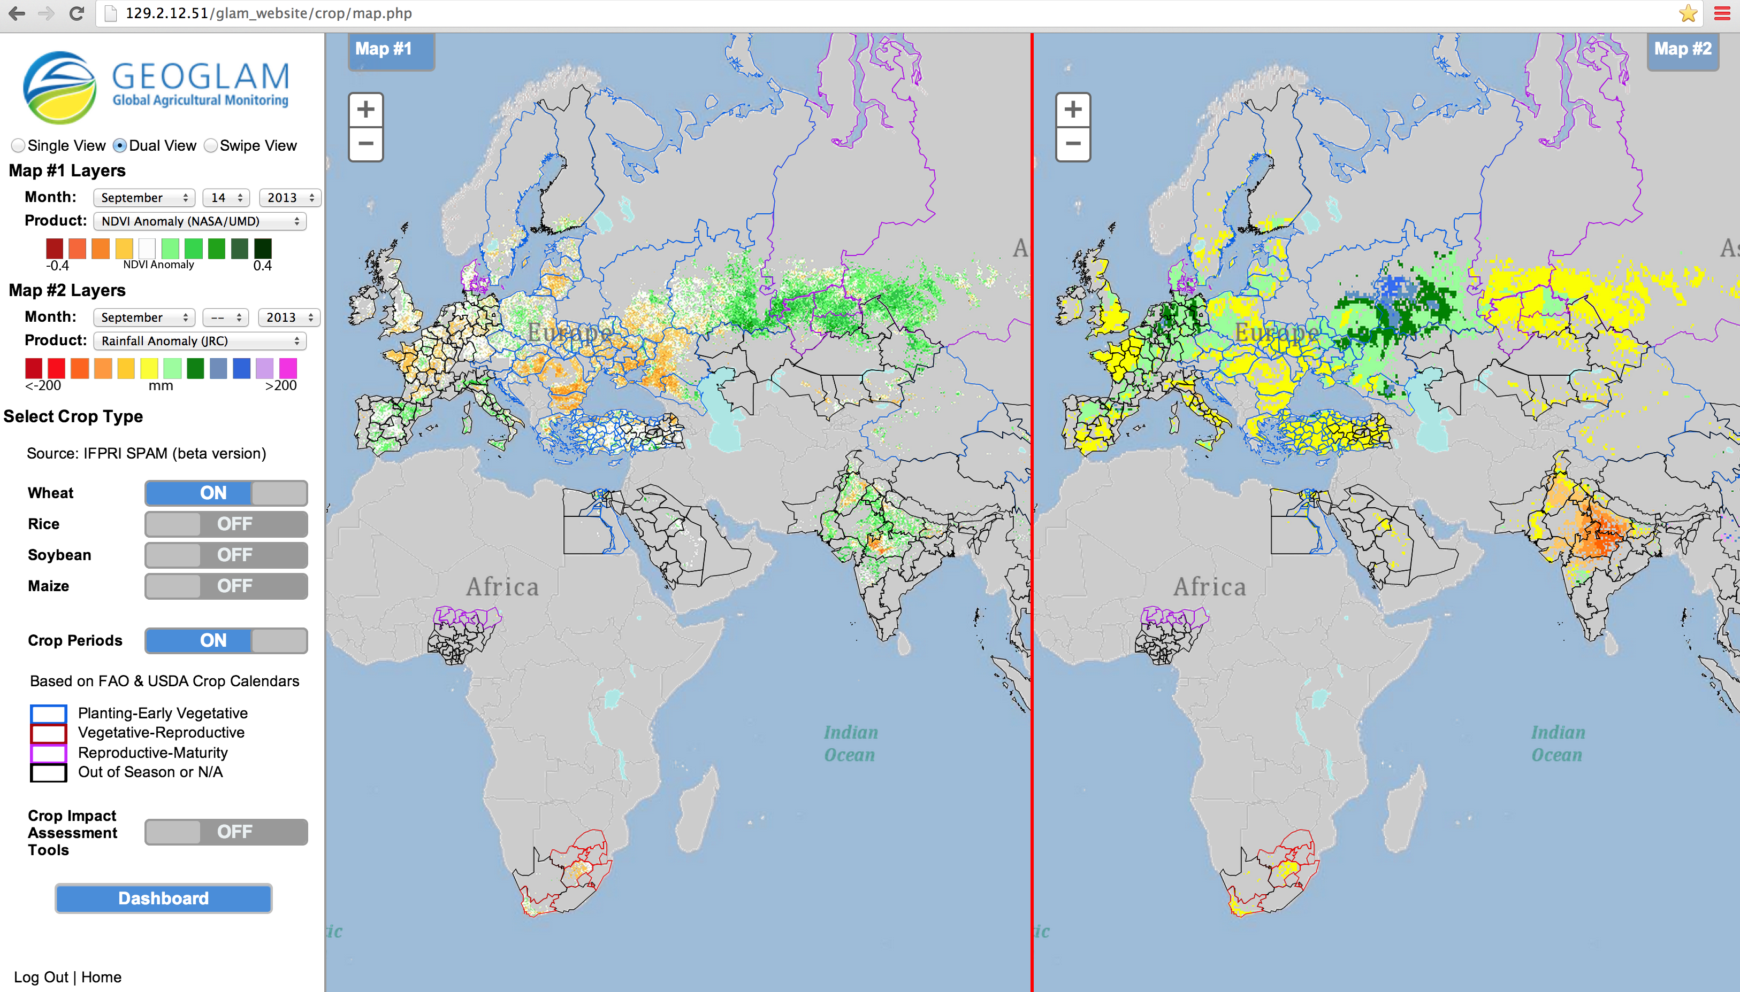
GEOGLAM Complement to AMIS bulletin
GEOGLAM Crop Monitor Interface
Enables comparison between relevant datasets (global, national and regional), by crop type and accounting for crop calendars; enables crop condition labeling and commenting to reflect national expert assessments
Notes:
I would add to the top of the list the Crop Monitor- saying it is operational and provided to AMIS
You could also change the order, so first show the list of accomplishments with the crop monitor as one, and then give the example after

Slide 13
GEOGLAM Accomplishments
Established a network of pilot sites across the globe for sharing best practices - JECAM (www.jecam.org)
Developed a community of practice of more than 300 members engaged in achieving the GEO strategic targets for agriculture
Developed Asia-RiCE, a new regional system for Rice Crop Estimation and Monitoring
Developed a set of baseline datasets**
Set up framework for new regional agricultural monitoring services
Secured funding for multiple projects in support of GEOGLAM (EC FP7, NASA, Canada, Asia Development Bank, USDA)
Attracted attention of donors such as World Bank, Gates Foundation – shared goals with GEOGLAM
Engaged national governments in developing capacity for incorporating EO into their crop projections system (Argentina, Australia, Mexico, Pakistan, Ukraine…)
Presented GEOGLAM at high level meetings such as G8 Open Data for Agriculture
Notes:
I would add to the top of the list the Crop Monitor- saying it is operational and provided to AMIS
You could also change the order, so first show the list of accomplishments with the crop monitor as one, and then give the example after

Slide 14
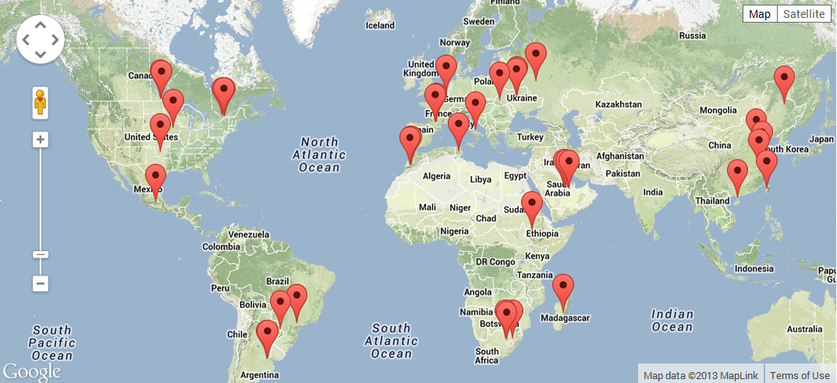
GEOGLAM Accomplishments
JECAM
JECAM activities are being undertaken at a series of study sites which represent many of the world’s main cropping systems
29 sites currently exist or are in development

Slide 15
GEOGLAM Accomplishments
Baseline datasets 1
Development of key baseline datasets and science inputs to an acquisition strategy for global agricultural monitoring
  Where are crops growing? – Where are imagery required?
Fritz et al. IIASA
Notes:
The data are useful for both our own scientific needs as well as for serving as key inputs to the acquisition strategy

Slide 16
GEOGLAM Accomplishments
Baseline datasets 2
  When are crops growing? – When are imagery required?
  e.g. Median Start of Agricultural Growing Season
Whitcraft et al. UMD

Slide 17
GEOGLAM Accomplishments
Baseline datasets 3
  How frequently are cloud-free views possible?
  e.g. Probability of a Cloud Free Clear View within a 5 km block, mid-season
Whitcraft et al. UMD

Slide 18
GEOGLAM & CEOS Collaboration
Ad-Hoc Team on GEOGLAM
Meetings of the Ad-Hoc Advisory Group thus far
  Jul 2012, Montreal – Initial requirements articulation
  Nov 2012, Newport News, VA – Development of phasing approach for acquisitions; refinement of requirements
  Mar 2013, Newport News, VA, CEOS SIT – Nomination of Phase 1A/B countries
  Jun 2013, Washington, DC – Review of requirements; further incorporation of Asia-RiCE; refinement of phasing approach
  Sep 2013, Pasadena, CA, CEOS SIT –– GEOGLAM Status Update to SIT

Slide 19
GEOGLAM and CEOS Collaboration
Requirements for Monitoring
Rationale : translating monitoring objectives into information needs and EO requirements
Information needs
Objectives
Obs. requirements
Reference data
Environm. data
Crop map (area, loc.)
Crop type map
Crop conditions
models
stat. rel.
Yield
forecast
Seasonal, real time
global, regional, national, local
Agricultural statistics
Environmental impact
Multi-year
global, regional, national, local
Farming system
Farming practice
Land use evolution
Farm. syst. evolution
Crop cond./ yield evol.
Agriculture
changes
Long term
global, regional, national, local

Slide 20
Current and Future Challenges
Continuation of Mandate for Ad-Hoc Advisory Group
Funding
  Ad-hoc advisory working group meetings
  Regional GEOGLAM workshops
  Commercial data buys for Post-evaluation phase
Data pre-processing and establishment of standards
Data distribution
  Data distribution organisation (centralised / distributed)
    → Near Real Time is Crucial!
Notes:
Brian Killough has put forward the idea of an “evaluation phase” during which commercial data suppliers will provide data at low-to-no cost in order for GEOGLAM community of practice to evaluate the utility and appropriateness of said data. After this “evaluation phase” ends, we’ll need to purchase the data.

Slide 21
Conclusion
GEOGLAM has a good policy mandate
- the global food problem is not going away!
GEOGLAM has momentum in the Community of Practice , and
National institutional participation established and growing
International and national funding support exists and is growing
First successes have been achieved
Crucial need of EO data (with adequate resolution & timing, near-real time delivery)
EO data are at the core of GEOGLAM,
and will be fully utilised
A close partnership between GEOGLAM and CEOS is critical
“the benefits are clear,
costs are relatively minor,
the cost of inaction is considerably greater”

