Slide 1

Update on Global Forest Observations Initiative (GFOI) and the Space Data Coordination Group (SDCG)
Agenda Item: 30
Stephen Briggs, Stephen Ward
Ake Rosenqvist, Eugene Fosnight, Frank Martin Seifert

Slide 2
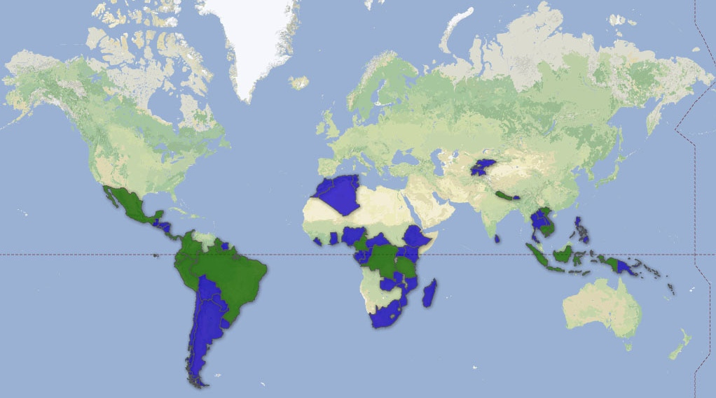

Global Forest Observation Initiative (GFOI)
GFOI Objectives:
to foster sustained availability of satellite and ground observation in support of national forest information systems
to support countries in the use of observations for their national forest information systems
GFOI Country Coverage In 2013 AND 2014
2008 Establishment of GEO FCT task
2009+ FCT demonstration based on NDs
2010 GFOI Concept plan
2011 GFOI Implementation plan
2012 GFOI Start-Up Phase
2013-15 Incrementing coverage
2016+ Operations Phase
Co-leads:
Australia (DoE)
Norway (NSC)
USA (USGS)
FAO
CEOS (ESA)
www.gfoi.org

Slide 3
Four Pillars of GFOI
Methods and Guidance Documentation (Australia lead)
  Coordinated approach with writing leads, external review and approval
Coordination of satellite data supply (CEOS lead)
  Space Data Coordination Group (SDCG) – ESA, NSC, USGS
R&D on technical challenges (Norway lead)
  Gap analysis, dedicated R&D plan with priority topics
  Enhanced cooperation with CEOS space agencies
Capacity Building (US lead)
  SilvaCarbon: focused series of workshops in Latin America
  Bilateral capacity-building activities in Indonesia (supported by Australia) and Tanzania (supported by Norway)

Slide 4
The Role of SDCG in GFOI
Coordination of satellite data acquisition and supply is fundamental to GFOI objectives and supports all countries’ participation in reporting
Satellite data can provide
  Measurements of forest extend and characteristic
  Support to countries in GHG Reporting
  Independent Verification
2011 plenary endorsed the set-up of the Ad-hoc WG “Space Data Coordination Group” to support GFOI, putting emphasis on physical outcomes from CEOS in support of GEO activities.

Slide 5
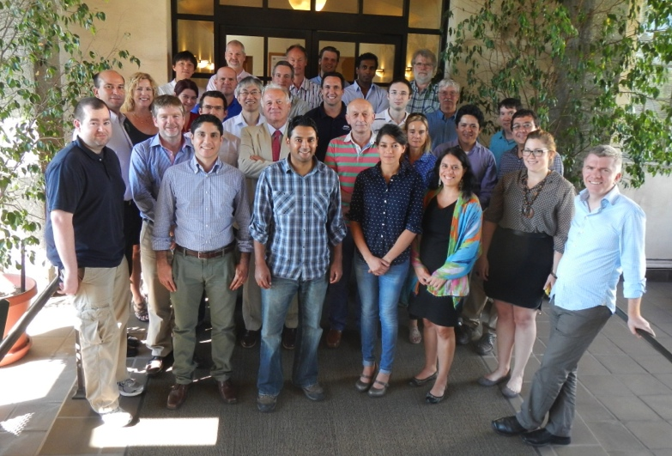
SDCG Set-up
SDCG Co-chairs: ESA, NSC, USGS
SDCG Secretariat: DCCEE
SDCG Members: CNES, CONAE, CRESDA, CSA, DLR, INPE, ISRO, JAXA, NASA
Pending invitations: KARI, ASI
Convene biannual meetings of SDCG
  CSA hosted SDCG-1 in March 2012
  USGS hosted SDCG-2 in Sep 2012
  Australia hosted SDCG-3 in Feb 2013
  NASA hosted SDCG-4 in Sep 2013
  ESA will host SDCG-5 in Feb 2014
Notes:
.

Slide 6
The CEOS Data Strategy for GFOI
Element 1: A baseline, coordinated global data acquisition strategy involving a number of ‘Core data streams’ that can be used free-of-charge and openly for GFOI purposes. This will involve global, systematic and sustained wall-to-wall acquisitions of forested areas
Element 2: Coordinated strategies for national space data services including historical coverage characterisation, impartial data needs assessment, core data delivery and value adding, …
Element 3: Data supply in support of the GFOI R&D activities, including in support of: the science studies assisting the development and evolution of the Methods and Guidance document for GFOI

Slide 7
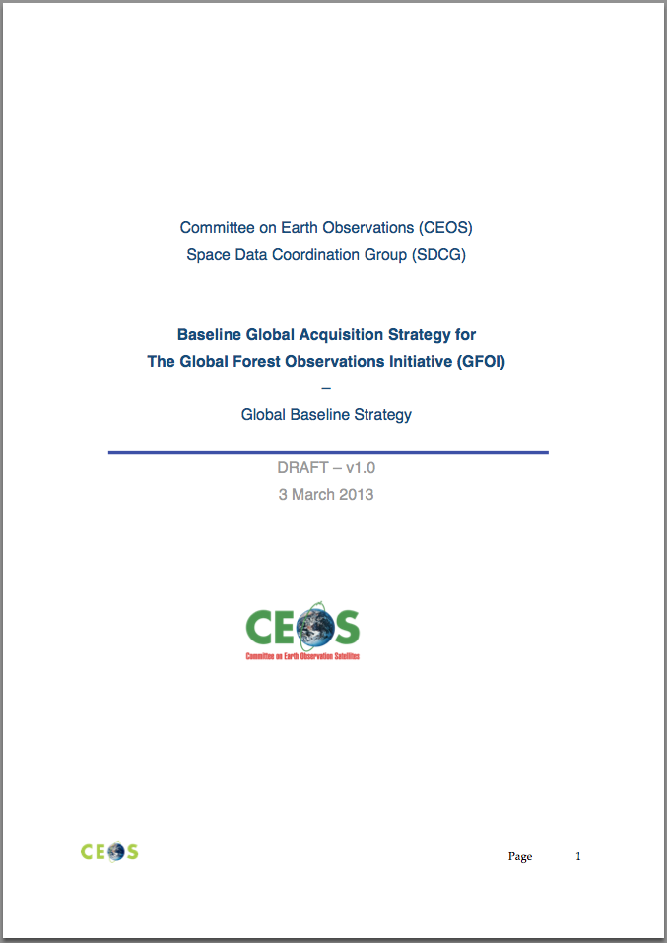
Accomplishment
Global Baseline Strategy and Implementation Plan for 2013 approved by CEOS @ SIT-28
Baseline strategy objective to assure the availability of temporally and spatially consistent time-series of optical and SAR satellite data over the global forest cover.
Initial priority on tropical forest countries developing national MRV systems for REDD+
Element 1 focus on publicly open (“core”) satellite data
Phased implementation with aim at full global scale operations by 2016

Slide 8
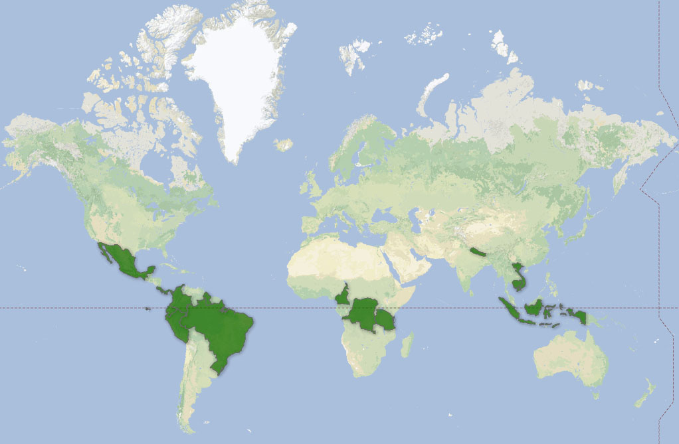
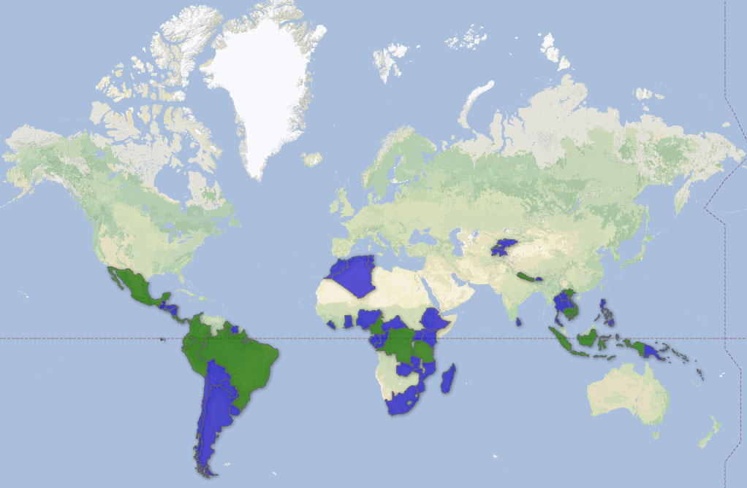
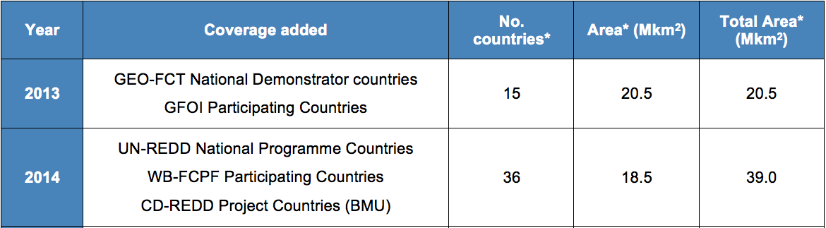
Phased Implementation Plan
2013
2014
Notes:
Cambodia, Republic of Congo, Costa Rica, Ecuador, Panama, Viet Nam are either UN-REDD or/and World Bank FCPF (Forest Carbon Partnership Facility) countries or adjacent (facilitating seamless acquisitions)

Slide 9
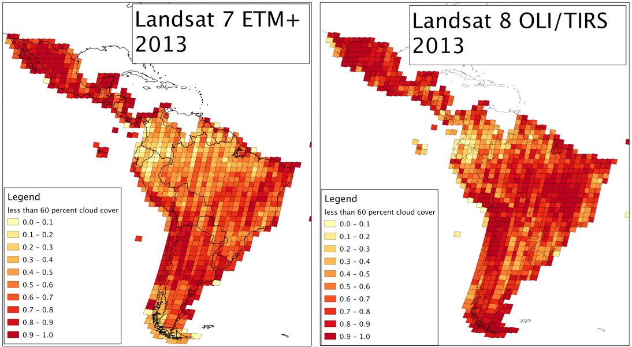
IP 2013: Landsat 7&8 - Americas

Slide 10
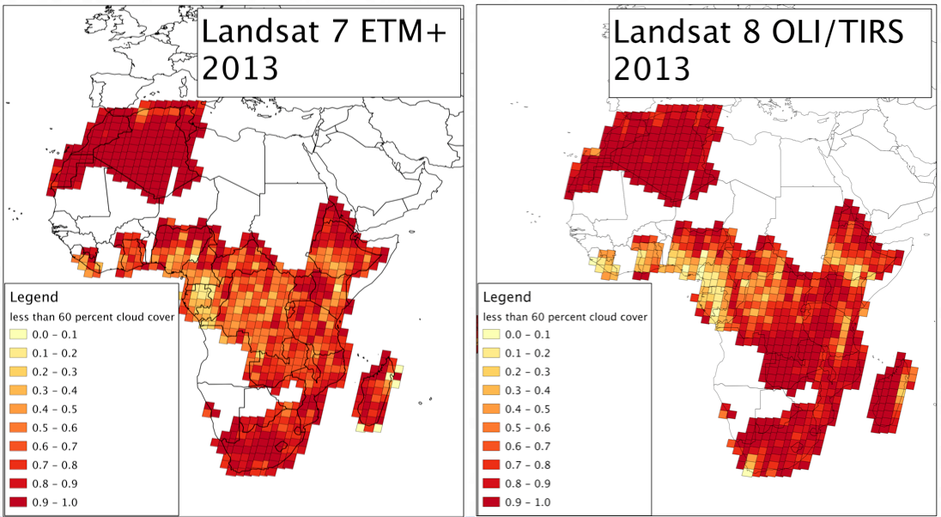
IP 2013: Landsat 7&8 - Africa

Slide 11
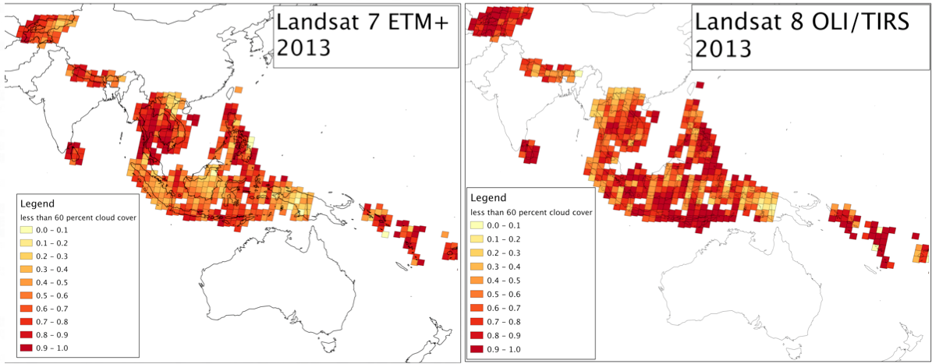
IP 2013: Landsat 7&8 - Asia

Slide 12
Progress and IP 2014
Core mission status
Landsat 8 now fully operational and performing beyond expectations
Sentinel-1A and CBERS-3 launches shifted into 2014. Expected (limited) operations in mid/late 2014.
Sentinel-2A launch in late 2014. Ramping-up operations in 2015.
GFOI target countries increasing from 15 to 51, approximately doubling the area.

Slide 13
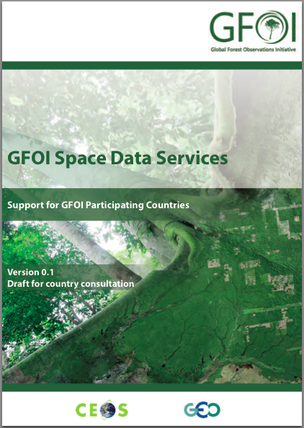
Progress Element-2
Space Data Services - 4 broad categories tentatively considered:
Historical Coverage Characterisation: support to assess archived satellite data for a given country for past years;
Core Data Delivery: support for physical delivery of data;
Core Data Value Adding: enhanced core data products
Data Processing: “Data Hub” capacity to assist country generation of inputs to forest information products.

Slide 14
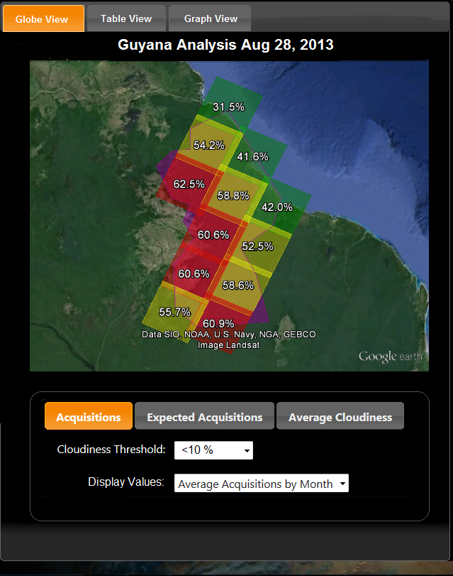
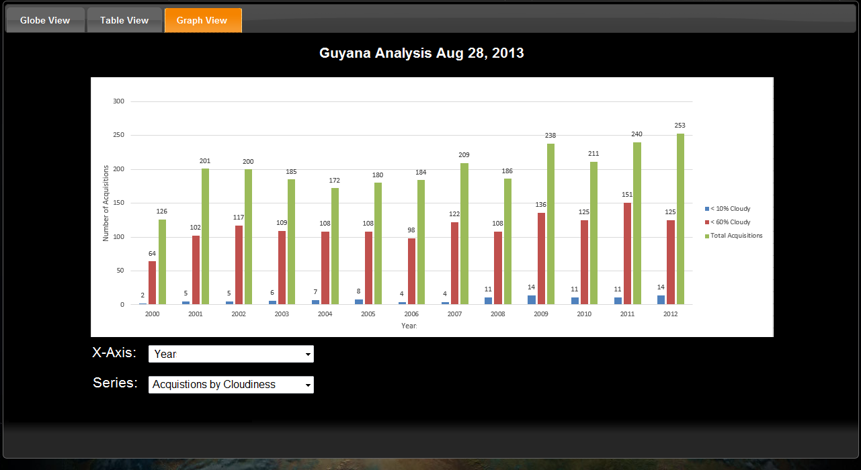
SEO Support to Element-2
Coverage Analyser for
Historical Coverage Characterization and National Data Acquisitions:
View data in graphical form
Select data (Acquisitions, Cloud%)
View bar charts of Total vs. Cloudy

Slide 15
Current challenges
  Data availability
    2012 low-water mark for CEOS mission availability (loss of CBERS-2, ALOS, Landsat 5, Envisat, within 1.5 yrs)
    Successful launch of Landsat-8 has been a big step forward, is now together with Landsat-7 the only core missions in orbit.
    Near-future looks positive! (CBERS-3, Sentinel-1 and -2, ALOS-2 potentially in orbit within next year)
  Data delivery and handling
    Difficulties to deliver large data volume in areas with insufficient internet connection,
    In country handling and processing of huge data volumes with their current IT infrastructure.

Slide 16
Upcoming activities and milestones
SDCG-5
planned for 25-27 Feb 2014 at ESA/ESRIN
Include a country day together with FAO / UN-REDD
Deliverables for CEOS SIT-29
Baseline (Element 1) implementation 2013 – results summary
Element 1 Implementation Plan for 2014
GFOI Space Data Services (Element 2) Plan
Others activities
Seek Plenary approval for a further year of SDCG operation
Advance the R&D Plan (Element-3)
Improve representation of EO in the GFOI MGD
Continue close co-operation with GEOGLAM

