Slide 1
CEOS Support to the Geohazard Supersites
The CEOS Supersite Coordination Team:
Simona Zoffoli, ASI
Steven Hosford, CNES
Christine Giguère, CSA
Jörn Hoffmann, DLR (Chair)
Wolfgang Lengert , ESA
Kazuo Umezawa, JAXA
Shizu Yabe, JAXA
Francis Lindsay, NASA
Klaus Schmidt, Dr. Jörn Hoffmann, DLR

Slide 2
Background
The GEO Geohazards Supersites Initiative
Aims at enriching our knowledge about geohazards by empowering the global scientific community through collaboration of space and in‐situ data providers and cross‐domain sharing of data and knowledge
Primarily through providing easy and free-of-charge access to comprehensive satellite and ground-based geophysical data sets derived from different sources and different disciplines

Slide 3
Status Summary
Previous CEOS Plenary decisions:
Approved process for Supersite selection (2012)
Accepted Hawai’i as first Permanent Supersite (2012)
Tasked Supersites Coordination Team (SCT) to coordinate CEOS contributions and facilitate coordinated access to data
Main 2013 accomplishments
CEOS-proposed selection process for Supersites accepted in GEO
SCT agreed on making metadata for data provided to Supersites accessible through standard web services (CSW)
Proposal to accept new Supersite for Iceland
7 additional Supersite proposals under review

Slide 4
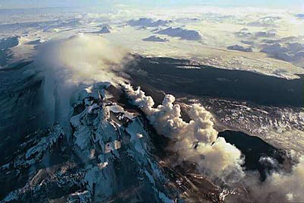
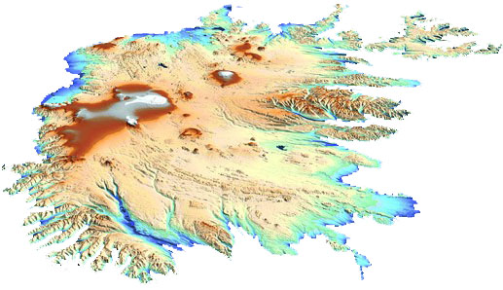
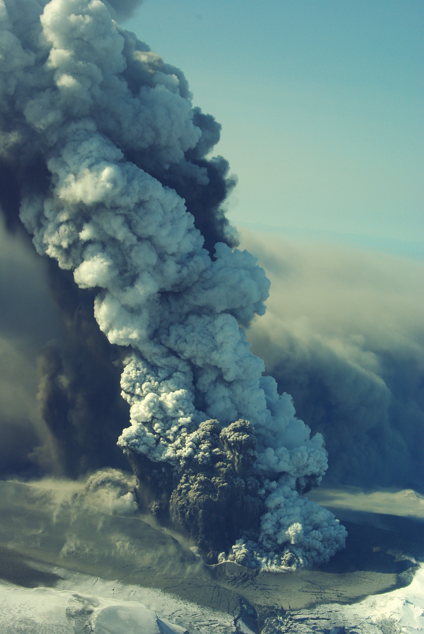
Iceland Supersite
Iceland Supersite Proposal
Photo: Thor Thordarson, Volcanic Institute of Iceland
Tandem-X DEM of Iceland
Over 30 active volcanic systems; frequent eruptions
Core Team organized around FutureVolc Project (EC-funded)
(photo: Eyjólfur Magnússon)
Notes:
Top right: Hekla
Bottom right: Eyafjallajökull

Slide 5
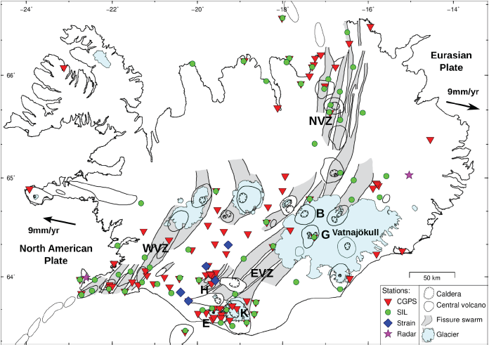
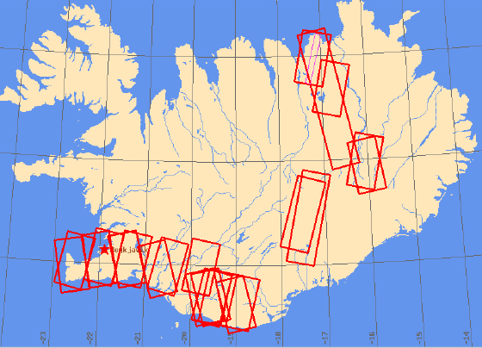
Iceland Supersite: Resources
Available in situ data:
Seismic
CGPS
Infrasound
Real-time hydrological data (river flow)
Courtesy of F. Sigmundsson, Nordic Volcanological Centre
Notes:
Available in situ data, space data tbd, but lots available, inluding ERS, ENVISAT, TSX, RSAT, RSAT-2, …

Slide 6
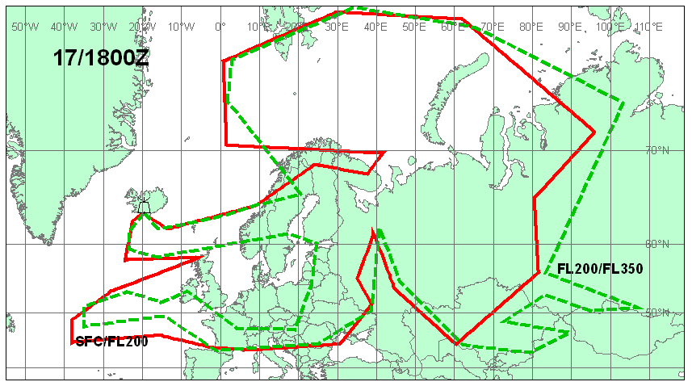
Iceland as case study for socio-economic impact of geohazards
Eyjafjallajökull: Airspace Closure in April 2010
Notes:
Graphical display of volcanic ash advisory on 17 April 2010 at 18:00 GMT from the London VAAC. Red and green outlines delimit air space with predicted contamination of ash. Red outline from the Earth’s surface to flight levels (FL) 200, corresponding to about 20000 feet. Dashed line for FL200-350, or from about 20000 feet to 35000 feet.

Slide 7
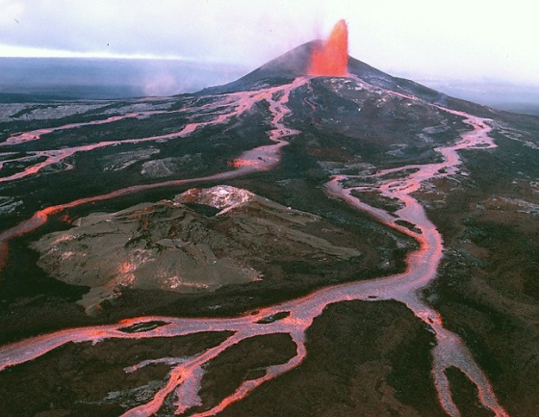
For decision: CEOS Plenary…
… accepts the Iceland Supersite Proposal and agrees to support it by making available data according to the request in the proposal and up to the limits listed below.
… requests that the Supersites Coordination Team inform the PoC for the Iceland Supersite of this decision and the procedures of ordering and accessing the data
Indicative data resources committed
CEOS intends to to support this Supersite with these resources:
(ASI) 300 scenes/yr by end 2015 COSMO/Skymed
plus 500 past acquisitions
(CNES) 2 coverages @ 2.5m, tbc SPOT-5
1 coverage per volcano, tbc Pleyades
(CSA) 160 scenes/yr by end 2015 Radarsat-2
(DLR) 250 scenes by end 2015 TerraSAR-X
plus 550 past acquisitions
(ESA) complete archive ERS-1, -2, Envisat any available acquisition Sentinel-1, -2
(JAXA) tbd ALOS-2
(NASA) any available acquisition EO-1
tbd ASTER
For Plenary Action

Slide 8
Status Summary
Future Supersite Coordination Team activities and milestones
Complete implementation of coordinated access to Supersites metadata (best effort, expected 2014)
Evaluate new Supersite proposals, by SIT 2014:
Marmara Sea / NAFZ, Turkey
Mt. Etna, Italy
Mt. Vesuvius / Campi Flegrei, Italy
San Andreas Fault
Piton de la Fournaise volcanoe, Reunion Island
Equadorian volanoes
New Zealand (volcanoes)
Main Issues
Engagement of science community still maturing

Slide 9
Summary: Plenary Actions
CEOS Plenary is requested to
Approve Iceland as a new Permanent Supersite
Approve delegation to SIT for additional Supersites reviewed prior to April 2014, to avoid delays in support.
Corresponding recommendations of SCT and annexed full-length Supersite proposal available as documents for CEOS Plenary.

Slide 10
Backup Slides

Slide 11
Permanent Supersite selection (1)
Process for Permanent Supersites
Supersite Nomination
using standard proposal based on existing Agency standards
Recommendation by Scientific Advisory Committee (SAC)
Recommendation by CEOS Supersites Coordination Team (SCT)
includes details on data contributions planned
Approval by CEOS SIT and Plenary
SAC confirms successful setup
Regular review
Are Supersites actively exploited? Are they the right ones?
Every 2 years
Notes:
Plenary is asked to accept the proposed approach
Supersites proposals will be in SOAR format – Scientific and Operational Applications Research (CSA Standardformat, auch von DLR bereits verwendet)

Slide 12
Permanent Supersite selection (2)
Criteria applied by Supersites Coordination Team (SCT)
Geohazard threatens human population or infrastructure
subject to investigations aimed at broadening scientific understanding
Substantial interest of a broad scientific community, e.g. demonstrated by a minimum number of research teams
Support by the country – or countries – in which the Supersite is located
Availability of relevant in situ data
Dis-similarity to already existing Supersites
CEOS Agencies are able to provide sufficient remote sensing satellite resources to make a meaningful contribution
Single PoC identified and committed to coordinate space data requests and reporting, if applicable.
Notes:
Plenary is asked to accept the proposed approach
SOAR – Scientific and Operational Applications Research (CSA Standardformat, auch von DLR bereits verwendet)

