Slide 1
CEOS Disaster Risk Management CEOS DRM Observation Strategy
CEOS ad hoc Disasters Team

Slide 2
Overview
Growing interest in Disaster Risk Management (DRM)
Large international organisations (UN, WB, EC,..), nations, dedicating growing resources to disaster risk reduction
Role for CEOS
Satellites have a unique role to play to support DRM
Lack of awareness of potential satellite contributions
Users need to see benefit of EO through dedicated pilots
Coordinated action greater than sum of individual agency’s contribution.
Build on existing initiatives e.g. Charter, Supersites, Sentinel-Asia,..
Mandate of ad hoc Disasters Team (from 26th Plenary)
Define a CEOS DRM Observation Strategy to support enlarged actions for disaster risk management
Position satellite EO in the post-Hyogo Framework for Action activities

Slide 3
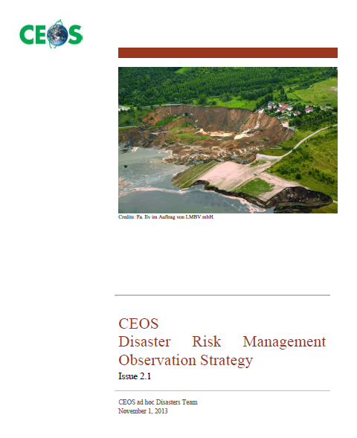
CEOS DRM Observation Strategy doc
Detailed document (+100 pages ) starting with Executive Summary
Includes in particular:
Pilots definition, needs and EO requirements
Does not include the CEOS Agencies’ response to the EO requirements
3 previous issues of document distributed to CEOS for review

Slide 4
4 Demonstrators: 3 Pilots + Recovery Observatory
Observation Strategy
Coordinate CEOS acquisitions to reduce overlap and eliminate gaps
Support pilots with focussed objectives scalable to global action
2014-2016 - address pilot needs; longer-term vision for post 2016 to be assessed through pilots
Flood, seismic and volcano R&D demonstrator Pilots defined by experts
35 experts from 10 CEOS Agencies; 26 from non-CEOS organisations (user and practitioner community at local/national or regional levels).
EO observation requirements based on real and prioritised user needs.
Maximum reuse of existing projects, initiatives & assets from CEOS agencies targeted new activities to bridge gaps. Aligned with GEO.
Demonstration period 2014-2016 with significant outcomes for the 2015 World Conference on Disaster Risk Reduction – WCDRR (UN, Japan).
“Recovery Observatory” (builds on Charter and CNES’ Haiti work)
Sharing EO data to support recovery from catastrophic disaster.

Slide 5
Pilots Overview
Pilot | Team Co-Leads | Deliverables
Floods | NASA, S. Frye NOAA, B. Kuligowski | Global Flood Dashboard (single access for multiple existing systems) Three regional pilots showcasing end user benefit of frequent high spatial resolution observations (Caribbean, Southern Africa, Mekong/Java)
Seismic Risks | ESA, P. Bally DLR, J. Hoffmann | Demonstrator for EO-based global strain map (main focus on Turkey, Himalayas and Andes) Exploitation platform for large data set analysis (strain map, supersites) Rapid scientific products for 4 to 6 earthquakes per year (>M5.8)
Volcanoes | USGS, M. Poland ASI, S. Zoffoli | Demonstrate feasibility of systematic global monitoring in regional arc (Latin America) Develop new EO-based monitoring products at supersites Real-time in-depth monitoring of one ‘100-year’ category major eruption
Recovery Observatory | CNES, A. Giros | Provide multi-year EO-based database to support recovery from one catastrophic disaster
5

Slide 6
Synergy With Existing GEO Activities
FLOODS
CARIBBEAN &
NAMIBIA
Flood Monitoring
Objective A
Objective B
Objective C
Geohazard Supersites &
National Laboratories
SEISMIC
RISKS
Objective A
Objective B
Objective C
VOLCANOES
Objective A
Objective B
Objective C

Slide 7
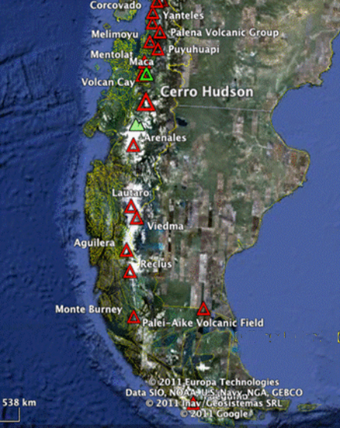
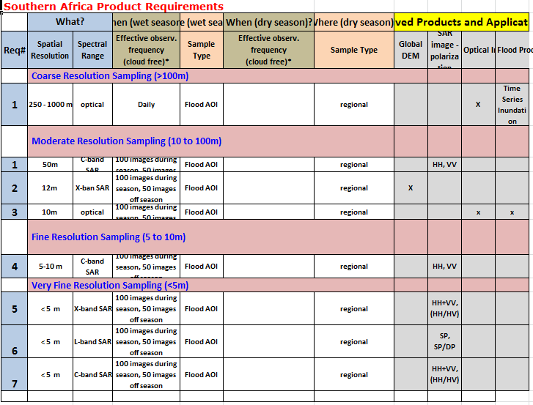
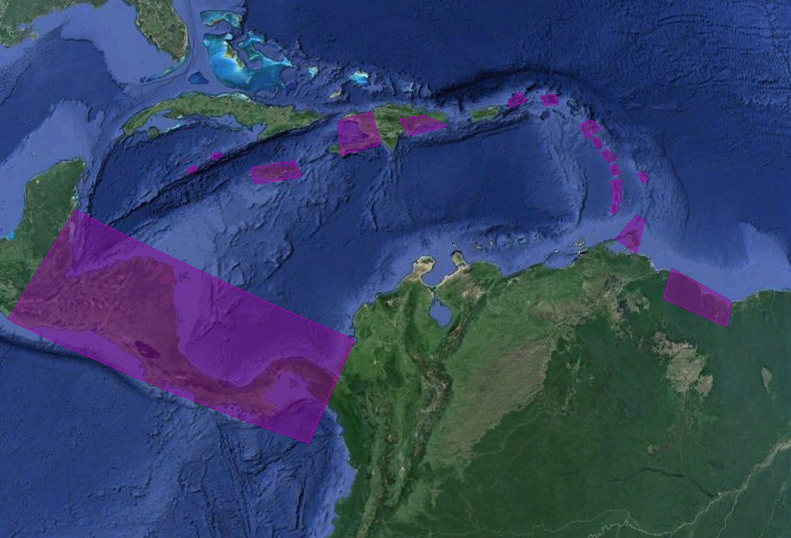
EO Requirements
Approach and Status:
EO Data Requirements completed by thematic teams for all Pilots
Polygons of areas of interest identified in shape files (Google Earth KMZ)
Data types and frequency identified (e.g. C-band SAR, VHR optical, thermal, etc.) and captured in Excel tables
Strategic Data Acquisition Plan by SIT spring 2014
CEOS’ response to Pilots’ EO requirements.
Simulations to support Strategic Data Acquisition Plan development (on-going)
Notes:
On 10 October 2013, pilots’ overlaps between:
==============================
Seismic risks & volcanoes over Andes
Floods & volcanoes over Central America and Caribbean

Slide 8
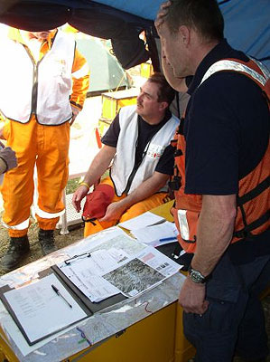
Floods – the need
WHY? Most prevalent global disaster – largest number of events and largest number of people affected (500 million people every year), greatest economic impact (1-2 billion $ /yr in the 1970s ; 15 billion $/yr today); EO can track flood waters, predict affected areas and support prevention.
WHAT’S MISSING? Lots of rapid mapping for response today, but little flood cycle management using EO. Full-cycle real-time flood monitoring using high resolution optical and radar data brings greatly improved accuracy. Application of EO globally is either at low resolution on large geographical zones or high resolution over limited areas on ad hoc basis; few linkages between global and regional efforts.
Photo Telecom sans frontière
Notes:
Increasing economic and human losses in the future due to the increase of extreme weather events (x3 in 2100) combined to growing urban population (x2 in 2050)
6.8 million deaths in 20th century , 500 million people are affected by floods every year. Insured losses from floods rose from 1-2 billion $ /yr in the 1970s to over 15 billion $/yr today.

Slide 9
Flood Pilot Objectives
Application of satellite EO to the full cycle of flood management at global and regional/local scales by:
Objective A – Integrating information from existing near-real time global flood monitoring and modeling systems in a Global Flood Dashboard for hydro-met modelling by science users;
(higher temporal and lower spatial resolution)
Objective B – Delivering EO-based flood mitigation, warning and response products and services through regional end-to-end pilots for local authorities in:
The Caribbean (with particular focus on Haiti);
Southern Africa, including Namibia, South Africa, Zambia, Zimbabwe, Mozambique and Malawi;
Southeast Asia (with particular focus on the lower Mekong Basin and Java, Indonesia).
(higher spatial and lower temporal resolution)
Objective C – Encouraging regional in-country capacity to access EO data and integrate into operational systems and flood management practices.
Notes:
Too

Slide 10
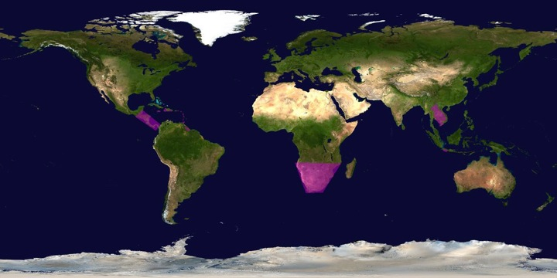
Flood Pilot – regional areas of focus
High spatial resolution full-cycle flood monitoring in Caribbean/Central America, Southern Africa and Southeast Asia (Mekong and Java); will be used to validate high temporal resolution low spatial resolution global work

Slide 11
Volcanoes – the need
WHY?
Over 300,000 people have been killed by volcanoes since the 1600s, and hundreds of millions live within 20 km of an active volcano today.
WHAT’S MISSING?
Only ~10% of the ~1500 active volcanoes in the world are being monitored in some way
Current EO data collection is not coordinated for volcano monitoring
Need partners to exploit data that are currently collected
Need systematic observations before, during, and after volcanic events
Merapi, Indonesia, erupting in 2010. From Pallister and others, in press
Notes:
maybe the economic losses would have been more relevant in 2013 e.g. the consequences of the 2010 eruptions of the Eyjafjallajökull (Iceland): 95.000 flights cancelled, a daily loss of $200 million for the airlines w/o mentioning the consequences on tourism.

Slide 12
Volcano Pilot Objectives
Stepping-stone towards the long-term objectives of the Santorini Report:
global background observations at all Holocene volcanoes;
weekly observations at restless volcanoes;
daily observations at erupting volcanoes;
development of novel measurements;
20-year sustainability; and
capacity-building.
Three main outcomes for volcano observatories and VAACs:
Demonstration of systematic monitoring in Latin America
Development of new products for geohazard supersites initiative GSNL (Hawaii & Iceland)
Showcase 1 major eruption 2014-2016
Deformation of several volcanoes was detected in an arc-wide InSAR survey of South America by Pritchard and Simons, 2002.
Notes:
Forecasting volcanic eruptions has been demonstrated on long timescales (~centuries) based on geologic mapping and shorter terms (days to weeks) from monitoring data, but intermediate term (years to decades) forecasting remains elusive.
Aseismic inflation may indicate volcanoes that will erupt within years to decades. InSAR is perhaps the best way to monitor for precursory inflation and prevent volcanologists from having to play “catch-up” with volcanoes that are about to erupt.

Slide 13
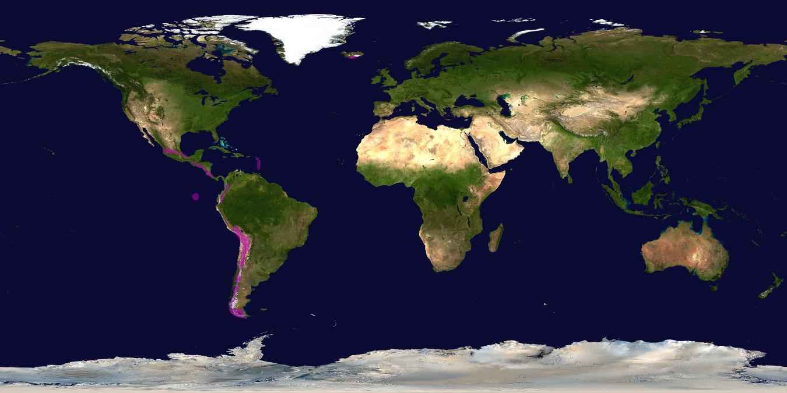
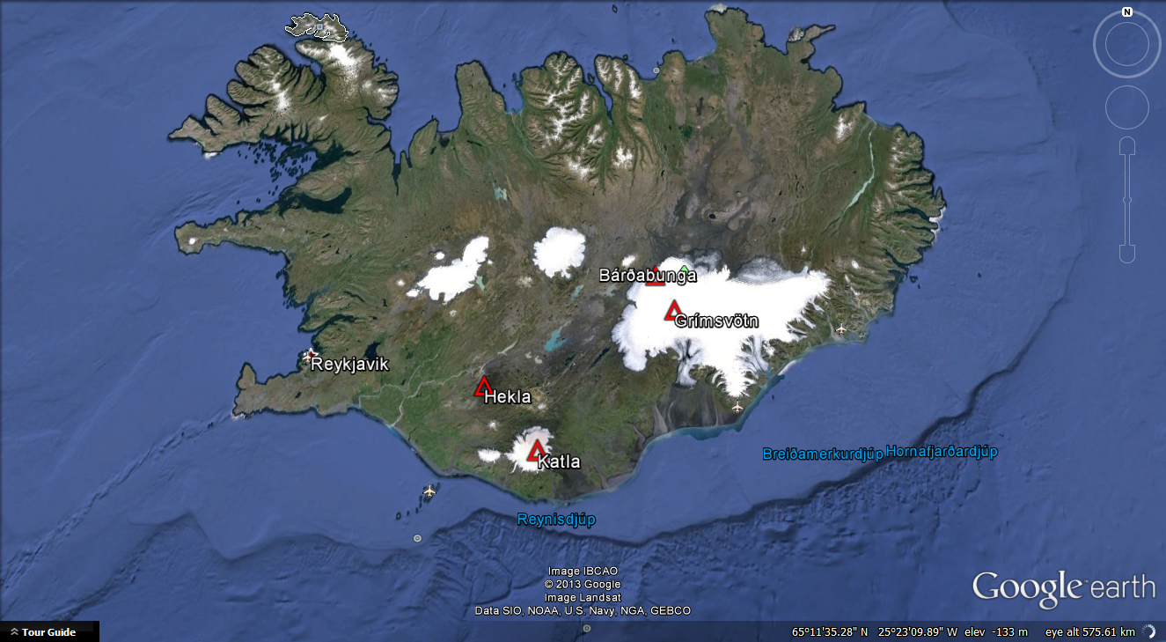
Volcano Pilot – regional areas of focus
Regional monitoring demonstration in Latin America; new product development over existing volcanic GSNL (Hawaii and Iceland); single volcano response demonstration if major event in 2014-2016

Slide 14
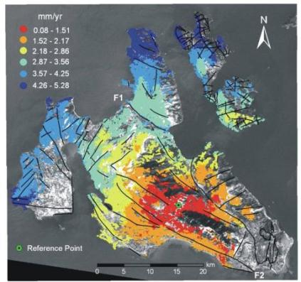
Seismic Hazards – the need
WHY? Most devastating global disaster – large number of events and largest number of total deaths (large events); EO can support increased understanding of nature and extent of risk – cannot predict earthquakes. EO also supports response and other phases.
WHAT’S MISSING? Large data collects over seismic strain belt (15% earth surface) to improve scientific knowledge of seismic hazard; partners to analyse data to generate surface strain model based on interferometric SAR analysis. GSNL provide EO data for improved scientific understanding but only over limited areas. Science products for EQ response (M>5.8 not covered by GSNL, data types for science not covered by Charter).
Precise terrain motion product to support Crustal Block Boundaries analysis over the Cephalonia Island, Greece, Standard Deviation of Velocity Field using ENVISAT Descending (2003 – 2008), Credits: NKUA.

Slide 15
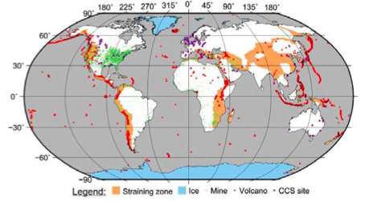
Seismic Hazards Pilot Objectives
Objectives based on priorities elaborated through an open review process in the framework of the Santorini Conference.
The three objectives are:
A) Support the generation of globally self-consistent strain rate estimates and the mapping of active faults at the global scale by providing EO InSAR and optical data and processing capacities to existing initiatives, such as the iGSRM for science users
[Wide extent satellite observations]
B) Support and continue the geohazard supersites initiative (GSNL) for seismic hazards & volcanoes for science users
[Satellite observations focused on supersites]
C) Develop and demonstrate advanced science products for rapid earthquake response for civil protection authorities
[Observation of earthquakes with M>5.8]
Straining areas (seismic belts) and volcanoes of the world (Kreemer et al., 2003). Figure : GSNL Strategic Plan 2012.
Notes:
Examples of Rapid Response Products:
Co-seismic ground displacement maps
Seismic source models
Maps of surface effects
Post-seismic ground velocity maps
Coulomb stress change models on neighboring faults
Note: Charter does not acquire data in interferometric mode. This is complementary to existing Charter work after earthquakes.

Slide 16
Seismic Pilot – regional areas of focus
Strain estimation in Himalayan lift area, Turkey and the Andes; Validation zones in Turkey, California and Japan. GSNL exploitation platform in Hawaii and Iceland.

Slide 17
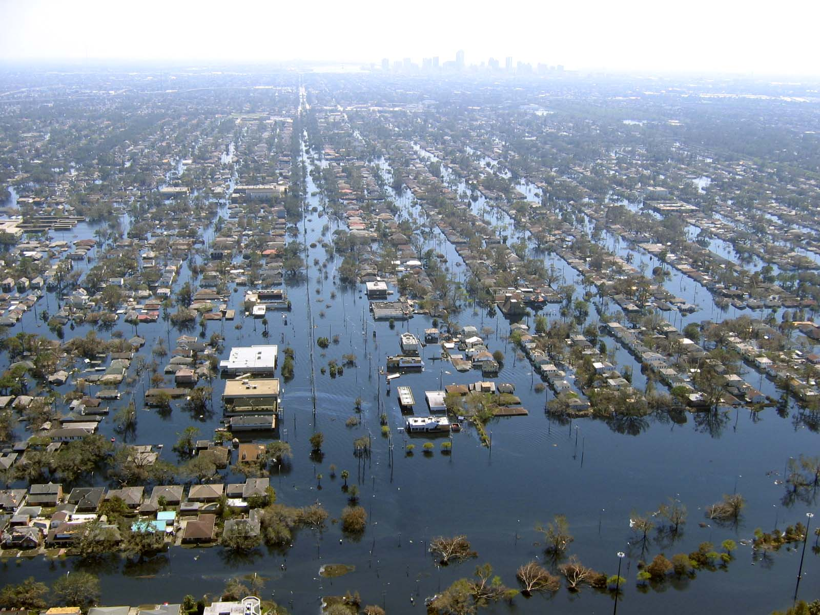
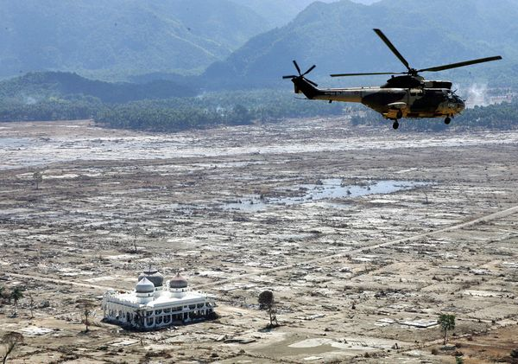
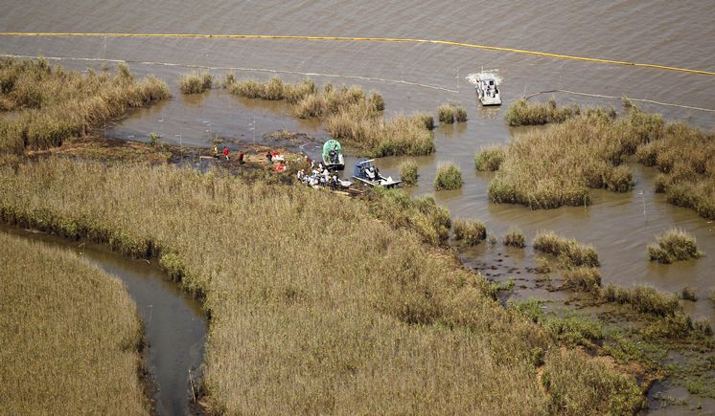
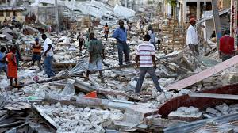
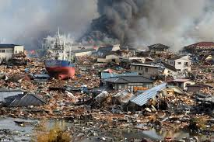
Recovery Observatory – the need
Indian Ocean Tsunami
2004
Hurricane Katrina
2005
Deepwater Horizon
2009
Haiti Earthquake
2010
Tohoku Tsunami
2011
Photo credits: www.nationalgeographic.com; www.mediamythalert.com; www.tampabay.com; www.manongeo.wordpress.com; www.japansociety.org.uk.

Slide 18
Recovery Observatory – the idea
Response
(weeks)
Recovery
(years)
Recovery Observatory (3-5 yrs)
Organise EO data from response phase and pre-disaster in repository
Plan coordinated acquisitions to support:
Built area damage assessment (initial and later detailed);
Natural resource and environment assessment;
Reconstruction planning;
Reconstruction monitoring; and
Change monitoring.
International Charter
Sentinel-Asia
EO data from National Agencies
and commercial providers
Copernicus/GMES
Coordination
Effective Resource Allocation
Clear Institutional Links
Ad Hoc Approach
Lack of Coordination and Cooperation
Lack of Institutional Links
Lack of Awareness of Role of EO
Notes:
Space agencies already
organise the “response” part of the cycle (International Charter, Sentinel-Asia)
propose an “ad-hoc” approach on scientific requirements for a specific zone or disaster/theme (better understanding of hazard phenomena, modelling, etc.)
After the initial response, space agencies have little or no coordination for the post-crisis part of the disaster management cycle
What is a “Recovery Observatory”?
Infrastructure(s) providing access to EO data of use in the Recovery phase (non profit activities)
Data should include that acquired during the response and a regular (every several months) acquisition during Recovery
Links to local users and to international organisations

Slide 19
Recovery Observatory – the proposal
Recovery Observatory Implementation:
Oversight Team (CNES, ESA, JAXA, NASA, ASI) created summer 2013
Proposes ONE Observatory as part of Observation Strategy 2014-2016
Builds on success of Charter, Sentinel-Asia and KAL-Haïti project
Next steps:
Completed detailed analysis
Preparation (conditions for triggering, infrastructure establishment, generic planning)
Cold storage
Triggering
Operations (3-5 years)
Closing
Detailed analysis to be presented by Oversight Team at SIT April 2014.
Notes:
Proposal
set-up and agree all organisational aspects (including procedure to decide on the creation of an RO following a major event)
create ONE pilot RO following a major event during the CEOS DRM activities
Example of “Kalhaiti” RO established by CNES following Haiti earthquake, Jan 2010
integration of large quantity of EO data acquired during the Charter activation (approx. 3Tb – 69000 files)
regular acquisitions during Recovery period (<150 images since 2010)
large community of local and international users

Slide 20
CEOS DRM Observation Strategy : Content & Status
CEOS DRM Observation Strategy (1st issue at SIT WS, 2nd issue at CEOS Plenary, final issue at 2014 SIT Meeting) contains:
Thematic Pilots definition,
Recovery Observatory definition
Pilots EO Requirements;
Response from Agencies’ to EO requirements (list of relevant satellite missions/instruments and products with Strategic Data Acquisition Plan).
Final at 2013 Plenary
Preliminary at 2013 Plenary,
Final at 2014 SIT meeting
Final at 2013 Plenary
Preliminary at 2013 Plenary,
Final at 2014 SIT meeting

Slide 21
CEOS participation in 2015 WCDRR
WCDRR Preparation meeting with JAXA – Japan Cabinet Office and Japan Foreign Ministry (September 26, 2013):
Good contacts established with WCDRR local host (Thanks to GEO SEC)
Active participation of CEOS welcome by Japanese officials
Still perception gap as to positioning of space assets in HFA.
Meeting B.Ryan (GEO) and M.Walhstrom (UN ISDR) (Sep. 2013):
CEOS DRM presented to UN ISDR
M.Walhstrom’s advice:
Local users are still missing the capabilities to access and exploit the information derived from EO satellite data
EO satellite data needs to be integrated in traditional disaster management processes.
A Task Force led by JAXA (Chu) will define and implement a strategic approach for the CEOS’ participation in the WCDRR (e.g. side event, exhibition, conference declaration, ..) and CEOS’ contribution to the HFA2 (2015-2025).
call for membership
Notes:
WCDRR Preparation meeting with JAXA – Japan Cabinet Office and Japan Foreign Ministry (September 26, 2013):
- Presentation of CEOS DRM activities found useful and very timely.
- Japan attaches a great importance to technology for DRM and CEOS participation to the WCDRR will be welcome to promote space technologies for DRM.
- Official of Foreign Ministry observed that space technology is well already reflected in HFA and the level of description will be maintained in HFA2.
- Official of the Cabinet Office suggested CEOS may consider using WCDRR to propagate and increase awareness of space technology among WCDRR stakeholders.
- CEOS may consider either participate in the official technology WG, or hold a session in the general public forum (including exhibition).

Slide 22
CEOS DRM at CEOS Plenary
Decisions for CEOS Plenary:
Approve:
Pilot definitions (i.e. Users’ High-level Information Needs and Detailed EO requirements)
Endorse way forward recommendations for 2014:
CEOS Agencies’ “Response to EO requirements” and “Recovery Observatory” proposal to be both consolidated at 2014 SIT meeting
Data & Products delivery to Pilots’ Users from 2014 SIT meeting onwards
Prepare CEOS participation at 2015 WCDRR

Slide 23
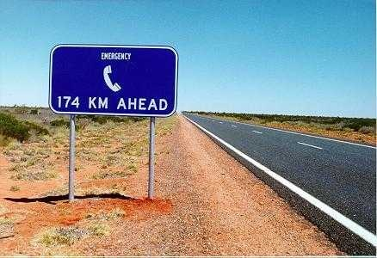
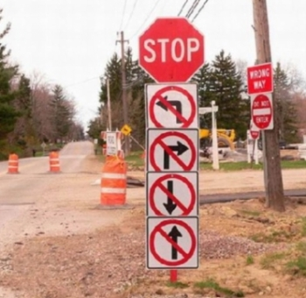
Long way up to 2015 WCDRR …
Clear messages to Disaster Community
Focus on top priorities and not to be distracted by side issues

Slide 24
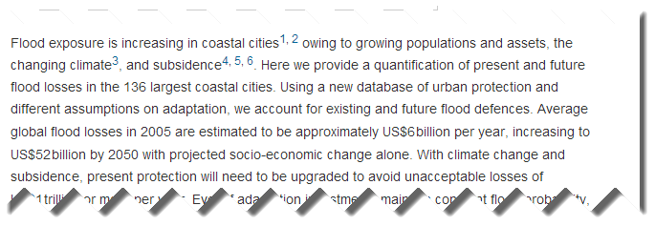
Thank
you !!!!
© article “Future flood losses in major coastal cities” by Hallegatte, Green, Nicholls, Corfee-Morlot
Published in Nature Climate Change (Aug. 18, 2013)

