Slide 1
Update on Copernicus
Agenda item: 12
Dr. Reinhard Schulte-Braucks
European Commission - Head Copernicus Infrastructures

Slide 2
Copernicus strategy
A source of information for policymakers, scientists, business and the public at large
A European response to global needs
to manage the environment,
to mitigate the effects of climate change and
to ensure civil security
A user-driven programme of services
An integrated Earth Observation system (combining space-based and in-situ data with Earth System Models, delivered to users by 6 service providers)

Slide 3
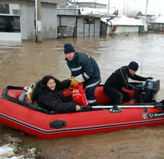
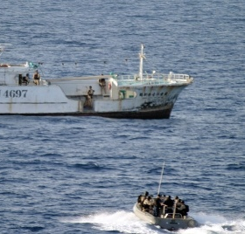
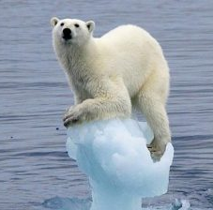
Copernicus services
Services monitoring Earth systems
Land Monitoring
Marine Monitoring
Atmosphere Monitoring
Horizontal services
Emergency Management
Security
Climate Change
Output: Value-Added Information

Slide 4
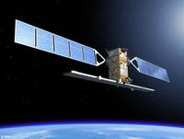
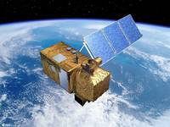
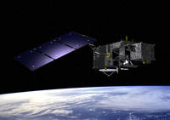
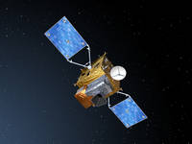
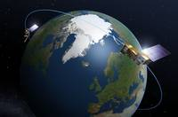
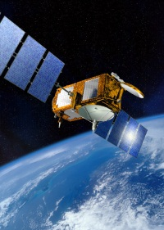
Copernicus space infrastructure
Sentinels
Five EO missions developed specifically for Copernicus
AND
High Precision Ocean
Altimetry (HPOA) mission
PLUS
Contributing Missions
Third party EO missions offering their data to Copernicus (EU/ESA MSs, EUMETSAT, commercial, international)
Sentinel 1
Sentinel-2
Sentinel-3
Sentinel-4
Sentinel-5
Sentinel-6 = Jason-CS

Slide 5
Copernicus space infrastructure
SAR imaging | Multi spectral imaging | Ocean and global land monitoring | GEO atmospheric composition | LEO atmospheric composition
Global and European land monitoring for cloudy areas | Land applications: urban, forest, agriculture | SST, ocean colour, ocean topography wave height, altimetry | Air quality, Ozone, surface UV, climate protocol monitoring | Air quality, Ozone, surface UV, climate protocol monitoring
Sea-ice monitoring | complementing Landsat | Vegetation monitoring | Complementing data for ocean monitoring | Complementing data for ocean monitoring
Wall-to-wall coverage | Wall-to-wall coverage | Support for long time data series for climate | Support for long time data series for climate | Support for long time data series for climate
Jaon-CS

Slide 6
Copernicus Deployment Schedule

Slide 7
Copernicus
Thank you for your attention
Reinhard.Schulte-Braucks@ec.europa.eu
Website: http://copernicus.eu
Facebook: CopernicusEU
Twitter: @Copernicus EU

