Slide 1
CEOS PLENARY
Annual Progress Report:
CEOS Implementation of the GEOSS Space Segment
Agenda item: 10
Michael Freilich/SIT Chair/NASA

Slide 2
Annual Progress Report - Outline
This report includes two parts, and one item for approval:
    Part 1:Highlights of CEOS contributions to the GEO 2012-2015 Work Plan (information)
    Part 2: Update on the CEOS Virtual Constellations (VCs)
    Individual VC Status Reports (information)
    CEOS Virtual Constellations Process Paper (for approval)
    Update on Harmonization of all VC Terms of Reference (information)
      Request extension to 23 December 2013 for completion

Slide 3
PART 1
Highlights of CEOS Contributions to GEO 2012-2015 Work Plan
3

Slide 4
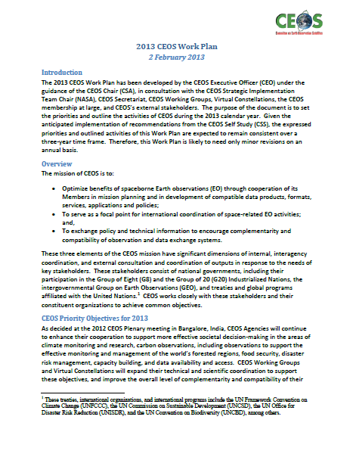
CEOS 2013 Work Plan and
Associated CEOS-GEO Actions
Highlight the commitment of Space Agencies to implement the Global Earth Observation System of Systems (GEOSS)
  Actions focus exclusively on space segment aspects and efforts of Space Agencies to implement Components of the GEO Work Plan and GEOSS
Address the Elements of the Annual CEOS Work Plan

Slide 5
Priority Objectives for 2013
2013 CEOS Work Plan: 2 FEB 2013 FINAL
CEOS Agencies will continue to enhance their cooperation to support more effective societal decision-making in the areas of climate monitoring and research, carbon observations, including observations to support the effective monitoring and management of the world’s forested regions, food security, disaster risk management, capacity building, and data availability and access.
CEOS Working Groups and Virtual Constellations will expand their technical and scientific coordination to support these objectives, and improve the overall level of complementarity and compatibility of their Earth observation and data management systems for societal benefit.
CEOS will consider other requests from external stakeholders and determine what, if any, support is possible and appropriate. CEOS will also continue its outreach and communications efforts.
CEOS will continue its consideration of 2011 CEOS Self-Study recommendations, with near-term (e.g., 1-3 years) decisions anticipated on its organization, structure, decision-making processes, and stakeholder relations.

Slide 6
Eight Elements of the 2013 CEOS Work Plan
Climate Monitoring and Research
Carbon Observations, including Observations to Support the Effective Monitoring and Management of the World’s Forested Regions
Food Security
Disaster Risk Management
Capacity Building and Data Availability and Access
CEOS Support to Further Key Stakeholder Initiatives
Continued and Enhanced CEOS Outreach to Key Stakeholders: GEO, UNFCCC, UN ISDR, UN CBD, G8/G20, and Others
Adoption of Recommendations from the 2011 CEOS Self-Study

Slide 7
Updates on CEOS 2013 Outcomes and Associated CEOS-GEO Actions
1. Climate Monitoring and Research
Development of Climate Data Records (CDRs) and related datasets addressing Essential Climate Variables established by the Global Climate Observing System (GCOS). Agenda Item 27
Continued cooperation with GEO, GCOS, the World Meteorological Organization (WMO), and the Coordination Group for Meteorological Satellites (CGMS) in the development of a space-based system to support climate information and adaptation. Agenda Item 27
Further alignment of the Virtual Constellations objectives as building blocks of the space-based climate information strategy and as contributions to facilitating the observation of ECVs, as defined in the CEOS Response to the Satellite Supplement of the 2010 GCOS IP. Next Section of this Presentation
Five CEOS-GEO Actions Related to Climate and Constellations

Slide 8
Updates on CEOS 2013 Outcomes and Associated CEOS-GEO Actions
2. Carbon Observations, including Observations to Support the Effective Monitoring and Management of the World’s Forested Regions
CEOS leadership within and support to GEO Global Forest Observation Initiative (GFOI). Agenda Item 23
Publication of the CEOS Strategy for Carbon Observations from Space. Agenda Item 22
3. Food Security
Continued support to the Joint Experiments on Crop Assessment and Monitoring (JECAM) initiative. Agenda Item 24
4. Disaster Risk Management
  Enhanced support for Disaster Risk Management (DRM). Agenda Item 19
Continued support to the Geohazards Supersites and Natural Laboratories initiative. Agenda Item 21
Five CEOS-GEO Actions Related to Carbon and Forests
Two CEOS-GEO Actions Related to JECAM
Ten CEOS-GEO Actions Related to Disasters

Slide 9
Updates on CEOS 2013 Outcomes and Associated CEOS-GEO Actions
5. Capacity Building and Data Availability and Access
  Advancement of CEOS Data Democracy activities. Agenda Item 32
  Continued support to the development and operationalization of the GEOSS Common Infrastructure (GCI) and its CEOS-related elements. Agenda Item 30
Continued CEOS leadership of, and support to, the Quality Assurance for Earth Observations (QA4EO) initiative. Agenda Item 31
Ten CEOS-GEO Actions Related to CEOS WGCV, WGISS, and WGCapD

Slide 10
Updates on CEOS 2013 Outcomes and Associated CEOS-GEO Actions
6. CEOS Support to Further Key Stakeholder Initiatives
Decision on whether and how CEOS Agencies may provide coordinated data acquisition support to the GEO Global Agricultural Monitoring (GEOGLAM) initiative. Agenda Item 24
Continued dialogue on potential CEOS contributions to Integrated Water Cycle products and services. Agenda Item 15
Continued dialogue on potential CEOS contributions to the GEO Biodiversity Observation Network (GEO BON). Agenda Item 17
Dialogue on potential enhanced CEOS-level coordination to support improved research and monitoring of the Earth’s polar regions. CEOS Action
Determine the level and scope of engagement of the four ocean-related Virtual Constellations in the GEO Blue Planet Task. Agenda Item 16
Eight CEOS-GEO Actions Related to these Activities

Slide 11
Updates on CEOS 2013 Outcomes and Associated CEOS-GEO Actions
7. Continued and Enhanced CEOS Outreach to Key Stakeholders: GEO, UNFCCC, UN ISDR, UN CBD, G8/G20, and Others
Engagement, attendance, and where appropriate, strategic involvement , reporting on CEOS achievements, and presentations at key meetings. Ongoing activities and support from all CEOS Agencies
Maintenance to CEOS online services such as the CEOS website and Missions, Instruments and Measurements (MIM) database. Agenda Item 34
Publication of the CEOS Newsletter. Many thanks to JAXA for their continued support of the Newsletter.
8. Adoption of Recommendations from the 2011 CEOS Self-Study
Development of strategic guidance documents, stemming from participative analysis and options proposed by the CEOS Self-Study Implementation Initiative (CSSII) Topical Teams. Agenda Items 5 and 6
Plenary review and adoption of CSSII proposed options for refinement. Agenda Item 7
One CEOS-GEO Action Related to MIM

Slide 12

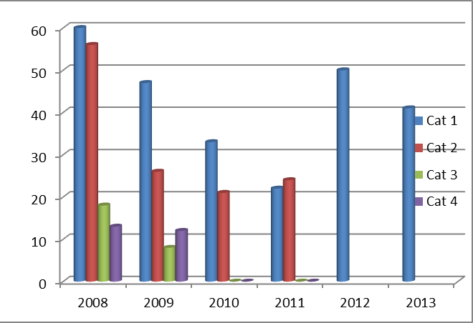
Current Status of CEOS-GEO Actions
47 Actions for 2013
4 CLOSED
Of the 43 remaining open Actions, 33 have been updated within the past two months

Slide 13
CEOS Participation in the 2012-2015 GEO Work Plan
CEOS is identified as:
  Component Lead for sixteen (16) of the proposed 58 Components
  Component POC for six (6) Components
  Contributor for twelve (12) Components
  Task Coordinator for two (2) Tasks
  Implementation Board Member for two (2) Boards
    (Two on IIB and one on SB)

Slide 14
Infrastructure and Institutions and Development Tasks/Components
CEOS is identified as:
Component Lead for 16 of the proposed 58 Components
Component POC for 6 Components
Contributor for 12 Components
Task Coordinator for 2 Tasks
Implementation Board Member for 2 Boards
  Two on IIB and one on SB
Green text indicates those GEO Components where CEOS is an identified Lead Agency
Pink text indicates those GEO Components where CEOS is identified as a Component POC
Green shading indicates a known change to the Rev 2.1 of the GEO 2012-2015 Work Plan
Grey shading indicates a Component with no known CEOS leadership role

Slide 15
Societal Benefits Tasks/Components

Slide 16
IN-01-C2 Priority Actions
CEOS (Brian Killough, NASA) Leads the IN-01-C2 Component, which includes these priority actions (modified in June 2013)
  Promote rapid development of CEOS Constellations
  (CEOS Constellations)
  Establish and upgrade ground station capacity in Africa for CBERS (INPE)
  Establish actions securing ECV data from satellites
  (CEOS/CGMS WGClimate)
  Promote space missions to fill gaps from the loss of key instruments (i.e., Envisat, AURA) (CEOS Constellations)

Slide 17
IN-01-C2 Accomplishments for 2013
Summary 1 of 4
  CEOS Constellations ... New focus in 2013 within CEOS.
    Virtual Constellations (VC) have a key role supporting delivery of GEOSS space segment outcomes. 33% of the CEOS-GEO actions utilize VCs to accomplish their tasks.
    Renewed emphasis on VC outputs with a priority-driven approach and feedback from CEOS leadership.
    A new VC Process Paper has improved the governance and function of the VCs.
    CNES will focus its 2013-2015 CEOS SIT leadership on improved data access for VCs through enhanced portals.

Slide 18
IN-01-C2 Accomplishments for 2013
Summary 2 of 4
  CEOS Constellation outcomes for 2013 include ...
    Ocean Surface Topography – International consensus on measurement requirements, launch of SARAL
    Ocean Surface Vector Winds – Data continuity and increased utilization, Rapidscat mission approved on ISS, training courses for marine forecasters planned for South Africa.
    Ocean Colour Radiometry – Implementation of INSITU-OCR (multi-agency sensor calibration and validation network), two IOCCG reports (GEO Ocean Colour observations and Requirements for future sensors), 1st international Ocean Colour Science Meeting.
    Sea Surface Temperature – 100% of GHRSST products discoverable through CEOS IDN, fully developed Climate Data Assessment Framework (CDAF).
    Land Surface Imaging – LSI Explorer portal for improved data access.
    Precipitation – New Precipitation Constellation data portal initiated, GCOM-W1/AMSR-2 and Megha-Tropiques/SAPHIR data publicly available, METOP-B fully operational.
    Atmospheric Composition – progress on total Ozone ECV and volcanic ash alert system, initial discussions for a GEO air quality constellation.

Slide 19
IN-01-C2 Accomplishments for 2013
Summary 3 of 4
  CBERS ground stations in South Africa and Spain have been established and upgraded by Brazil (INPE) and China (CRESDA). Additional ground receiving stations are planned for CBERS-3 (launch scheduled for Dec 2013) in Hartebeeshoek, South Africa (MOU between China, Brazil and South Africa (SANSA)), and in Maspalomas, Spain (MOU between Spain (INTA) and Brazil). Brazil, France and Gabon are joining forces to develop the SEAS Gabon project, which will deploy an antenna and operational ground station for receiving data in West Africa.
  New combined CGMS-CEOS Working Group on Climate was formulated in 2013. The first meeting of this new joint group is in March 2014. Focus on Essential Climate Variable (ECV) Inventory (www.ecv-inventory.com) developed by CEOS, CGMS, and WMO includes 200+ data records. This data will be used to assess gaps in a sustained climate architecture. These groups have also continued efforts towards defining a Climate Monitoring Architecture for space-based observations.

Slide 20
IN-01-C2 Accomplishments for 2013
Summary 4 of 4
  Envisat and Aura measurement gaps cannot be “filled” but only minimized. There are few future global Low Earth Orbit (LEO) missions planned with the same capability and readily accessible data. These past missions were uniquely focused on science research of the Oceans, Atmosphere and Land with many capabilities within each mission.
  There are many current missions that combine to achieve the capabilities of Envisat and Aura. Challenges remain with data access and cal-val of data products.
  Future Oceanography will be addressed by ...
  Oceansat-3 (ISRO), RapidSCAT (NASA) – Ocean and atmosphere applications
  Meteor-M N3 (Russia) – physical oceanography
  Jason-3 (NASA/NOAA/CNES/EUMETSAT), SWOT (NASA/CNES) – physical oceanography
  Future Land Imaging will be addressed by ....
  Sentinel-1 (ESA) – C-band SAR land imaging
  Sentinel-3A (ESA) – land imaging radiometry
  Landsat-8 and Sustained Land Imaging System (NASA/USGS) – multispect. land imaging
  Future Atmospheric chemistry and dynamics measurements will be obtained by ....
  EarthCARE (ESA/JAXA) – cloud-aerosol interactions
  PACE and ACE (NASA) – aerosol and clouds
  Sentinel-5 Precursor (ESA/NSO), SAGE-III (NASA), TEMPO (NASA),
  KOMPSAT/GEMS (KARI) – LEO atmospheric composition and air quality

Slide 21
Part 2
CEOS Virtual Constellations

Slide 22
CEOS Constellations
IN-01: Earth Observing Systems
C2: Development and Coordination of Space-based Observing Systems
  Promote rapid development of the “CEOS Constellations Concept.” Observations from Virtual Constellations provide higher temporal, spatial, and spectral resolution, as well as improved data management and dissemination. Virtual Constellations are active in seven areas: Precipitation, Atmospheric Composition, Land Surface Imaging, Ocean Surface Topography, Ocean Colour Radiometry, Ocean Surface Vector Wind, and Sea-Surface Temperature

Slide 23
SIT approach to VCs in 2012 & 2013
Presumption that VCs have a key role supporting delivery of GEOSS space segment outcomes
  3-year outcomes defined in support of 2015 GEO horizon
Consistent with CEOS Self Study VC Report recommendations
  Emphasis on tangible products (including climate architecture)
  Stronger top-down direction and target setting – aided by stronger feedback and support mechanisms
  More integrated approach, priority-driven
Stronger feedback and support mechanisms
  Dedicated VC workshops at SIT-27 & SIT-28 meetings
  Regular SIT Chair telcons with VC leads
  Systematic representation of VC issues on SEC (compilation report)

Slide 24
VC-related outcomes planned for CEOS Plenary
Update on progress of the VCs during 2013
A 2013 update to the “CEOS Constellations for GEO Process Paper” – bringing up to date the identification of the seven Virtual Constellations (VCs), with consistent terms of reference that have common elements – following the recommendations of the CEOS Self-Study Roles and Responsibilities Team.
Individual terms of reference for each of the seven VCs, including a characterisation of the relevant space segment, and of planned accomplishments and challenges – as the basis for reporting and managing progress with the CEOS SIT.
Harmonised statement of 2015 accomplishments of VCs (and WGs), to demonstrate the combined output of CEOS in support of the space segment of the GEOSS, and as a mechanism to guide the necessary consistency and coordination across the many CEOS subsidiary groups. Also a mechanism for dialogue with GEO and its stakeholders in demonstrating the effective contribution of space agencies to the societal benefit goals of GEO, including in relation to the post-2015 business case

Slide 25
Our VCs and lead agencies
Oceans
  Ocean Surface Topography: CNES & EUMETSAT
  Ocean Surface Vector Winds: NOAA, EUMETSAT & ISRO
  Ocean Colour Radiometry: NASA, NOAA, ESA
  Sea Surface Temperature: ESA & NOAA
Land
  Land Surface Imaging: USGS, INPE & ISRO
Atmosphere
  Precipitation: NASA & JAXA
  Atmospheric Composition: NASA & ESA
Refer to the leadership summary document (plenary website) for information

Slide 26
Ocean Surface Topography (OST-VC)
Key outcomes
  International consensus on the OST measurement requirements
  Continuity of the OST measurement capability
  Sea level ECV support
  Engagement of the science/user community through the OST-ST
Progress
  Launch of SARAL
  Working meeting with SOA/NSOAS
Issues
  Support for enlargement of the OST constellation with additional missions by other CEOS member organisations.
  Adoption of open data policies and promotion of free and easy data access for contribution to the ocean surface topography observing system as a whole, and facilitate joint work across data providers to allow for easy inter-calibration and merging

Slide 27
Ocean Surface Vector Winds (OSVW-VC)
Key outcomes
  OSVW data continuity (& reprocessing etc)
  Cross-calibration of OSVW sensors
  Improved utilisation in forecasting and warning services
  User Training courses
Progress
  Rapidscat/ISS approved
  OSCAT Level 1B processing update implemented
  Training courses continuing: Satellite winds and waves marine forecaster training workshop rescheduled for December 2013 with the South African Weather Service
Issues
  Continuity of open and timely data access – Metop series is the only operational core mission – others are either research or without commitment to open and timely data access.

Slide 28
Ocean Colour Radiometry (OCR-VC)
Key outcomes
  ECV development
  Implementation of the INSITU-OCR (supporting an in situ sensor calibration and data validation network), including setting up a multi-agency INSITU-OCR Project Office
Progress
  Publication of IOCCG Report #12: “Ocean-Colour Observations from a Geostationary Orbit”
  Publication of IOCCG Report #13: “Mission Requirements for Future Ocean-Colour Sensors”
  First International Ocean Colour Science (IOCS) Meeting – May 2013
Issues
  CEOS Agency review and support for implementation of INSITU-OCR
  Active engagement and support of all appropriate CEOS agencies in the implementation of OCR-VC activities

Slide 29
Sea Surface Temperature (SST-VC)
Key outcomes
  ECV support and Fully developed Climate Data Assessment Framework (CDAF)
  long term continuity of all necessary space-based components including passive microwave and dual-view, high quality IR reference-sensor SST data VC Portal
  100% of GHRSST products discoverable through CEOS IDN and CWIC
Progress
  83% of GHRSST products discoverable through CEOS IDN and CWIC
  Version 1 CDAF presented to Science Team and under consideration for adoption. Pilot applications of CDAF identified at June 2013 meeting
Issues
  Participation essential and remains a challenge
  Request CEOS Agencies to digitize and curate paper archives for past, present and future missions

Slide 30
Land Surface Imaging (LSI-VC)
Key outcomes
  Mid Resolution Guidelines document
  MS3Ortho engine (INPE’s contribution)
  LSI Explorer (USGS’s contribution)
  Data discovery and open access (INPE, USGS, ESA)
Progress
  LSI future under review - Land Surface Study Group established at SIT-28 with INPE leadership
Issues
  Participation unclear – including Leads
  Essential that LSSG report be completed and distributed prior to, and for discussion at, SIT-29
  SIT Chair and CEOS Chair should monitor/report progress at SEC meetings

Slide 31
Precipitation (P-VC)
Key outcomes
  Deployment of GPM phase constellation satellites, maintaining continuity with TRMM, and advocacy of post-GPM phase P-VC
  Precipitation ECV support – Response to GCOS Action A-8 - Ensure continuity of satellite precipitation products
  PC Data Portal and links to CEOS Water Portal
Progress
  Phase 1 of data portal completed and Phase 2 initiated
  NASA-EUMETSAT GPM Cooperation MOU signed
  GPM observatory testing completed and final preparations for launch in process
  2013 NASA Senior Review recommended TRMM extension through 3Q2017
  Precipitation ECV support – Response to GCOS Action A8
        GCOM-W1/AMSR2 data publicly available; Megha-Tropiques/SAPHIR data publicly available; Metop-B fully operational
        CEOS P-VC Microwave Imager Availability White Paper Update drafted and under review by P-VC agencies
Issues
  Potential coverage gaps (post GCOM-W1 and post DMSP)
  Support for data exchange and access

Slide 32
Atmospheric Composition (AC-VC)
Key outcomes
  Total ozone ECV validation & harmonization
  Geostationary Air Quality constellation coordination
  Multi-sensor volcanic eruption alert system
  Greenhouse gas (GHG) constellation
Progress
  Good progress on Total Ozone ECV -
  AQ organisational aspects progressed
  Excellent progress in implementation of web-based volcanic alert system
  GHG activity will respond to the CTF report
Issues
  Volcanic alert – need coordination among CEOS, CGMS, WMO SP
  Looming gap in atmospheric limb sounding (EE7 did not select PREMIER)

Slide 33
The VC Process Paper
Updated with comments from the VC teams and CEOS SEC
  Section 3 revised to include descriptions of all 7 of the current constellations.
  Sections 4 and 5 revised to simplify/shorten the process of proposing a new constellation, and include definition of Terms of Reference in that process
  Section 6 revised to indicate the ongoing role of SIT in managing the VCs, not just in relation to approving new VCs
  Annex 3 presents a template for the Terms of Reference proposed to be developed to characterise all the existing and new VCs
DECISION: Asking CEOS Plenary to endorse the 2013 update

Slide 34
VC ToRs Preview
Only the most recent VCs (SST, OCR) have a formal characterisation of their scope and objectives (post- Process Paper) – the consistent set of ToRs seeks to help CEOS better characterise, communicate and manage the ambitions of the current and future VCs
VC Leads are asked to follow the template for substance, but have freedom to emphasise the unique nature and foci of the individual VC activities
Emphasis on outcomes and deliverables and in specifying the implementation and coordination issues to be addressed by SIT
Clear characterisation of the relevant space segment – including identification of the core missions as priorities for coordination
VC activities and governance should benefit significantly from this upgrade in documentation
Full set of ToRs is not ready for Plenary – SIT Chair requests an extension for submission of the documents to Principals (by Dec 23, 2013)

Slide 35
2015 deliverables
The case for GEO and the GEOSS beyond 2015 benefits greatly from strong evidence of achievements and return on investment during the first 10 years, with tangible benefits for governments
CEOS and space agencies are major donors and stakeholders in the GEO process and have committed substantially
The harmonised statement of CEOS contributions to GEOSS 2015 seeks to consolidate the various contributions from the CEOS VCs & WGs – building on the information gathered in the process of the VC TORs development – to communicate the full extent of the CEOS effort to GEO
Includes communication of the 2015 state of the VCs and the services and benefits we can expect from them
2015 Deliverables statement dependent on inputs from the VC ToRs and will be finalised by Dec 23, 2013 – ahead of GEO-X Plenary

Slide 36
Going forward…
VCs and WGs have done considerable strategic reflection, work, and reporting in support of the CEOS Self-Study and SIT Chair Team activities
Overall structure, direction, and efficiency will likely be better going forward – in particular the connection and alignment of the VCs to CEOS objectives are much stronger and they are far better characterised
Our delivery teams should increasingly focus on delivering NOW
Thank you to all VC Leads, WG Chairs, and all of the VC and WG members for engaging with the SIT Chair team so enthusiastically these past 2 years

Slide 37
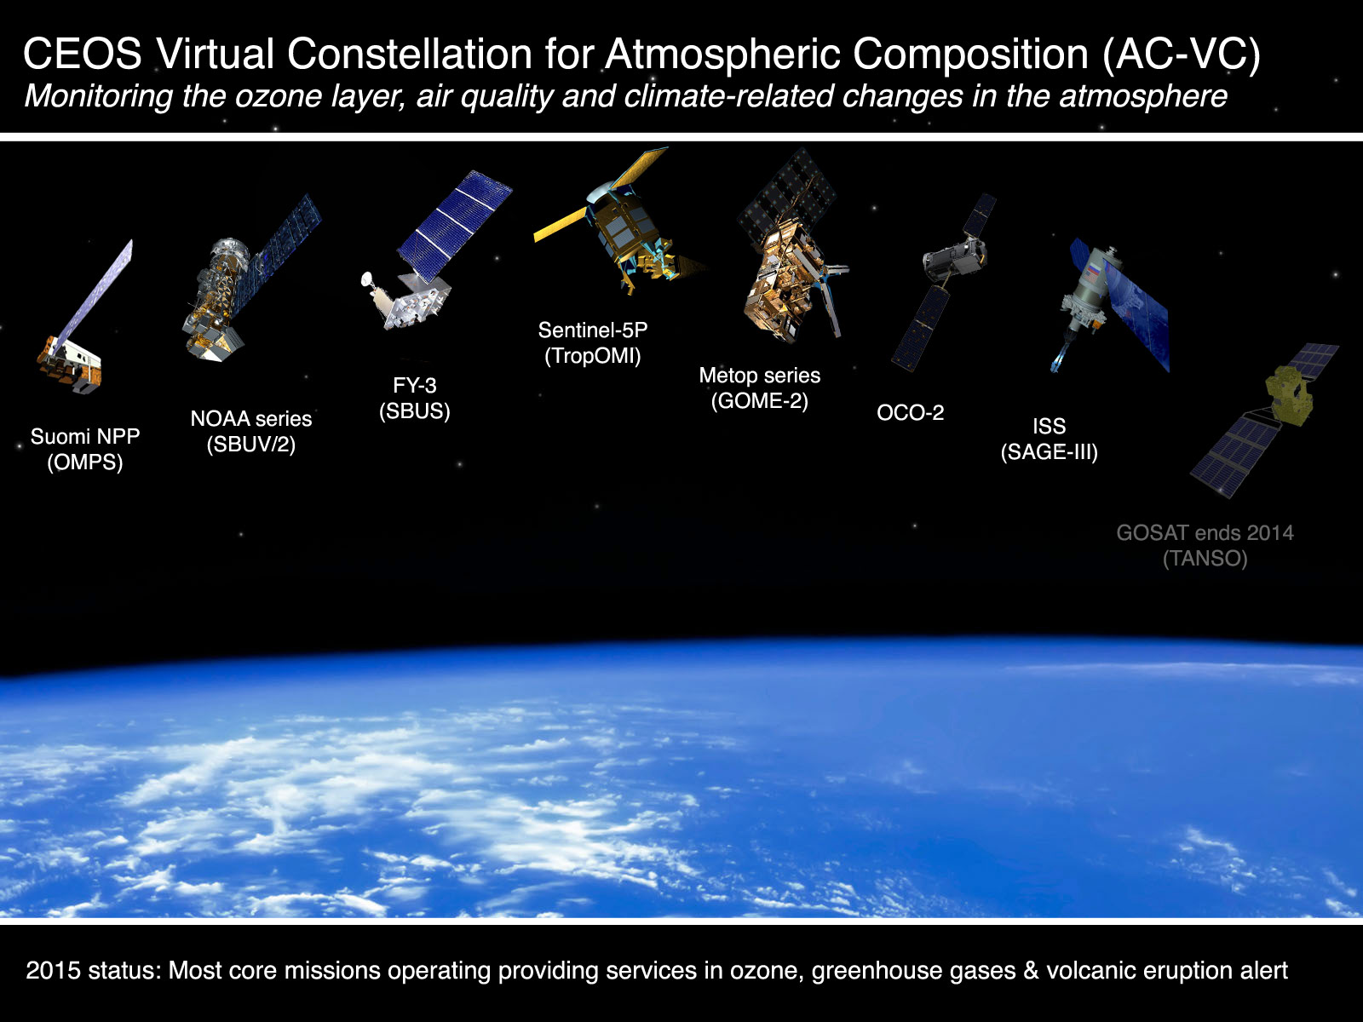
2015 deliverables

