Slide 1
CEOS PLENARY – CEOS Self Study Overview
Agenda item: 5
Michael H. Freilich

Slide 2
CEOS Self-Study
CSS Objectives:
To identify, articulate and evaluate CEOS successes and strengths in achieving real coordination in space-based Earth observations for societal benefit.
To identify successes as well as areas for improvement
To identify potential new CEOS initiatives for the next 5-7 years
To strengthen engagement and involvement of a broad range of CEOS members through participation in a shared activity

Slide 3
Chronology
Major Milestone / Accomplishment | Date
CEOS Self-Study (CSS) is conducted | February – October 2011
Key recommendations are accepted | 2011 CEOS Plenary
Implementation Phase 1: Develop Inputs/Options | November 2011- March 2013
Key Decisions on Options | SIT-28
Implementation Phase 2: Strategic Documents | March 2013 – October 2013
Strategic Documents presented for approval | 2013 CEOS Plenary
2011 | 2012 | 2013
CEOS Self-Study
CSS Implementation (CSSII) Phase 1
CSSII
Phase 2
CSS COMPLETE

Slide 4
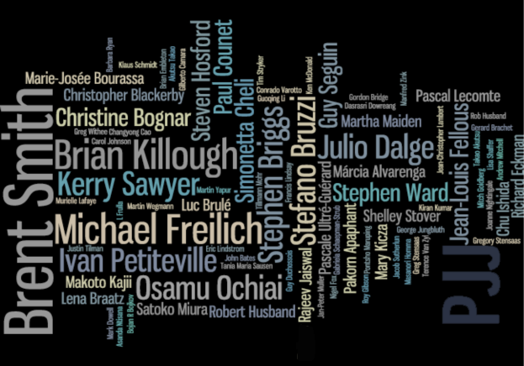
CEOS Engagement / Involvement: This has been a true CEOS effort, from start to finish.
ASI
CAS
CNES CONAE CSA
CSIRO
DLR
EC
ESA
EUMETSAT
GISTDA
INPE
ISRO
JAXA
NASA
NOAA
SANSA
UKSA
USGS
DIRECT PARTICIPATION BY:
93 Individuals representing
24 Members, Associates,
and Partners
CSIR GCOS GEO GOOS WMO

Slide 5
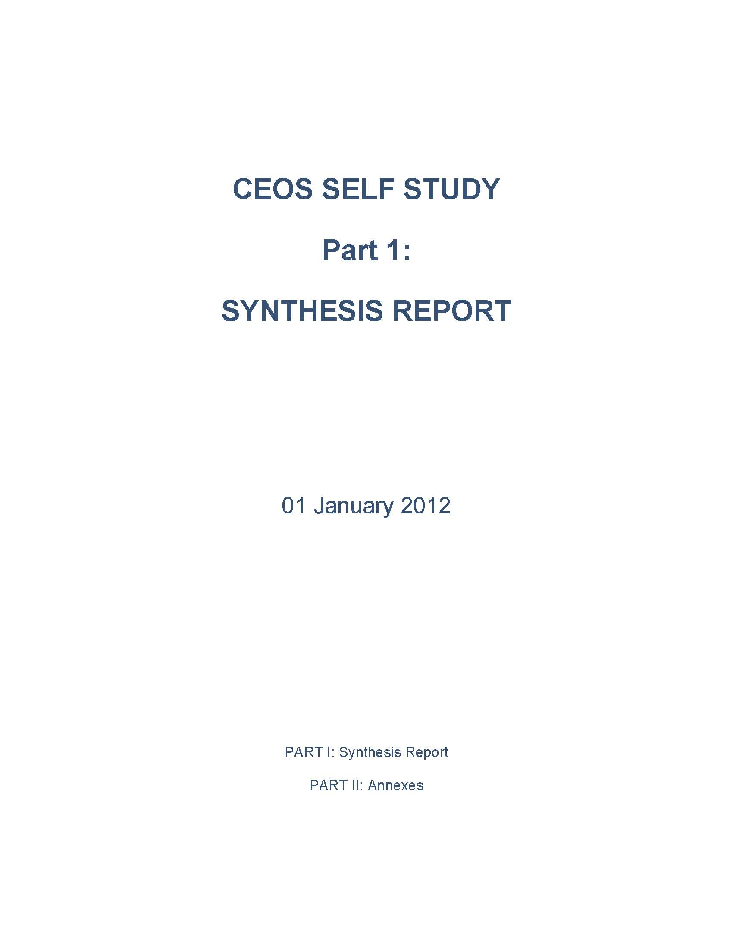
Major Milestones & Accomplishments (1 of 3)
Delivery of the CEOS Self Study
January

Slide 6
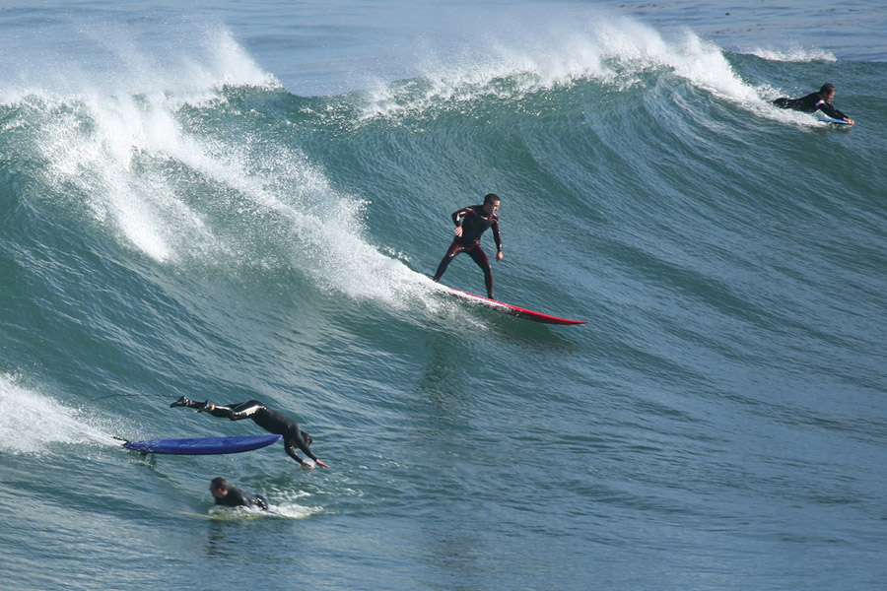
Major Milestones & Accomplishments (2 of 3)
SIT-27: CSSII Phase I - Membership & Participation Report is Delivered, Essential Questions exercise begins
SEO
CEO/DCEO/
NASA CEOS Team
Mike
CEOS Members

Slide 7
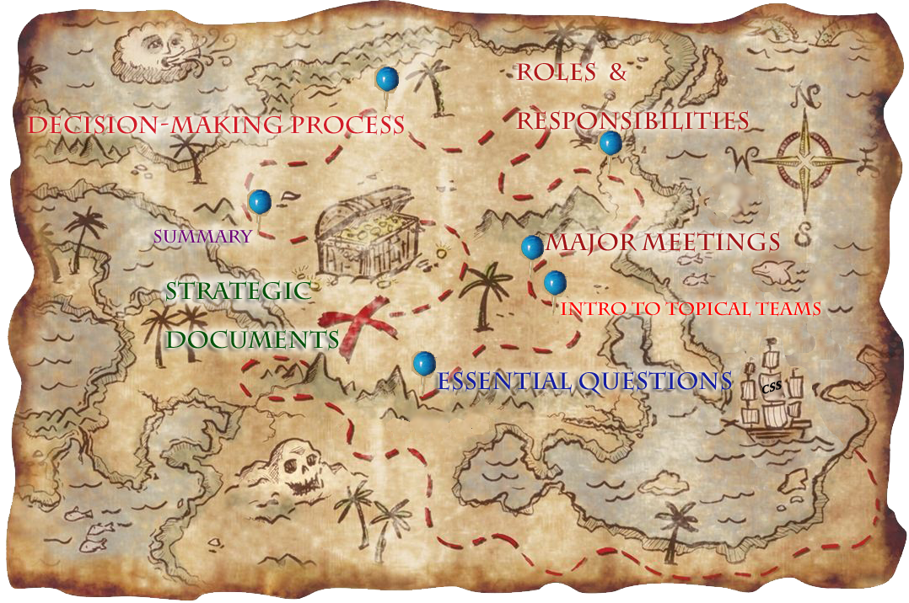
Major Milestones & Accomplishments (3 of 3)
SIT-28: Essential Questions and Topical Teams report; Strategic Documents Steering Committee kicks into high gear

Slide 8
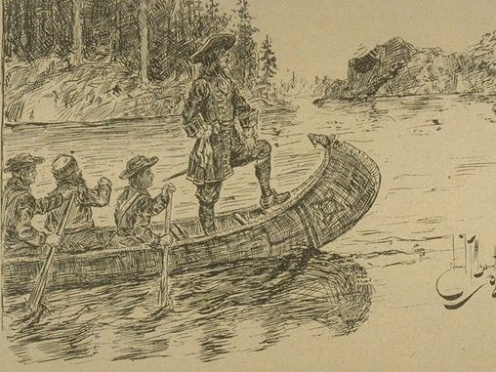
CEOS Self Study Implementation Final Phase: Strategic Document Preparation
This?
Lentement,
mes amis!
Town Hall Telecon,
Ahead
Pierre Le Moyne D’Iberville
(b. Montreal, 1661)

Slide 9
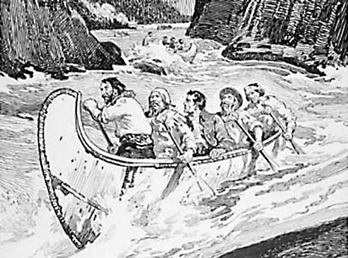
CEOS Self Study Implementation Final Phase: Strategic Document Preparation
This.
Paddle hard, people!
Critical comments
ahead.
And deadlines are in
the boat behind!
Simon Fraser

Slide 10
CEOS Self Study Implementation Final Phase: Strategic Document Preparation
This.
This is a job for
EUMETSAT
Let CNES finish
Paddle hard, people!
Critical comments
ahead.
And deadlines are in
the boat behind!
Simon Fraser

Slide 11
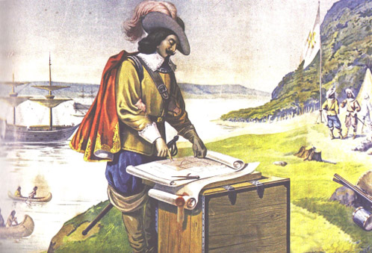
Now: New CEOS Strategic Documents
“Ad hoc Teams”?
or
“Ad hoc Groups”?
For Approval:
CEOS Terms of Reference
Strategic Guidance
Governance and Processes
Terms of Reference
CEOS Chair
CEOS Secretariat
CEOS Strategic Implementation Team (SIT) Chair
CEOS Executive Officer
CEOS Systems Engineering Office (SEO)
Samuel
de Champlain

