Slide 1

Earth Observation Satellite projects in Vietnam
<Agenda item: X>
Vu Anh TUAN

Slide 2
Contents
About VAST
VAST activities in Earth Observation Satellite development:
  VNREDSat 1 project
  VNSC project
  VNREDSat 1b project
VAST and CEOS

Slide 3
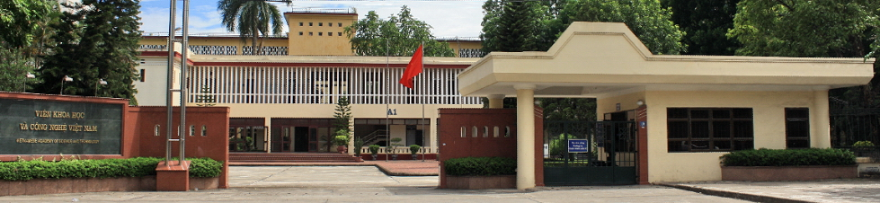
About VAST
VAST: Vietnam Academy of Science and Technology
Established: May 1975
VAST has:
  27 National Institutes, 7 VAST institutes; 4 national key laboratories
  6 Non-academic Units; 1 company

Slide 4
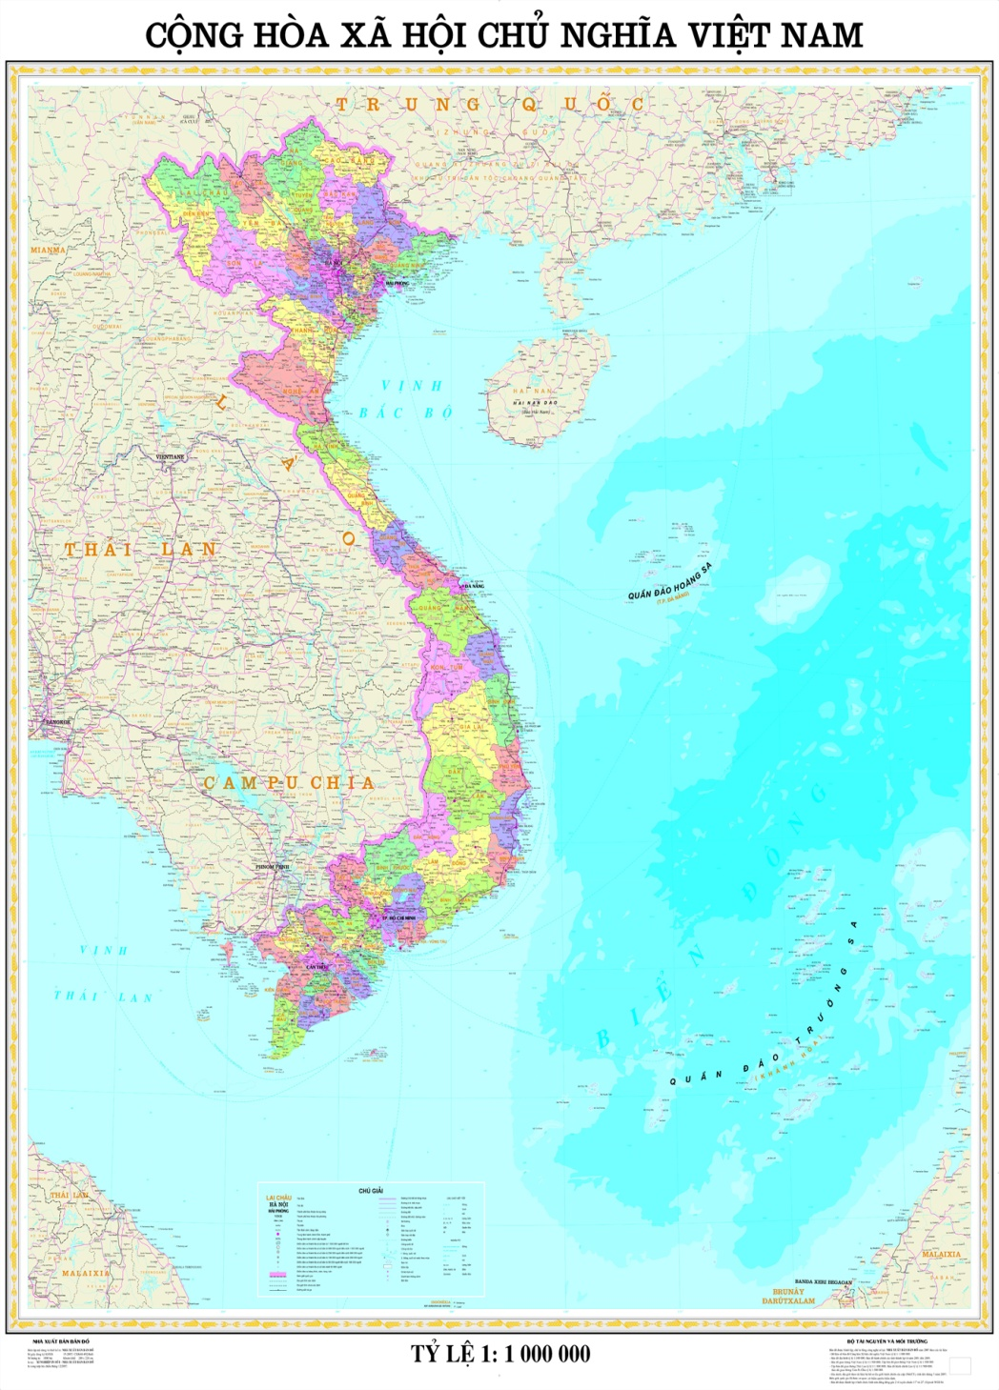
About VAST
VAST located at Hanoi, Ho Chi Minh city, Haiphong, Nha trang, Da lat, Hue
More than 700 scientist (scientific staff - doctor)/2600 staff
Half of int. publications of Vietnam annualy
VAST has co-operated with 52 Academy sciences and scientific institutions in the world (Europe: 22; Asia: 19; America: 7; Oceania: 4)

Slide 5
Space technology in VAST
Unique in Vietnam: 2 research institutes in space technology under VAST
  STI: established 2006
  VNSC: established 2011
Now VAST is running 3 major projects of EOS in Viet Nam:
  VNREDSat 1: launched May 2013
  VNREDSat 1b: on-going; launching plan: 2017
  VNSC (LOTUSat 1 and LOTUSat 2): launching plan 2017, 2020

Slide 6

VAST activities in EOS
2013: VNREDSat 1
2017: VNREDSat 1b and LOTUSat 1
2020: LOTUSat 2
2009: 1st project of EOS: VNREDSat 1
2011: VNSC project
2013: VNREDSat 1b

Slide 7
VAST activities in EOS
Satellite | Type | 2013 | 2014 | 2015 | 2016 | 2017 | 2018 | 2019 | 2020
VNREDSat 1 | Multi-spectral
VNREDSat 1b | Hype- spectral
LOTUSat 1 | SAR
LOTUSat 2 | SAR

Slide 8
VAST activities in EOS
VNREDSat 1 project:
Project Owner:
Vietnam Academy of Science and Technology
Small Satellite Project Management Unit
Implementation period: 2011 – 2014
Total budget: 55,2 million Euro
Finance source: French ODA
Prime contractor: EADS Astrium

Slide 9
VAST activities in EOS
VNREDSat 1 project:
1. Design, manufacture and launch of VNREDSat-1 satellite.
2. Establishment of a Satellite Ground Control Station
3. Upgrade of the Remote Sensing Receiving Station (Vietnam National Remote Sensing Center, MONRE)
4. Satellite image calibration site
5. Procurement of Launch and Insurance services for VNREDSat-1 satellite.
6. Setting up a Communication links between Ground stations.
7. Training and Transfer of Small Satellite Technology
Items 1, 3, 5, 7 are implemented by EADS Astrium.
Items 2, 4, 6 are of VAST responsibilities.

Slide 10
VAST activities in EOS
VNREDSat 1 project:
The 1st optical earth-observation satellite of Vietnam
Mission: Earth observation in PAN and 4 MS bands (Blue, Green, Red, near Infrared)
Revisit time: 3 days
Orbit characteristics: SSO, 680 km altitude
Local time of ascending node : 10:30 PM
Spatial resolution: 2.5m (PAN) and 10m (MS)
Platform: 600 mm x 570 mm x 500 mm
Total mass: ~130kg
Life-time: 5 years (guaranteed)

Slide 11
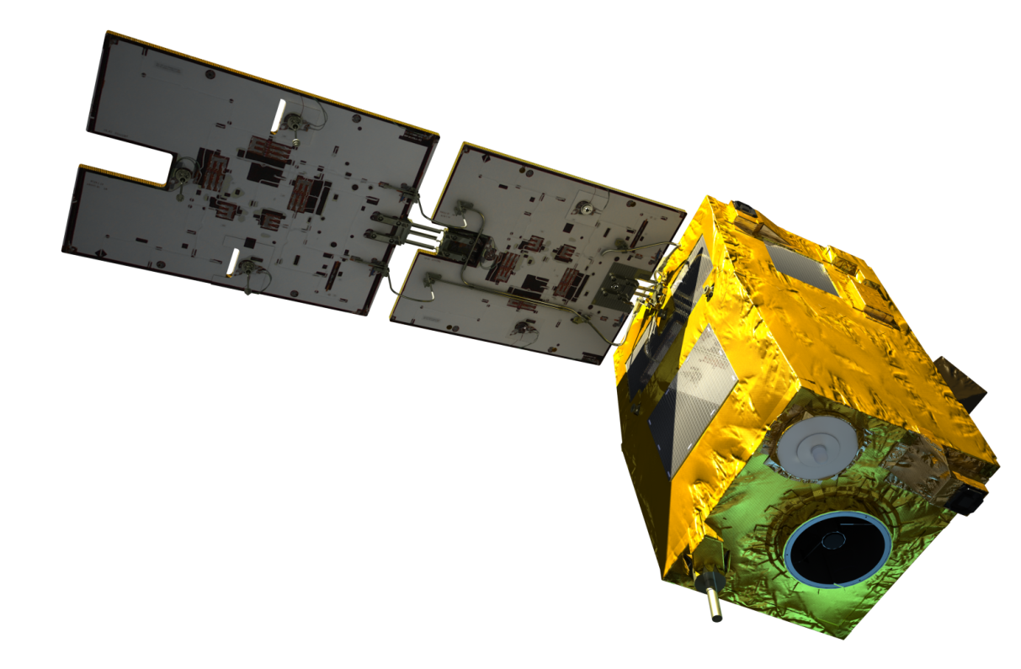
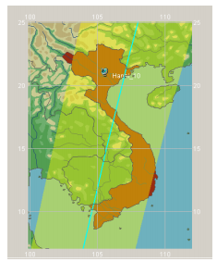
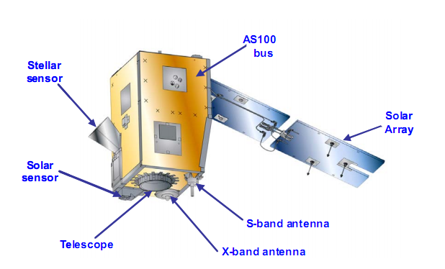
VAST activities in EOS
VNREDSat 1 project:

Slide 12
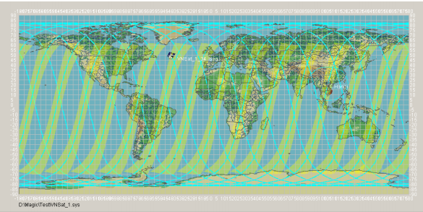
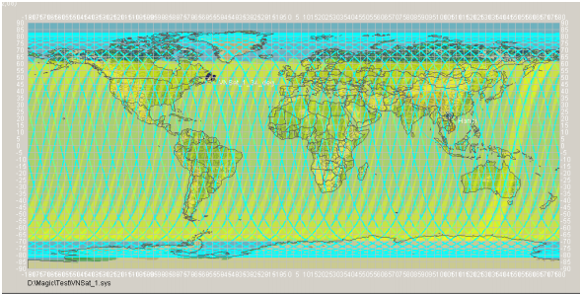
VAST activities in EOS
VNREDSat-1 access corridors over 1 day
VNREDSat-1 access corridors over 3 day:
Whole world coverage
12

Slide 13
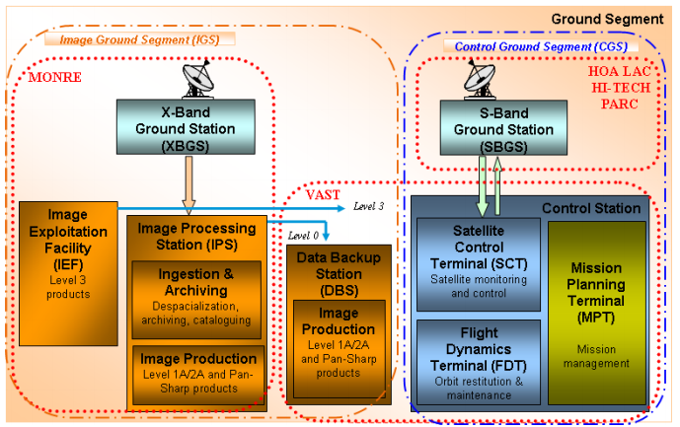
VAST activities in EOS

Slide 14
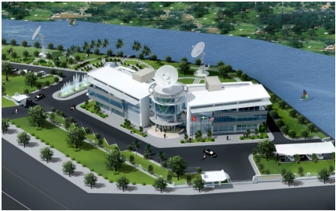
VAST activities in EOS

Slide 15
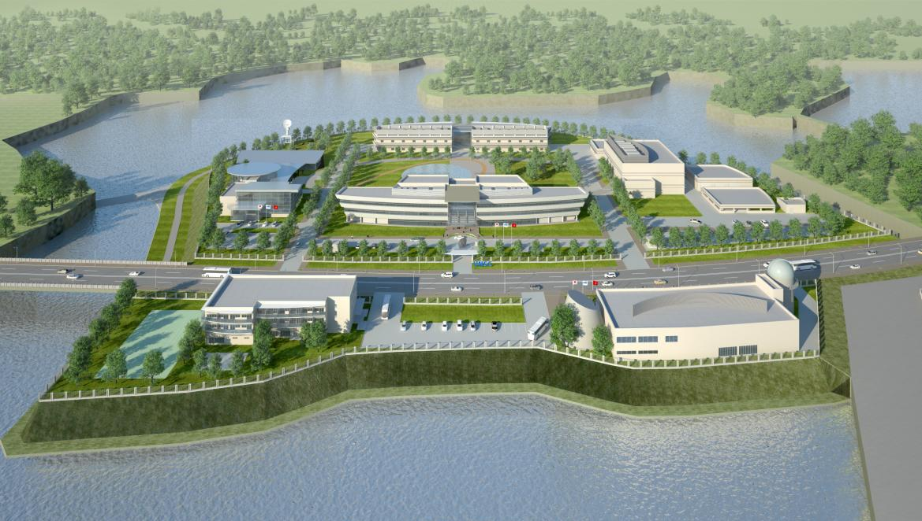
VAST activities in EOS
VNSC project
  Location: Hoa Lac Hi-Tech Park, Hanoi
  Duration: 2012 - 2020
  Total investment: 54,4 billion Jap. Yen (ODA Fund)
  Executing Agency: VNSC

Slide 16
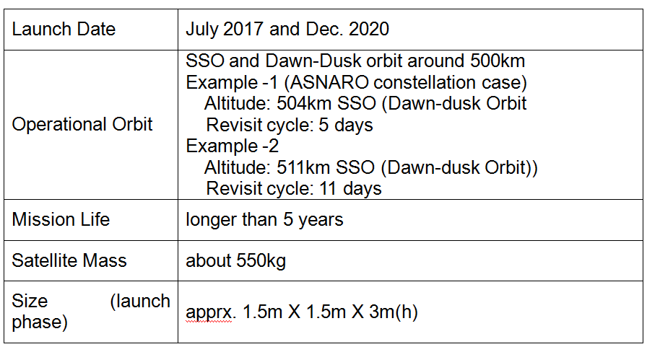
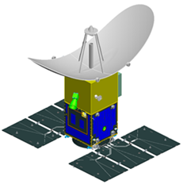
VAST activities in EOS
VNSC project

Slide 17
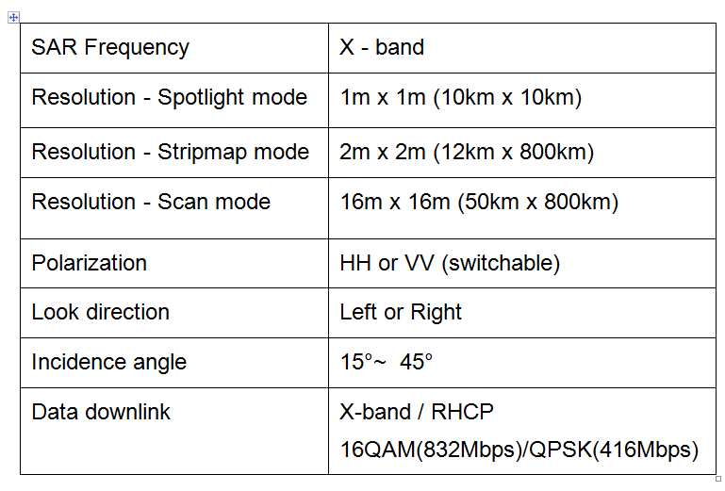
VAST activities in EOS
VNSC project

Slide 18
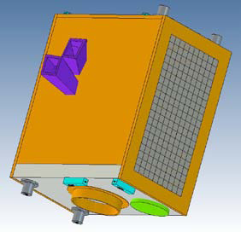
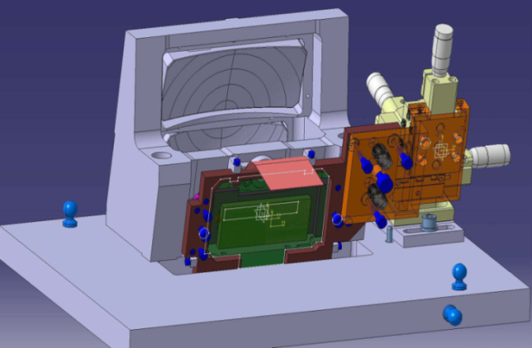
VAST activities in EOS
VNREDSat 1b project
Orbit characteristics: SSO, altitude ~600km
Mission: Hyper spectral sensor
Revisit time: 3 days
Ground station located in Hanoi with 3-4 satellite contacts/day
Wide swath width: 250-300 km
Source of Capital: Belgium ODA
Total investment: 63 million Euro
Launch date: 2017

Slide 19
VAST as a member of CEOS
Constellations
  VAST would like to join CEOS as a member, also join with the constellation group: Land Surface Imaging, Ocean groups (Ocean Surf Topography, Ocean Color, Sea surface temperature). At the moment, the ability of VAST is limited. However, VAST will participate to the research project in CEOS members in these field, specially in Vietnam and ASEAN countries.

Slide 20
Working groups:
  VAST would like to be a active member of all working group in CEOS. The two research institutes of VAST (STI and VNSC) will be ready to join with the research, share the data collected from VAST’s satellite as well as the related field data

Slide 21
Strategic groups:
  As research agency of Vietnam government, VAST would like to join the activities of Strategic groups for enhance the ability of Vietnam in development of Earth observation system; its applications for better life as well as sustainable development

Slide 22
THANK YOU

