Slide 1

Perspective on the 27th CEOS Plenary
Review of CEOS progress during 2013
Agenda item: 2
Luc Brûlé, CEOS Chair,
Canadian Space Agency

Slide 2






























The CEOS Family
30 CEOS Members
  ASI, 1986
  CAST, 1993
  CDTI, 2007
  CNES, 1984
  CONAE, 1999
  CRESDA, 2007
  CSA, 1984
  CSIRO, 1989
  DLR, 1986
  EC, 1994
  ESA, 1984
  EUMETSAT, 1989
  GISTDA, 2001
  INPE, 1984
  ISRO, 1984
  MEXT / JAXA, 1984
  KARI, 2001
  NASA, 1984
  NASRDA, 2004
  NOAA, 1984
  NRSCC, 1993
  NSAU, 1993
  NSMC/CMA, 2010
  NSO, 2011
  Roshydromet, 1992
  Roskosmos, 1992
  SANSA, 2010
  Tubitak-Uzay, 2006
  UKSA, 1986
  USGS, 2000
23 CEOS Associates
  BELSPO, 1992
  CCMEO, 1990
  CRI, 1990
  ESSO, 2012
  SAC, 1998
  ESCAP, 1997
  FAO, 1994
  GCOS, 1992
  GGOS, 2011
  GOOS, 1992
  GTOS, 1997
  ICSU, 1991
  IGBP, 1991
  IOC, 1991
  IOCCG, 2000
  ISPRS, 1998
  NSC, 1990
  SNSB, 1991
  UNEP, 1992
  UNESCO, 2002
  UNOOSA, 1994
  WCRP, 1991
  WMO, 1991
Individual Members of CEOS use their best efforts to implement CEOS recommendations in their respective Earth observation programs.

Slide 3
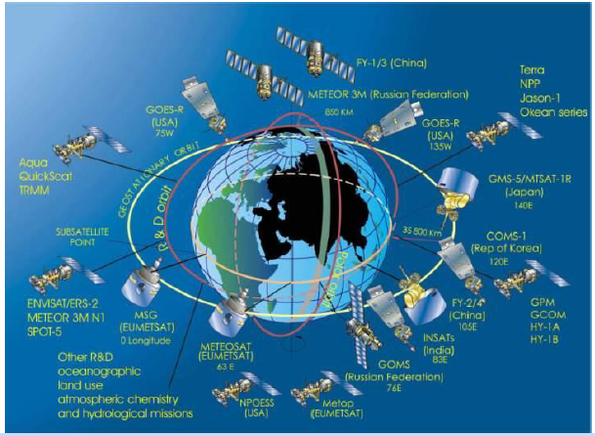
CEOS Consolidated Assets
Updated governance structure supported by a series of Working Groups and thematic Virtual Constellations, Ad Hoc Teams and permanent support (CEO, and SEO).
30 EO-based space agencies
107 EO missions and 286 instruments are currently operating
~100 new missions will be launched in next 5 years
~240 Earth observing satellite missions in next decade

Slide 4
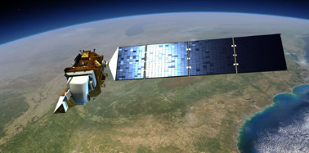
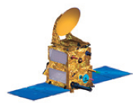
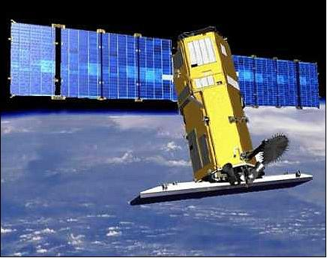

Member Highlights
EO Satellites Launched
November 19
December 2
February 11
February 25
May 7
June 25
July 26
August 22
September 23
September 29
2012
CRESDA & CAST: HJ-1C
CNES: Pleiades 1B
USGS & NASA: Landsat-8
CNES & ISRO: SARAL
ESA & BELSPO: Proba-V
ROSKOSMOS & ROSHYDROMET: Resurs P N1
ISRO: INSAT-3D
KARI: KOMPSAT-5
NSMC-CMA & NRSCC: FY-3C
CSA: CASSIOPE
2013

Slide 5

Member Highlights
May 7 – Second flight of ESA’s newest launch vehicle.
September 25 – An agreement was signed between ASI and CNSA to accommodate an Italian payload on board the Chinese CSES satellite.
October 1 – JAXA marked its 10th anniversary, followed by the creation of a new management
philosophy and corporate slogan.
October 9 – TÜBITAK UZAY (Turkey's
Space Technologies Research Institute) announced its intent to make RASAT imagery available to the general public later this year.

Slide 6
From the Bangalore Statement
CEOS Priorities for 2013
Improved Coordination of Space Agency Activities Related to Climate
Development and provision of climate data records, in support of climate monitoring and research.
Progress Towards Established CEOS-GEO Priorities
  Coordinated observations to support the effective monitoring and management of the worlds’ forested regions and Development of a strategy for observing and assessing the global carbon cycle.
  Development of a more integrated approach in the application of Earth observations for the purposes of disaster risk management;
Considering CEOS Support to Further Key GEO Priority Initiatives
The application of space-based Earth observations to support research in agricultural Productivity and an improved understanding of the global water cycle.
Continued and Enhanced CEOS Outreach to Key Stakeholders
Close collaboration with all countries, especially developing countries, to share new sources of EO satellite data and enhance their governments’ capacity to apply these data for societal benefit.

Slide 7
2013 CEOS Chair Priorities
Support the implementation of the CEOS Self-Study action plan.
Support the development of the GEO post 2015 objectives.
Initiate the development of 2013 CEOS workplan with an horizon of 3 years
Sustained emphasis on :
  Impact of Climate Change on polar regions
  Improving Disaster Risk Management through closely coordinated actions

Slide 8
Sec Team Activities during 2013
CEOS captures 25 actions at the 26th Plenary. 19 are complete, 6 ongoing
Thirteen SEC Telecons were held and addressed 103 action items
CEOS Secretariat provides a regular, consistent, and stable forum to raise and discuss issues, address the status of these actions and conduct its regular business.
A special thanks to the Sec team
CNES: Pascale Ultré-Guérard, Steven Hosford
CSA: Luc Brûlé (CEOS Chair), Marie-Josée Bourassa, Christine Giguère, Stephen Ward, George Dyke
ESA: Ivan Petiteville
EUMETSAT: Paul Counet, Robert Husband
INPE: Júlio D’Alge, Márcia Alvarenga
ISRO: Rajeev Jaiswal
JAXA: Chu Ishida, Shizu Yabe, Yukio Haruyama, Masatoshi Kamei, Azusa Fukui, Takayuki Kawai, Kazuo Umezawa
NASA: Mike Freilich, Christine Bognar, Justin Tilman, Patricia Jacobberger-Jellison
NOAA: Brent Smith
WGClimate: Mark Dowell, John Bates
WGCV: Satish Srivastava
WGCapD: Hilcéa Ferreira, Jacob Sutherlun
WGISS: Satoko Miura
CEO: Kerry Sawyer
SEO: Brian Killough
GEO: Espen Volden

Slide 9







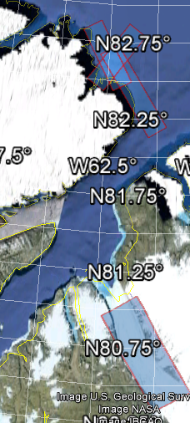
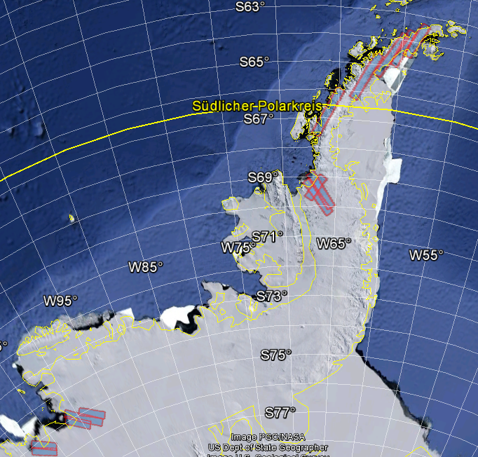
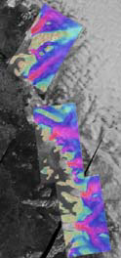
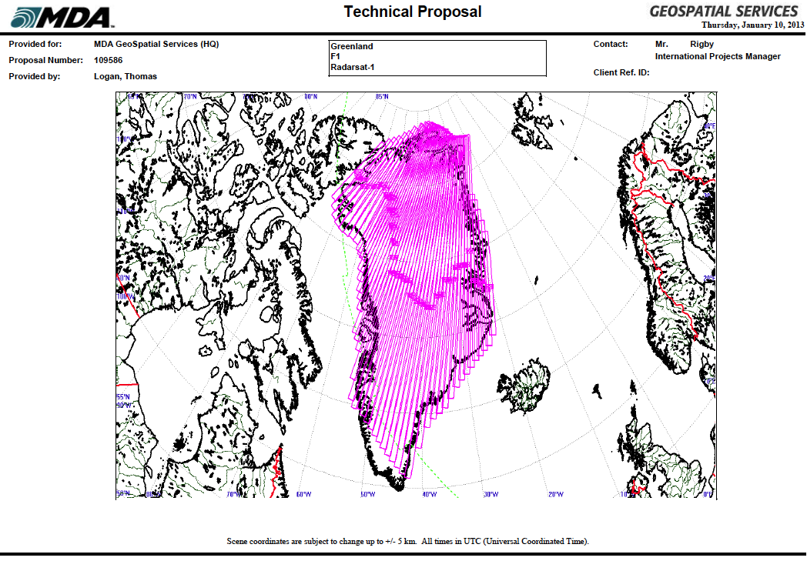
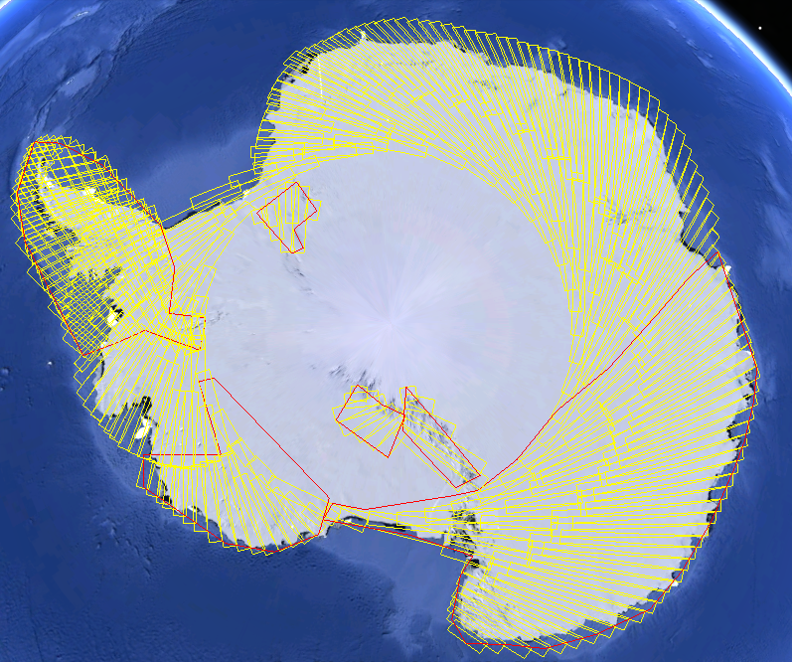
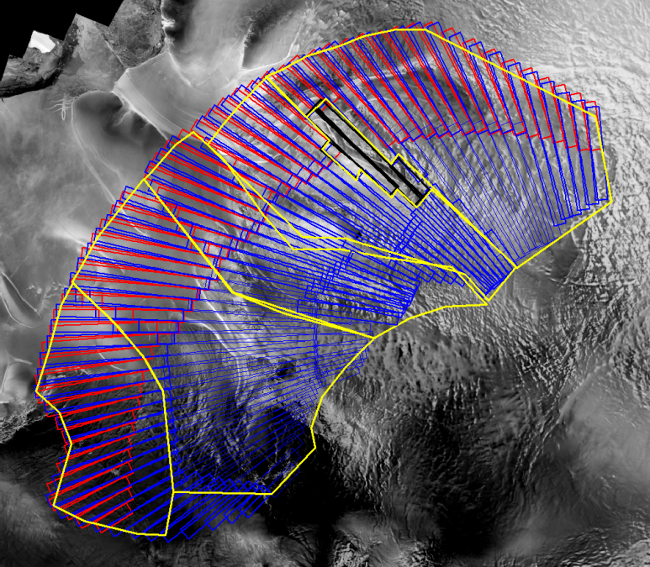
  Impact of Climate Change on Polar Regions
Enhanced coordination to address climate-related issues (proposal for a joint CEOS/CGMS WG on climate)
Space agencies contribution toward monitoring of Polar Regions
RADASAT 1
RADASAT 2
DLR TanDEM X bistatic mission
DLR TerraSAR X on fast flowing
glaciers
Continental and site specific data coverages from contibuting SAR missions
Notes:
Agencies involved include ASI, CS, DLR, ESA, JAXA, NASA, NSC with the support of ASF, E-GEOS, KSAT and MDA.
Presentation was made at SIT 28 where the value of a constructive dialogue among agencies on polar/cryosphere matters was recognized.
Definition of a multi-year strategy for the observation of ice sheets using space-based EO platforms.
Execution of the acquisition plans for Greenland and Antarctica - Over 7500 images were collected between Jan to May 2013.
Collecting requirements for sea ice and permafrost.

Slide 10
Challenges and Opportunities
Capacity to deliver on our objectives and sustainability
  Stay focused and aligned on goals and objectives
  The renewed governance will help us greatly focus on our essential business in the future.
Leadership continuity
  While in general, majority of key positions are covered, there are a few that require our attention, including DCEO and SIT Vice-Chair.
Responsiveness and relevance
  Among others, the GEO post-2015 workplan will likely require adjustments to CEOS 3 year workplan.

Slide 11
Key Decisions of the 27th Plenary
Membership applications from Geosciences Australia and Vietnam Academy of Science and Technology
Strategic Guidance and the CEOS Governance and Processes documents
Process Paper for the Virtual Constellations
The creation of a permanent Working Group on disasters
The 3 disasters pilot definition and the way forward on the “Response to EO requirements”, the “Recovery Observatory” and the Data & Products delivery to Pilots’ Users
The Iceland supersite

Slide 12
Key Decisions of the 27th Plenary
The GEOGLAM Phase 1 Space Data Acquisition Strategy
The creation of a joint CEOS-CGMS WGClimate
The Phase 1 and 2A of the SST comparison campaign and the detailed definition of SST (pilot) Operational Validation Project
The continuation of ad hoc Teams
The CEOS Montreal Statement

Slide 13

Lastly...
The Self-Study definitely brings forward the necessary strategic alignment and structural changes for CEOS to remain as pertinent and influential a global leader as it can be.
Because CEOS members interact, stimulate discussion and exchange ideas, this committee is a lot more than the sum of its members.
It is capable of reaching and engaging the greatest minds in space-borne earth observation worldwide.
This is why we should settle for
no less than stepping up to the
many challenges ahead of us.

