Slide 1
2013 Incoming Chair Objectives
Canadian Space Agency’s Perspective
Luc Brûlé

Slide 2
Canada in CEOS – A Brief History
Canada was one of the founding members of CEOS.
Involved since the first Multilateral Meeting on Remote Sensing held in Ottawa in 1980, the leadership role shifted from Canada’s Center for Remote Sensing (CCRS) to the Canadian Space Agency created in 1989.
The 3rd Plenary meeting was held in Ottawa in 1989
The 9th Plenary meeting was held in Montreal in 1995
The CSA is proud to have the opportunity to become CEOS Chair in 2013 and to hold the 27th Plenary meeting

Slide 3
Canada in CEOS
Canadian contribution is in kind through participation in CEOS action plan (lead of Disaster SBA), working groups (Chair of WGCV, member of WGISS) and satellite data provision in support of international initiatives (GFOI, GEOGLAM, Disaster flood management).
Did you know?
The Canadian Space Agency is the main contact to CEOS but is supported by other federal departments bringing sectoral expertise.

Slide 4
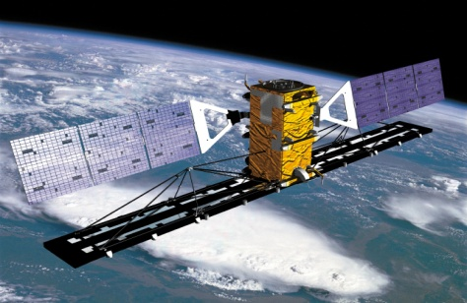
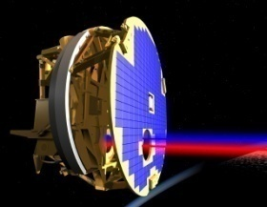
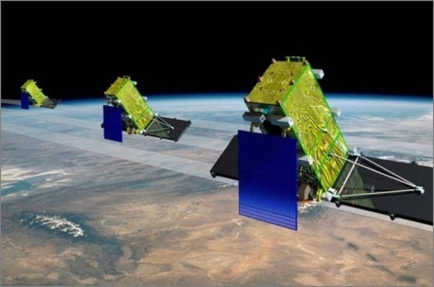
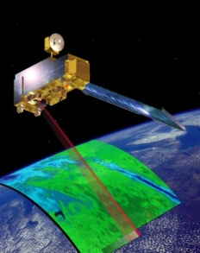
The Canadian Space Agency
Structure
Exploration
Utilisation
Capacity Building

Slide 5
The CSA Team
Structure
Marie-Josée Bourassa
POC
Thomas Piekutowski
Climate, Water, Precipitation
Luc Brûlé
Principal
Guy Séguin
Disaster SBA Lead
Yves Crevier
GEOGLAM, GFOI
Satish Srivastava
Chair WGCV
Christine Giguère
Secretariat, Disaster

Slide 6
CEOS Primary Objectives
Keeping in mind CEOS three primary objectives:
1. To optimize the benefits of spaceborne EO through cooperation in mission planning and in the development of compatible data products, formats, services, applications and policies;
To aid both its Members and the international user community by inter alia, serving as the focal point for international coordination of space-related EO activities, including GEO and entities related to global change;
To exchange policy and technical information to encourage complementarity and compatibility among spaceborne EO systems currently in service or development, and the data received from them.

Slide 7
CEOS Chair Considerations
As decided at SIT-27 in La Jolla in March 2012, the CEOS Chair is responsible for:
Top-level strategy development and guidance
Internal CEOS Coordination
External CEOS Coordination
With CEOS members involvement already stretched to capacity, it is important to focus on initiatives aligned with CEOS exclusive mandate, i.e. Developing requirements and providing multi-lateral coordination of satellite systems among CEOS members.

Slide 8
2013 CEOS Chair Considerations
CEOS, as an organization, is entering into a transitional phase
The self-study action plan will (most probably) bring strategic alignment and structural changes to the organization;
The GEO 2012-2015 workplan is well underway and the GEO post-2015 workplan under development will have a profound impact on future CEOS activities.
Working with the CEOS community, CSA will strive at providing leadership during the transition phase.

Slide 9
2013 CEOS Chair Priorities
Support the implementation of the CEOS Self-Study action plan.
Support the development of the GEO post 2015 workplan.
Initiate the development of 2013 CEOS workplan with an horizon of 3 years
Sustained emphasis on :
Impact of Climate Change on polar regions
Improving Disaster Risk Management through closely coordinated actions

