Slide 1



Recent Development of
EO Satellite in Vietnam
Assoc. Prof. Dr. Pham Anh Tuan
Director of Vietnam National Satellite Center

Slide 2

CONTENTS
  Strategy for research and application of Space Technology of Vietnam until 2020
  Organization Chart of VAST/VNSC
  Vietnam Space Center Project
  VNREDSat-1 Project
  VNREDSat-1B Project

Slide 3



Strategy for research and application of Space
Technology of Vietnam until 2020
Objectives of the strategy
To form the national policy and legal frame for research, application and international cooperation on space technology, human resource policies
To build the initial infrastructure for space technology
To plan and carry out a national science-technology program on space technology
To master the manufacture technology of ground station, the small satellite technology
Positioning Satellites
To manufacture and launch some earth observation small satellites
Ground system
To apply the space science and technology

Slide 4
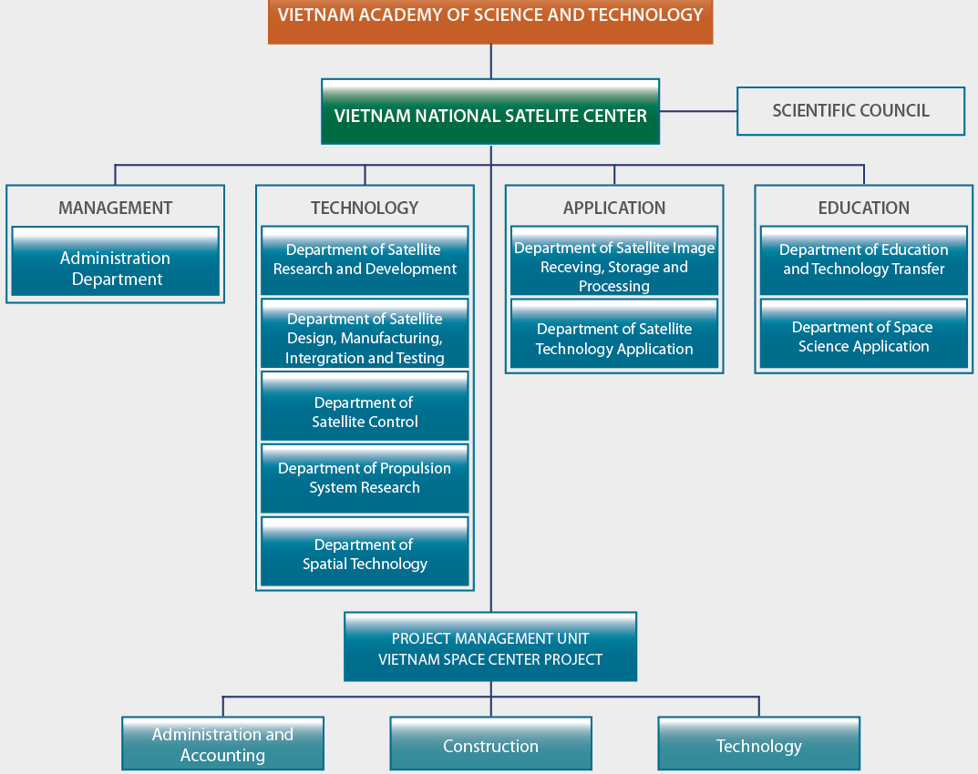
Organization Chart of VNSC

Slide 5
Vietnam Space Center Project
  Project: Vietnam Space Center
  Location: Hoa Lac Hi-Tech Park
  Area: 09 ha
  Duration: 2011 - 2020
  Total investment: 54,4 billion Yen
  Line Agency: Vietnam Academy of Science and Technology (VAST)
  Executing Agency: VNSC

Slide 6
Vietnam Space Center Project
Human resource development
  Small satellite development
  Remote sensing technology
Construction of infrastructure
  Assembling, integration & test facility of small satellite
  Data image receiving and processing facility
  Research and education facility
Technology transfer
  Small earth observation satellite
  Satellite image data utilization

Slide 7
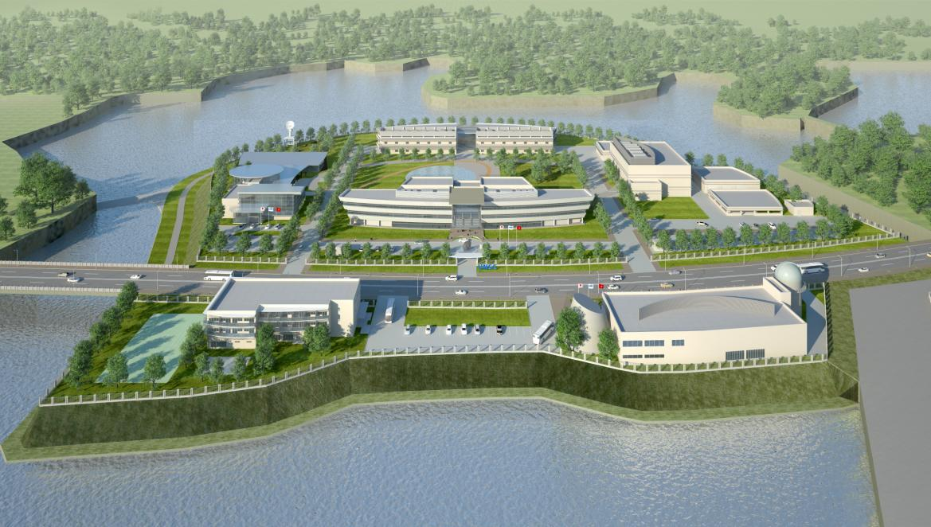
Vietnam Space Center Project
Vietnam Space Center

Slide 8
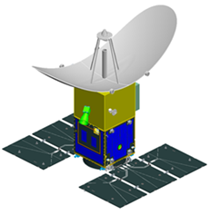
Vietnam Space Center Project
SAR Observation Satellite
Mass: 500kg
Life: 5 years
Size: Approx. 2.6m x 3.5m x 3m
<Mission>
X-band SAR sensor
Spatial resolution ~ 1.0m

Slide 9
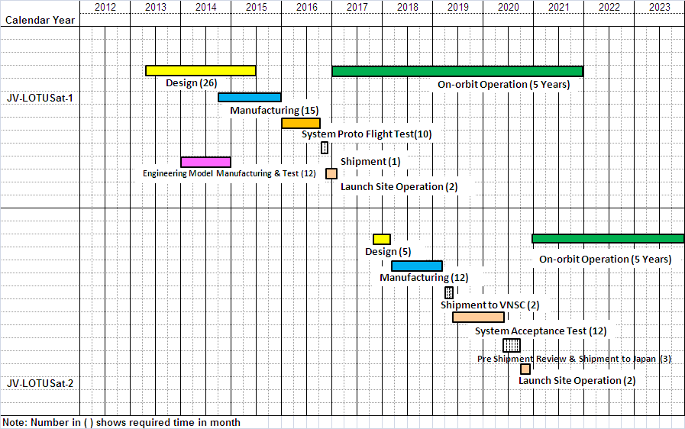
Vietnam Space Center Project
JV-LOTUSat Development Schedule

Slide 10
VNREDSat-1 Project
(Vietnam Natural Resources, Environment and Disaster monitoring satellite system)
Project Owner: Vietnam Academy of Science and Technology
Small Satellite Project Management Unit
Implementation period: 2010 – 2014
Source of Capital: French ODA
Total investment: 55,8 million Euro
Prime contractor: EADS Astrium
Main Items:
Design, manufacture and launch of VNREDSat-1 satellite
Establishment of a Satellite Ground Control Station
Upgrade of the Remote Sensing Receiving Station (Vietnam National Remote Sensing Center, MONRE)
Satellite image calibration site
Procurement of Launch and Insurance services for VNREDSat-1 satellite
Setting up a communication links between Ground stations
Training and Transfer of Small Satellite Technology

Slide 11
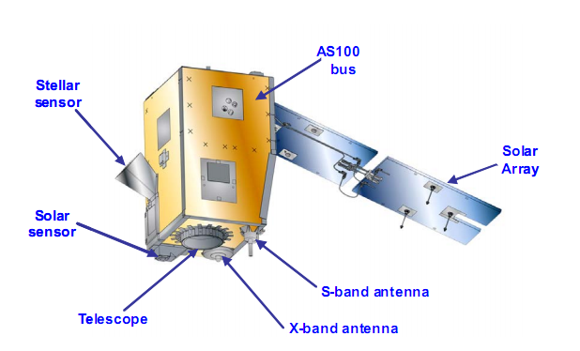
VNREDSat-1 Project
(Vietnam Natural Resources, Environment and Disaster monitoring satellite system)
The 1st optical earth observation satellite in Vietnam
Mission: Earth observation in PAN and 4 MS spectral bands
Revisit time: 3 days
Orbit characteristics: SSO, 680 km altitude
Spatial resolution: 2.5m (PAN) và 10m (MS)
Dimensions: 600 mm x 570 mm x 500 mm
Total mass: ~130kg
Life-time: 5 years
Launch date: 2013

Slide 12
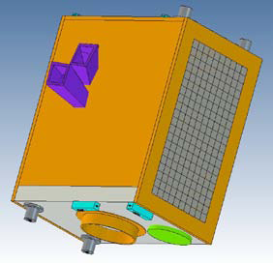
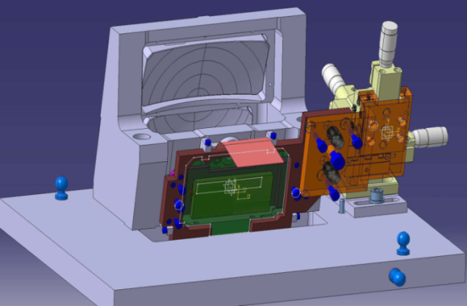
VNREDSat-1b Project
Orbit characteristics: SSO, altitude ~600km
Heritages: successful launch of PROBA 1,2 PROBA V, PROBA 3 and PROBA Altius (~100kg, 80x60x60cm, piggyback launch)
Revisit time: 3 days
Ground station located in Hanoi with 3-4 satellite contacts/day
Wide swath width: 250-300 km
Source of Capital: Belgium ODA
Total investment: 63 million Euro
Launch date: 2017

Slide 13
Thank you very much!

