Slide 1
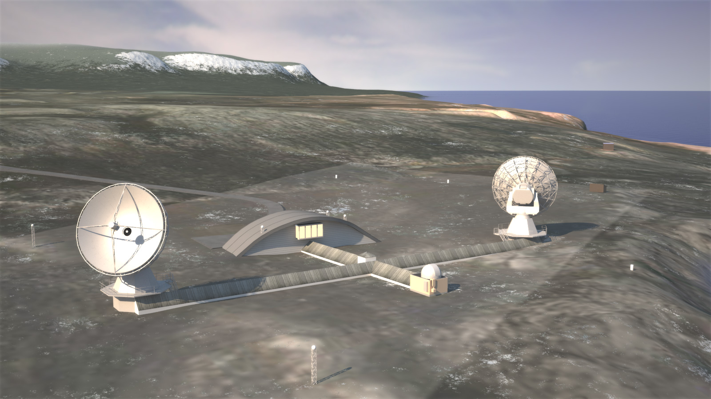
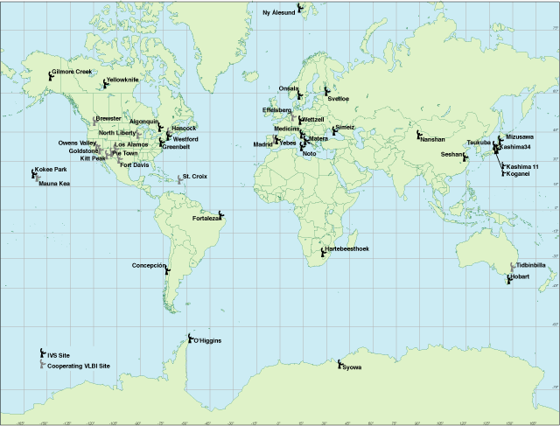
The only core network station in the Arctic
Photo: Rambøll
Notes:
The Norwegian Mapping Authority (NMA) is in the process of upgrading the geodetic observatory in Ny-Ålesund/ Svalbard in the Arctic to a core network station within the Global Geodetic Observing System (GGOS).
The very long baseline interferometry – VLBI antennas receive signals from space which make it possible to calculate how the Earth’s surface moves, how fast the planet is rotating and its exact position in the cosmos. Such data are needed to calculate the orbits of Earth observation satellites, which must be known in turn to monitor the climate accurately.
The observatory at 79 degrees north is the only one in the global network of such installations located so far to the north. The NMA’s Ny-Ålesund Observatory will serve as a keystone for the network of geodetic stations in the northern hemisphere.

Slide 2
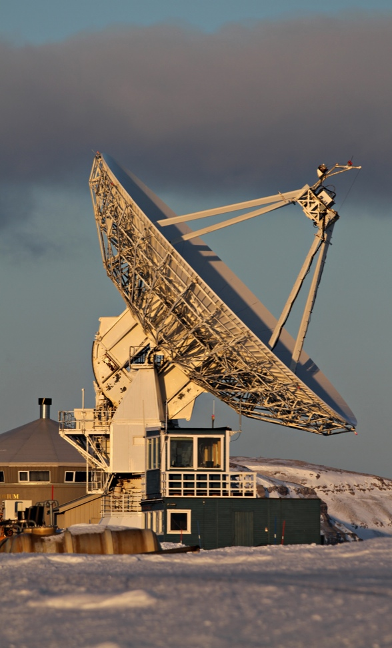
Need for a renewed network world wide
The current ground network is not adequate and the international geodetic reference frame has to be improved
Norway is investing including fiber optic cable more than 35 million Euros in Ny-Ålesund, 79 degrees north
The new observatory will combine all geodetic measurement techniques at one site = a core network station
It will adapt to the VLBI 2010 standard and include Satellite Laser Ranging (SLR)
More stations like Ny-Ålesund are needed world wide
Photo: Bjørn-Owe Holmberg
Notes:
The international geodetic reference frame has to be improved. GGOS has set the following requirements for future reference frame: Precision 1.0 mm and 0.1mm/year stability. In order to achieve this, GGOS has said that 20 to 30 stations evenly distributed around the earth are required. These stations must include all the geodetic space techniques on site; core stations.
The new Ny-Ålesund observatory will be such a core network station. Now it is important that we work for an initiative for development of a renewed global geodetic observing network worldwide.
The Norwegian government has this year allocated 30 million Euros to the building of the new observatory which will combine all geodetic measurement techniques at one site. NMA will adapt to the VLBI2010 standard and extend the activity to integrate Satellite Laser Ranging (SLR). With the new SLR in Ny-Ålesund, the NMA will lead the northernmost observation of the European satellites Galileo.

Slide 3
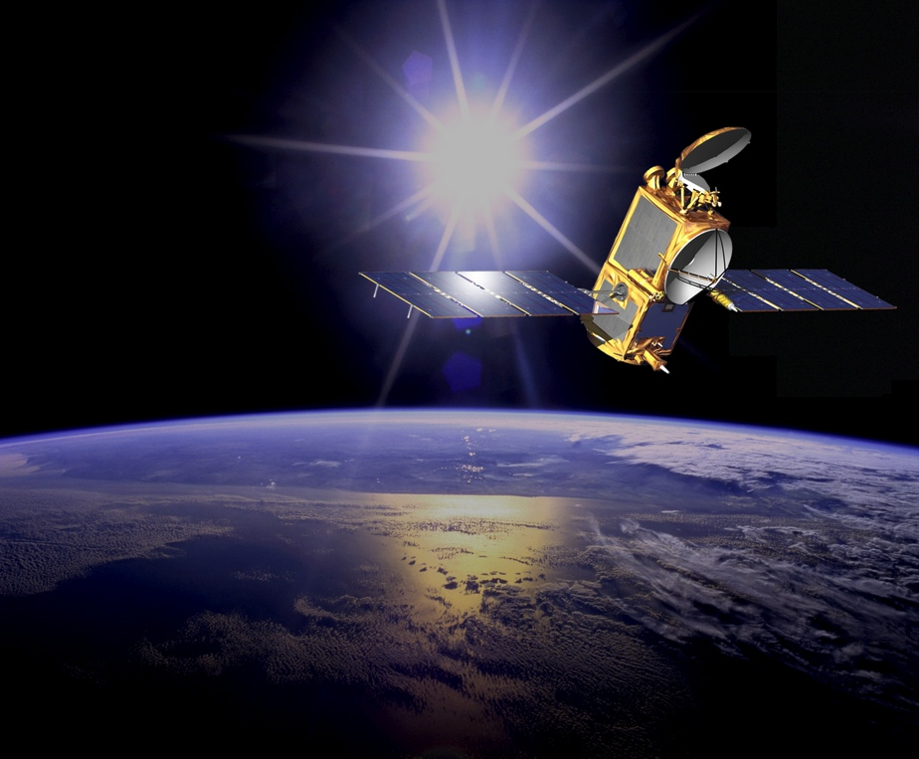
Essential to satellite technology
The global geodetic observing network is essential to the functioning of high precision satellite technology
Provide reference system
The data are needed to calculate the orbits of Earth observation satellites
Photo: NASA/JPL Calltech
Notes:
The VLBI network to which the Ny-Ålesund observatory belongs to is essential to the functioning of high precision satellite technology. Without the reference system provided by the geodetic infrastructure, we cannot monitor the changes of the Earth precisely.
The goal of upgrading the global geodetic network is to form the basis for a more precise observation of the earth from space.
Current and future satellites will have ever increasing measurement capability and should lead to increasingly sophisticated models to explain the sea level trend. Yet the current ground network is far from adequate in terms of both; individual station capability and network distribution to support the ability to obtain the necessary geodetic reference frame

Slide 4
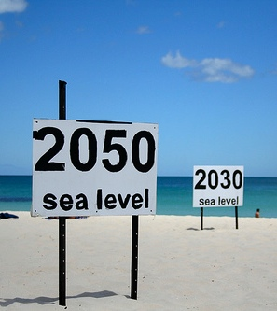
Crucial for climate monitoring
A renewed network will form the basis for a more precise observation of the Earth from space
The new Ny Ålesund station will be ready in 2018 and the old system will overlap for 3 years to secure time series
Notes:
We need to improve the underlying infrastructure to be able to separate the effect of the climate changes from the natural trend. Improvements in observations will contribute to more reliable estimates for the future. Knowledge about changes in global sea level, as an example, is essential information for those decision makers that deals with social developments. In worst case large populated regions will be flooded, reliable estimates for future sea level may help on planning.

