Slide 1
JAXA’s Current and Future
Remote Sensing Activities
October, 2012
Shizuo Yamamoto
Senior Chief Officer of Space Applications
Japan Aerospace Exploration Agency (JAXA)

Slide 2

Japan’s Space related Agencies
<Structure >
As of August 1, 2012
The Space
Basic Law
(May 2008)
Cabinet
Cabinet Secretariat
The Strategic Headquarters
for Space Policy
Cabinet Office
Basic Plan
for Space Policy
(June 2, 2009)
<New> Strategic Office for Space Activities
<New> Space Policy Comission
Council for S&T Policy (CSTP)
Ministry of Education, Culture, Sports, Science and Technology (MEXT)
Japan Aerospace Exploration Agency
Ministry of Internal Affairs & Communications
Ministry of Economy, Trade and Industry
JAXA Mid-term Plan
Ministry of the Environment

Slide 3


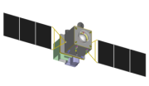




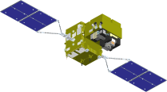


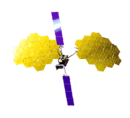

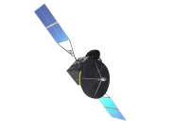
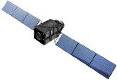
Mid-Term Plan
Target | GEOSS SBA | Sensors | 2005 | 2006 | 2007 | 2008 | 2009 | 2010 | 2011 | 2012 | 2013 | 2014 | 2015 | 2016 | 2017 | 2018
Disaster/ Resource | Disaster | SAR Optical
Climate Change/ Water Cycle Global Warming | Water | Precipitation Radar Microwave Radiometer
 | Climate | Optical Sensor Cloud Radar
 |  | Spectrometer
Communi-cation | Disaster | Mobile Communication Wideband Internetworking
 |  | Data Relay
Navigation |  | Quasi-zenith
JFY
ALOS-2 (SAR)
PALSAR
ALOS
PRISM, AVNIR2 (Optical)
ALOS-3 （Optical）
TRMM/PR
GPM/DPR
Aqua/AMSR-E
GCOM-W/ AMSR2
GCOM-C/ SGLI
EarthCARE/CPR
GOSAT
GOSAT-2
ETS-VIII
Next-generation
WINDS
DRTS
DRTS Follow-on
QZSS
Operation
Development
Research

Slide 4
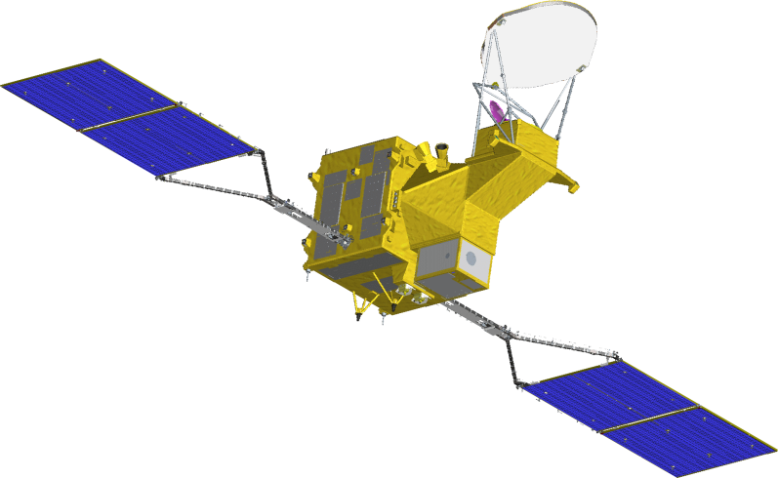
Global Change Observation Mission (GCOM)
Long-term observation (over 10 years) for global climate change and water cycle.
Two satellite series;
  GCOM-W : Microwave observation using AMSR2 (AMSR-E follow on)
for observing water circulation
(water vapor, precipitation, soil moisture, sea surface temp., wind speed, etc)
  GCOM-C : Optical multi-channel observation using SGLI (GLI follow on)
  for radiation budget and carbon cycle
(aerosol, clouds, ocean color, vegetation, snow ice, etc)
GCOM-C1
(CLIMATE)
GCOM-W1
(WATER)
or SHIZUKU”
AMSR2
SGLI
Launched: 18 May 2012
(Regular observation operation
from 10 August 2012)
Target Launch: JFY 2015
Sensor | Advanced Microwave Scanning Radiometer 2 (AMSR2)
Design Life | 5 years
Sensor | Second generation GLobal Imager (SGLI)
Design Life | 5 years
3
Notes:
3

Slide 5
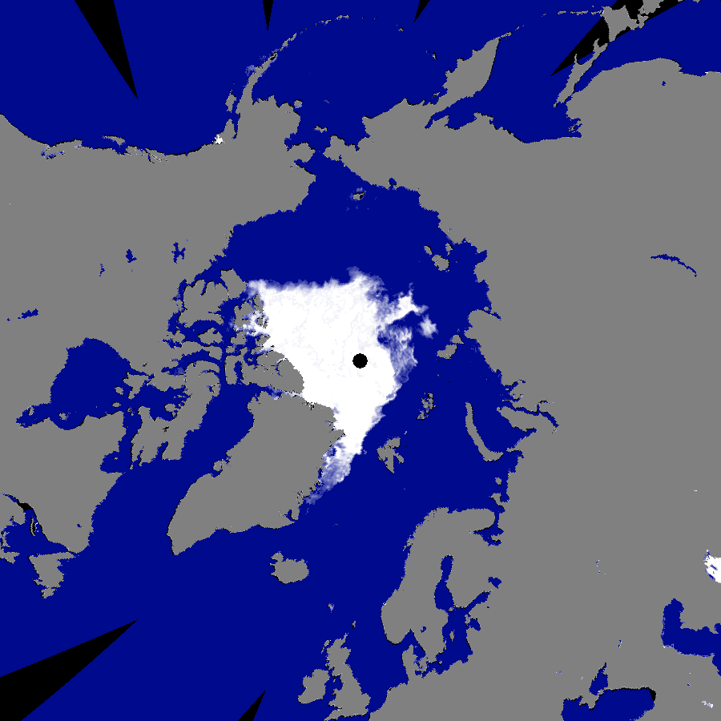
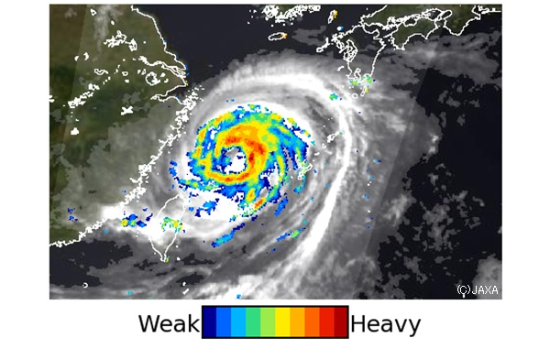
The current status of GCOM-W1 “SHIZUKU”
Initial CAL/VAL has started in August, after satellite commissioning
L1 Products: released in Jan 2013, L2 Products: released in May 2013
at “GCOM-W1 Data Providing Service” https://gcom-w1.jaxa.jp
16th Sep 2012
SHIZUKU/AMSR2
Sea ice extent in the Arctic Ocean
Typhoon No.11 “HAIKUI” on 7 August
Sea ice extent in the Arctic Ocean has become the smallest (3.49 million square kilometers) on this September in observation history,
comparing with the past record marked in 2007.
“SHIZUKU” image identified the eye of the typhoon more clearly than “HIMAWARI”.

Slide 6
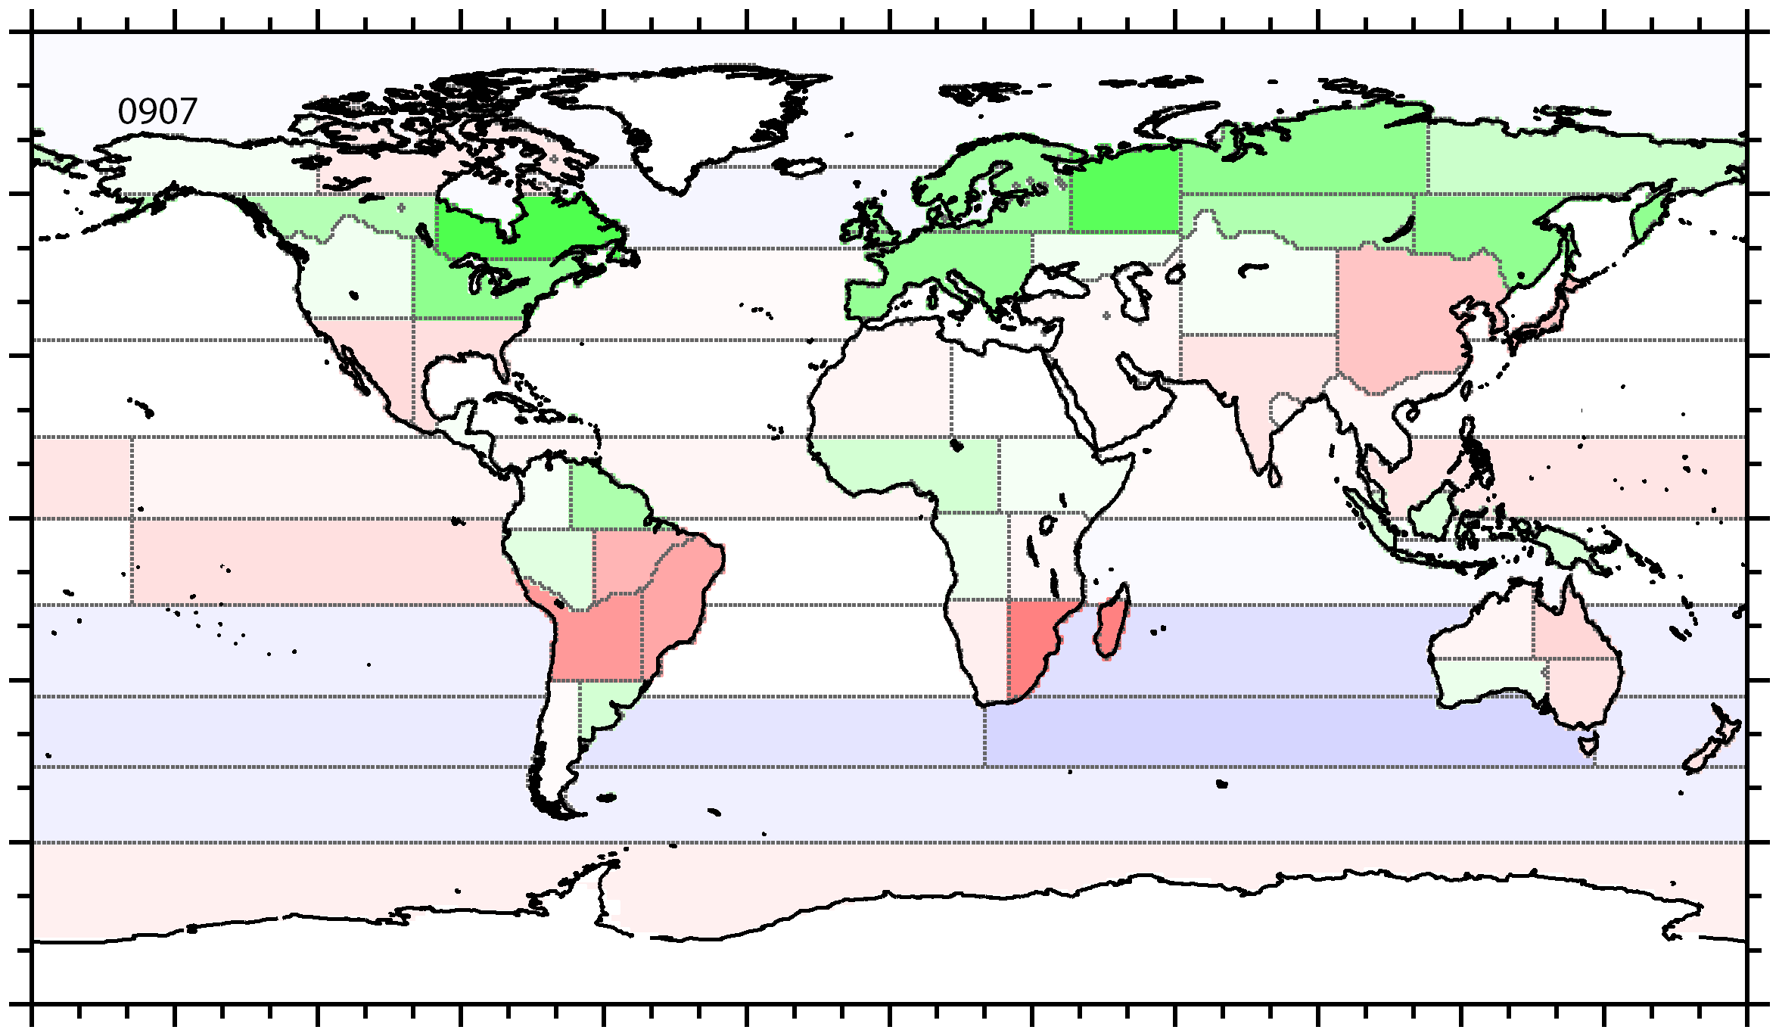
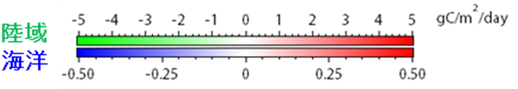
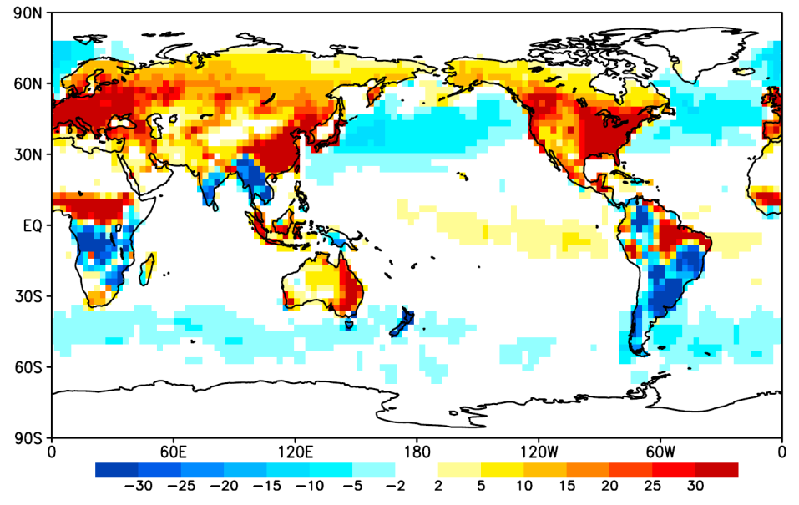
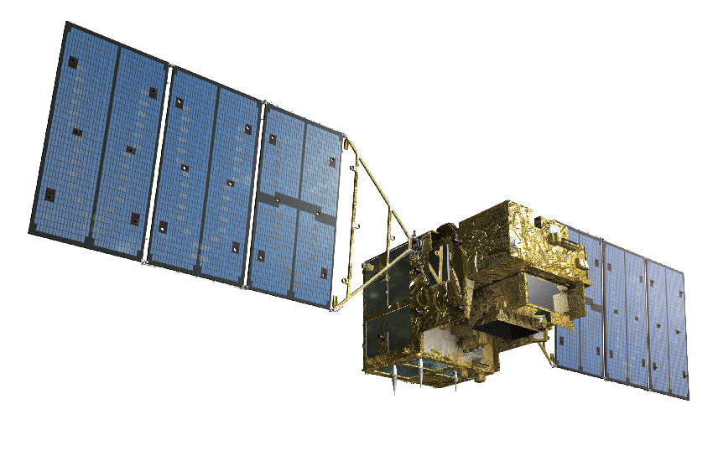
GOSAT and GOSAT-2
「いぶき」以前
Monthly CO2 sources and sinks (net fluxes) in 64 subcontinental-scale regions over a 12 month period from June 2009 to May 2010 were estimated using both CO2 concentrations retrieved from the soundings of the Greenhouse gases Observing SATellite "IBUKI" (GOSAT) and the published ground-based CO2 values
JAXA/NIES/MOE
・地上データ
・世界を22分割した地域毎
Simulated image of expected improvement by GOSAT-2
GOSAT-2
K. Miyazaki(JAMSTEC) et al

Slide 7




Asia-Pacific Regional Space Agency Forum (APRSAF)
Next Plan for APRSAF-19
Date: 11-14 December, 2012
Theme: Enriching the quality of life through innovative space programs
Venue: Berjaya Times Square Hotel, Kuala Lumpur, Malaysia
Co-organizers:
  National Space Agency (ANGKASA)
  Sea to Space Division (S2S)
  Ministry of Science, Technology and Innovation (MOSTI)
  Ministry of Education, Culture, Sports, Science and Technology of Japan (MEXT)
  Japan Aerospace Exploration Agency (JAXA)
Initiatives related Earth Observation:
  SAFE (Space Application for Environment)
  Sentinel Asia (Disaster Management)
  Climate R3
6
Notes:
Ok, this is information of the next APRSAF-19.
The APRSAF–19 will be held in December this year in Kuala Lumpur, Malaysia.
Local co-organizers are ANGKASA, Sear-to-Space.
In details of the next APRSAF-19 are on the website of APRSAF.

