Slide 1
The CEOS MIM Database &
EO Handbook 2012
G Dyke & S Ward (ESA MIM team)
I Petiteville (ESA)
26th CEOS Plenary
Bengaluru, 24-27 Oct 2012

Slide 2
MIM Overview
The CEOS Missions, Instruments, and Missions database is the only official consolidated statement of the programmes and plans of CEOS agencies
Mature resource - variety of uses and users
Data backbone of the EO Handbook
Cornerstone for CEOS coordination on gaps and overlaps to optimise global observations
Staff from EO space agencies, climate research scientists, …

Slide 3
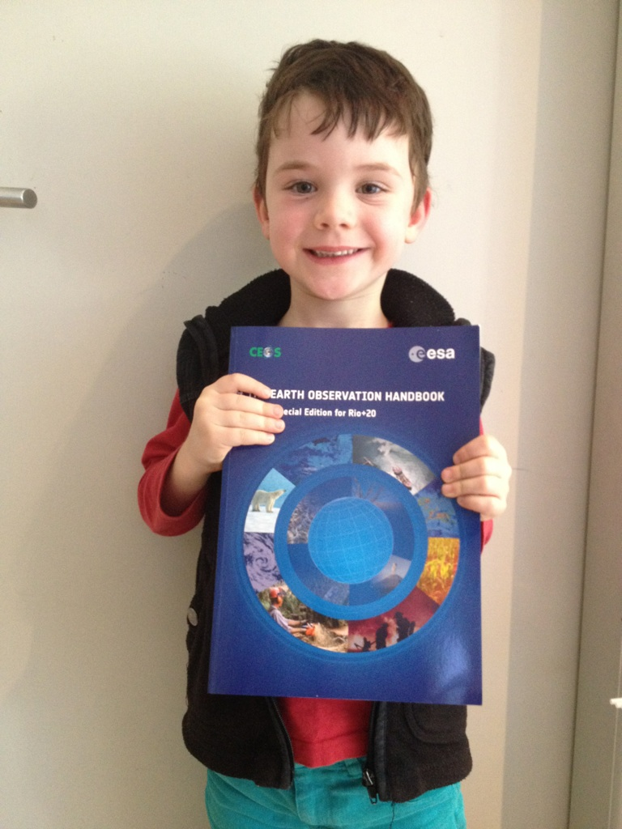
A variety of uses and users
Thank you very much Ivan !!!
…. from
Sydney ,
Australia !!!!

Slide 4
2012 Highlights
Two successful survey processes – thank you Contacts
In support of Rio+20 EO Handbook, and full annual update
Highly productive coordination with the SEO
Further enhancement of database contents based on on going dialogue (measurement accuracy, etc.)
Sharing information on VCs, ECVs, and SBAs
Collaboration on future directions
Support to WGClimate – distribution of ECV Inventory survey materials within MIM survey
Additional measurement parameters to the mission profiles

Slide 5
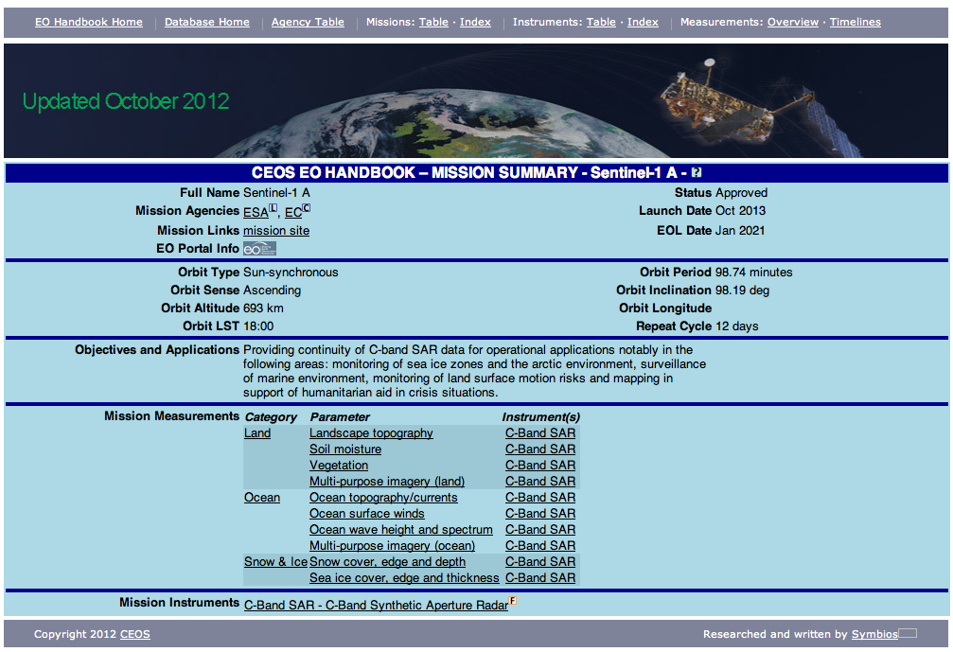
2012 Result
Addition of Mission Measurements

Slide 6
2012 Result
Support to print publication of the Rio+20 EO Handbook
Section 6 instrument type tables; Section 7 timelines; Section 8 and 9 missions and instruments tables
Consolidated and up to date statement of CEOS agency programmes and plans
Expanded data content and analysis functions

Slide 7
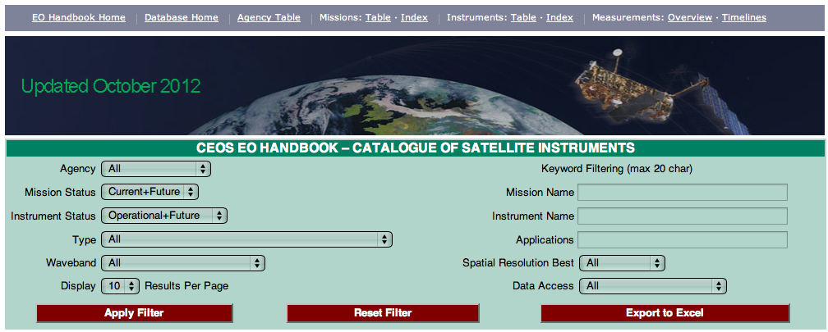
Data Content and Analysis

Slide 8
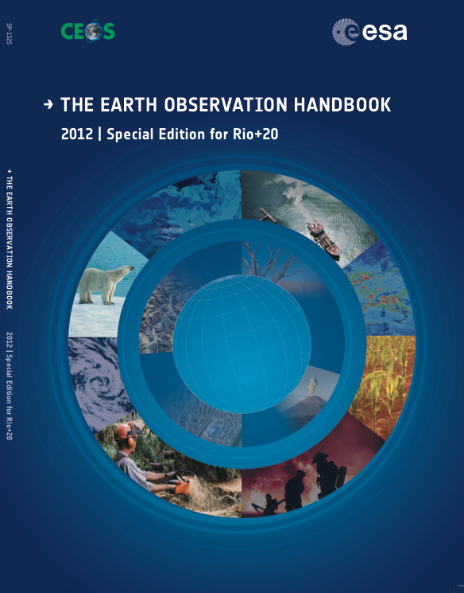

Slide 9
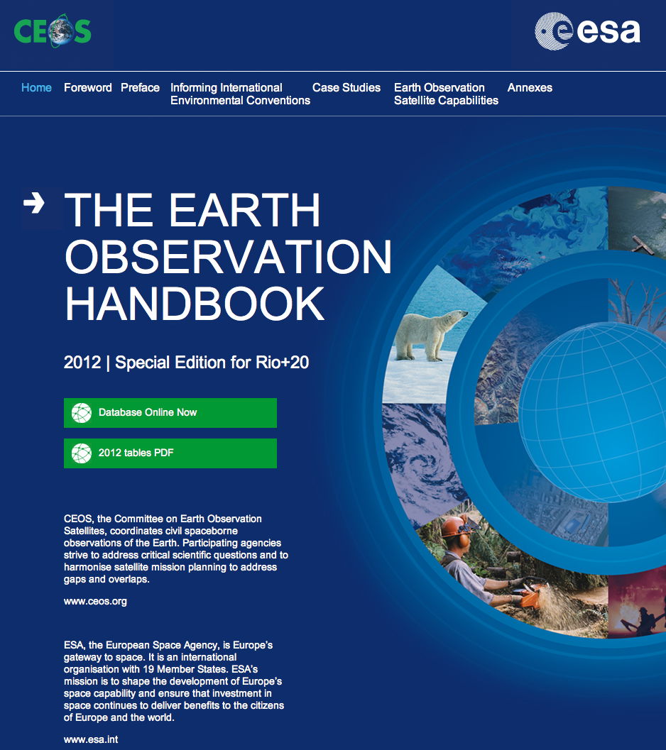
CEOS EO Handbook
2012 Special Edition
Rio+20 Summit edition; +300 pages; 2500 copies printed – all CEOS agencies included (please confirm receipt!)
Content:
Scientific articles highlighting the important role of satellites in support to UN conventions (climate change, desertification and biodiversity)
Timelines indicating worldwide plans for each of 30 different key Earth system measurements
Tables featuring information on 260 satellite missions and 395 instruments planned for the next 20 years
An interactive database which supports queries of particular agency plans or measurement types (web version)

Slide 10
Website User Statistics eohandbook.com
Last 12 months
Total unique visitors: 22,938 (+6% year on year)
Page views: 155,559
New visitors: 60%
Top content
Mission and instrument table and index: 32K views
Monthly Visits Since Launch (database)

Slide 11
Coordination with WGClimate
Direct support provided to WGClimate in getting the ECV Inventory out to CEOS agency MIM POCs
On going discussions on integrating ECV Inventory information within the MIM online
Objective always to maximise availability and utility of information gathered: end-to-end analysis within a single information system is valuable and important
Different ‘branding’ of entry points is straightforward
MIM team continues to be responsive in support of this important activity that contributes to the CEOS response to the 2010 GCOS IP
Anticipate further support as a focus of 2013 activities

Slide 12
Way Forward
Support to WGClimate and ECV Inventory & survey – expanded MIM capabilities & content
Continued and further expansion of work with SEO & strengthened support and interaction with CEOS community
Annual updates – call expected in April-May 2013
Continued enhancement of content and utilities for analysis
Further integration and consistency with key sources
EO Handbook print edition is approx. every 3 years as major events to promote CEOS activities permit
Notes:
Key source”: EO portal, CGMS, GOS dossier, COVE, SEO database, etc..

Slide 13
Users & feedback welcome
www.eohandbook.com
database.eohandbook.com

