Slide 1
Capacity Building and Data Democracy
Working Group
Hilcéa Ferreira, INPE
Jacob Sutherlun, NOAA

Slide 2
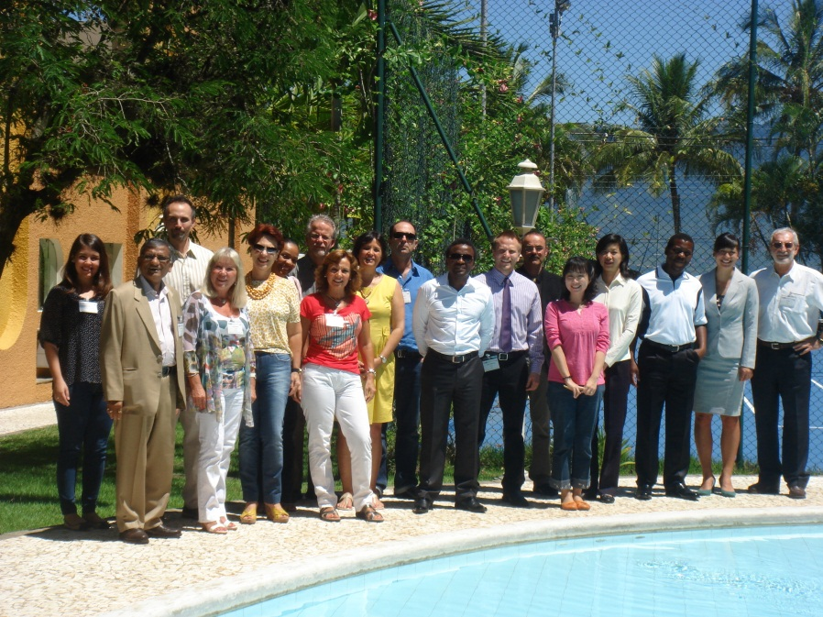
2012 Accomplishments
1st meeting of WGCapD - Ilhabela, Brazil, 29 February to March 02, 2012
16 participants: INPE, NOAA, CONAE, CMA, DLR, ISRO, ESA, SANSA, GEO Sec, Secure World Foundation, USGS, CEOS CEO
6 virtual attendees: NASA, UNOOSA and WMO

Slide 3
2012 Accomplishments
Engagement of other CEOS Agencies
CNES (1)
CONAE (4)
CRECTEALC-Mexico (2)
CSA (1)
DLR (1)
ESA (2)
GEO (2)
INPE (5)
IRD (2)
ISRO (2)
NASA (7)
NASRDA (1)
NOAA (2)
NSMC,CMA (2)
RCMRD (2)
SANSA (3)
SERVIR (2)
SWF (1)
UNESCO (1)
UNOOSA (3)
USGS (1)
World Bank (1)
WMO (1)
CEOS SEO (1)
CEOS CEO (1)

Slide 4
2012 Accomplishments
Data democracy explored
WGCapD is focused on building capacity for the effective use of EO data as well as providing wider and easier access to those data
Data
Democracy
Data Access
Data Dissemination
Capacity Development
Software Tools
Illustrated through the exploration of the WGCapD activities
Notes:
1- Providing wider and easier access to Earth Observation data.
2- Increasing the sharing of software tools suh as the use of open source software and open systems interface.
3- Increasing data dissemination capabilities, transferring relevant technologies to end users, and
4- Providing intensive capacity building, education, and training (including
awareness and outreach) for enabling end users to gather the information they
need and for increasing communication on achieved results.

Slide 5
2012 Accomplishments
Updated WGCapD 3-year objective:
Improved access to global DEM developed on a country-by-country basis
Development of a remote-sensing E-learning course
Support to GEO 2012 – 2015 Work Plan Task ID-02
Continued support to GEONETCast, including an event at the GEO Plenary (“GEONETCast Americas User Forum”)

Slide 6
Current Developments
Data Access
Capacity development: DEM workshops
Capacity Development
Regional workshops across the world utilizing the SRTM 2 data
Train participants on how to utilize the data in capacity building workshops
Focus of workshops will be on flash flood forecasting and settlement planning
First workshop planned in Nairobi, Kenya, 2013
Maximize the skillsets and contributions of a range of partners: RCMRD, INPE, SANSA, NOAA, NASA/SERVIR, USGS, Secure World Foundation

Slide 7
Current Developments
Data Access
Capacity Development
180 hour courses that target university professors in the sciences to teach them the benefits of incorporating EO into their classes
Use of data sets that are normally restricted
Taught by consortium of CEOS agencies and partners
Professional Development Certificate
Coordinated by INPE, Brazil

Slide 8
Current Developments
Data Access
Capacity Development
First Pilot course: 15 Feb - 15 June, 2013
4 modules:
Introduction, History and International Support
Principles of Remote Sensing, Sensors and Platforms
Data and Tools
Remote Sensing Applications
+ Project development
Target Region: Africa (English speaking countries) – Nigeria, Kenya and South Africa
Notes:
knowledge hubs for building EO data democracy

Slide 9
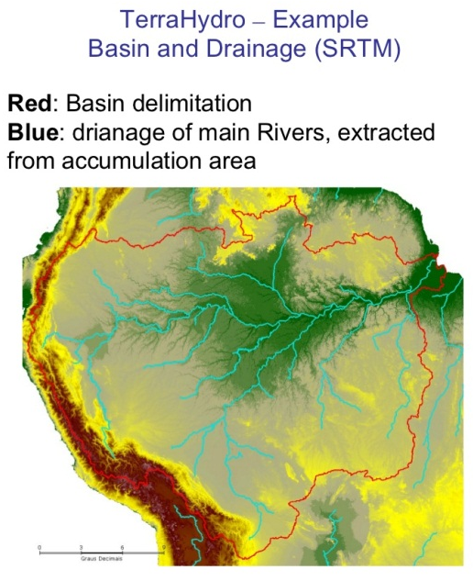
Current Developments
Data Access
Capacity Development
Software Tools: Open Source software
Software Tools
Regional DEM Development Workshops
Train on open source software tools (TerraHidro and TerraMA2)

Slide 10
Current Developments
Data Access
Capacity Development
S Software Tools: Open Source software
Software Tools
E-learning Courses
SPRING
TerraView
ORFEU Tool box
SOPI

Slide 11
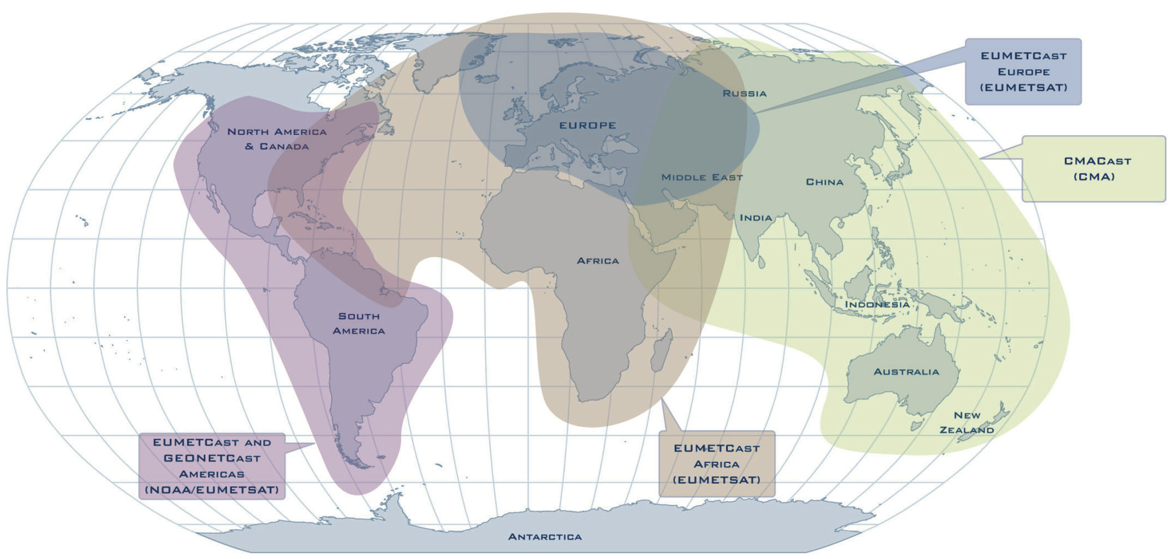
Current Developments
Data dissemination: GEONETCast
GEONETCast is a low cost satellite-based data and product dissemination system
WGCapD support of GNC
GEONETCast Americas Forum
GEO Plenary side event
Focus on the end users
Synergies, issues, improvements
DEM Development Project
Work with regional GEONETCast provider to ensure that appropriate agencies have ability to receive and transmit data as necessary

Slide 12
Current and Future challenges
Overarching Strategy
Minimizing the chance of duplicating current capacity building efforts within GEO and helping to establish synergies and determine possible gaps.
→ Synergies with GEO – ID02 Task – Developing Institutional and Individual Capacity
Outreach Strategy
Updating CEOS website
Training Calendar
Mailing Lists (try to have WGCapD accomplishments listed in magazines, newsletters etc.
Spreading the word about the WG through presentations at events WG
members are already attending.

Slide 13
Decision sought / Way forward
Spreading the word about the WGCapD
Getting help from other WGs
Connecting with GEONetCab Project
Connecting with Portal for EO Resources
Connecting with WMO/CGMS Virtual Laboratory (VLab) for Education and Training in Satellite Meteorology
GEONetCast Training Channel

Slide 14
Decision sought / Way forward
Thank you!

