Slide 1
CEOS Contribution to Disaster Risk Management Way Forward
Ivan Petiteville, ESA
on behalf of the Ad Hoc CEOS DRM Team

Slide 2
Summary of CEOS Principals’ Comments
Relationship & coordination with on-going CEOS disaster activities needs to be clarified and consolidated.
Worries that some proposed actions could draw too many resources from on-going CEOS disaster activities
Some Agencies find the plan of actions too ambitious for the time being and rather recommend a phased approach

Slide 3
CEOS Vision for DRM: 5+3 Actions
5 Major Actions:
Define a Global Satellite Observation Strategy for DRM
Detailed assessment of needs, gaps and definition of observation requirements in terms of EO data (similar to FCT and JECAM)
Definition of strategy in response to observation requirements; includes definition of a DRM Baseline Dataset (data at no cost for selected observations/selected themes & limited geography). Includes existing strategic plans such as Charter.
Implement the Global Satellite Observation Strategy for DRM
each CEOS agency to acquire, process and archive the EO satellite data and products (e.g. L0 to L2)
Set up a virtual repository for DRM-relevant data / products / information from both space agencies and DRM-Users and make the repository content accessible to all DRM users
provide DRM user community with a series of tools to discover & access EO data through DRM-dedicated web portal (one stop shop); includes access to DRM Baseline Dataset
Set up DRM Data Processing Platform:
a capacity to enable access to EO based Value Added products, tools & on demand processing - support science & services exploitation of Satellite EO (requires infrastructure for science data) – enable EO based content generation & hosting user generated content
Ensure the positioning of EO from Space in the 2015 post-Hyogo Framework of Actions
2015 post-Hyogo FA Plan (2015-2025) to be adopted at 2015 World Conference on Disaster Risk Reduction and UN Nations Assembly
Close dialog with the major stakeholders in charge of defining the 2015 post-Hyogo FA
3 Supporting Actions: 6. DRM Outreach & Evaluation of CEOS DRM Actions
7. EO Capacity Building for DRM,
8. Satellite EO DRM Projects Database

Slide 4
Decision Sought / Way Forward
The CEOS Principals are requested to:
Endorse the Study Consensus Report incl. the action plan as amended
Authorize the initial actions proposed
Continue the current Ad Hoc CEOS DRM Project Team
March 2013 SIT meeting: generate a Implementation Plan., ensuring complementarity with Disaster SBA team’s activities
2013 CEOS Plenary : prepare a Strategic Observation Plan and a set of recommendations for follow-on activities
Mandate the DRM Team to begin coordination with the UN ISDR in the lead-up to the May 2013 post-Hyogo Framework for Action activities (Global Platform for Disaster Risk Reduction);
Mandate the DRM Team to liaise with UN ISDR, other major stakeholders and users to prepare the future Implementation Plan.

Slide 5
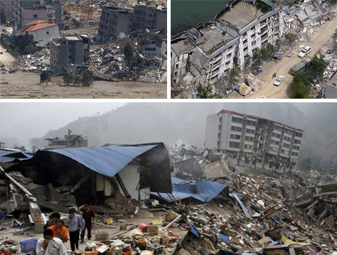
THANK YOU !!!!
… And many thanks to the Agencies that have contributed to that study
Thank you ….
2008 earthquake in Beichuan (China)
© weburbanist.com
Notes:
Author / Credits: Dutch School, Museum of London

