Slide 1



CEOS Contribution to Disaster Risk Management
Ivan Petiteville, ESA
on behalf of the Ad Hoc CEOS DRM Team

Slide 2
Agenda
Background on Disaster Risk Management (DRM)
CEOS Vision for DRM
Background on Disaster Risk Management (DRM)
CEOS Vision for DRM

Slide 3
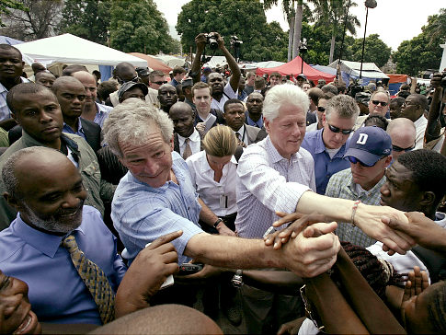

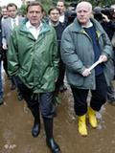

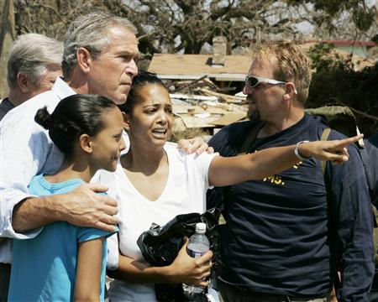
Increasing Politicians’
Interest in DRM
DRM gaining more political importance for economic, political and geopolitical reasons
2010, 385 natural disasters: 297 000 people killed worldwide, 217.0 million others affected, $ 123.9 billion of economic damages.
Increase of economic impacts: growing urbanization (x2 in 2050) + increasing number of extreme events (x3 in 2100).
Politicians very sensitive to consequences of disasters ; want to show leadership when a crisis strikes.
Humanitarian aid can be motivated by governments’ will to increase their influence in devastated regions.
© nydailynews
Bill Clinton in Haiti
© Skynews
Bush - Katrina
© Deutsche Welle
© United Nations
© www.jackofallthoughts.com
Schröder – Flood Elbe River 2002
Aid from Jordan - Haiti
© Deutsche Welle

Slide 4


Increasing Organisations’
Interest in DRM
Growing international engagement (financial, programmatic, ..) by international organizations e.g. World Bank, UN agencies, EC, G8,..
  - World Bank: Natural disaster assistance : about 10% of total WB commitments between 1984 and 2005. Since 1980, more than 500 operations (US$40 billion).
  - UN International Strategy for Disaster Risk Reduction (UNISDR) created in 2000.
  - WMO Disaster Risk Reduction started in 2003 (one of 4 GFCS’ priorities)
  - European Commission: 2007: disaster prevention in Lisbon Treaty; 2010: development of integrated approach to disaster management addressing response, preparedness and prevention activities; 2014-2020 €455 million-budget proposed for Civil protection and future European Emergency Response Capacity
Ban Ki-Moon - Floods in Pakistan (2010)
Humanitarian aid from EC to Cambodian flood victims (2011)
Notes:
The Sixteenth WMO Congress in 2011 also agreed that the four initial GFCS prioritieswould be disaster risk reduction, water, health, and food security.

Slide 5
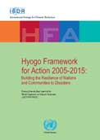
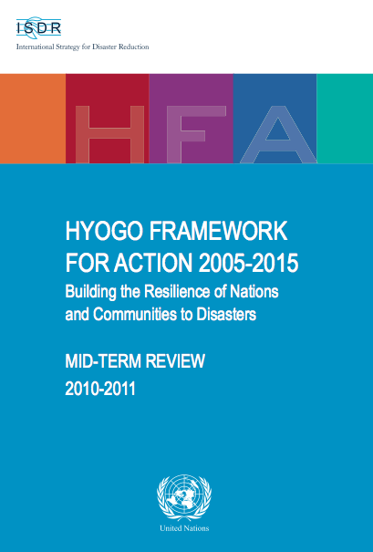

An Opportunity for Space Agencies
Growing political interest in DRM: might be an opportunity (and obligation ?) for space agencies to play a major role in near future
Recent major international conferences, publications and declarations from decision-makers explicitly refer to the necessity to increase the means of observations including from satellites.
Space agencies’ support to post-crisis response can still be improved (e.g. International Charter), but space agencies should be ready to respond to the current increasing political pressure to invest more in preparedness and prevention phases.
World Bank 2010 report: Recommendations to governments for better spending the funds allocated to DRM.

Slide 6
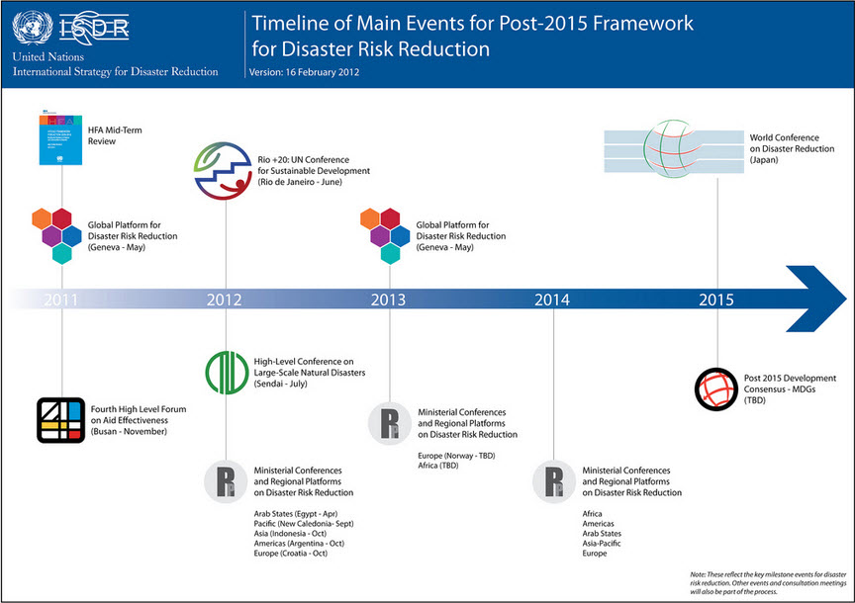
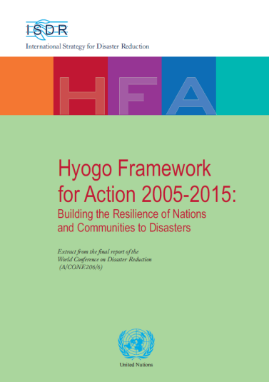
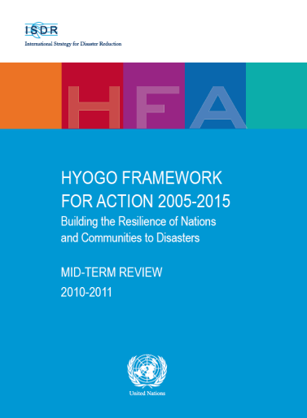

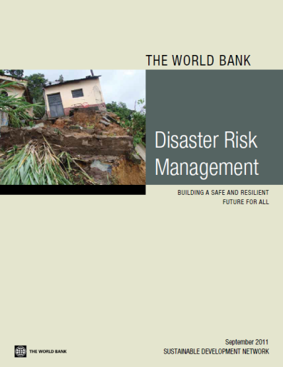
Key Milestones in DRM
NEW
POST
2015-2025

Slide 7
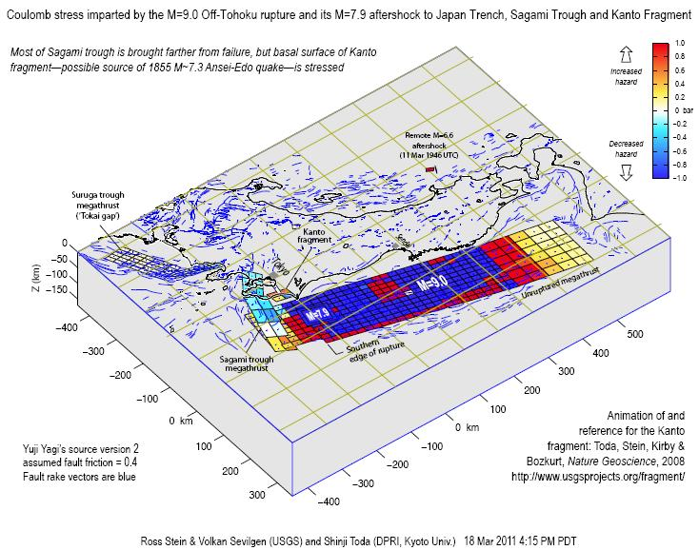
Many Stakeholders
National governments, Local authorities, Civil Protections Agencies (field teams and decision makers)
The International Humanitarian community
  UN aid organisations (e.g. UN OCHA) and Red Cross/Red Crescent & NGOs
International Development Organisations
  World Bank, World Health Org., UN International Strategy for Disaster Reduction (ISDR), etc
  GEO & CEOS
Science community
National agencies incl. Space agencies
Mass media
From S.Toda (DPRI, Kyoto Univ.), R.Stein (USGS), V.Sevilgen (USGS)
Notes:
Stress changes on faults throughout Japan due to the Tohoku mainshock. Faults brought closer to failure are shaded red.

Slide 8





Space Agencies Contribution to
Disaster Risk Management
Several initiatives involving space agencies contribute to DRM in GEO framework such as …
… Multi-lateral agreements outside CEOS with various forms of cooperation such as
  International Charter Space & Major Disasters (15 members)
  Sentinel Asia (Asia Pacific region)
  GMES Emergency Management Services (SAFER, etc)
  Preparedness through DLR (Tsunamis), Astrium/Meteo Fr (flash flood)
… Other GEO initiatives with significant CEOS involvement (e.g. via CEOS Disaster SBA team, WGs, VCs, SEO) such as
  Volcanic ash monitoring,
  GEO GeoHazards Supersites & National Laboratories
  Regional flood prediction & monitoring over Caribbean and over Namibia
… Individual Agencies’ projects such as
# 8
Notes:
Be careful you forgot TERRAFIRMA (geo-hazards) while SAFER is mainly Flood & Fire (and crsiis response rather than risk prevention).
You also forgot the Geo-Hazard Supersites!
8

Slide 9

GEO Disaster SBA
Disaster: one of 9 GEO Societal Benefit Areas (SBA) …
Implemented through specific GEO task:
focus on 4 main areas -
  Support to operational systems
  Enable and inform risk and vulnerability analyses
  Implement regional end-to-end pilots projects
  Conduct gap analyses to identify missing data, system and capacity gaps
For more details: http://www.earthobservations.org/

Slide 10
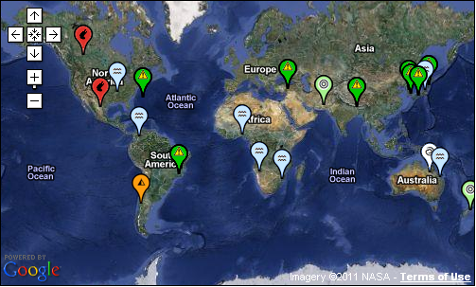
International Charter Space and Major Disasters
Over 11 years, 320+ activations in 100+ countries
More than 30 satellites from space agencies and commercial providers provide data.
Satellite agencies members of CEOS
Covers immediate disaster response.
Disaster Charter Activations since Jan. 2011
Charter activations
per year 2000-2010
Notes:
Only 12 logos: those who have signed the Charter.

Slide 11
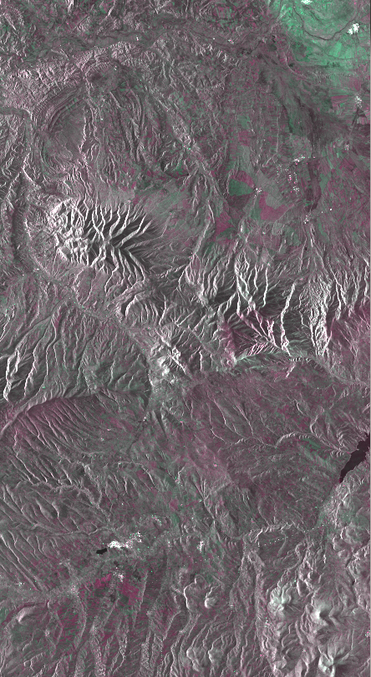
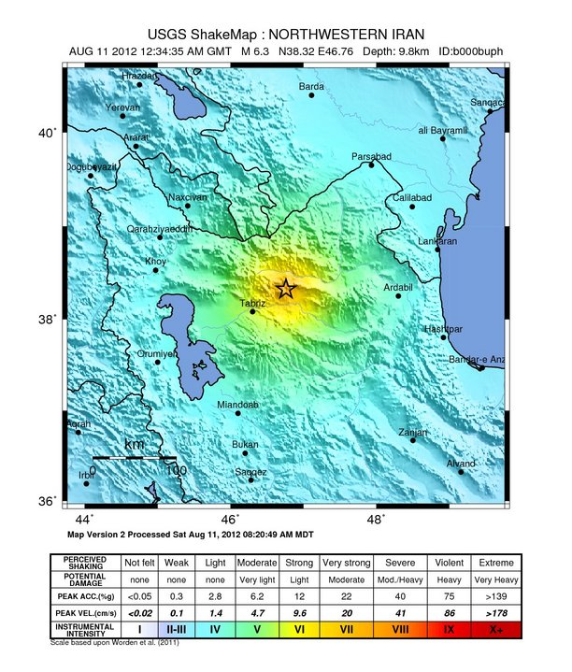
GeoHazards Supersites &
Natural Laboratories
On Aug. 11, 2012, two strong earthquakes have shaken Iran's northwest, leaving at least 306 people dead and more than 3,000 injured.
Image generated from a strip 12 images acquired on 10.08.2011 from the TanDEM-X mission and 18.08.2012 from the TerraSAR-X mission.
Red channel: pre-seismic image, Green channel: post-seismic image
© DLR Earth Observation Center

Slide 12
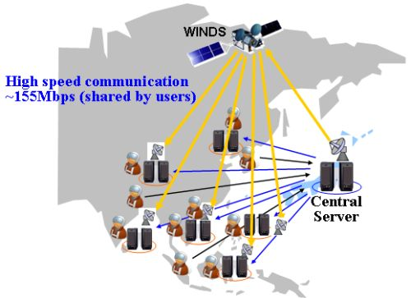

Sentinel Asia
Volcanic Ash
Monitoring
US Agencies (NASA, USGS, and NOAA) and ESA (PROMOTE) support national VAACs (Volcanic Ash Advisory Center) by providing alerts based on satellite data.
Supported by CEOS Atmospheric Composition VC
Sentinel Asia (Disaster management in Asia-Pacific region) (67 organizations from 24 countries/regions and 11 international organizations). JAXA, ISRO, GISTDA, KARI and others

Slide 13
AGENDA
Background on Disaster Risk Management (DRM)
CEOS Vision for DRM

Slide 14
Some History …
At CEOS Plenary (Oct. 2011), ESA’s proposal aiming at delivering greater benefits from CEOS agencies to DRM communities through a more effective CEOS contribution.
  Improve awareness and communication between existing on-going efforts
  Assessment of gaps, overlaps and consideration of balance of efforts.
2011 CEOS Plenary accepted the proposal:
  Topic to be further studied by interested volunteer space agencies
  Report to be prepared for 2012 CEOS Plenary. Report content: on-going actions, findings and recommendations incl. any further initiative by CEOS.

Slide 15
Ad Hoc Team on DRM
After go ahead from 2011 CEOS Plenary (Oct. 2011) CEOS Ad Hoc “Disaster Risk Management Team” created with volunteer Agencies:
  ASI, CNES, CSA, DLR, ESA, EUMETSAT, JAXA, NASA, NOAA, USGS
Main Team’s task: prepare a report with findings & recommendations including specific actions to improve CEOS support to DRM (2012 CEOS Plenary )

Slide 16
CEOS Vision for DRM
Top Objectives:
  Increase and strengthen the contribution of EO satellite to the various DRM phases through a series of coordinated enlarged actions
  Raise the awareness of politicians, decision-makers and major stakeholders on the benefits of using satellite EO in all phases of DRM.
How ? …
Improve the coordination between EO satellites observations and take appropriate actions aiming at better distributing EO satellite data and fostering its use by the DRM users…
If successful, demonstration of space agencies’ capacity to provide the right EO data that can be transformed into high-value information
Facilitate the positioning of EO from Space in the 2015 post-Hyogo framework of actions …

Slide 17
Challenges & Constraints
Define a CEOS vision around a few “big ideas” capable to attract CEOS Principals in order to get their approval at 2012 CEOS Plenary
  Actions based on users’ real needs but feasible with resources available in contributing space agencies (budget, space assets, staff, ..) and compatible with their mandates, interests, data policies, …
  Maximum reuse of past, on-going and future planned relevant Space Agencies’ activities and assets such as:
    Disaster Charter, Sentinel Asia, GEO tasks (Geohazards Supersites, Flood monitoring over Caribbean / Namibia), CEOS Agencies DRM-related activities
  Beneficial for the user community (based on user needs) but also for the space agencies.
  High profile to politicians, decision makers, major stakeholders, media,… Increase awareness of the utility of EO.
  Synchronized with major world events on Disaster Risk Reduction

Slide 18
Team Activies (1/2)
Review the work of the former CEOS Disaster Management Support Group (DMSG)
  many of the Findings made in 2000 are still valid. Most of Recommendations never concretized.
  For 3 specific geohazards (flood, landslide, earthquake), interface with users and practitioners (Santorini , May 2012) to discuss what they do and expect using Satellite EO concerning DRM.
  detailed analysis of real needs & identification of existing gaps.
Notes:
For instance flooding costs, info needs for DRM can be spelled out, what is available today can be said (primarily damage impact) and what is lacking is identified (systematic observations of events, building archives of reference non-flooded scenes, etc, a NRT system to make multi-sensor coregistered stacks of radar imagery for monitoring, leaving space for VA resellers to exploit such datastacks and provide industrial solutions, etc).

Slide 19
Team Activies (2/2)
Reviewed in detail the specific DRM-related projects from various CEOS space agencies participating in the ad hoc team
  several projects focus on similar themes but no coordination / synergy that might improve the individual projects
Reuse the outcomes produced by the CEOS Disaster SBA Team in support to the GEO Work Plan Disaster tasks
  work from CEOS SBA team under the GEO framework is an important contribution to the work of the Ad Hoc team.

Slide 20
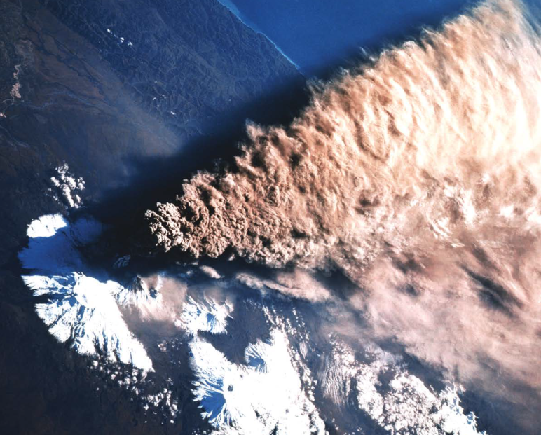
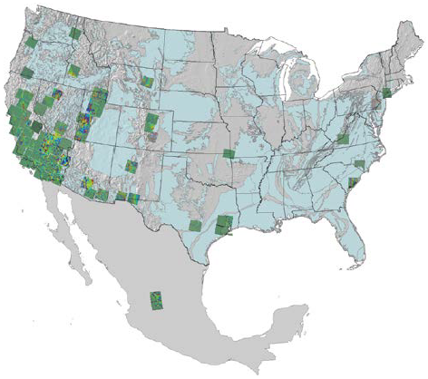
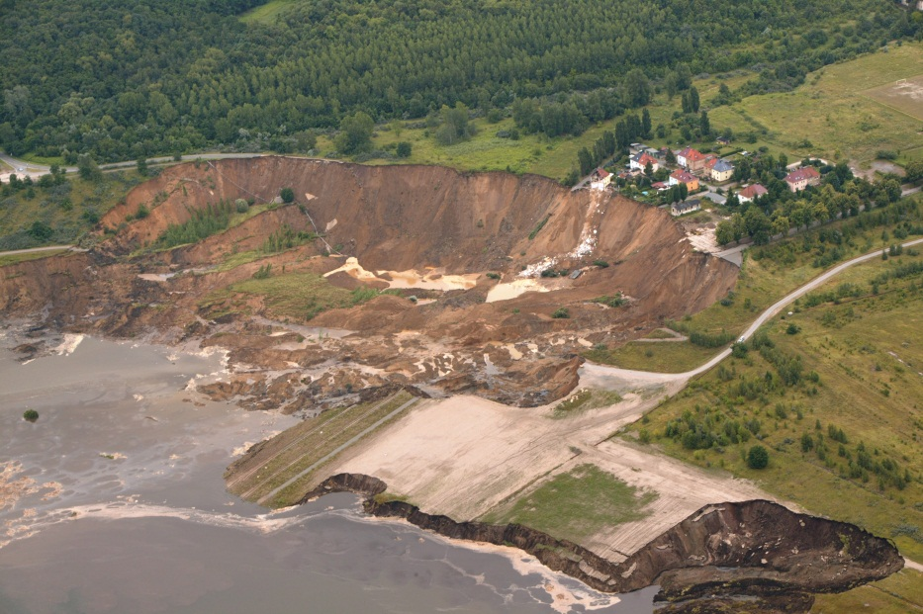
Inputs from the International
Forum on Satellite EO & geohazard
The “Santorini Conference” organised by ESA and GEO:
  140+ participants from 20 countries including European countries, the US, Canada, Japan and China. 70+ organisations represented, ranging from international organisations (e.g. World Bank) to public institutes, space agencies, universities and the private sector.
  USGS, CNES & ESA in the Science Programme Committee
  Concerning five critical areas of application: volcanoes; landslides; seismic hazards; coastal subsidence and flood defence; and inactive mine hazards.

Slide 21
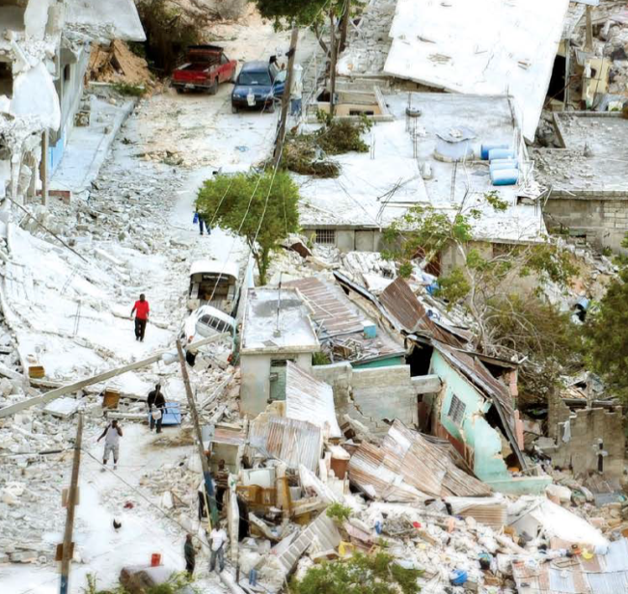
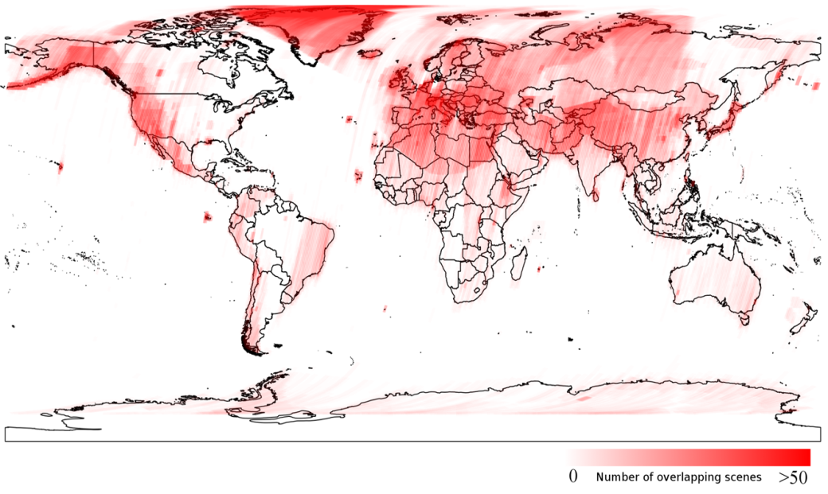
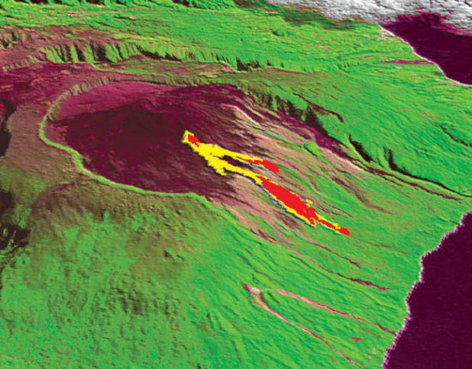
Inputs from the International
Forum on Satellite EO & geohazard
The “Santorini Conference” organised by ESA and GEO:
  an opportunity for DRM users and practitioners to formulate priorities & objectives over the next 5-10 years
  Includes geographic priorities & observational strategies
  Community Papers elaborated by Users with an open review process & examined in conference sessions
  a Scientific & Technical Memorandum released now.

Slide 22
CEOS Vision for DRM:
5+3 Actions
5 Major Actions:
Define a Global Satellite Observation Strategy for DRM
  Detailed assessment of needs, gaps and definition of observation requirements in terms of EO data (similar to FCT and JECAM)
  Definition of strategy in response to observation requirements; includes definition of a DRM Baseline Dataset (data at no cost for selected observations/selected themes & limited geography). Includes existing strategic plans such as Charter.
Implement the Global Satellite Observation Strategy for DRM
  each CEOS agency to acquire, process and archive the EO satellite data and products (e.g. L0 to L2)
Set up a virtual repository for DRM-relevant data / products / information from both space agencies and DRM-Users and make the repository content accessible to all DRM users
  provide DRM user community with a series of tools to discover & access EO data through DRM-dedicated web portal (one stop shop); includes access to DRM Baseline Dataset
Set up DRM Data Processing Platform:
  a capacity to enable access to EO based Value Added products, tools & on demand processing - support science & services exploitation of Satellite EO (requires infrastructure for science data) – enable EO based content generation & hosting user generated content
Ensure the positioning of EO from Space in the 2015 post-Hyogo Framework of Actions
  2015 post-Hyogo FA Plan (2015-2025) to be adopted at 2015 World Conference on Disaster Risk Reduction and UN Nations Assembly
  Close dialog with the major stakeholders in charge of defining the 2015 post-Hyogo FA
3 Supporting Actions: 6. DRM Outreach & Evaluation of CEOS DRM Actions
7. EO Capacity Building for DRM,
8. Satellite EO DRM Projects Database

Slide 23
Status
1st issue of Report with findings & recommendations (incl. 5+3 actions) distributed to CEOS Agencies (Sep. 12, 2012)
2nd issue of Report ready for distribution (mid-Oct. 2012)
Dedicated session at coming CEOS Plenary (Oct. 24-25, 2012)
  CEOS Principals requested to endorse full report and to authorize start of implementation phase

Slide 24
Implementation: Way Forward
  To be ready for 2015, start with “easy-to-reach” objectives such as:
Limited number of types of hazards & limited geographical coverage to quickly produce concrete results.
As showcases, report focuses on 3 specific hazard types (plain flooding, seismic hazards, landslides). Assessment of information needs, ability of satellite EO to address them and main gaps
A few types of hazards might be added in the coming months depending on the interests of the CEOS Agencies
3-year demonstrator project 2013-2015 (R&D activity to get data more easily).
each CEOS DRM Action to be led by a champion agency with support from other Agencies
Actions “à la carte”
some Agencies might support only a subset of the actions or part of an action proposed in the report.
Open participation
some new Agencies might join the implementation group
Activity to be proposed as GEO task at next revision of GEO Work Plan
In parallel, initiate a closed dialog with right stakeholders to prepare the 2015 World Conf. on Disaster Risk Reduction …
e.g. some UN agencies, World Bank, GFDRR, scientific community, value added industry, local end users, key national governments, …)

Slide 25
Decision Sought /
Way Forward
The CEOS Principals are requested to:
Endorse the Study Consensus Report incl. the “5+3 Actions”
Authorize the start of the Implementation phase
Establish a CEOS DRM Project Team in charge of implementation
  Project team structure similar to the CEOS FCT/GFOI and CEOS JECAM/GEO-GLAM ones
  First tasks for the March 2013 SIT meeting: generate Terms of Reference and a draft Implementation Plan.
If needed, extend the mandate of the current ad hoc Disaster Team until the establishment of the DRM Project Team to ensure continuity of the activity;
Mandate the DRM Team to begin coordination with the UN ISDR in the lead-up to the May 2013 post-Hyogo Framework for Action activities (Global Platform for Disaster Risk Reduction);
  Worldwide consultation has started on August 27, 2012
Mandate the DRM Team to liaise with UN ISDR, other major stakeholders and users to prepare the future Implementation Plan.
  Start just after 2012 CEOS Plenary

Slide 26
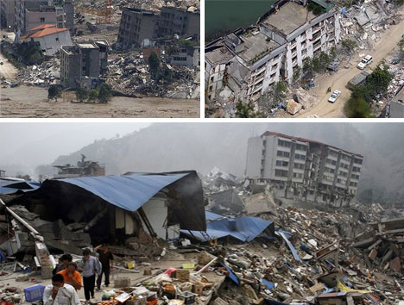
THANK YOU !!!!
… And many thanks to the Agencies that have contributed to that study
Thank you ….
2008 earthquake in Beichuan (China)
© weburbanist.com
Notes:
Author / Credits: Dutch School, Museum of London

